Slide 1
Spring Boot Web Apps – Spring Security www.cs.uoi.gr/~zarras/http://www.cs.uoi.gr/~zarras/se.htm
https://spring.io/guides/topicals/spring-security-architecture/

Slide 2
Authentication and Authorization
Application security boils down to two more or less independent problems: authentication (who are you?) and authorization (what are you allowed to do?).
Sometimes people say “access control” instead of "authorization"

Slide 3
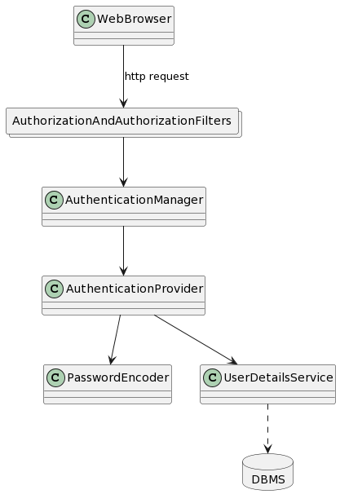
Authentication in Spring Security

