Slide 1
Java Persistence API &
Related Patterns
Domain Logic, Data Source, Object Relational www.cs.uoi.gr/~zarras/http://www.cs.uoi.gr/~zarras/se.htm
https://docs.spring.io/spring-data/jpa/docs/current/reference/html/#jpa.query-methods
https://www.vogella.com/tutorials/JavaPersistenceAPI/article.html/
https://www.baeldung.com/spring-data-derived-queries

Slide 2
What is JPA?
Mapping objects to database table rows and vice versa is called Object-Relational Mapping (ORM).
The Java Persistence API (JPA) is an approach to ORM for Java objects.
Via JPA the developer can map, store, update and retrieve data from relational databases to Java objects and vice versa.
JPA is a specification from Oracle
https://download.oracle.com/otn-pub/jcp/persistence-2_1-fr-eval-spec/JavaPersistence.pdf?AuthParam=1647415880_273dae2fb012962231cd5758a30e83d3
It can have multiple compliant implementations Hibernate, EclipseLink and Apache OpenJPA.

Slide 3
How do we organize Domain layer logic?

Slide 4
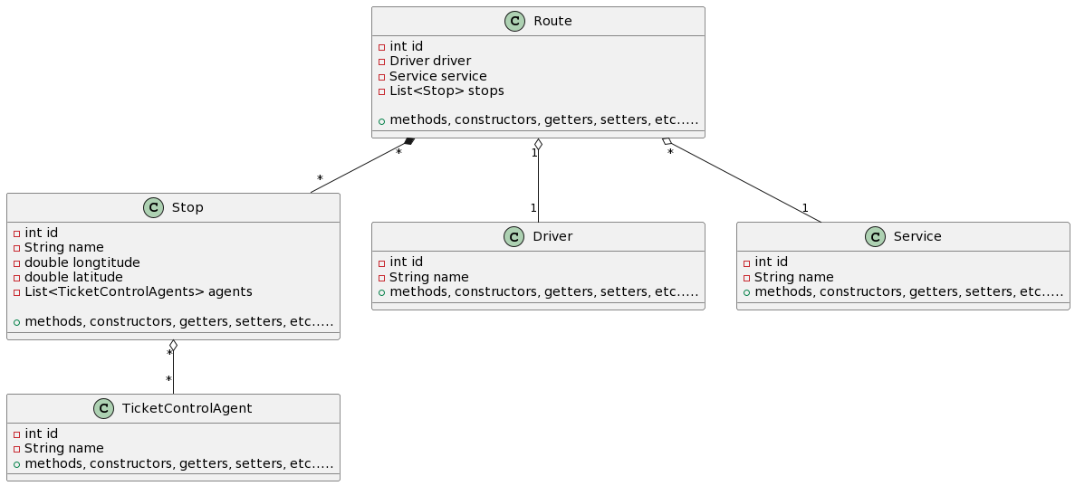
Domain Model
An object model of the domain that incorporates both behavior and data. A different object per table tuple …..
https://martinfowler.com/eaaCatalog/domainModel.html

Slide 5
How do we transfer data from/to the Domain layer to/from the Data Layer ?

Slide 6
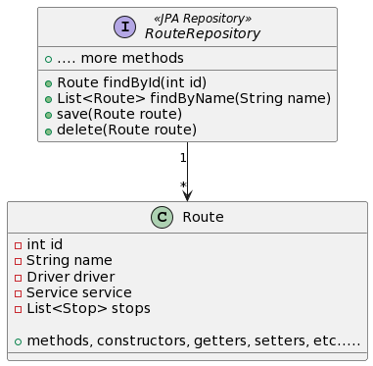
Data Mapper
A layer of Mappers moves data between objects and a database while keeping them independent of each other and the mapper itself.
In Spring Boot these are called JPA Repositories
https://martinfowler.com/eaaCatalog/dataMapper.html

Slide 7
How to map objects to
tuples (table rows) ?

Slide 8
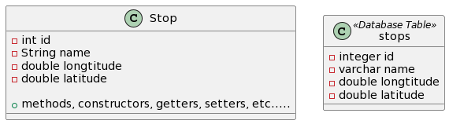
Identity Field
Saves a database ID field in an object to maintain identity between an in-memory object and a table row.
Intent
Reading data from a database is all very well, but in order to write data back you need to tie the database to the in-memory object system.
In essence, Identity Field is mind-numbingly simple. All you do is store the primary key of the relational database table in the object’s fields.
https://martinfowler.com/eaaCatalog/identityField.html

Slide 9
Foreign Key Mapping
Maps an association between objects to a foreign key reference between tables.
Objects can refer to each other directly by object references.
To save these objects to a database, it’s vital to save these references.
A Foreign Key Mapping maps an object reference to a foreign key in the database.
https://martinfowler.com/eaaCatalog/foreignKeyMapping.html

Slide 10
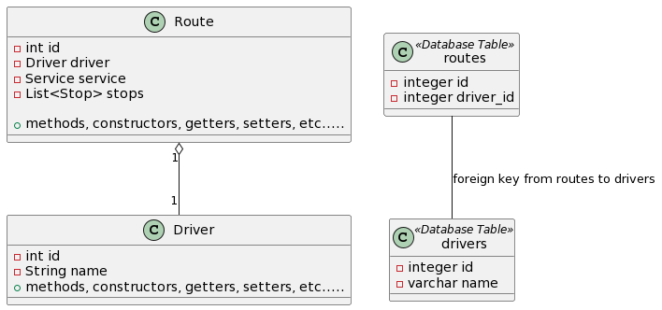
Foreign Key Mapping
Maps an association between objects to a foreign key reference between tables.
One-to-One relation – Route to Driver

Slide 11
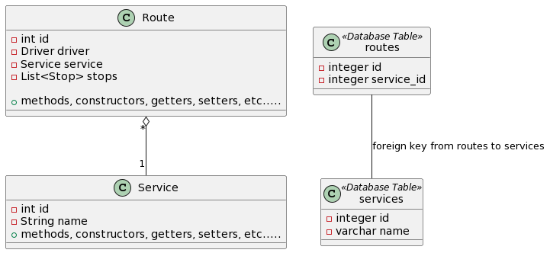
Foreign Key Mapping
Maps an association between objects to a foreign key reference between tables.
Many-to-One relation – Route to Service

Slide 12
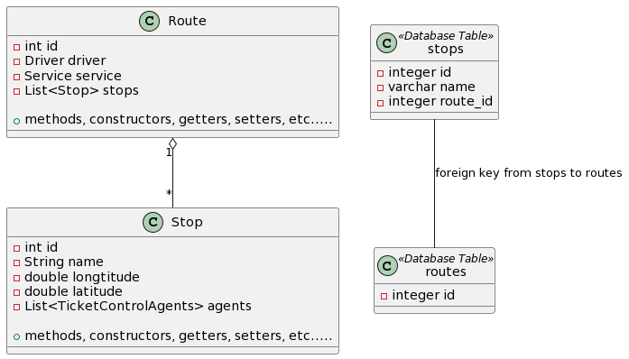
Foreign Key Mapping
Maps an association between objects to a foreign key reference between tables.
One-to-Many relation – Route to Stop

Slide 13
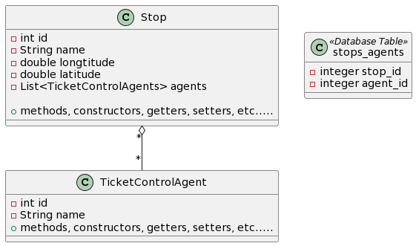
Association Table Mapping
Saves a Many-to-Many association as a table with foreign keys to the tables that are linked by the association.

Slide 14
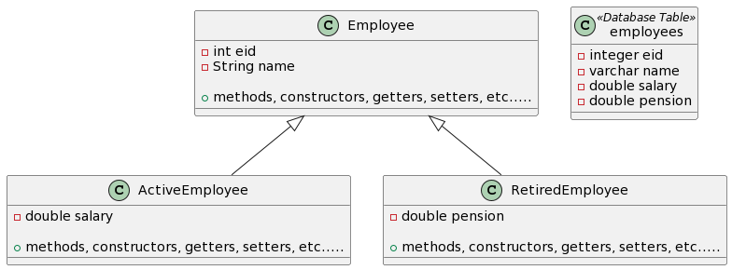
Single Table Inheritance
Represents an inheritance hierarchy of classes as a single table that has columns for all the fields of the various classes.
https://martinfowler.com/eaaCatalog/singleTableInheritance.html

Slide 15
Single Table Inheritance
There’s only a single table to worry about on the database. There are no joins in retrieving data. Any refactoring that pushes fields up or down the hierarchy doesn’t change the DB.
Fields are sometimes relevant and sometimes not, which can be confusing. Columns used only by some subclasses lead to wasted space in the database. The single table may end up being too large.

Slide 16
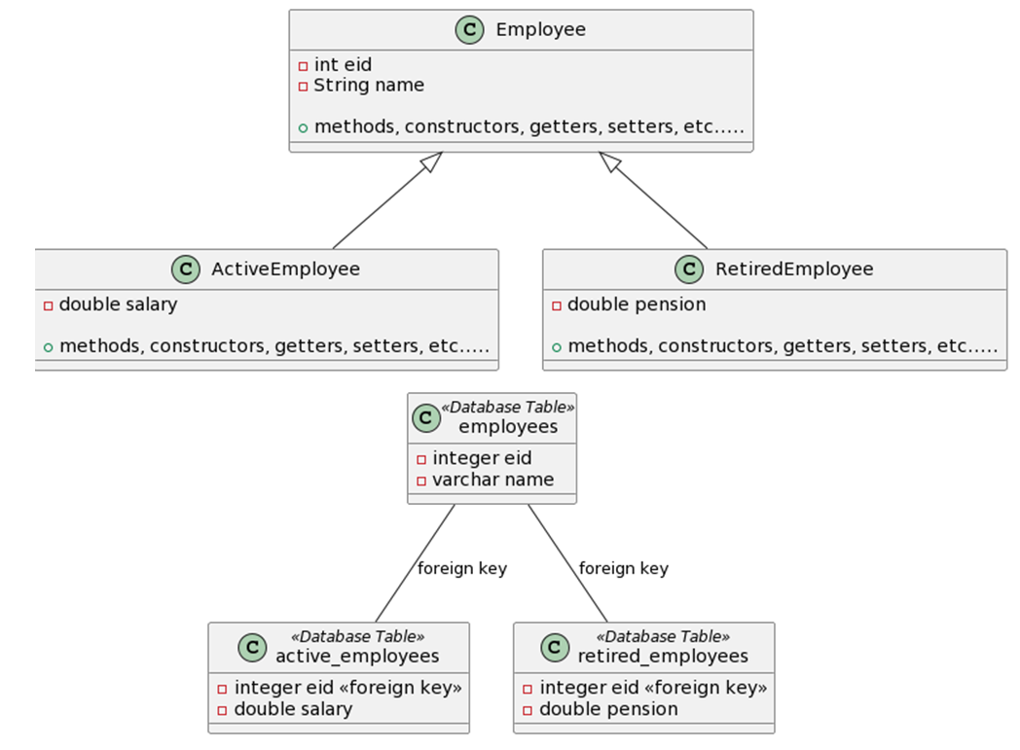
Class Table Inheritance
Represents an inheritance hierarchy of classes with one table for each class.
The linking between the tables can be done by foreign keys between the tables
https://martinfowler.com/eaaCatalog/classTableInheritance.html

Slide 17
Class Table Inheritance
Represents an inheritance hierarchy of classes with one table for each class.
All columns are relevant for every row so tables are easier to understand and don’t waste space.
The relationship between the domain model and the database is straightforward.
Need to touch multiple tables to load an object, which means a join or multiple queries and sewing in memory.
Any refactoring of fields up or down the hierarchy causes database changes.

Slide 18
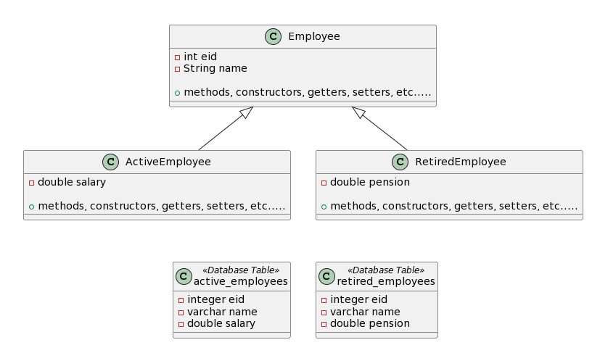
Concrete Table Inheritance
Represents an inheritance hierarchy of classes with one table per leaf class in the hierarchy with all fields in the table row.
https://martinfowler.com/eaaCatalog/concreteTableInheritance.html

Slide 19
Concrete Table Inheritance
Represents an inheritance hierarchy of classes with one table per leaf class in the hierarchy with all fields in the table row.
Each table is self-contained and has no irrelevant fields.
There are no joins to do when reading the data from the concrete mappers.
Each table is accessed only when that class is accessed, which can spread the access load.
Redundancy in the data
With fields are pushed up or down the hierarchy, you don’t have to alter the table definitions. If a superclass field changes, you need to change each table.

