Slide 1
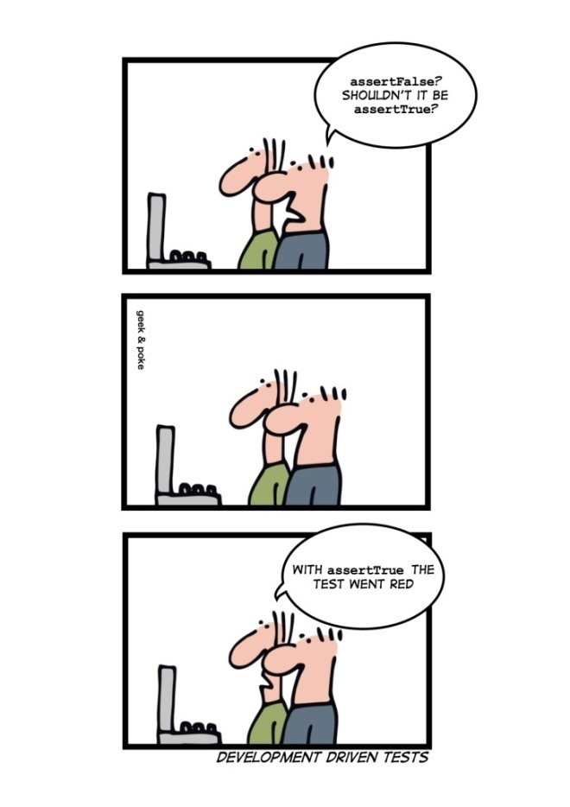
Software Testing www.cs.uoi.gr/~zarras/http://www.cs.uoi.gr/~zarras/se.htm
Slides material sources:
Software Engineering - Theory & Practice, S. L. Pfleeger
Introduction to Software Engineering, I. Sommerville
SWEBOK v3: IEEE Software Engineering Body of Knowledge
Working Effectively with Legacy Code, M. Feathers
Software Testing – A Craftsman’s Approach, P Jorgensen
xUnit Patterns by Gerard Meszaros

Slide 2
Testing fundamentals

Slide 3
Why does software fail?

Slide 4
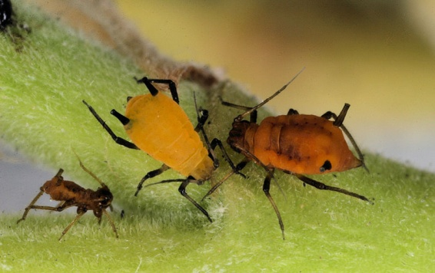
Why does software fail?
A more complete answer includes the famous triplet:
Errors
Faults
Failures
Bugs !!!

Slide 5
What do we mean by error?

Slide 6
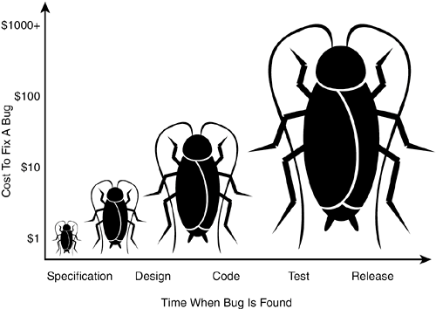
Errors
Error
People make errors. A good synonym is mistake.
Errors tend to propagate; a requirements error may be magnified during design and amplified still more during coding.
International Software Testing Qualification Board (ISTQB)

Slide 7
What do we mean by fault?

Slide 8
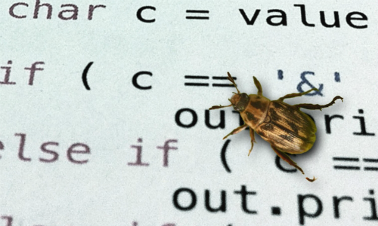
Faults
Fault
A fault is the result of an error. It is more precise to say that a fault is the representation of an error, where representation is the mode of expression, such as narrative text, UML diagrams, hierarchy charts, and source code.
Defect (see the ISTQB Glossary) is a good synonym for fault, as is bug.
International Software Testing Qualification Board (ISTQB)

Slide 9
What do we mean by failure?

Slide 10
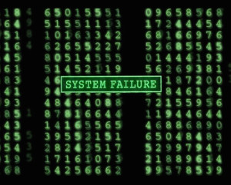
Failures
Failure
A failure occurs when the code corresponding to a fault executes.
In general a failure is the manifestation of a fault.
International Software Testing Qualification Board (ISTQB)

Slide 11
What is software testing?

Slide 12

Software testing
Testing is the act of exercising software with test cases.
A test has two distinct goals:
  To find failures (verification aspect).
  To demonstrate correct execution (validation aspect).

Slide 13
What is a test case?

Slide 14
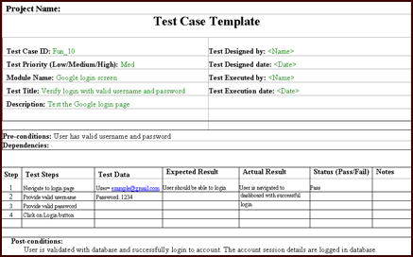
Test cases
The essence of software testing is to determine a set of test cases for the item to be tested.
A test case is (or should be) a recognized work product.
A complete test case will contain a test case identifier, a brief statement of purpose, a description of preconditions, the actual test case inputs, the expected outputs, a description of expected post-conditions (system state after test execution), and an execution history.
The execution history is primarily for test management use—it may contain the date when the test was run, the person who ran it, the version on which it was run, and the pass/fail result.

Slide 15
Why should we write tests?

Slide 16
Why should we write tests ?
We need tests to improve software quality
We need tests to improve software understanding
Tests as specification.
  Insure that we build the right software.
Defect localization.
  Insure that the software is correct.
Defect prevention.
  Insure that bugs wont crawl back to the software.
Tests as documentation.
  Allow the developer/maintainer to answer questions like “what should be the expected outcome of the software is the given input is …”

Slide 17
How do we write good tests?

Slide 18
How do we write good tests ?
The tests that we write should be easy to run
Tests should not introduce new risks
Fully automated.
  Execute without any effort.
Self checking.
  Detect and report any errors without human intervention.
Repeatable.
  Can be run many times in a row and produce the same results without human interventions in between.
Independent from each other.
  Can be run by themselves and NOT depend on the execution order, failure or success of other tests.
Refrain from modifying the software to facilitate the development of the tests as safety net.

Slide 19
Which are the targets of testing?

Slide 20

Testing targets
The target of the test can vary:
A single module, a group of such modules (related by purpose, use, behavior, or structure), or an entire system.
Three test stages can be distinguished: unit, integration, and system.

Slide 21
xUnit Basic Patterns http://xunitpatterns.com/index.html
Examples: https://github.com/zarras/myy803-junit-mockito-tutorials/tree/master/basic-xunit-patterns

Slide 22
How do we make it easy to write and run tests written by different people?

Slide 23
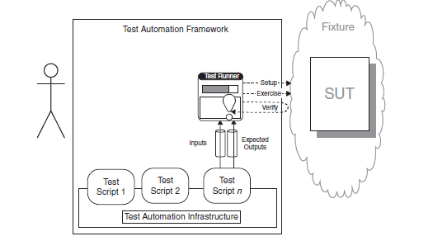
Test Automation Framework
We use a framework that provides all the mechanisms needed to run the test logic so the test writer needs to provide only the test-specific logic.
…

Slide 24
Where do we put our test code?

Slide 25
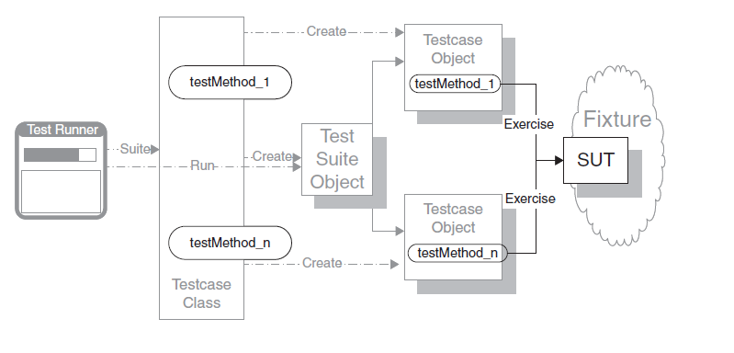
Test Method
We encode each test as a single Test Method on some class.
Variations:
Simple success test (happy day)
Expected exception test
Constructor test

Slide 26
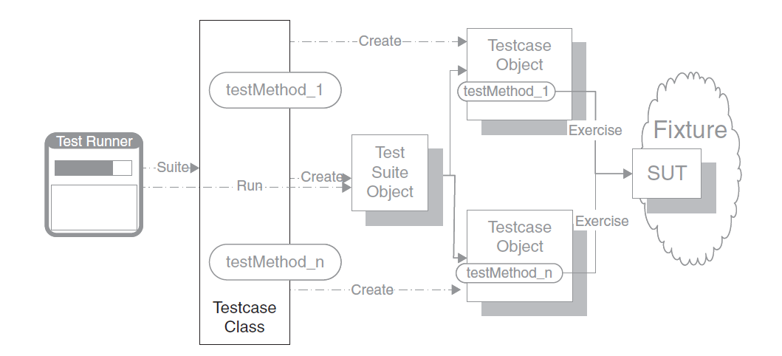
Test Case Class
We group a set of related Test Methods on a single Testcase Class.
Notes:
https://www.javatpoint.com/junit-test-case-example-in-java

Slide 27
How do we structure our test code?

Slide 28
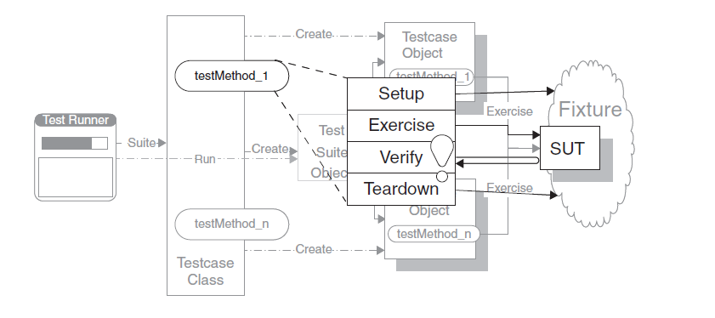
Four Phase Test
We structure each test with four distinct parts executed in sequence.
In the first phase, we set up the test fixture and anything we need to put in place to be able to observe the actual outcome .
In the second phase, we interact with the SUT.
In the third phase, we determine whether the expected outcome has been obtained.
In the fourth phase, we tear down (clean up) the test fixture to put the world back into the state in which we found it.

Slide 29
How do we make tests self-checking?

Slide 30
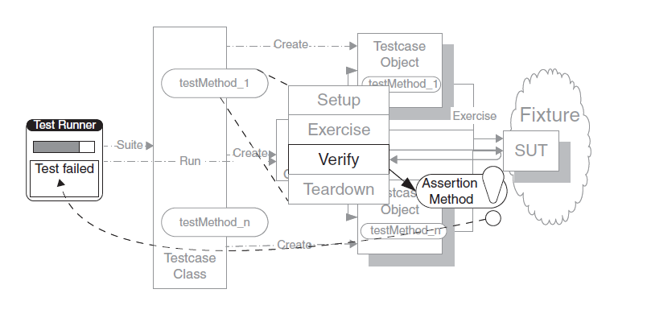
Assertion Method
We call a xUnit assertion method to evaluate whether an expected outcome has been achieved.
Variations:
(In) Equality assertions
Fuzzy equality assertions (for floating point results with an error tolerance)
Stated outcome assertions (is null, is true, …)
Expected exception assertions.
Single outcome assertions (fail)
Notes:
https://www.baeldung.com/junit-assertions
https://howtodoinjava.com/junit5/junit-5-assertions-examples/

Slide 31
How do we provide more information about a failed assertion?

Slide 32
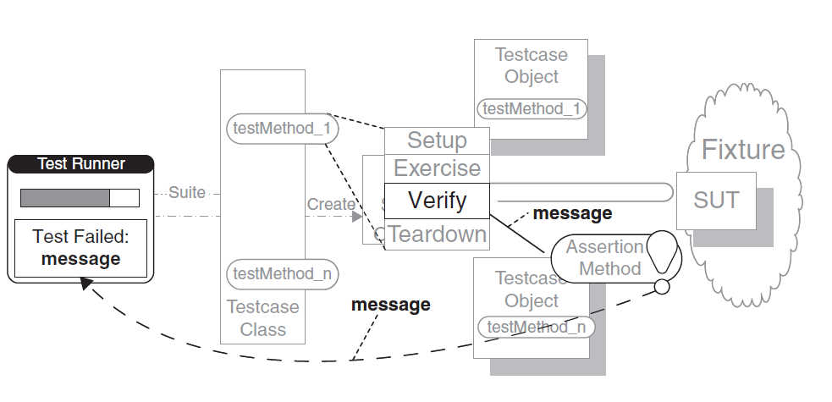
Assertion Message
We include a descriptive string argument in each call to an Assertion Method.

Slide 33
How do we run the tests?

Slide 34
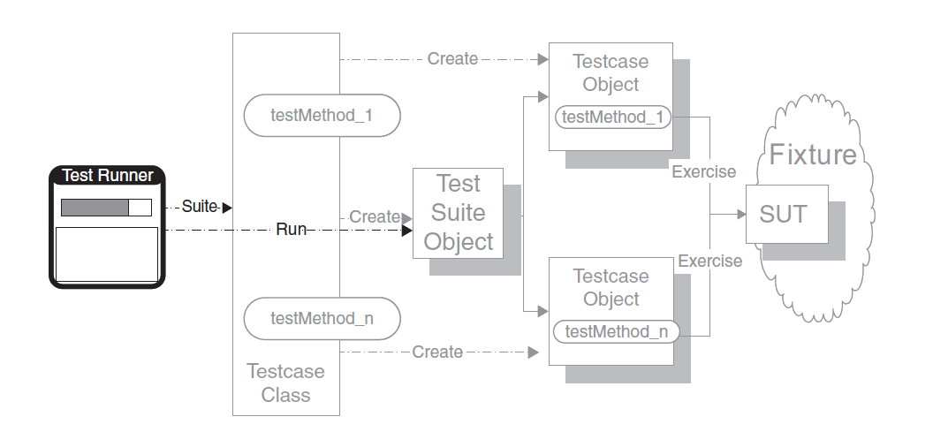
Test Runner
We execute the xUnit framework’s specific program that instantiates and executes the Testcase Objects. When we have many tests to run we can organize them in Test Suites.
Notes:
https://howtodoinjava.com/junit5/junit5-test-suites-examples/

Slide 35
Fixture Setup/Teardown Patterns http://xunitpatterns.com/index.html
Examples: https://github.com/zarras/myy803-junit-mockito-tutorials/tree/master/fixture-patterns/

Slide 36
What is a test fixture?
A test fixture is everything we need in place to be able to test the System Under Test (SUT)

Slide 37
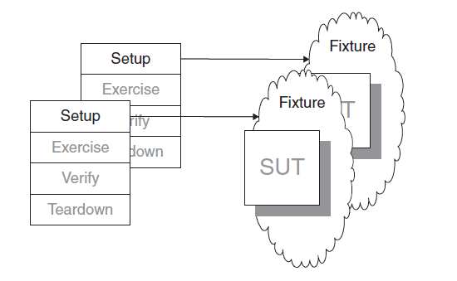
Fresh Fixture
Each test constructs its own brand-new test fixture for its own private use.
We should use a Fresh Fixture whenever we want to avoid any interdependencies between tests (which is in fact almost always the case …..)

Slide 38
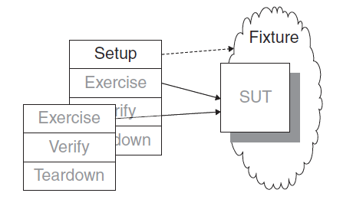
Shared Fixture
We reuse the same instance of the test fixture across many tests.
If we want to avoid slow tests.
Or, when we have a long, complex sequence of actions, each of which depends on the previous actions. In customer tests, this may show up as a workflow; in unit tests, it may be a sequence of method calls on the same object.
With the big risk (!!!!) of introducing interdependencies between tests ….

Slide 39
How do we construct (destroy) a fresh fixture?

Slide 40
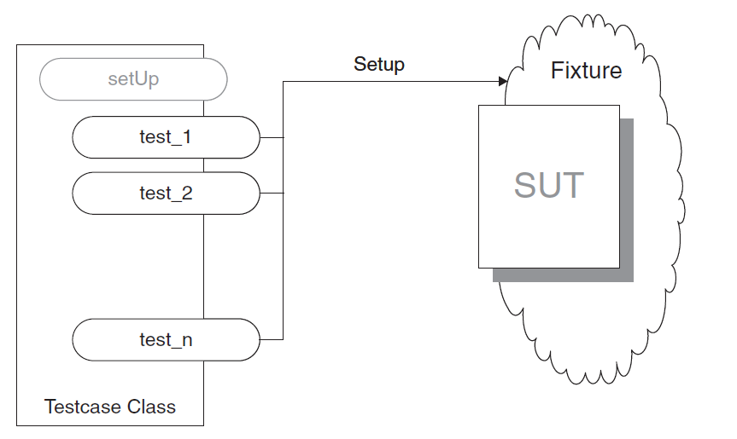
Inline Setup (Teardown)
Each Test Method creates its own Fresh Fixture by calling the appropriate constructor methods to build exactly the test fixture it requires (the method destroys the fixture at the end).
We can use In-line Setup when the fixture setup logic is very simple and straightforward.

Slide 41
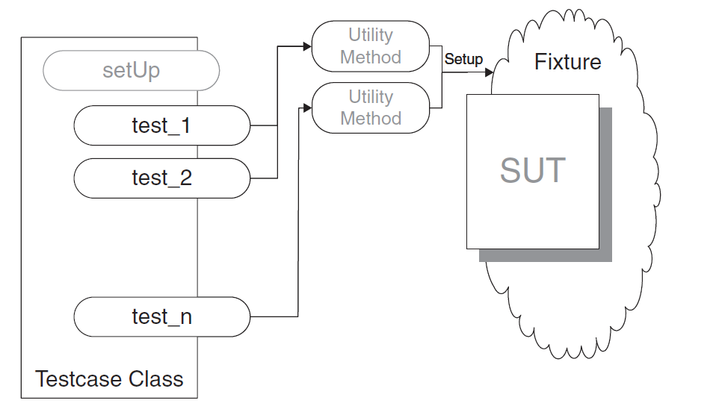
Delegated Setup (Teardown)
Each Test Method creates (destroys) its own Fresh Fixture by calling Creation/Destruction Methods from within the Test Methods.
We can use a Delegated Setup when we want to avoid the test code duplication caused by having to set up similar fixtures for several tests and we want to keep the nature of the fixture visible within the Test Methods

Slide 42
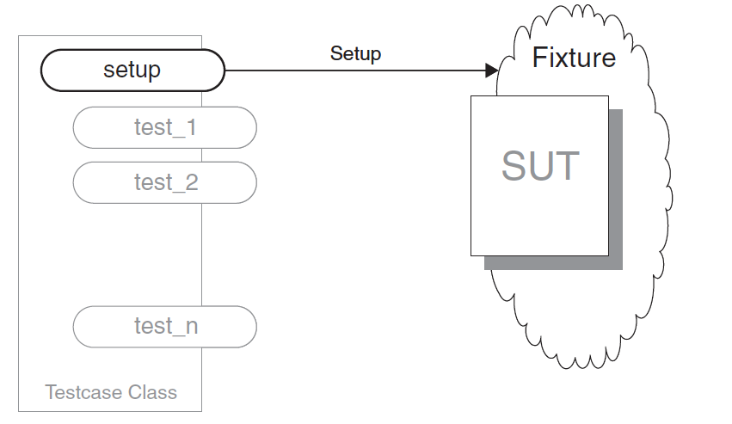
Implicit Fresh Fixture Setup (Teardown)
We build (destroy) the test fixture common to several tests in set up/tear down methods called by the test framework.
We can use Implicit Setup when several Test Methods on the same Testcase Class need an identical Fresh Fixture.
Notes:
https://www.baeldung.com/junit-before-beforeclass-beforeeach-beforeall

Slide 43
How do we create (destroy) a shared fixture if the test methods that need it are in the same test class?

Slide 44
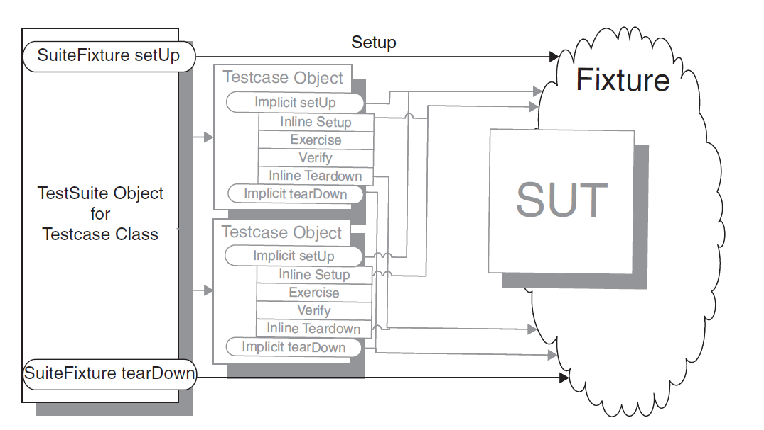
Implicit Shared Fixture Setup (Teardown)
We build (destroy) the shared fixture in special methods called by the Test Automation Framework before/after the first/last Test Method is called
Notes:
https://www.baeldung.com/junit-before-beforeclass-beforeeach-beforeall

Slide 45
Result Verification Patterns http://xunitpatterns.com/index.html
Examples: https://github.com/zarras/myy803-junit-mockito-tutorials/tree/master/result-verification-patterns

Slide 46
How do we verify a method that returns a value?

Slide 47
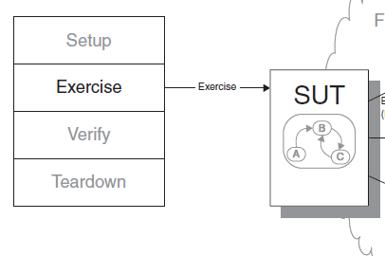
Return Value Verification
We inspect the returned value of the method and compare it with an expected return value.
check return value

Slide 48
How do we verify a method that changes the state of the SUT?

Slide 49
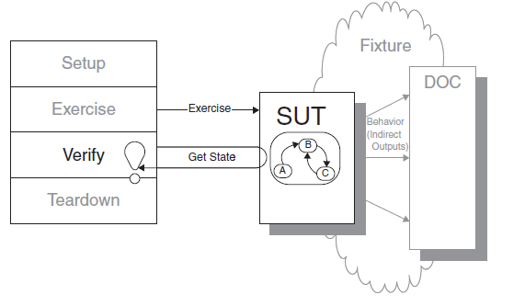
State Verification
We inspect the state of the system under test after it has been exercised and compare it to the expected state.
Variations:
Procedural State Verification, we simply write a series of calls to Assertion Methods that pick apart the state information into pieces and compare to individual expected values.
Expected State Specification, we construct a specification for the
post-exercise state in the form of one or more objects populated with the expected attributes. We then compare the actual state with these objects.

Slide 50
How do we verify a method of the SUT that interacts with other Depend-On-Components (DOC)?

Slide 51
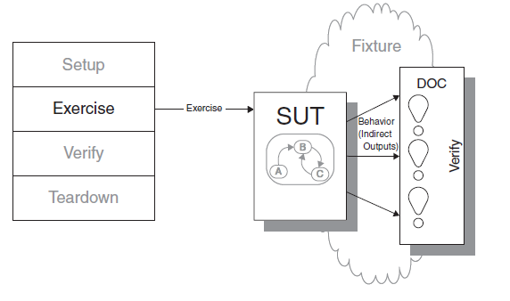
Behavior Verification
We capture the indirect outputs/interactions of the SUT with DOC as they occur and compare them to the expected behavior.
Usually this is done with the help of the test framework.
Typically to verify behavior we have to use some kind of a Test Spy or Test Fake or Test Stub
(see Test Double patterns that follow)
Notes:
Attention !!! these – self checking - mock objects are not supported by mockito, they have to be build by hand !!! Typical mockito mock objects are just fake objects or stub objects
A way to make a spy without mockito is to subclass the DOC and override its methods to keep track of when they are called.

Slide 52
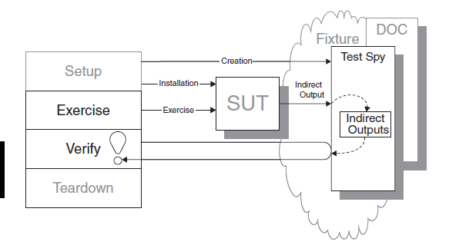
Test Spy
We use a Test Spy to wrap the DOC to capture the indirect output calls made to DOC by the SUT for later verification by the test.
Spy Implementation options:
Use a mocking framework like mockito (spy() and verify() commands).
Examples
https://github.com/zarras/myy803-junit-mockito-tutorials/tree/master/test-double-patterns/

Slide 53
How do we verify the behavior of the SUT when it calls another component, independently from this component?

Slide 54
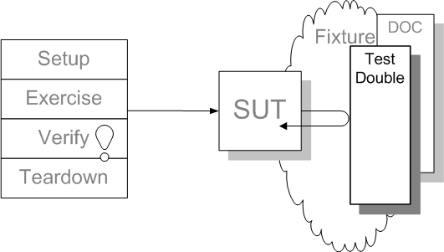
Test Double
We replace the DOC that the SUT depends on with a much lighter-weight implementation.
Fake Object – a test double that we just call.
Stub Object – a test double that we call to get some predetermined values
Mock Object – a test double that we use to check the interaction of the SUT with the DOC
Implementation:
Use a mocking framework like mockito (mock() and when-then-return/throw commands).
Examples https://github.com/zarras/myy803-junit-mockito-tutorials/tree/master/test-double-patterns/

Slide 55
Testing techniques

Slide 56
How do we create test cases?

Slide 57

How do we create test cases?
There are several ways:
Based on the software engineer’s intuition and experience, the specifications, the code structure, the
real or imagined faults to be discovered, predicted
usage, models, or the nature of the application.
Sometimes these techniques are classified as white-box (also called glass-box, code based), if the tests are based on information about how the software has been designed or coded, or as black-box (input domain based) if the test cases rely only on the input/output behavior of the software.

Slide 58
Which is the most widely practiced technique?

Slide 59

Ad-hoc testing
Perhaps the most widely practiced technique is ad hoc testing:
Tests are derived relying on the software engineer’s skill, intuition, and experience with similar programs.
Ad hoc testing can be useful for identifying test cases that not easily generated by more formalized techniques.
Test (good, bad) scenarios, use cases, user stories, …..

Slide 60
How about input domain based techniques?

Slide 61
Input domain based techniques
Two widely know categories are:
  Boundary value testing techniques.
  Equivalence class testing techniques.

Slide 62
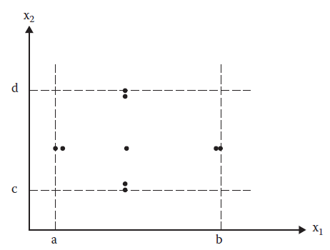
Normal boundary value technique
The rationale behind boundary value testing is that errors tend to occur near the extreme values of an input parameter.
The basic idea of normal boundary value analysis is to use input parameter values at their minimum, just above the minimum, a nominal value, just below their maximum, and at their maximum.
Boundary value analysis test cases for a function of two variables.

Slide 63
Normal boundary value technique
Generalization
If we have a function of n parameters**, we hold all but one at the nominal values and let the remaining variable assume the
min, min + t, nom, max – t, and max
Where t is an appropriate threshold we chose for the parameter
To create all the test cases we repeat this for each parameter. Thus, for a function of n parameters, boundary value analysis yields 4n + 1 unique test cases.
Boundary value analysis test cases for a function of two variables.
** In general when we talk about parameters we refer to the test input data. So these could also be method parameters, object attributes, etc….

Slide 64
class Triangle {
public void checkType(int sideA, int sideB, int sideC){
if((sideA < 1) || (sideA > 200) || (sideB < 1) ||
(sideB > 200) ||(sideC < 1) || (sideC > 200)) {
System.out.println("Wrong input");
return;
}
if(
// then check if the triangle inequality holds
(sideA >= sideB + sideC) ||
(sideB >= sideA + sideC) ||
(sideC >= sideA + sideB)){
System.out.println("Not a Triangle");
return;
}
// check if it is equilateral
if((sideA == sideB) && (sideA == sideC) && (sideB == sideC)){
System.out.println("The triangle is equilateral");
return;
}
// if not equilateral, check if it is isosceles
if((sideA == sideB) || (sideA == sideC) || (sideB == sideC)){
System.out.println("The triangle is isosceles");
return;
}
// otherwise it is scalene
System.out.println("The triangle is scalene");
return;
}
}

Slide 65
sideA: [1, 200] sideB: [1, 200] sideC: [1, 200] t = 1
Test Case | sideA | sideB | sideC | Expected output
1 | 100 | 100 | 1 | Isosceles
2 | 100 | 100 | 2 | Isosceles
3 | 100 | 100 | 100 | Equilateral
4 | 100 | 100 | 199 | Isosceles
5 | 100 | 100 | 200 | Not a triangle
6 | 100 | 1 | 100 | Isosceles
7 | 100 | 2 | 100 | Isosceles
8 | 100 | 199 | 100 | Isosceles
9 | 100 | 200 | 100 | Not a triangle
10 | 1 | 100 | 100 | Isosceles
11 | 2 | 100 | 100 | Isosceles
12 | 199 | 100 | 100 | Isosceles
13 | 200 | 100 | 100 | Not a triangle

Slide 66
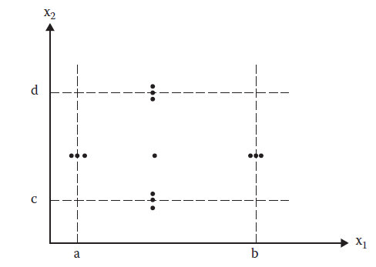
Robust boundary value technique
Robust boundary value testing is a simple extension of normal boundary value testing:
In addition to the five boundary value analysis values of a variable, we see what happens when the extremes are exceeded with a value slightly greater than the maximum (max+) and a value slightly less than the minimum (min–).
Robust boundary value analysis test cases for a function of two variables.

Slide 67
Robust boundary value technique
Generalization
If we have a function of n variables, we hold all but one at the nominal values and let the remaining variable assume the
min - t, min, min + t, nom, max – t, max, max + t
Where t is an appropriate threshold we chose for the variable
To create all the test cases we repeat this for each variable. Thus, for a function of n variables, boundary value analysis yields 6n + 1 unique test cases.
Robust boundary value analysis test cases for a function of two variables.
** In general when we talk about parameters we refer to the test input data. So these could also be method parameters, object attributes, class static attributes, etc….

Slide 68
class Triangle {
public void checkType(int sideA, int sideB, int sideC){
if((sideA < 1) || (sideA > 200) || (sideB < 1) ||
(sideB > 200) ||(sideC < 1) || (sideC > 200)) {
System.out.println("Wrong input");
return;
}
if(
// then check if the triangle inequality holds
(sideA >= sideB + sideC) ||
(sideB >= sideA + sideC) ||
(sideC >= sideA + sideB)){
System.out.println("Not a Triangle");
return;
}
// check if it is equilateral
if((sideA == sideB) && (sideA == sideC) && (sideB == sideC)){
System.out.println("The triangle is equilateral");
return;
}
// if not equilateral, check if it is isosceles
if((sideA == sideB) || (sideA == sideC) || (sideB == sideC)){
System.out.println("The triangle is isosceles");
return;
}
// otherwise it is scalene
System.out.println("The triangle is scalene");
return;
}
}

Slide 69
sideA: [1, 200] sideB: [1, 200] sideC: [1, 200] t = 1
Test Case | sideA | sideB | sideC | Expected output
1 | 100 | 100 | 0 | Wrong input
2 | 100 | 100 | 1 | Isosceles
3 | 100 | 100 | 2 | Isosceles
4 | 100 | 100 | 100 | Equilateral
5 | 100 | 100 | 199 | Isosceles
6 | 100 | 100 | 200 | Not a triangle
7 | 100 | 100 | 201 | Wrong input
8 | 100 | 0 | 100 | Wrong input
9 | 100 | 1 | 100 | Isosceles
10 | 100 | 2 | 100 | Isosceles
11 | 100 | 199 | 100 | Isosceles
12 | 100 | 200 | 100 | Not a triangle
13 | 100 | 201 | 100 | Wrong input
14 | 0 | 100 | 100 | Wrong input
15 | 1 | 100 | 100 | Isosceles
16 | 2 | 100 | 100 | Isosceles
17 | 199 | 100 | 100 | Isosceles
18 | 200 | 100 | 100 | Not a triangle
19 | 201 | 100 | 100 | Wrong input

Slide 70

Issues and limitations
Boundary value analysis works well with a function of several independent parameter that represent bounded physical quantities.
The parameters need to be described by a true ordering relation, in which, for every pair <a, b> of values of a parameter, it is possible to say that a ≤ b.
Test values for alphabet characters, for example, would be {a, b, m, y, and z}.
When no explicit bounds are present, we usually have to create “artificial” bounds (e.g., language specific Integer.MAX_VALUE, Integer.MIN_VALUE, etc).
Boundary value analysis does not make much sense for boolean variables; we can use as the extreme values TRUE and FALSE.
Notes:
When no explicit bounds are present, we usually have to create “artificial” bounds (e.g., language specific MAXINT, MININT, etc).
For other data types, as long as a variable supports an ordering relation, we can usually infer the
min, min+, nominal, max–, and max values. Test values for alphabet characters, for example, would be {a, b, m, y, and z}.
Boundary value analysis does not make much sense for Boolean variables; the extreme values are TRUE and FALSE, but no clear choice is available for the remaining three.

Slide 71
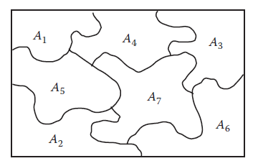
Equivalence class testing
Math preliminaries
Given a set B, and a set of subsets A1, A2, …, An of B, the subsets are a partition of B iff
A1 ∪ A2 ∪ … ∪ An = B, and i ≠ j ⇒ Ai ∩ Aj = ∅.

Slide 72
Equivalence class testing
Math preliminaries
Suppose we have a partition A1, A2, …, An of B.
Based on this partition two elements, b1 and b2 of B, are related if b1 and b2 are in the same partition element.
This is an equivalence relation because:
It is reflexive (any element is in its own partition),
It is symmetric (if b1 and b2 are in a partition element, then b2 and b1 are)
It is transitive (if b1 and b2 are in the same set, and if b2 and b3 are in the same set, then b1 and b3 are in the same set).

Slide 73
Equivalence class testing
Equivalence class testing
Assume we test a function f with n inputs: v1, v2, …vn
Each input vi has a domain dom(vi)
Our target set B is the possibly infinite set of input tuples, i.e. B = dom(v1) x dom(v2) x … dom(vn)
Our goal is to define a partition of B.
This partition would be useful for testing if for all the related input tuples (i.e., the tuples that belong to each Ai) the expected behavior of f is the same (although the exact outputs may differ).
➔In a sense we try to define classes (A1, A2, …) of expected outputs
Then the idea is to select at least one test case from each partition element Ai.
Notes:
Ισοδύναμες κλάσεις/υποσύνολα πλειάδων τιμών για τα οποία η συμπεριφορά του συστήματος είναι παρόμοια

Slide 74
class Triangle {
public void checkType(int sideA, int sideB, int sideC){
……….
}
}
For the triangle problem we can have the following partition:
B = A1 ∪ A2 ∪ A3 ∪ A4 ∪ A5
A1 = {a, b, c | wrong input} A2 = {a, b, c | not a triangle} A3 = {a, b, c | equilateral}
A4 = {a, b, c | isosceles} A5 = {a, b, c | scalene}
Test Case | sideA | sideB | sideC | Expected output
1 | 100 | 100 | 0 | Wrong input
2 | 100 | 100 | 200 | Not a triangle
3 | 100 | 100 | 100 | Equilateral
4 | 100 | 199 | 100 | Isosceles
5 | 100 | 200 | 45 | Scalene

Slide 75
How about code based techniques?

Slide 76
Code based techniques
Two widely know categories are:
  Control flow testing techniques.
  Data flow testing techniques.

Slide 77
Which are the fundamental concepts of control flow techniques?

Slide 78
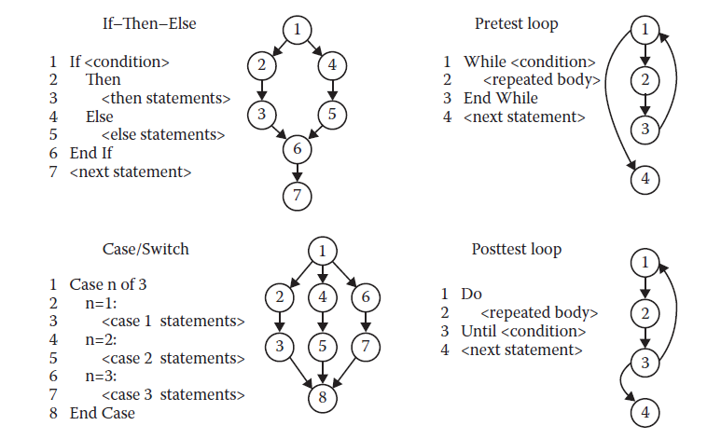
Control flow techniques
The control flow testing techniques are based on the concept of program graphs.
Given a program/function, its program graph is a directed graph in which nodes are statement fragments, and edges represent flow of control.
Program graphs of structured programming constructs

Slide 79
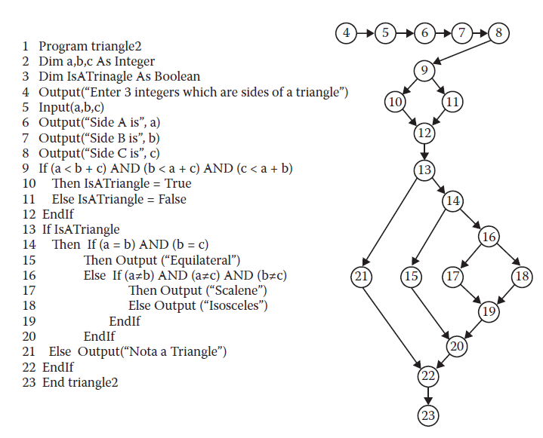
Control flow techniques

Slide 80
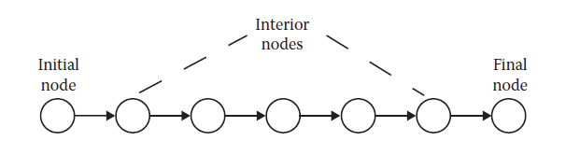
Control flow techniques
Simplified views (DD-graphs) of program graphs make things easier.
Starting for the program graph we produce the DD-graph as follows:
We keep the initial and the final nodes as is
We keep (decision) nodes with out-degree >=2 as is
We keep nodes with in-degree >=2 as is
We replace chains (with length >=2) of nodes with indeg = 1 and outdeg = 1 with a single node

Slide 81
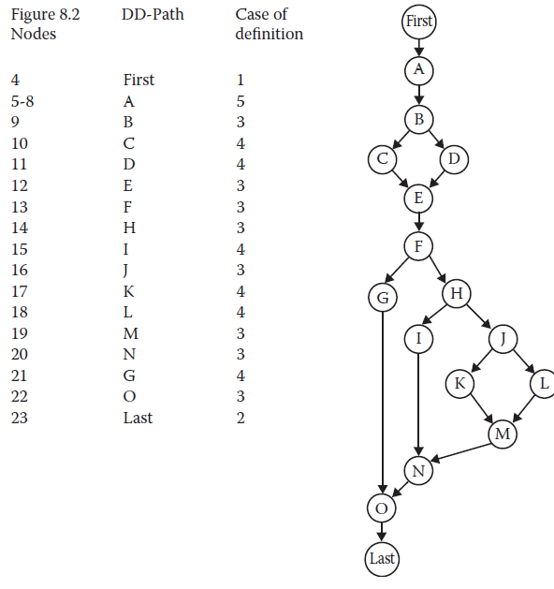
Control flow techniques
DD-path graph for triangle program

Slide 82
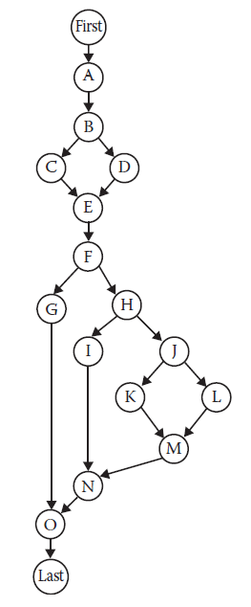
Statement testing
In statement testing our goal is to select a set of test cases T that satisfies the node coverage criterion.
A set of test cases T for a program/function, satisfies node coverage if, when executed on the program/function, every node in the program graph is traversed.
Denote this level of coverage as G_{node}, where the G stands for program graph.

Slide 83
Branch testing
In branch testing our goal is to select a set of test cases T that satisfies the edge coverage criterion.
A set of test cases T for a program/function satisfies edge coverage if, when executed on the program/function, every edge in the program graph is traversed.
Denote this level of coverage as G_{edge}.
The difference between G_{node} and G_{edge} is that, in the latter, we are assured that all outcomes of a decision-making statement are executed.

Slide 84
Path testing
In path testing our goal is to select a set of test cases T that satisfies the path coverage criterion.
A set of test cases T for a program/function satisfies path coverage if, when executed on the program, every feasible path from the source node to the sink node in the program graph is traversed.
Denote this level of coverage as G_{path}.
The difference between G_{edge} and G_{path} is that, in the latter, we are assured that all possible combinations of outcomes of decision-making statements are executed.
Keep in mind the possibility of infeasible paths and dependent decision points.

Slide 85
If (x) {
}
…
If (y) {
}
…

