Slide 1
Spring Boot Web Apps – Spring MVC www.cs.uoi.gr/~zarras/http://www.cs.uoi.gr/~zarras/se.htm
https://docs.spring.io/spring-framework/docs/3.2.x/spring-framework-reference/html/mvc.html

Slide 2
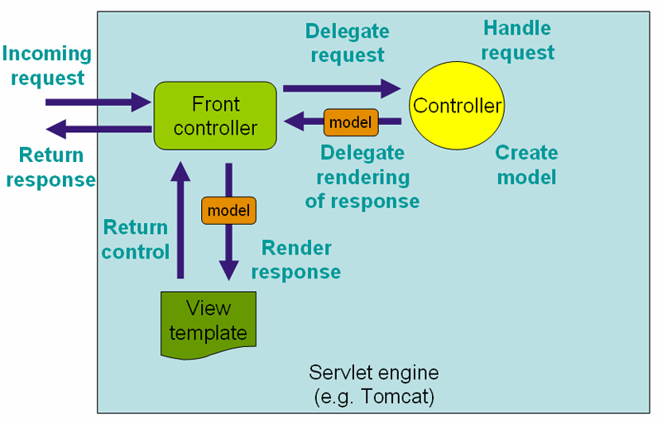
The basic idea …
View template engine
Template html pages
https://en.wikipedia.org/wiki/Web_server
https://en.wikipedia.org/wiki/Uniform_Resource_Identifier
Notes:
https://en.wikipedia.org/wiki/Web_server
https://en.wikipedia.org/wiki/Uniform_Resource_Identifier

Slide 3
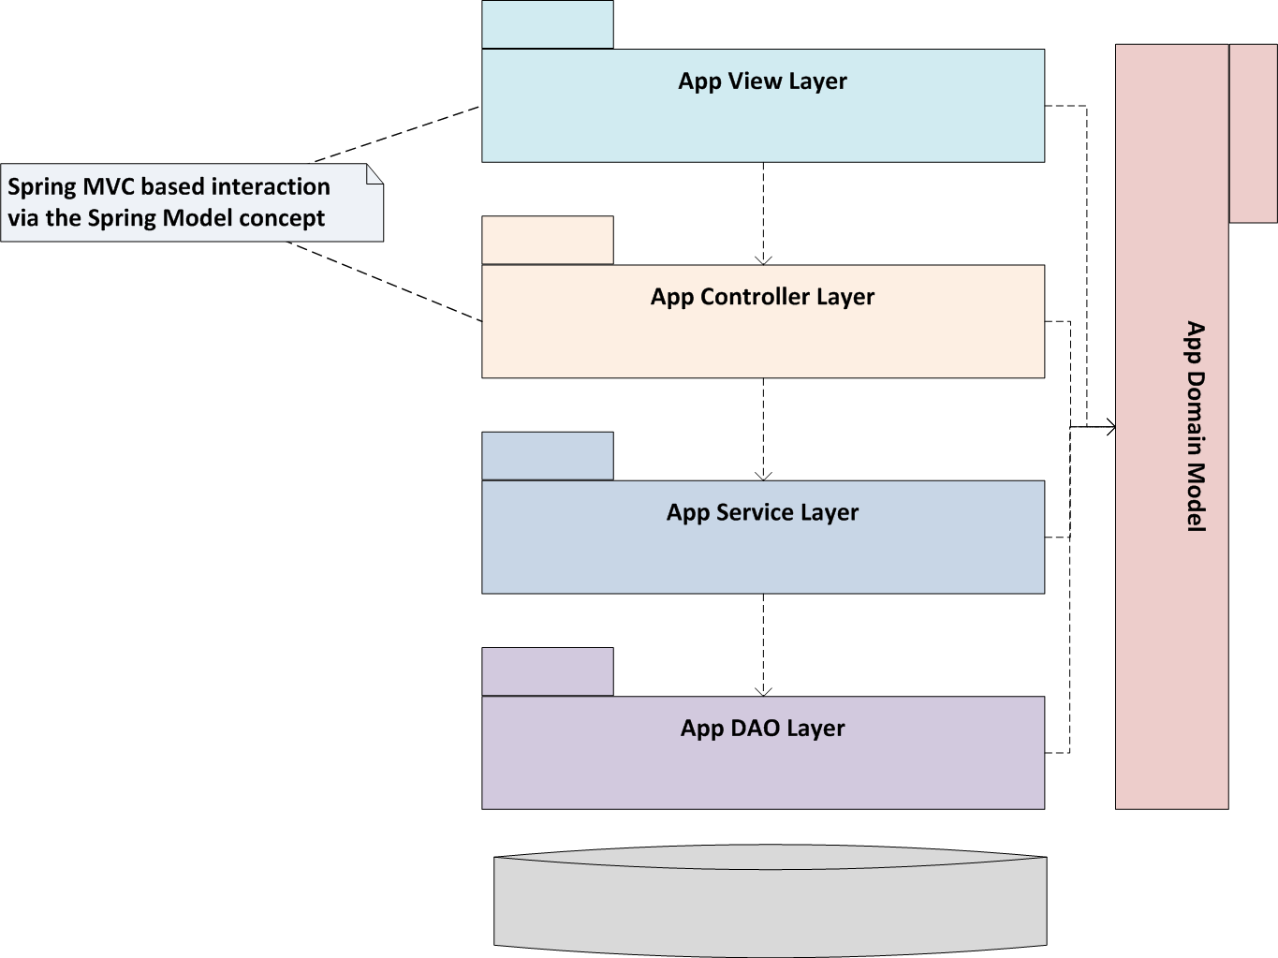
Typical architecture (Layered + MVC)
DBMS
Notes:
Views templates have (URI) links that specify which controller methods to call. The user uses these links from the web browser to sent http requests to the server side. Spring front controller determines which application controller methods to call based on the incoming requests.
Controller delegates method calls to service layer which uses the dao to provide the requested services. Dao brings/saves data model objects from the DBMS and gives the to the service layer for processing, the controller puts the data to the spring mvc model object and based on the model the template engine takes over to produce the result page

Slide 4
Some pointers …
Spring MVC docs.spring.io/spring-framework/docs/3.2.x/spring-framework-reference/html/mvc.html
Thymeleaf tutorial www.thymeleaf.org/doc/tutorials/2.1/usingthymeleaf.html
Bootstrap tutorial www.w3schools.com/bootstrap/default.asp
Notes:
Order
1) Slides 2) pom 3) proj structure 3) Controller annotations + methods that create pages 4) html templates (refer to thymeleaf expressions) --- 5) TESTS

