Slide 1
xUnit Patterns www.cs.uoi.gr/~zarras/http://www.cs.uoi.gr/~zarras/se.htm
xUnit Patterns by Gerard Meszaros
1

Slide 2
Goals of Test Automation
Why should we test ?

Slide 3

Goals of Test Automation
Tests should help us improve software quality
Tests should help us improve software understanding
Tests as specification.
  Insure that we build the right software.
Defect localization.
  Insure that the software is correct.
Defect prevention.
  Insure that bugs wont crawl back to the software.
Tests as documentation.
  Allow the developer/maintainer to answer questions like “what should be the expected outcome of the software is the given input is …”

Slide 4
Goals of Test Automation
Tests should be easy to run
Tests should help us reduce risk
Fully automated.
  Execute without any effort.
Self checking.
  Detect and report any errors without human intervention.
Repeatable.
  Can be run many times in a row and produce the same results without human interventions in between.
Independent from each other.
  Can be run by themselves and NOT depend on the execution order, failure or success of other tests.
Tests as safety net.
  Insure that we do no harm when we change the software.
Test development should not introduce new risks risk
Refrain from modifying the software to facilitate the development of the tests as safety net.

Slide 5
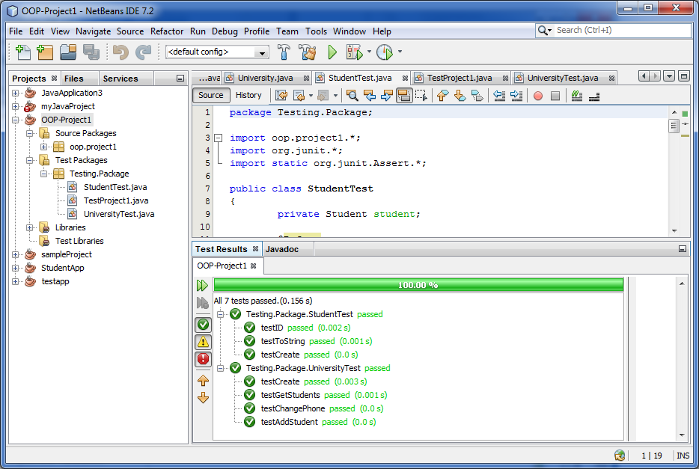
How to achieve these goals?
Use an xUnit test automation framework and patterns

Slide 6
Test Strategy Patterns

Slide 7
How do we prepare automated tests for our software?

Slide 8
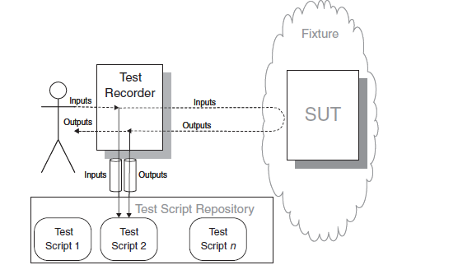
Recorded Tests
We automate tests by recording interactions with the application and playing them back using a test tool.
No need for programming skills for such kind of tests.
We have two basic choices when using a Recorded Test strategy:
We can either acquire third-party tools that record the communication that occurs while we interact with the application (e.g. Mercury QuickTest Professional)
or we can build a “record and playback” mechanism right into our application

Slide 9
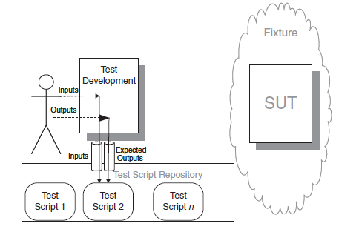
Scripted Tests
We automate the tests by writing test programs by hand.
The most typical kind of tests….
Traditionally, Scripted Tests were written as “test programs,” often using a special test scripting language.
Nowadays, we prefer to write Scripted Tests using a Test Automation Framework

Slide 10
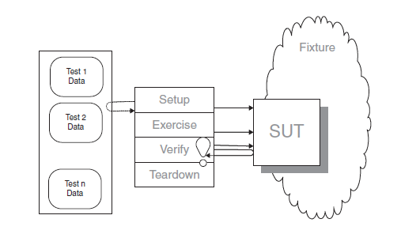
Data Driven Tests
We store all the information needed for each test in a data file and write an interpreter that reads the file and executes the tests.
A Data-Driven Test is an ideal strategy for getting business people involved in writing automated tests.
By keeping the format of the data file simple, we make it possible for the business person to populate the file with data and execute the tests without having to ask a technical person to write test code for each test.

Slide 11
How do we make it easy to write and run tests written by different people?

Slide 12
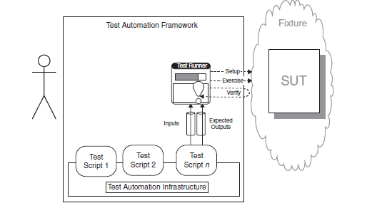
Test Automation Framework
We use a framework that provides all the mechanisms needed to run the test logic so the test writer needs to provide only the test-specific logic.
…

Slide 13
Which fixture** strategy should we use?
** fixture in xUnit terminology is everything we need in place to be able to test the System Under Test (SUT)

Slide 14
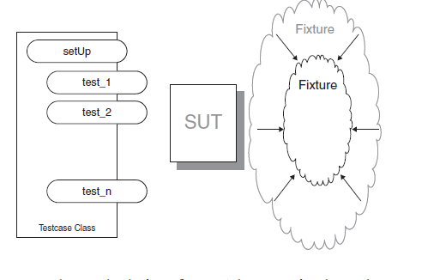
Minimal Fixture
We use the smallest and simplest fixture possible for each test.
A test that uses a Minimal Fixture will always be easier to understand than one that uses a fixture containing unnecessary or irrelevant information.

Slide 15
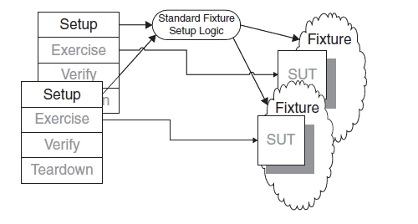
Standard Fixture
We reuse the design of the text fixture across the many tests
This approach makes a lot of sense in the context of manual execution of many customer tests because it eliminates the need for each tester to spend a lot of time setting up the test environment.

Slide 16
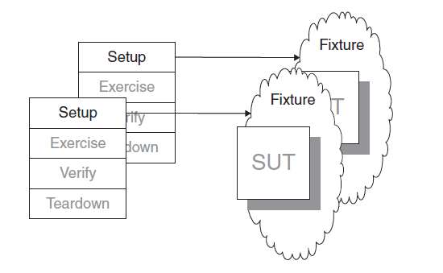
Fresh Fixture
Each test constructs its own brand-new test fixture for its own private use.
We should use a Fresh Fixture whenever we want to avoid any interdependencies between tests (which is in fact almost always the case …..)

Slide 17
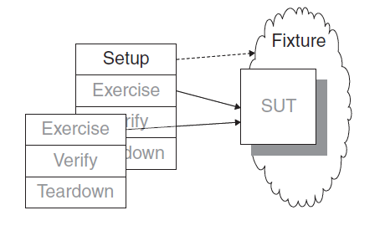
Shared Fixture
We reuse the same instance of the test fixture across many tests.
If we want to avoid slow tests.
Or, when we have a long, complex sequence of actions, each of which depends on the previous actions. In customer tests, this may show up as a workflow; in unit tests, it may be a sequence of method calls on the same object.
With the big risk of introducing interdependencies between tests ….

Slide 18
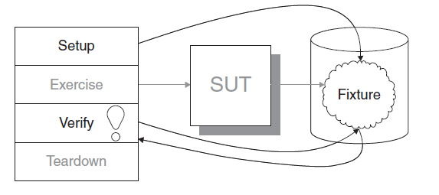
Back Door Manipulation
We set up the test fixture or verify the outcome by going through a back door (such as direct database access).
A common application involves testing basic CRUD (Create, Read, Update, Delete) operations on the SUT’s state.
In such a case, we want to verify that the information persisted and can be recovered in the same form.

Slide 19
xUnit Basic Patterns

Slide 20
Where do we put our test code?

Slide 21
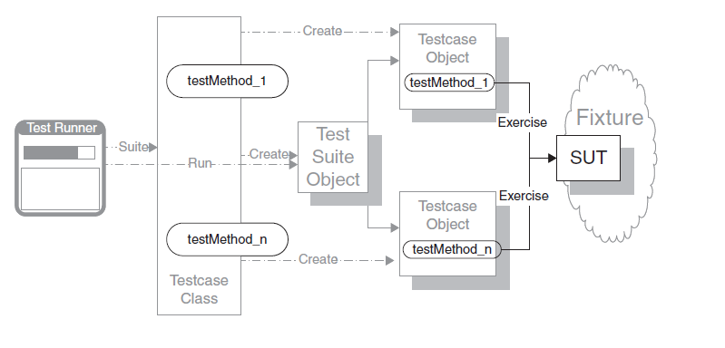
Test Method
We encode each test as a single Test Method on some class.
Variations:
Simple success test (happy day)
Expected exception test
Constructor test
Dependency initialization test

Slide 22
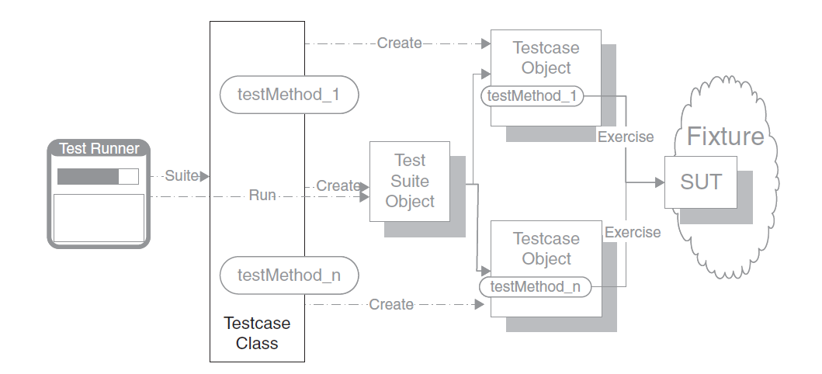
Test Case Class
We group a set of related Test Methods on a single Testcase Class.
Notes:
https://www.javatpoint.com/junit-test-case-example-in-java

Slide 23
How do we structure our test code?

Slide 24
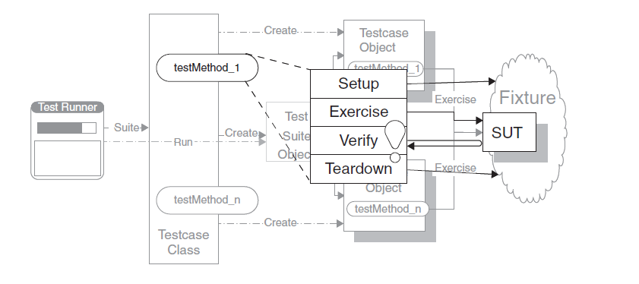
Four Phase Test
We structure each test with four distinct parts executed in sequence.
In the first phase, we set up the test fixture and anything we need to put in place to be able to observe the actual outcome .
In the second phase, we interact with the SUT.
In the third phase, we determine whether the expected outcome has been obtained.
In the fourth phase, we tear down the test fixture to put the world back into the state in which we found it.

Slide 25
How do we make tests self-checking?

Slide 26
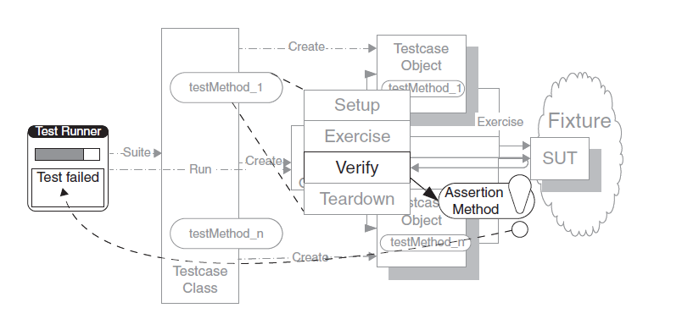
Assertion Method
We call a utility method to evaluate whether an expected outcome has been achieved.
Variations:
(In) Equality assertions
Fuzzy equality assertions (for floating point results with an error tolerance)
Stated outcome assertions (is null, is true, …)
Expected exception assertions.
Single outcome assertions (fail)
Notes:
https://www.baeldung.com/junit-assertions
https://howtodoinjava.com/junit5/junit-5-assertions-examples/

Slide 27
How do we provide more information about a failed assertion?

Slide 28
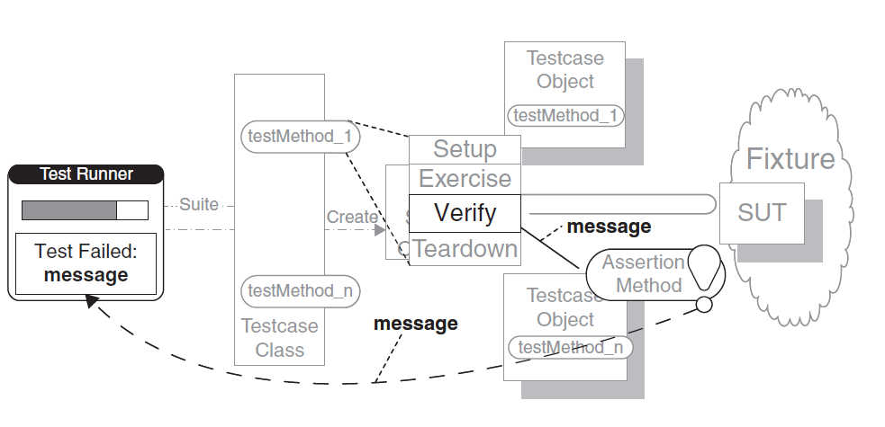
Assertion Message
We include a descriptive string argument in each call to an Assertion Method.

Slide 29
How do we run the tests?

Slide 30
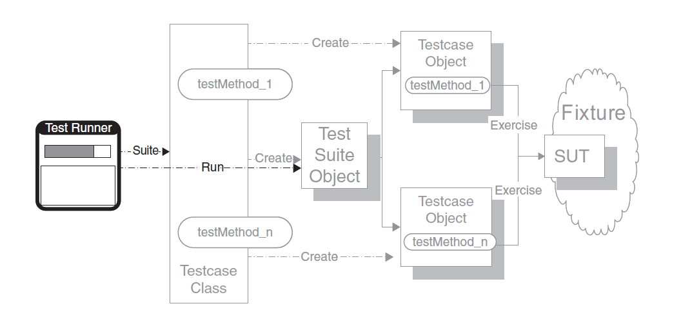
Test Runner
We execute the xUnit framework’s specific program that instantiates and executes the Testcase Objects. When we have many tests to run we can organize them in Test Suite classes.
Notes:
https://howtodoinjava.com/junit5/junit5-test-suites-examples/

Slide 31
Fixture Setup/Teardown Patterns

Slide 32
How do we construct (destroy) the fresh fixture?

Slide 33
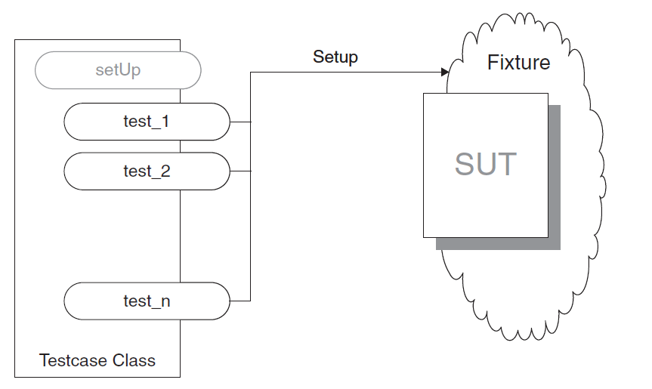
Inline Setup (Teardown)
Each Test Method creates its own Fresh Fixture by calling the appropriate constructor methods to build exactly the test fixture it requires (the method destroys the fixture at the end).
We can use In-line Setup when the fixture setup logic is very simple and straightforward.

Slide 34
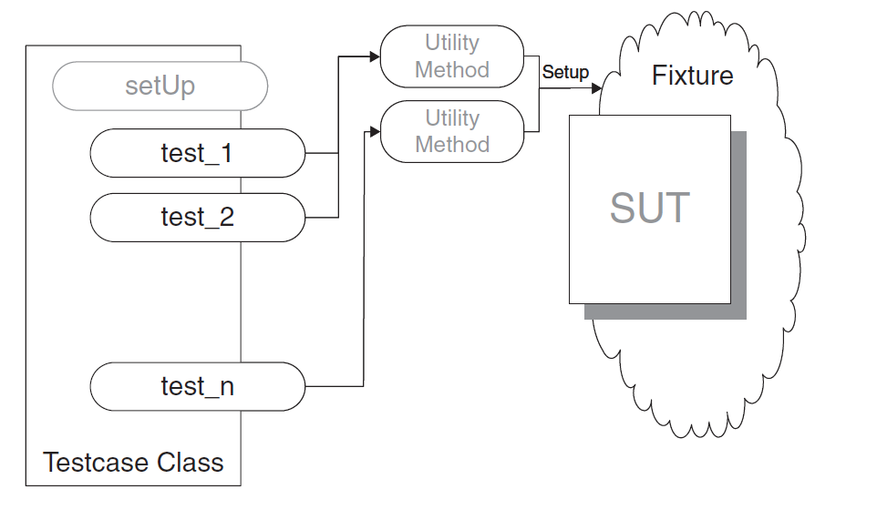
Delegated Setup (Teardown)
Each Test Method creates (destroys) its own Fresh Fixture by calling Creation/Destruction Methods from within the Test Methods.
We can use a Delegated Setup when we want to avoid the test code duplication caused by having to set up similar fixtures for several tests and we want to keep the nature of the fixture visible within the Test Methods

Slide 35
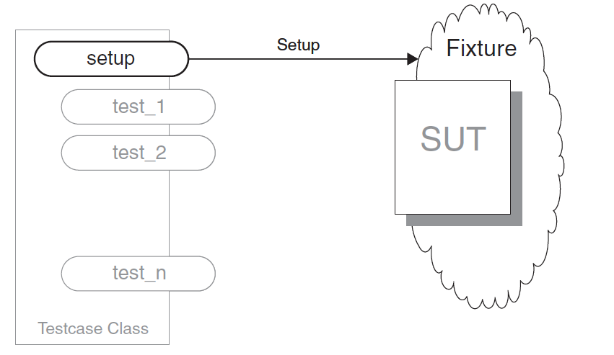
Implicit Fresh Fixture Setup (Teardown)
We build (destroy) the test fixture common to several tests in set up/tear down methods called by the test framework.
We can use Implicit Setup when several Test Methods on the same Testcase Class need an identical Fresh Fixture.
Notes:
https://www.baeldung.com/junit-before-beforeclass-beforeeach-beforeall

Slide 36
How do we create (destroy) a shared fixture if the test methods that need it are in the same test class?

Slide 37
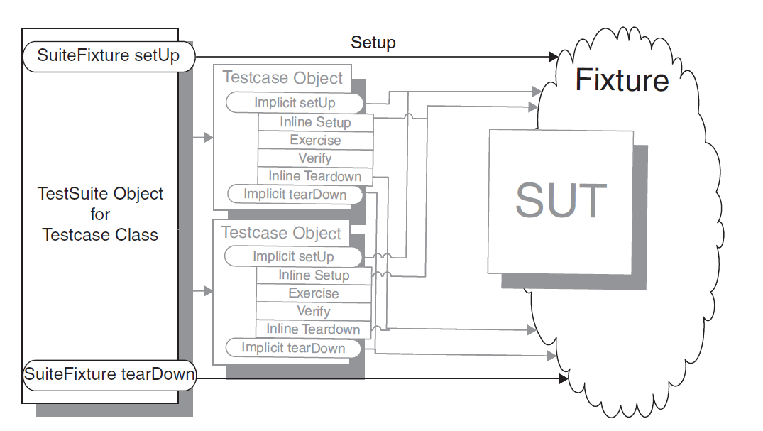
Implicit Shared Fixture Setup (Teardown)
We build (destroy) the shared fixture in special methods called by the Test Automation Framework before/after the first/last Test Method is called
Notes:
https://www.baeldung.com/junit-before-beforeclass-beforeeach-beforeall

Slide 38
How do we create (destroy) a shared fixture if the test methods that need it are not in the same test class?

Slide 39
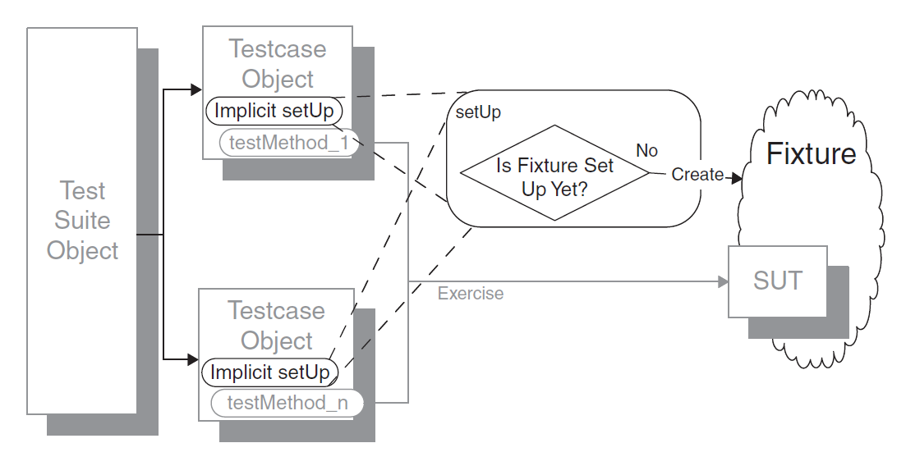
Lazy Setup
We use Lazy Initialization of the fixture to create it in the first test method that needs it.
The basic disadvantage is that we do not know when to tear down the fixture.
May be better to group all methods in the same test class….

Slide 40
How do we create (destroy) a shared fixture if the fixture setup takes too much time and resources?

Slide 41
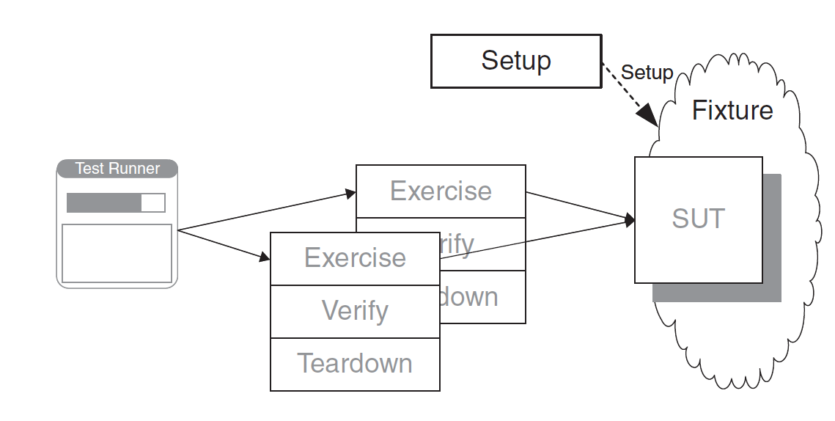
Prebuild Fixture
We build the Shared Fixture separately from running the tests.
Not very common but could be useful is the setup is very time or resource consuming.
Fits well with the Backdoor Manipulation strategy

Slide 42
Result Verification Patterns

Slide 43
How do we verify a method that returns a value?

Slide 44
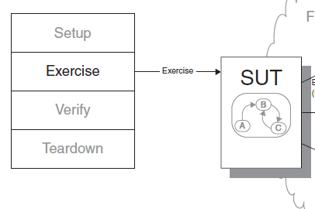
Return Value Verification
We inspect the returned value of the method and compare it with an expected return value.
check return value

Slide 45
How do we verify a method that changes the state of the SUT?

Slide 46
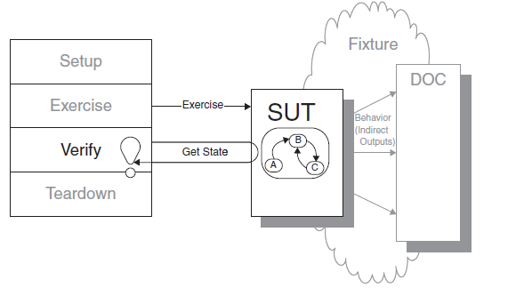
State Verification
We inspect the state of the system under test after it has been exercised and compare it to the expected state.
Variations:
Procedural State Verification, we simply write a series of calls to Assertion Methods that pick apart the state information into pieces and compare to individual expected values.
Expected State Specification, we construct a specification for the
post-exercise state in the form of one or more objects populated with the expected attributes. We then compare the actual state with these objects.

Slide 47
How do we verify a method of the SUT that interacts with other Depend-On-Components (DOC)?

Slide 48
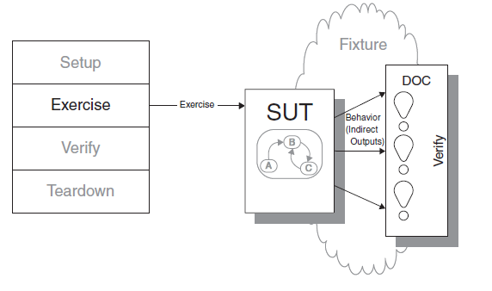
Behavior Verification
We capture the indirect outputs/interactions of the SUT with DOC as they occur and compare them to the expected behavior.
Variations:
Procedural State Verification, we capture the method calls made by the SUT to DOC as it executes and later get access to them from within the Test Method. Then we use Equality Assertions to compare them with the expected ones. The most common way of trapping the indirect outputs of the SUT is to install a Test Spy around the DOC.
Expected State Specification, instead of waiting until after the fact to verify the indirect outputs of the SUT by using a sequence of assertions, we specify the Expected Behavior Specification into a Mock Object use it instead of DOC and let it verify that the method calls are correct as they are received.
Notes:
Attention !!! these – self checking - mock objects are not supported by mockito, they have to be build by hand !!! Typical mockito mock objects are just fake objects or stub objects
A way to make a spy without mockito is to subclass the DOC and override its methods to keep track of when they are called.

Slide 49
Behavior Verification
We capture the indirect outputs/interactions of the SUT with DOC as they occur and compare them to the expected behavior.
Typically to verify behavior we have to use some kind of a Test Spy or Test Mock
(see Test Double patterns that follow)
Notes:
Attention !!! these – self checking - mock objects are not supported by mockito, they have to be build by hand !!! Typical mockito mock objects are just fake objects or stub objects
A way to make a spy without mockito is to subclass the DOC and override its methods to keep track of when they are called.

Slide 50
Test Double Patterns

Slide 51
How do we test the SUT when it interacts/depends with/on other DOC?

Slide 52
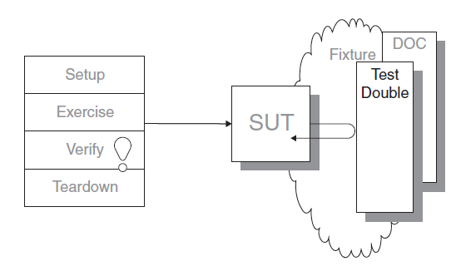
Test Double
We replace the DOC on which the SUT depends with a “test-specific equivalent” test doubles that allow us to control the input to the SUT and/or provide capture the interaction between them.

Slide 53
How do we verify the behavior of the SUT when it gets indirect inputs from another component, independently from this component?

Slide 54
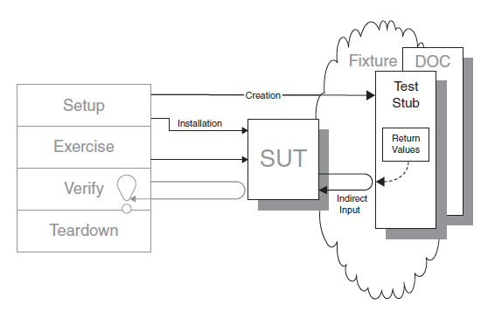
Test Stub
Use a test-specific object that feeds the desired indirect inputs into the system under test.
Variations:
Responder: a stub that feeds the SUT with valid (happy path) input.
Saboteur: a stub that feeds the SUT with invalid input.
Stub Implementation options:
Use a mocking framework like mockito (mock() and when-then-return/throw commands).
If DOC implements an interface, configure the SUT with a test-specific DOC interface implementation.
Notes:
Mockito to make a stub we create a mock and use when-then commands to specify its behavior
https://www.baeldung.com/mockito-behavior

Slide 55
How do we verify the behavior of the SUT when it calls another component?

Slide 56
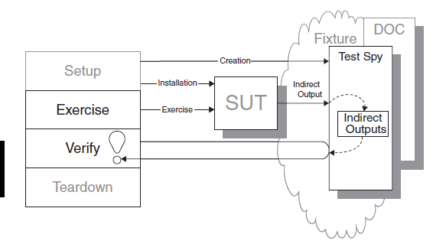
Test Spy
We use a Test Spy to wrap the DOC to capture the indirect output calls made to DOC by the SUT for later verification by the test.
Spy Implementation options:
Use a mocking framework like mockito (spy() and verify() commands).
Subclass DOC and override the required methods to capture SUT calls. Configure the SUT with a test-specific object of the DOC subclass.

Slide 57
How do we verify the behavior of the SUT when it calls another component, independently from this component?

Slide 58
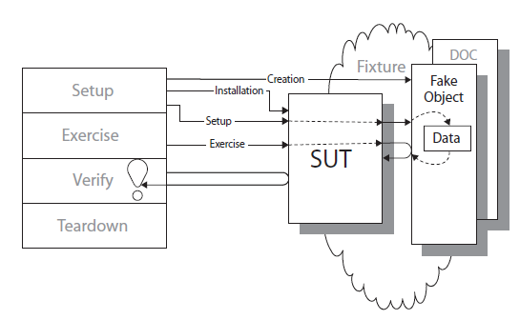
Fake Object
We replace the DOC that the SUT depends on with a much lighter-weight implementation.
Fake Object implementation options:
Use a mocking framework like mockito (mock() and when-then-return/throw commands).
If DOC implements an interface, configure the SUT with a test-specific DOC interface implementation.

Slide 59
……….

Slide 60
….
…….

Slide 61
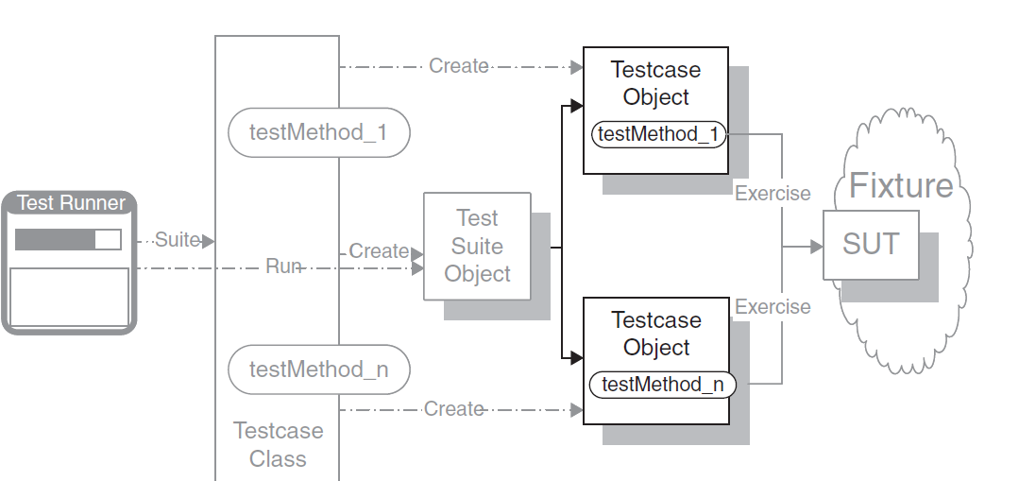
Test Object
The test runner creates a Command object for each test and call the test methods when we wish to execute it.

Slide 62
How do we run the tests when we have many tests to run?

Slide 63
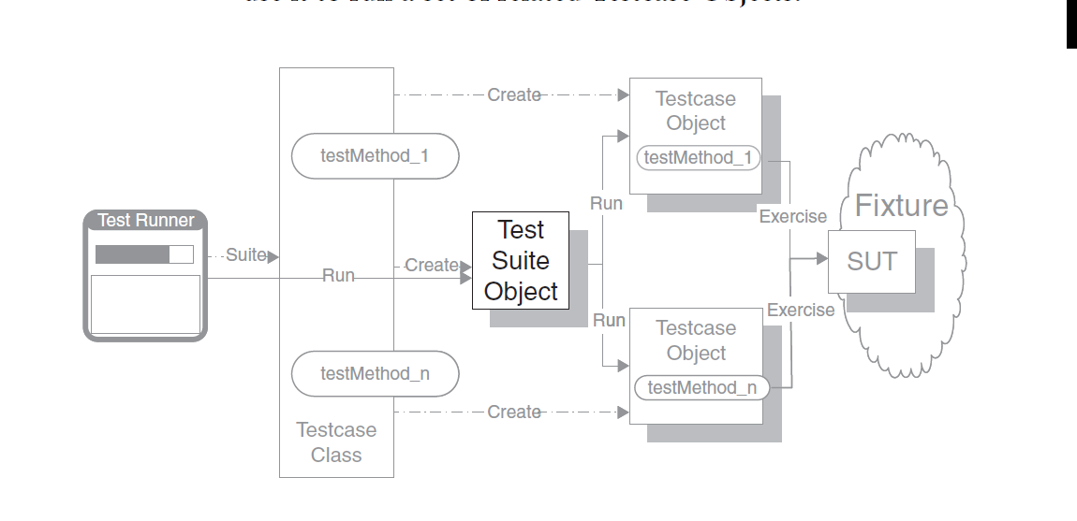
Test Suite
We define a collection class that implements the standard test interface and use it to run a set of related Testcase Objects.

