Slide 1
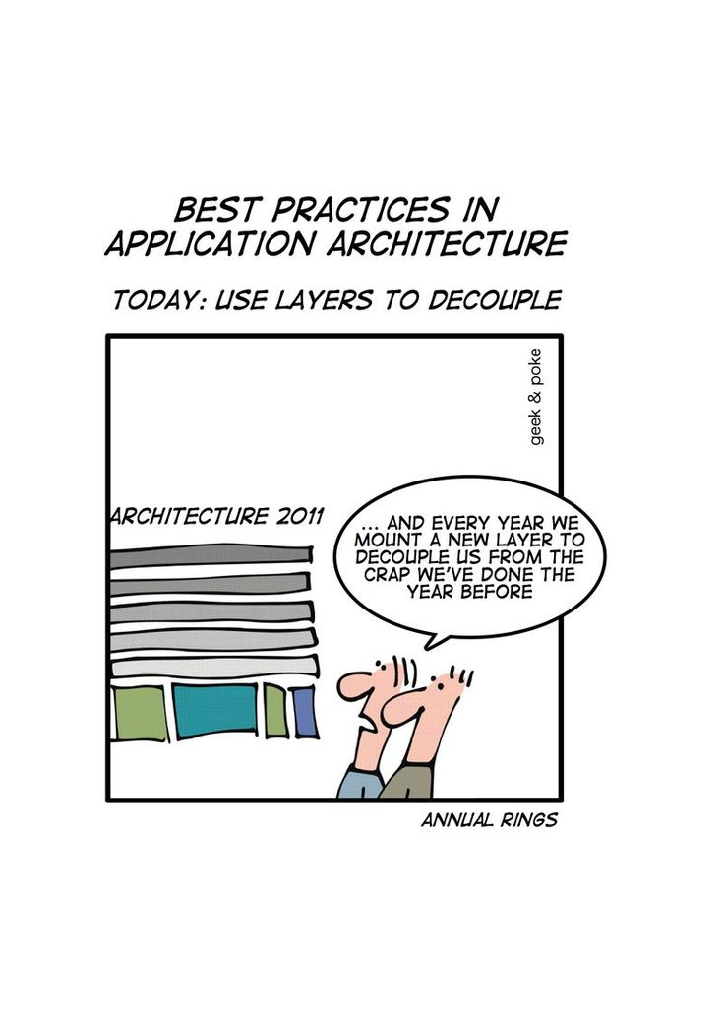
Enterprise Application Architecture Patterns www.cs.uoi.gr/~zarras/http://www.cs.uoi.gr/~zarras/se.htm
Patterns of Enterprise Application Architecture
by Martin Fowler
1

Slide 2
Enterprise Application Architectures

Slide 3
How does a typical EAA look like?

Slide 4
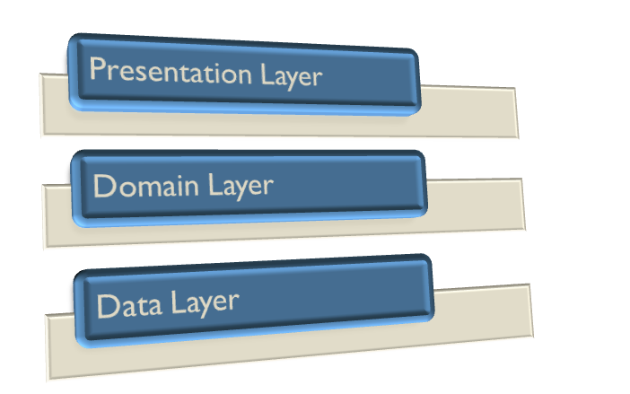
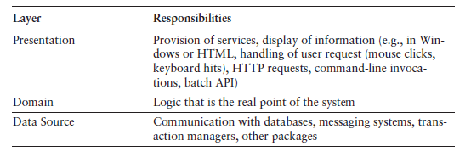
How does a typical EAA look like?

Slide 5
Domain Logic Patterns

Slide 6
How do we organize Domain layer logic?

Slide 7
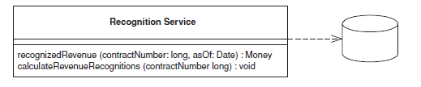
Transaction Script
Organizes domain logic by procedures where each procedure handles a single request from the presentation.
Most business applications can be thought of as a series of transactions. A transaction may view some information as organized in a particular way, another will make changes to it.
A Transaction Script organizes all this logic primarily as a single procedure, making calls directly to the database or through a thin database wrapper. Each transaction will have its own Transaction Script.
Suitable for cases where the business logic is simple.
But, transaction logic may get complex for complex apps
Code duplication in the case of more complex business logic.

Slide 8
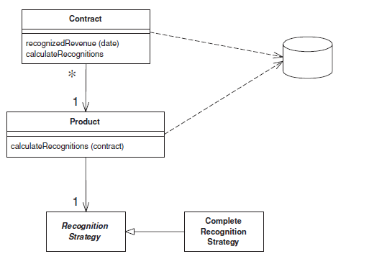
Domain Model
An object model of the domain that incorporates both behavior and data.
At its worst business logic can be very complex.
Rules and logic describe many different cases and slants of behavior, and it's this complexity that objects were designed to deal with.
A Domain Model creates a web of interconnected objects, where each object represents some meaningful concept.
Good for real world complex business logic.
May be too much for very simple cases; better use Transaction scripts, instead.

Slide 9
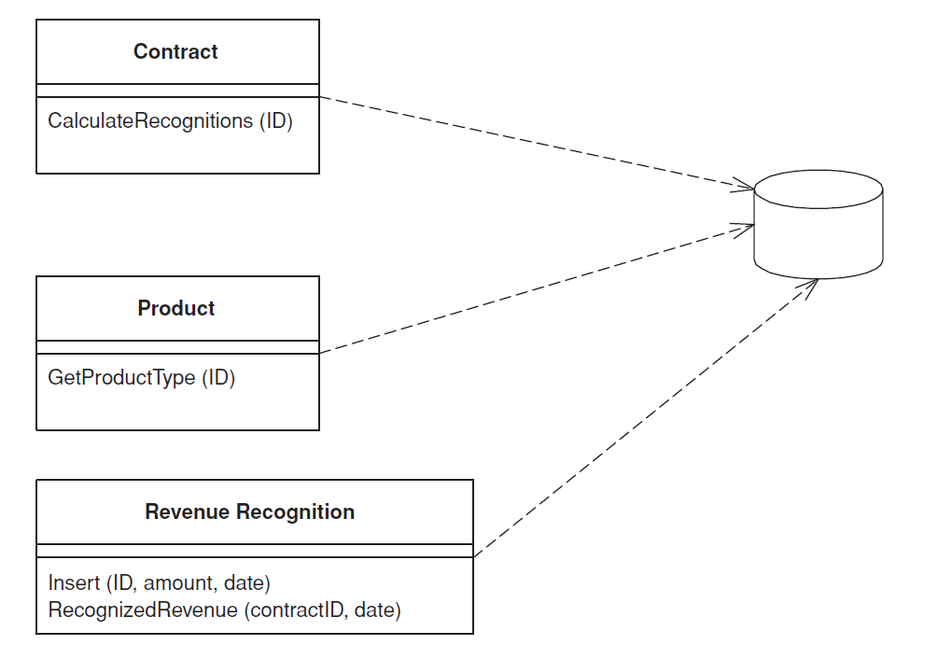
Table Module
A single instance that handles the business logic for all rows in a database table or view.
A Table Module organizes domain logic with one class per table in the data-base, and a single instance of a class contains the various procedures that will act on the data.
The primary distinction with Domain Model is that, if you have many orders, a Domain Model will have one order object per order while a Table Module will have one object to handle all orders.
The strong point of Table Module is the easy integration with the Data Layer. However, you do not have the full power of OO that the Domain Model pattern gives you.

Slide 10
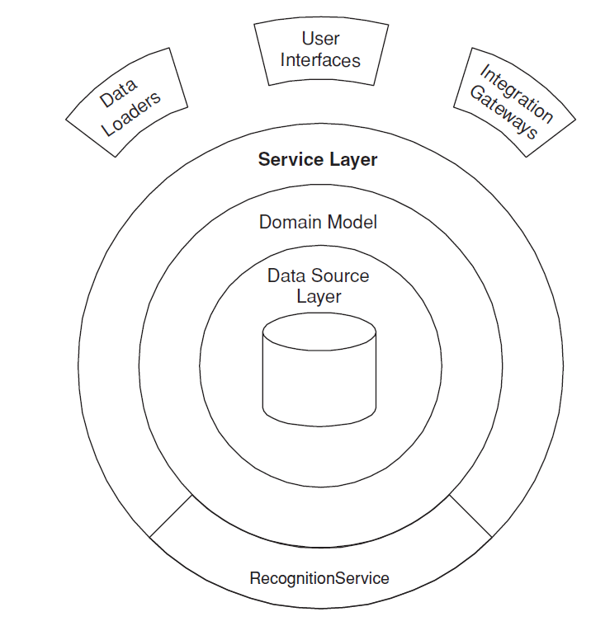
Service Layer
Defines an application's boundary with a layer of services that establishes a set of available operations and coordinates the application's response in each operation.
Enterprise applications typically require different kinds of interfaces to the data: HTML, REST, others.
Despite their different purposes, these interfaces often need common interactions with the application to access and manipulate its data and invoke its business logic.
Encoding the logic of the interactions separately in each interface causes a lot of duplication..
If an application has or will have to support different types of clients with different interfacing requirements.

Slide 11
Data Source Architectural Patterns

Slide 12
How do we transfer data from/to the Data layer to/from the Domain Layer ?

Slide 13
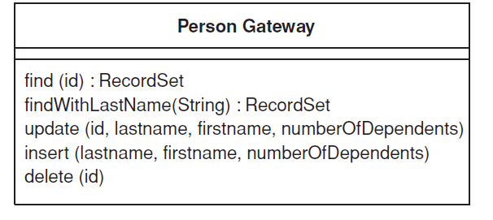
Table Data Gateway
An object that acts as a gateway to a database table. One instance handles all the rows in the table.
Mixing SQL in application logic can cause several problems. Many developers aren't comfortable with SQL, and many who are comfortable may not write it well.
A Table Data Gateway holds all the SQL for accessing a single table or view. Other code calls its methods for all interaction with the database.
It is a simple way to transfer data from/to a table. Fits well with Table Module (better than with Domain Model).

Slide 14
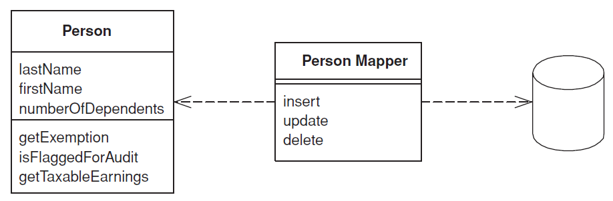
Data Mapper
A layer of Mappers moves data between objects and a database while keeping them independent of each other and the mapper itself.
The Data Mapper is a layer of software that separates the in-memory objects from the database. Its responsibility is to transfer data between the two and also to isolate them from each other.
With Data Mapper the in-memory objects needn't know even that there's a database present.
Fits well with Domain Model.

Slide 15
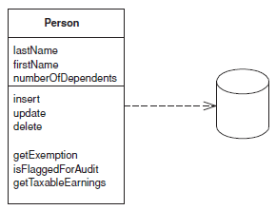
Active Record
An object that wraps a row in a database table or view, encapsulates the database access, and adds domain logic on that data.
Active Record uses the most obvious know approach, putting data access logic in the domain object. This way all people know hoe to read and write their data to and from the database.
Fits well with SIMPLE Domain Models.

Slide 16
Object Relational Structural Patterns

Slide 17
How to map OO - Relational concepts ?

Slide 18

Identity Field
Saves a database ID field in an object to maintain identity between an in-memory object and a database row.
Intent
Reading data from a database is all very well, but in order to write data back you need to tie the database to the in-memory object system.
In essence, Identity Field is mind-numbingly simple. All you do is store the primary key of the relational database table in the object’s fields.
Fits together with Domain Model

Slide 19
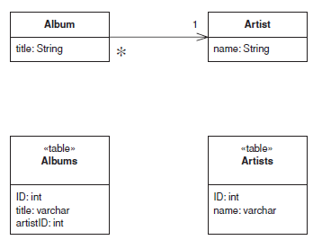
Foreign Key Mapping
Maps an association between objects to a foreign key reference between tables.
Objects can refer to each other directly by object references.
To save these objects to a database, it’s vital to save these references.
A Foreign Key Mapping maps an object reference to a foreign key in the database.
Single object reference →
Many to one / one to one
A Foreign Key Mapping can be used for almost all associations between classes. The most common case where it isn’t possible is with many-to-many associations. Instead you need to use Association Table Mapping

Slide 20
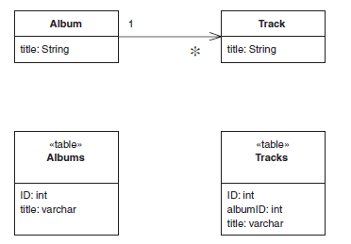
Foreign Key Mapping
Maps an association between objects to a foreign key reference between tables.
Objects can refer to each other directly by object references.
To save these objects to a database, it’s vital to save these references.
A Foreign Key Mapping maps an object reference to a foreign key in the database.
List of references → One to many
A Foreign Key Mapping can be used for almost all associations between classes. The most common case where it isn’t possible is with many-to-many associations. Instead you need to use Association Table Mapping

Slide 21
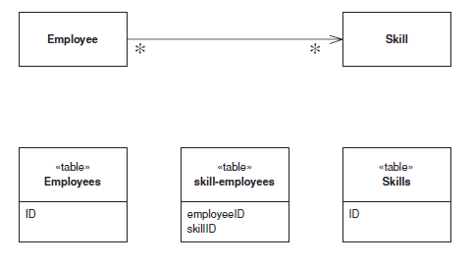
Association Table Mapping
Saves an association as a table with foreign keys to the tables that are linked by the association.
When you’re mapping a one-to-many association you can handle this using Foreign Key Mapping essentially using a foreign key to the single-valued end of the association.
But a many-to-many association can’t do this because there is no single-valued end to hold the foreign key.
The answer is the classic resolution that’s been used by relational data people for decades: create an extra table to record the relationship.
List of references → Many to many
The canonical case for Association Table Mapping is a many-to-many association, since there are really no any alternatives for that situation.

Slide 22
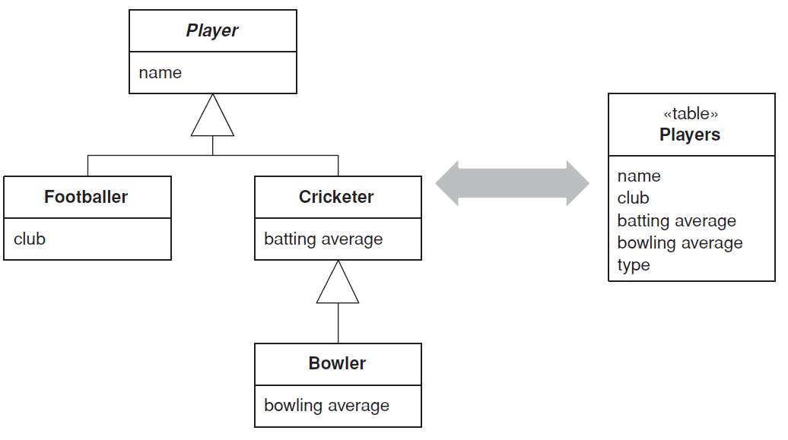
Single Table Inheritance
Represents an inheritance hierarchy of classes as a single table that has columns for all the fields of the various classes.
Relational databases don’t support inheritance, so when mapping from objects to databases we have to consider how to represent our nice inheritance structures in relational tables.
Single Table Inheritance maps all fields of all classes of an inheritance structure into a single table.

Slide 23
Single Table Inheritance
Represents an inheritance hierarchy of classes as a single table that has columns for all the fields of the various classes.
There’s only a single table to worry about on the database. There are no joins in retrieving data. Any refactoring that pushes fields up or down the hierarchy doesn’t change the DB.
Fields are sometimes relevant and sometimes not, which can be confusing. Columns used only by some subclasses lead to wasted space in the database. The single table may end up being too large.

Slide 24
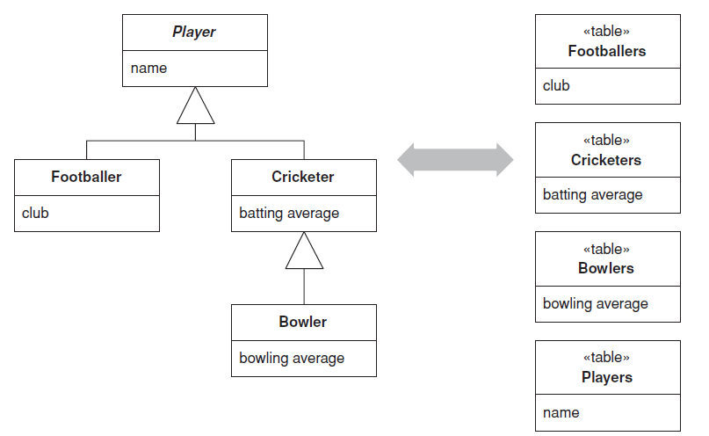
Class Table Inheritance
Represents an inheritance hierarchy of classes with one table for each class.
Relational databases don’t support inheritance, so we have to consider how to represent our nice inheritance structures in relational tables.
Class Table Inheritance supports this by using one database table per class in the inheritance structure.
The linking between the tables can be done by assuming a equality in the tables key values.
Another way is to have foreign keys between the tables

Slide 25
Concrete Table Inheritance
Represents an inheritance hierarchy of classes with one table for each class.
All columns are relevant for every row so tables are easier to understand and don’t waste space.
The relationship between the domain model and the database is straightforward.
Need to touch multiple tables to load an object, which means a join or multiple queries and sewing in memory.
Any refactoring of fields up or down the hierarchy causes database changes.

Slide 26
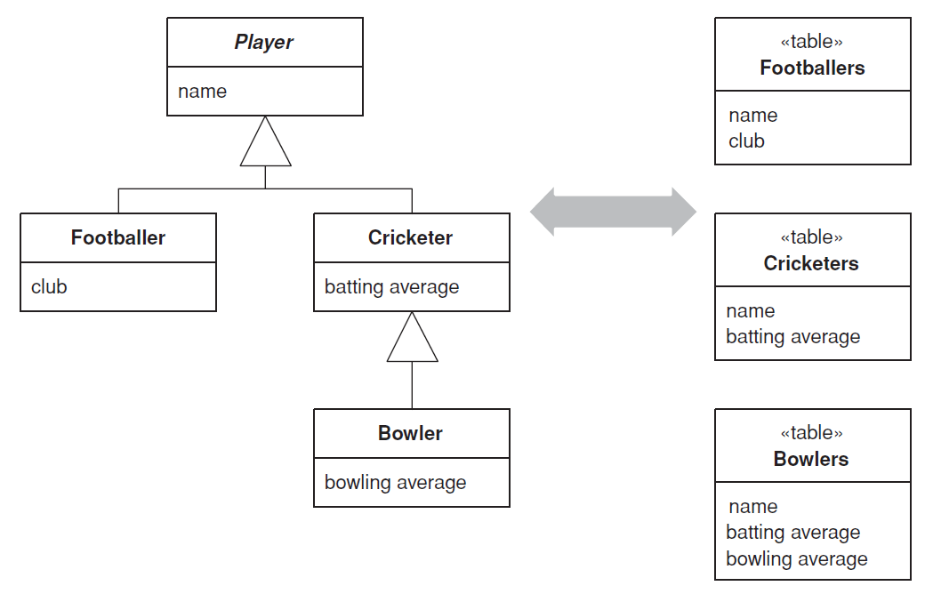
Joined Table Inheritance
Represents an inheritance hierarchy of classes with one table per leaf class in the hierarchy with all fields in the table row.
Relational databases don’t support inheritance, so when mapping from objects to databases we have to consider how to represent our nice inheritance structures in relational tables.
Concrete Table Inheritance supports this by using one database table per leaf class in the inheritance structure, with all fields in the table row.

Slide 27
Joined Table Inheritance
Represents an inheritance hierarchy of classes with one table per leaf class in the hierarchy with all fields in the table row.
Each table is self-contained and has no irrelevant fields.
There are no joins to do when reading the data from the concrete mappers.
Each table is accessed only when that class is accessed, which can spread the access load.
With fields are pushed up or down the hierarchy, have to alter the table definitions. If a superclass field changes, you need to change each table.

Slide 28
Identity Field
….
….
Applicability & Consequences …

Slide 29
Web presentation patterns

Slide 30
How to deal with the UI ?

Slide 31
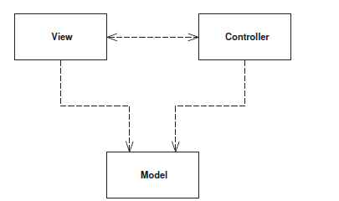
Model View Controller
Splits user interface interaction into three distinct roles.
The model is an object that represents some
information about the domain.
The view represents the display of the model in the UI.
The controller takes user input, manipulates
the model, and causes the view to update appropriately.
In this way UI is a combination of the view and the controller.
The separation of presentation and model is one of the most important design principles in software, and the only time we shouldn’t follow it is in very simple systems where the model has no real behavior in it anyway.

Slide 32
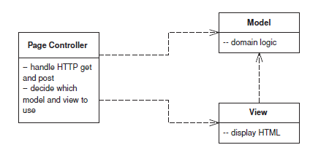
Page Controller
An object that handles a request for a specific page or action on a Web site.
The basic idea behind a Page Controller is to have one module on the Web server act as the controller for each page on the Web site.
In practice, it doesn’t work out to exactly one module per page, since you may get a different page depending on dynamic information.
More strictly, the controllers tie in to each action, which may be clicking a link or a button.
Page Controller works particularly well in a site where most of the controller navigational logic is pretty simple.

Slide 33
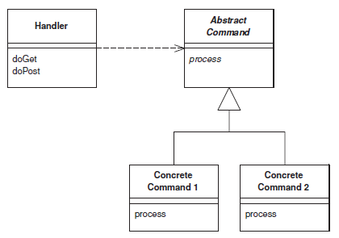
Front Controller
A controller that handles all requests for a Web site.
A Front Controller handles all calls for a Web site, and is usually structured in
two parts: A Web handler and a command hierarchy.
The Web handler is the object that actually receives post or get requests from the Web server. It pulls just enough information from the URL and the request to decide what kind of
action to initiate and then delegates to a command to carry out the action
Front Controller works particularly well in a site where the controller navigational logic is more complex.

Slide 34
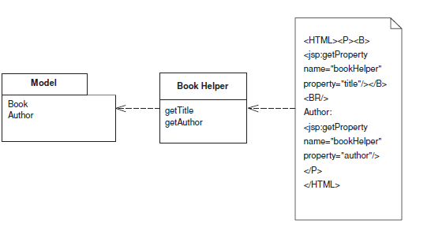
Template View
Renders information into HTML by embedding markers in an HTML page.
The basic idea of Template View is to embed markers into a static HTML page
when it’s written.
When the page is used to service a request, the markers are replaced by the results of some computation, such as a database query.
The strength of Template View is that it allows you to compose the content of the page by looking at the page structure.
But they are not easy to use with complex generation logic and they are not easy to test.

Slide 35
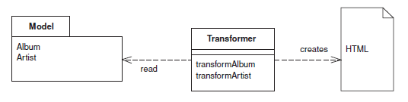
Transform View
A module that processes domain data element by element and transforms it into HTML.
The basic notion of Transform View is writing a program that looks at domain oriented data and converts it to HTML.
The program walks the structure of the domain data and, as it recognizes each form of domain data, it writes out the particular piece of HTML for it.
Transform View does not mix HTML with view generation logic and is easier to test.
However, several people may prefer to have everything embedded in one module.

