Slide 1

AN ENTERPRISE NETWORK OF A HOSPITAL USING CISCO PACKET TRACER
Presented by
Zarrar Husain Zakir Husain Khan (Roll No. 29)
Sanap Ghanshyam Vasabtrao (Roll No. 56)
Mitesh Latish Bauskar (Roll No. 03)
Under supervision of
Prof. V. M. Kharche
Department Of Information Technology
Konkan Gyanpeeth College Of Engineering, Karjat-410201
University of Mumbai

Slide 2
Introduction
The field of Information Technology and Network Infrastructure Management has become a crucial component inside the healthcare industry. Medical experts are working along with the IT departments to create more medical devices that can be connected to the network, hence providing doctors the facility to monitor patients easily over internet. Also, hospitals have initiated the method of electronic health records which are easy to access for doctors as well as the patient’s family members. There are several times when a doctor can’t be present and this factor has already been overcome by video communication. The hospital network has to be made secure as well so that essential data like medical records and research work does not fall into the wrong hands.
We need to design a network topology that is easy to understand, easy to manage, easy to troubleshoot and is adaptable to change in future according to the new medical equipment. Among the various topologies like bus topology, ring topology, mesh topology, star topology, etc., Hierarchical topology would best meet our demands. The hierarchical network design model serves to help us develop a network topology in separate layers. Each layer focuses on specific functions, enabling us to choose the right equipment and features for the layer. A hierarchical design avoids the need for a fully meshed network in which all network nodes are interconnected and thus making it simple and easy to understand.

Slide 3
Objectives
The main objectives of our project are:
Design and implement of an enterprise network, for Shopping Mall network using Cisco Packet Tracer.
Configuration of Network Devices and evaluating Point to Point Connections.

Slide 4
Project Goals & Scope
This work is related to a project that uses networking in hospitals and has examined various recommendations and techniques for using the hospital network's private addressing schemes. We switched quickly between the LANs and ensured a secure WLAN network was provided. This will contribute to health promotion, which together with patient safety and clinical effectiveness is a core dimension of quality in hospital services.

Slide 5

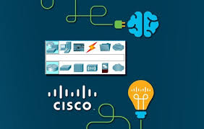
Cisco Packet Tracer
Packet Tracer is a cross-platform visual simulation tool designed by Cisco Systems that allows users to create network topologies and imitate modern computer networks. The software allows users to simulate the configuration of Cisco routers and switches using a simulated command line interface.

Slide 6
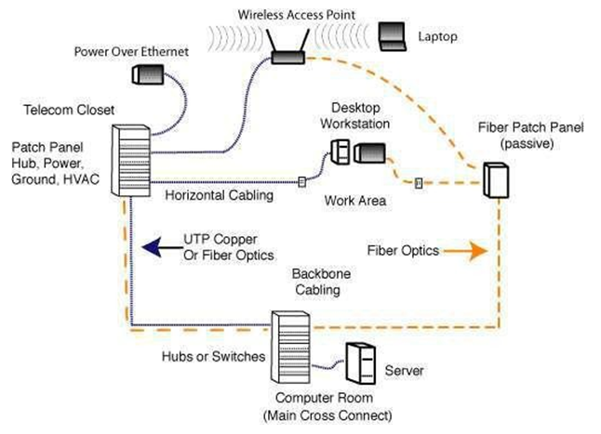
Network Devices
Router
Firewall
Server
Hub
Core Switch
Data Centre Switch
Access Switch
Fabric Extender Switch
ISP
Wireless Access Point (WAP)
Cables
Virtual LANs
Wireless Connection of a Network

Slide 7
Wireless Connectivity
Connectivity:
We have used the 5 connectivity types in my network.
Copper Straight- through,
Serial DCE (for connecting 2 or more router’s),
Copper Cross Over (Switch to Switch),
IoT Custom Cable (for the IoT device connectivity) and
Console
Routing Information Protocol (RIP) is a dynamic routing protocol which uses hop count as a routing metric to find the best path between the source and the destination network.
Routing Information Protocol (RIP) is a protocol that routers can use to exchange network topology information. It is characterized as an interior gateway protocol, and is typically used in small to medium-sized networks. The routing table is broadcast to all stations on the attached network.
Security: SSH, tacacs+, asa firewall, local login, vlans.

Slide 8
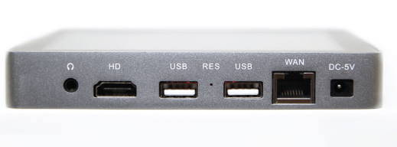
Routing Protocol Plan
In this network we have used:
FTP: used for file transfer between two different networks
SMTP (Emails): used for sending emails
NTP: used for the IoT devices used as well as the local storage of data and this shows the current date and time on the IP-phones used
SSH (Local Login): used so that for every doctor there has a separate username and password when the doctors enters his/her office
AAA (tacacs+): crucial admin data stored here which only one person knowing the password i.e. admin can access
VLAN: vlans are used for security internally among the same network
RIP: used for communication between two networks
NAT: used with the ASA firewall because people will access the hospital via the outside public network which the NAT translates and the firewall scans the packets to enter

Slide 9
Infrastructure
Table of Enterprise Edge
CORE | 3rd floor Admin area and the sales dept.
DISTRIBUTION | 1st floor ASA server
ACCESS | -1 and 2nd floor pcs in different areas
ENTERPRISE EDGE | Client accesses the hospital from an outside network through an ASA firewall.
The core layer is where the admin has access to his private network along with the information of the entire member’s, doctors and employees who work in the hospital.
The distribution layer is placed on the 1st floor is because many people will access, from an outside network to an inside network. Intrusion can also take place here, this can also be considered as the core layer part of the network.
The Access layer contains all the normal floors which includes emergency/mortuary on -1 floor and the patients floor with the doctor’s office.

Slide 10
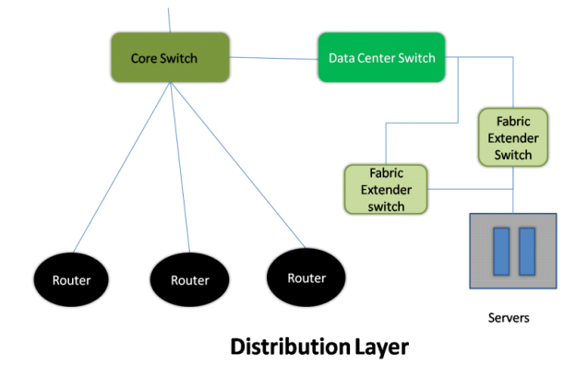
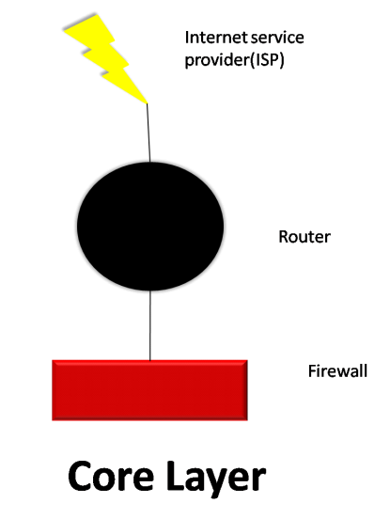
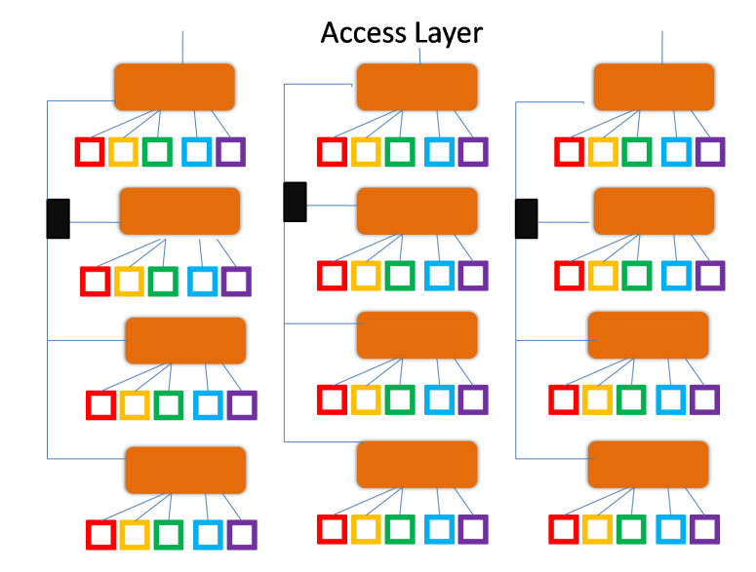
1st Floor
1st & 2nd Floors
3rd Floor

Slide 11

Network Topology
This network design starts with first floor followed by the 1st floor and so on…
The Distribution Layer is placed at the 1st Floor which has 2 sections:
The ASA (Adaptive Security Appliance),
The Cafeteria
The Core Layer is highly secure which is located at the 3rd floor of the hospital building which has 2 sections:
The Admin Area and
The Sales Area.
The 2nd and 1st Floor of the hospital are normal floors, which are the Access Layers. 2nd floor has the patient’s rooms, and 1 is the mortuary or the emergency floor.
The 2nd floor has 2 parts:
The Doctors office and
Operation Theatre rooms, normal wards.

Slide 12
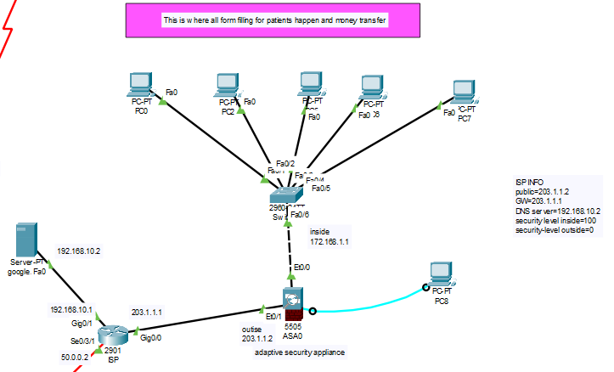
1st Floor

Slide 13
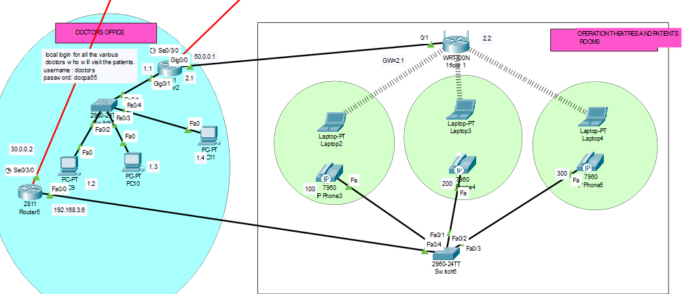
2nd Floor

Slide 14
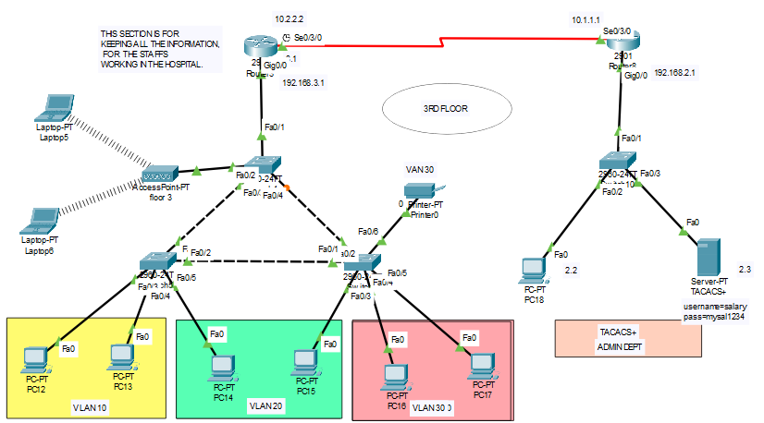
3rd Floor

Slide 15
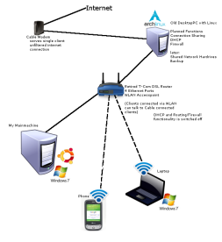
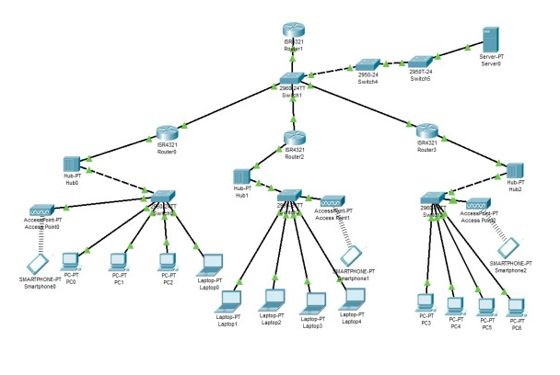
Conclusion
With the growth of Information Technology in every sector and the explosion of medical IOT devices, the design of a network of any hospital has become very essential factor. The hospitals need to have a reliable, secure and scalable network design in order to keep the patients information, doctor's research work safe, convenient communication between various departments, etc. as well as keep it ready for any new IOT medical equipment that may be introduced in the future. The hierarchical model of networking best suits our needs along with providing additional features like easy maintenance, high security, simplified troubleshooting and effective performance

Slide 16
Thank You!

