Slide 1
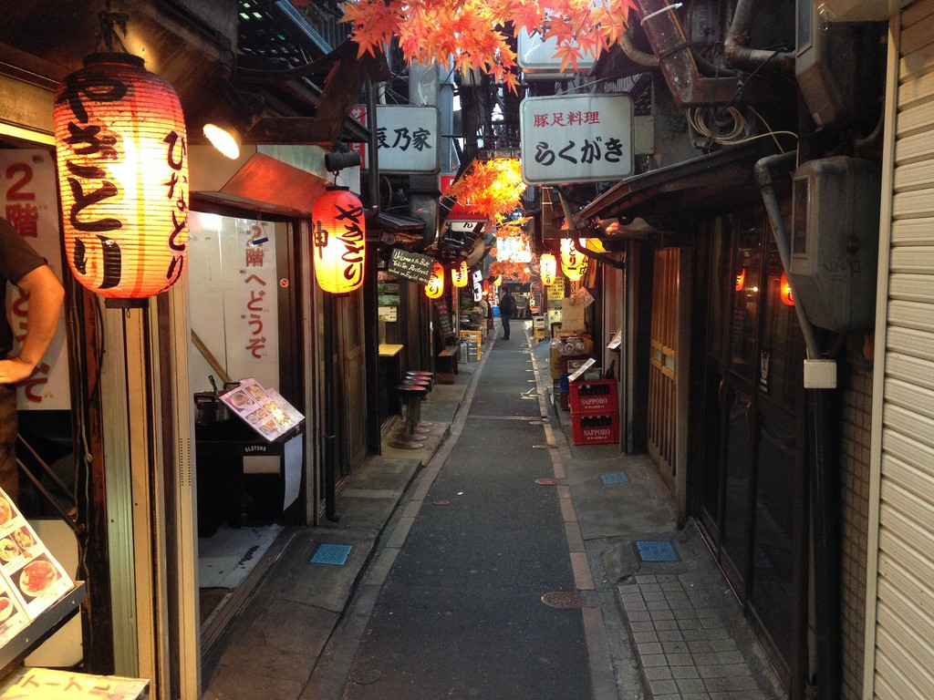
Battle of Neighbourhoods( Restaurants in Tokyo, Japan)

Slide 2
Introduction
Tokyo, is the most populous metropolitan area in the world. Tokyo is definitely one of the best places to start up a new business.
we will go through the benefits and pitfalls of opening a breakfast cum lunch restaurants in highly dense office places. Usually the profit margin for a decent restaurant lie within 15 - 20% range but, it can even go high enough to 35%

Slide 3
Target Audience
Business personnel who want to invest or open a restaurant. This analysis will be a comprehensive guide to start or expand restaurants targeting the large pool of office workers in Tokyo during lunch hours.
Freelancer who loves to have their own restaurant as a side business. This analysis will give an idea, how beneficial it is to open a restaurant and what are the pros and cons of this business.
New graduates, to find reasonable lunch/breakfast place close to office.
Budding Data Scientists, who want to implement some of the most used Exploratory Data Analysis techniques to obtain necessary data, analyse it, and, finally be able to tell a story out of it.

Slide 4
Data and steps followed
Name the 23 wards, area and population from web scrapping.
Obtain information about best business districts.
Use foursquare data to obtain info about restaurants.
Data Visualization and some simple statistical analysis.
Analysis using clustering, specially K-Means Clustering
Compare the Neighbourhood to find the best place for starting up a restaurant.

Slide 5
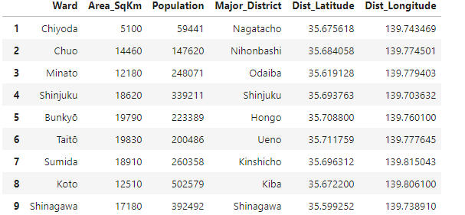
Data Preparation
Web-Scrapping and Cleaning, get the Names of Wards, Major Districts and Population from Wikipedia
Get the Coordinates of the Major Districts
Obtain the Average Land Price Data from Web-Scrapping
Foursquare Data

Slide 6
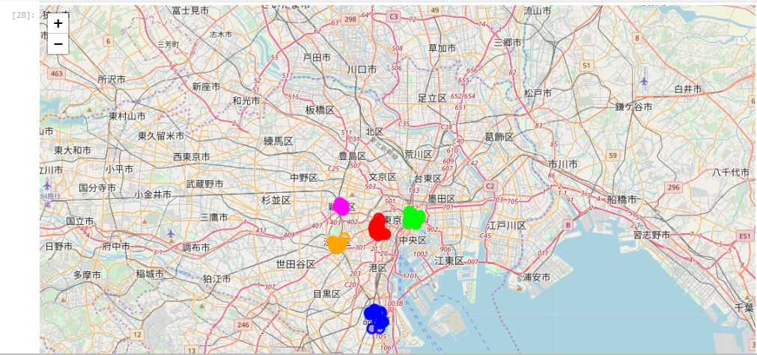
Exploring the Data and Major Districts of Tokyo
As the focus is on 5 major business districts (Nagatacho, Nihombashi, Shibuya. Shinjuku, and Shinagawa), we found that there are 193 restaurants (searching for keyword Restaurant) among the 500 top venues in these 5 districts.

Slide 7
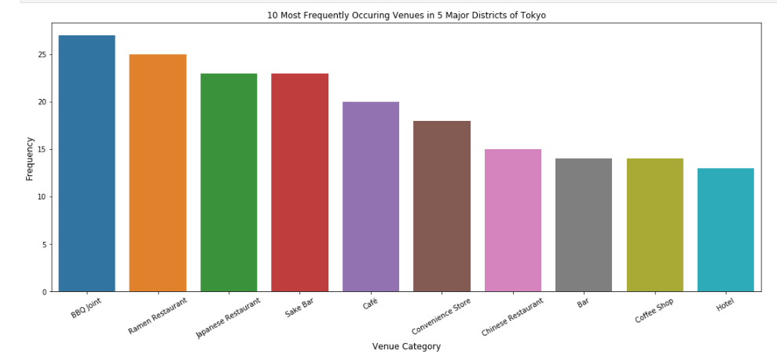
Ramen restaurants top the charts of most common venues in the 5 districts, followed by Japanese restaurants and BBQ joints.
A plot of the ten most frequent venues in these 5 districts are as below
Next step is to obtain information about the top 5 venues of each district.

Slide 8
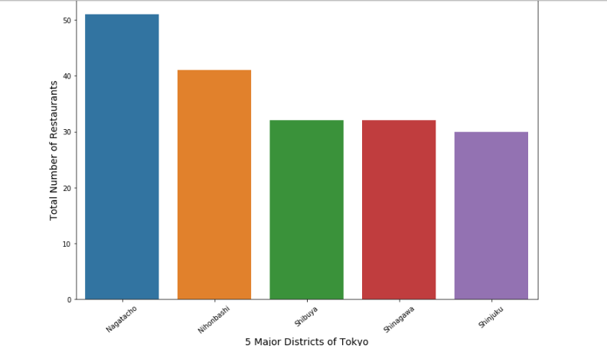
District which has the highest number of restaurants as the most common venue and the plot below is the answer

Slide 9
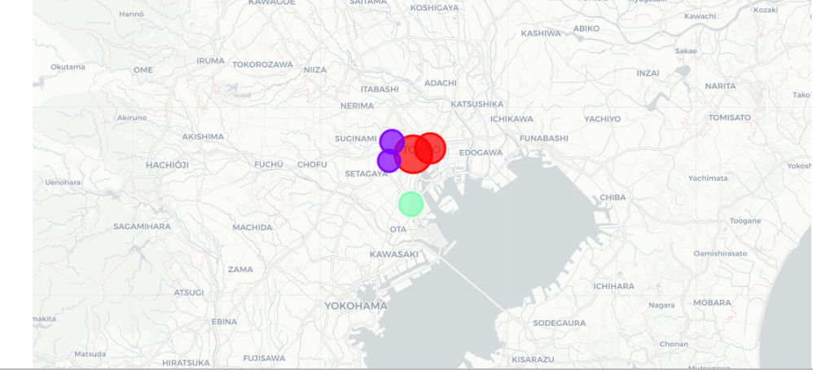
Clustering the Major Districts of Tokyo

Slide 10
Results of the exploratory data analysis and clustering
Ramen restaurants top the charts of most common venues in the 5 districts.
Nagatacho district in Chiyoda ward and Nihombashi in Chuo ward are dominated by Japanese and Chinese restaurants as the most common venues
Shibuya and Shinjuku areas are dominated by bars, pubs, and cafe as most common venues.
Nagatacho has maximum number of restaurants as the most common venue whereas has Shibuya area has the least. But, Cafe and BBQ joints are found to be among the most visited destinations in this area.

Slide 11
Conclusion
Finally to conclude this project, We have got a small glimpse of how real life data-science projects look like. I have made use of some frequently used python libraries to scrap web-data, use Foursquare API to explore the major districts of Tokyo and saw the results of segmentation of districts using Folium leaflet map. Potential for this kind of analysis in a real life business problem is discussed in great detail. Also, some of the drawbacks and chance for improvements to represent even more realistic pictures are mentioned. Finally, since my analysis were mostly concentrated on the possibilities of opening a restaurants targeting the huge pool of office workers, some of the results obtained are surprisingly what I have expect after staying 5 years in Tokyo.

