Slide 1
METRONIDAZOLE
Dr. Rabia Hanif
(Demonstrator , deptt. Of Pharmacology, IIDC)

Slide 2
METRONIDAZOLE
Metronidazole, marketed under the brand name Flagyl among others, is an antibiotic and antiprotozoal medication
It is used either alone or with other antibiotics to treat pelvic inflammatory disease, endocarditis, and bacterial vaginosis
It is effective for giardiasis, trichomoniasis, and amebiasis
Metronidazole is of the nitroimidazole class.
It inhibits nucleic acid synthesis by disrupting the DNA of microbial cells This function only occurs when metronidazole is partially reduced, and because this reduction usually happens only in anaerobic bacteria and protozoans, it has relatively little effect upon human cells or aerobic bacteria.

Slide 3
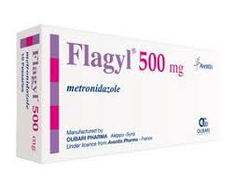


Slide 4
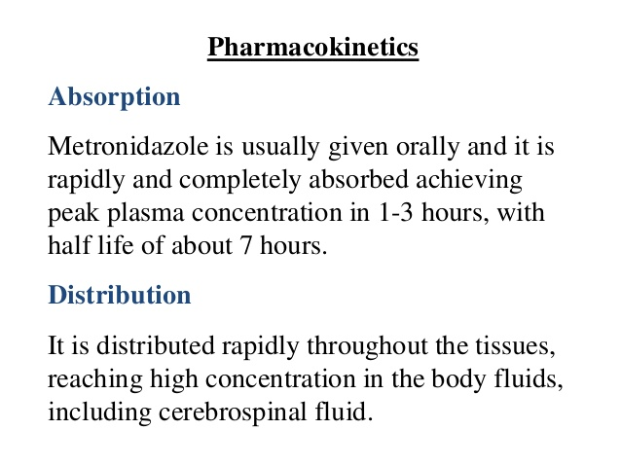
PHARMAKOKINETICS

Slide 5
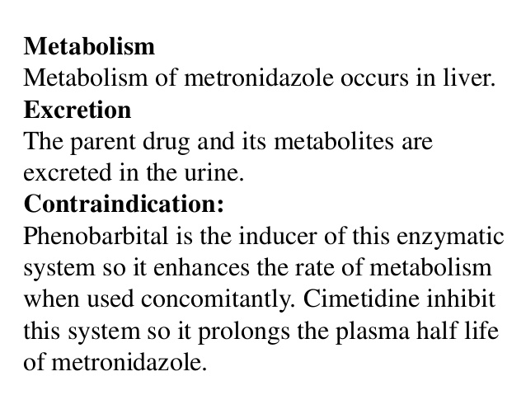
PHARMAKOKINETICS

Slide 6
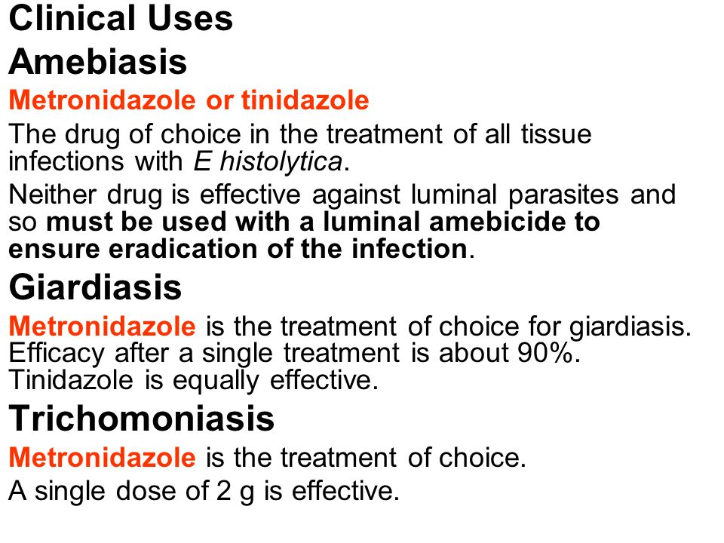
THERAPEUTIC USES of METRONIDAZOLE

Slide 7
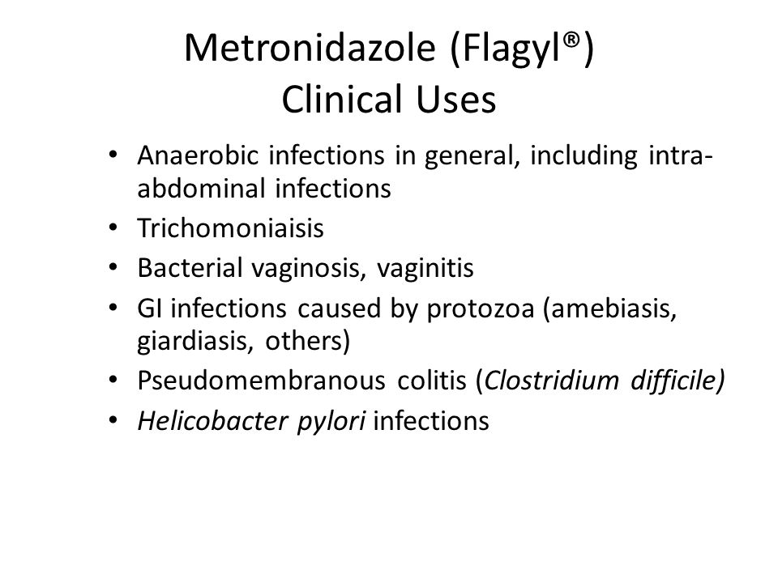
THERAPEUTIC USES Of METRONIDAZOLE

Slide 8

USES OF METRONIDAZOLE IN DENTISTRY

Slide 9

USES OF METRONIDAZOLE IN DENTISTRY

Slide 10



Slide 11


s

Slide 12

SIDE EFFECTS OF METRONIDAZOLE

