Slide 1
Questions
Can we measure how well-served a region is by existing bus routes and use this to compare service among regions?
How has the the new CMAX line improved travel times along Cleveland Avenue?
Notes:
The following slides describe the process of using COTA and City of Columbus data to answer these questions.

Slide 2
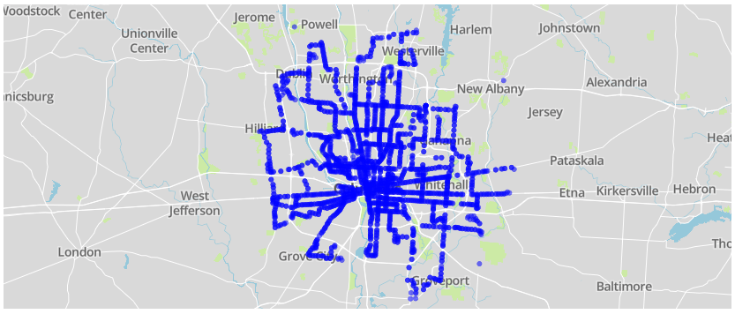
Data Source: COTA
cota.com/data
COTA Bus Stops
Notes:
The COTA data site offers three different sets of data:
static GIS data describing routes and and stops as of September 2017,
real-time route and vehicle information, and
static data in the Google Transit Feed Specification (GTFS) format describing route location and timing information – this data is used to provide bus arrival times on Google Maps other services.
For this analysis we’ll make use of the static GIS data to address the first question and include the static GTFS data to address the second.
The plot above shows the location of active COTA bus stops.

Slide 3
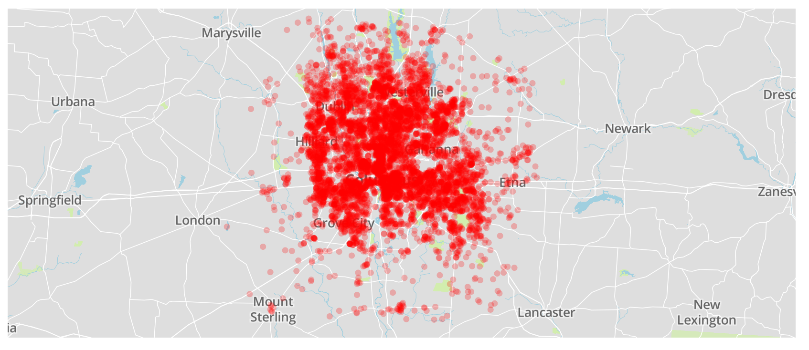
Data Source: City of Columbus
data-columbus.opendata.arcgis.com
Address Locations in Franklin County and a Seven-Mile Radius, 1% Sample
Notes:
The City of Columbus has a variety of datasets available on their ArcGIS site. Among these is a collection of addresses and their corresponding latitude and longitude values. This data set includes addresses within Franklin county as well areas within a 7-mile radius. The original dataset includes over 700,000 addresses. The plot above contains approximately 7,000 randomly-selected addresses from the original dataset.

Slide 4
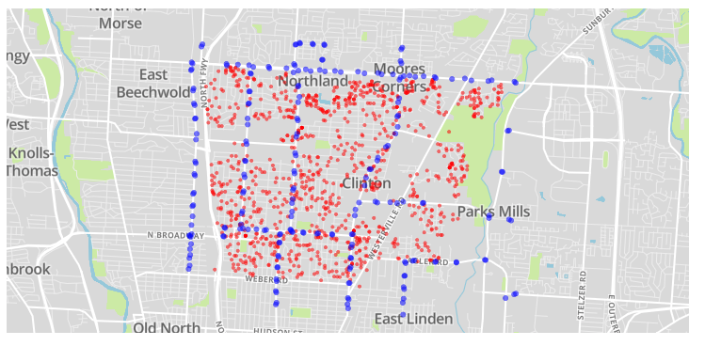
Combining Data
Bus Stop and 10% Sample of Address Locations in the 43224 ZIP Code
Notes:
To determine how well a region is served by a bus route, we can look at bus stops and addresses within a ZIP code. The City of Columbus data includes a ZIP code for each addresses. For a given ZIP code, we can create a bounding box in terms of minimum and maximum latitude and longitude from the address data. We use this bounding box to to select the appropriate stops from the COTA data for the ZIP code.
The plot above shows a sample of addresses from the 43224 zip code in red. These locations were used to determine bounds for latitude and longitude and filter the COTA bus stop data, which appears in blue.

Slide 5
Measuring Service
Bus Stop
Location
Distance
To determine how well an area is served by bus lines we can calculate the distance from a location to a nearby bus stop.
Notes:
To determine how well-served a region is by bus service, we’ll look at distances between address locations and bus stops within the region. We can calculate distances using latitude and longitude information for both addresses locations and bus stops.

Slide 6
Measuring Service
Bus Stop 2
Bus Stop 1
Location
Minimum Distance
When there are multiple bus stops, we can find distance to the nearest stop.
Notes:
For a given location and multiple bus stops, we can calculate the minimum distance to a bus stop by comparing the distances from the location to each of the bus stops.

Slide 7
Measuring Service
Location 1
Bus Stop 2
Minimum Distance 1
Bus Stop 1
Location 2
Minimum Distance 2
For each location, we can find the distance to the nearest bus stop.
Notes:
With multiple locations, we can find the distance to the nearest bus stop for each location.

Slide 8
Measuring Service
Location 1
Bus Stop 2
Greatest Minimum Distance
Bus Stop 1
Location 2
By finding the greatest distance between locations and their nearest bus stop, we have a sense of how far one would need to travel to use a bus.
Notes:
We use the greatest of the distances between a location an its nearest bus stop as a measure of how accessible bus service is in a region. Alternative methods we might use include the mean distance between a location and the nearest bus stop or the median distance. For this example, we chose the greatest minimum distance because it presents the “worst-case scenario” – the farthest one would have to travel from an location within a region to a bus stop. Using the greatest minimum distance also provides a bounding value – for a region, the distance between a location and its nearest bus stop will always be less then or equal to the greatest minimum distance.

Slide 9
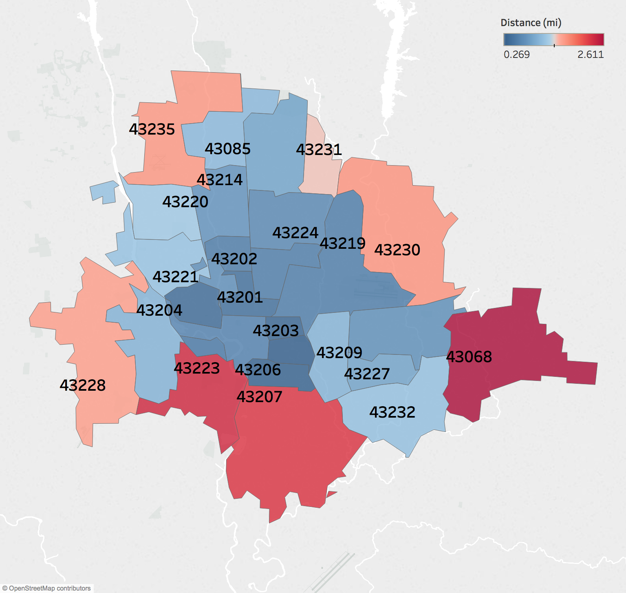
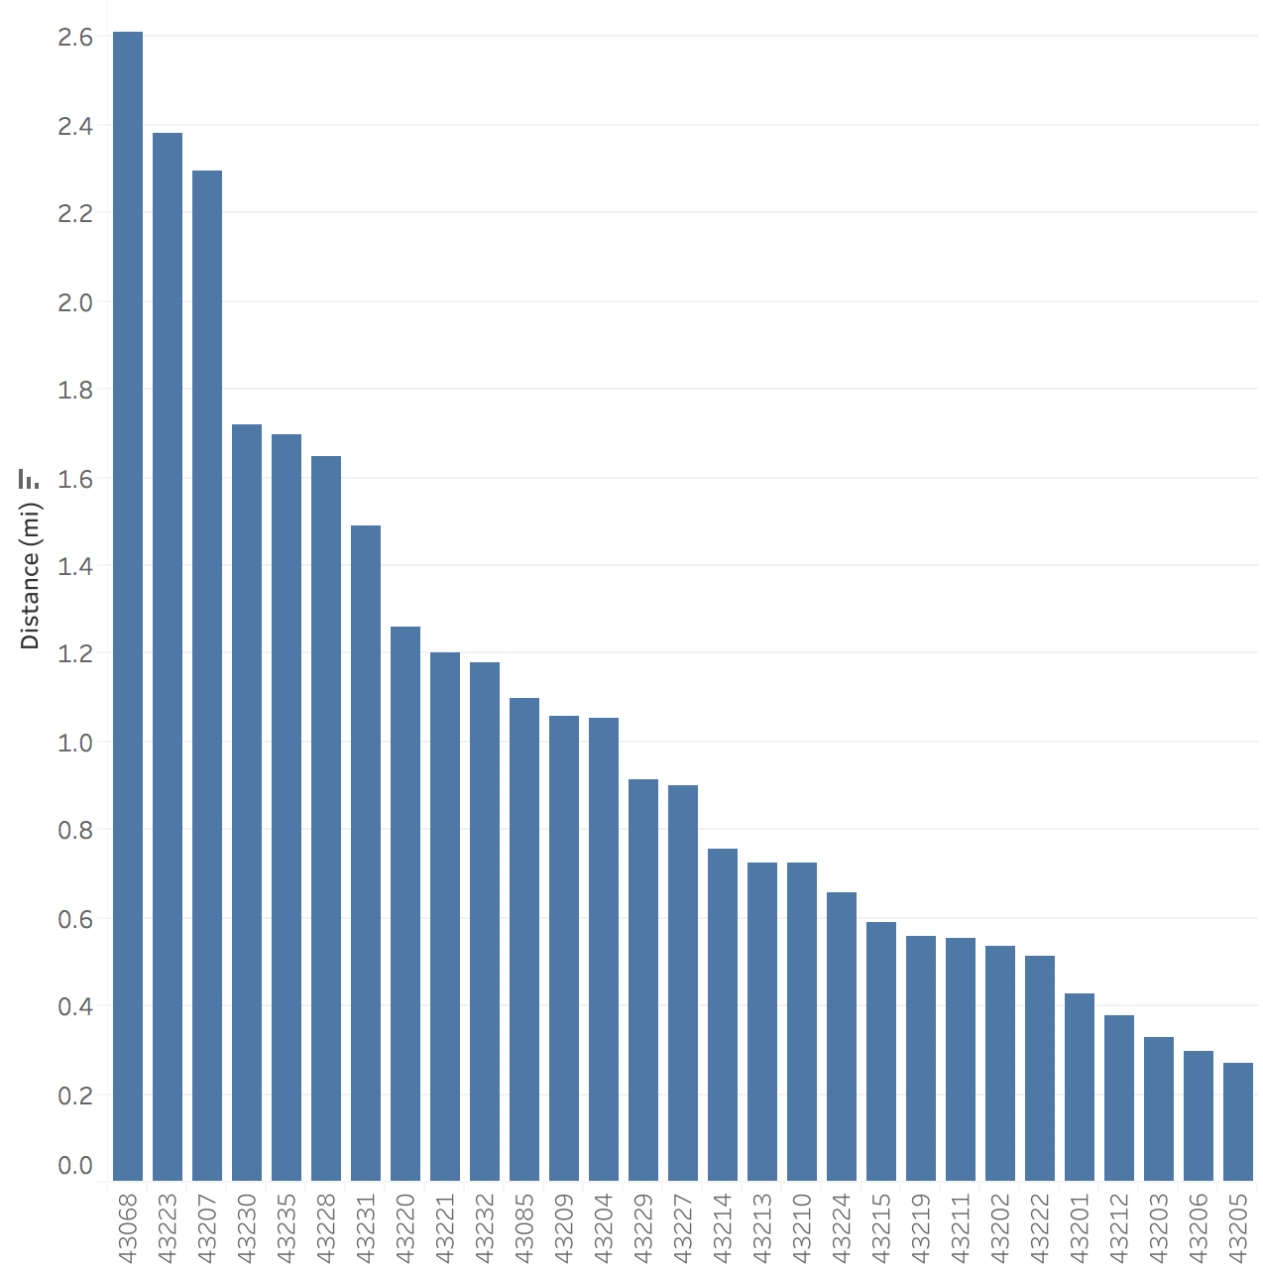
Results
Regions farther from downtown are less well-served by existing bus routes. This could be due to differences in population density as well as other factors worth exploring.
Notes:
We can calculate the greatest minimum distance for each ZIP code in the Columbus area. The visualization on the left is a choropleth map with each region corresponding to a ZIP code and the coloring of the region based on its greatest minimum distance. On the right, we have a bar chart showing greatest minimum distance for each ZIP code in descending order based on distance.
From the visualizations, we might conclude that the the farther a region is from downtown, the farther one might have to travel from a location to the nearest bus stop. There are likely other factors that influence this such as population density that could be explored.

Slide 10
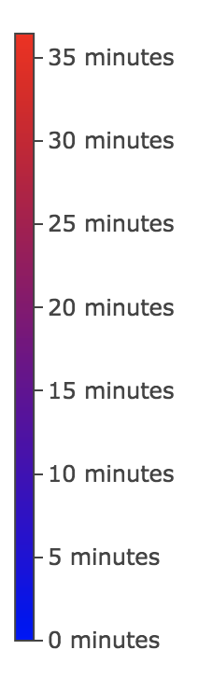
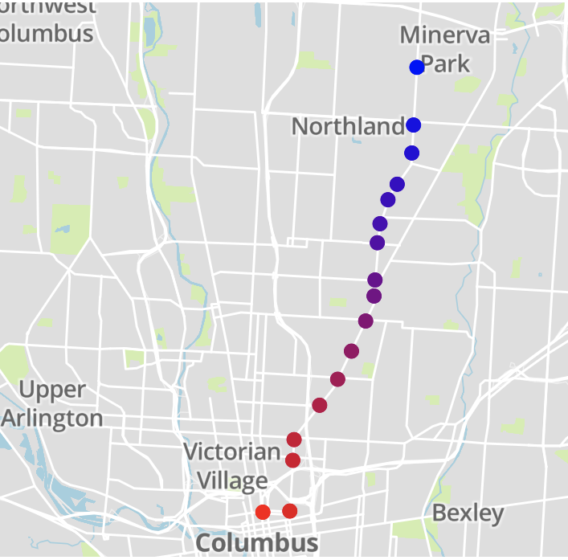
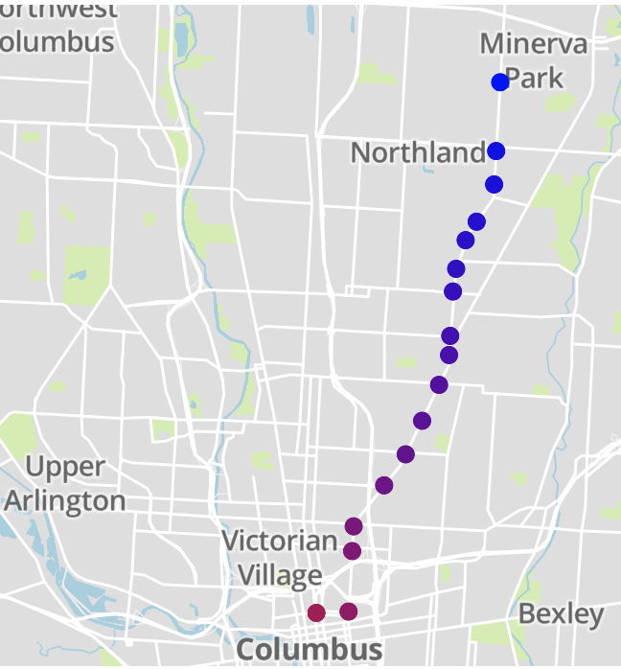
Effectiveness of New Routes
Existing 6 Cleveland/Sullivant Route
New CMAX Route
Starting from a stop in the northern portion of the route, we see improvements in travel time.
Notes:
We can use the static COTA GTFS data along with the static GIS data to address the second question, “how has the the new CMAX line improved travel times along Cleveland Avenue?”. The new CMAX route overlaps with portions of the existing 6 Cleveland/Sullivant route. From the GTFS data, we can extract arrival times for each stop along a route. To compare the routes, we first find the set of stops that are common between both routes then adjust arrival times at each stop as if the routes start at the northern-most common stop. Then, combining the data with the GIS data, we can plot arrival times at each stop on a map.
In the visualization above, we can see that a bus on the Cleveland/Sullivant route takes longer to arrive downtown than a bus on the CMAX line. The COTA GTFS data contains several sets of trip data for the same routes; the visualization above show the greatest difference in downtown arrival times between the routes.

Slide 11
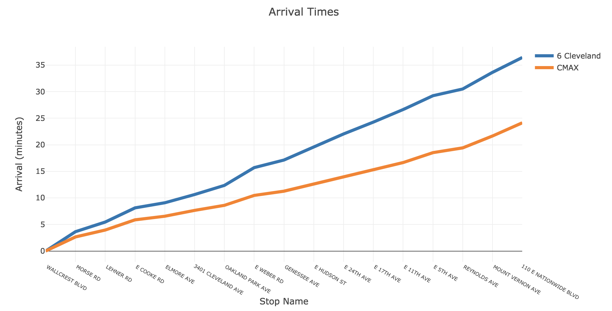
Effectiveness of New Routes
Beginning with the first stop along the common route, travel time to downtown is decreased by up to 12 minutes.
Notes:
While the previous visualization can be useful to see where the common stops between the Cleveland/Sullivant and CMAX route are, it doesn’t allow us to easily compare arrival times at various stops in a quantitative sense. Using a line chart, we can see that the travel time from the northern-most common stop to downtown can be up to 12 minutes longer on the existing Cleveland/Sullivant route compared to the new CMAX route.

