Slide 1
Using GitHub with Visual Studio
Part 2: Collaboration

Slide 2
Helpful Sites
https://desktop.github.com/

Slide 3
Collaboration on GitHub
Forks and Pull Requests

Slide 4
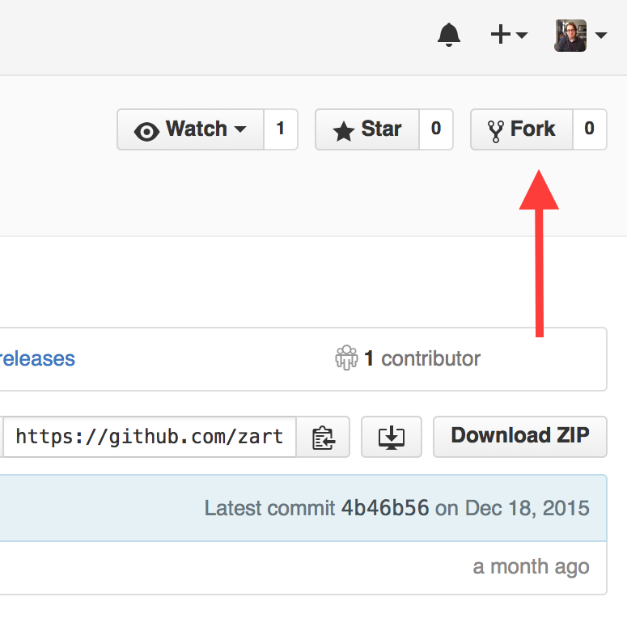
Forks
A copy of a repository
GitHub keeps track of upstream changes
We can import the project from GitHub into IntelliJ
gitignore used to ignore certain files

Slide 5
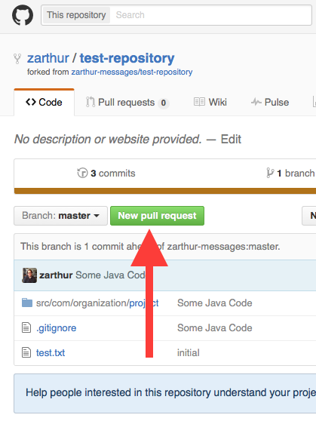
Pull Requests
Used to incorporate changes into original repository
Owner can approve changes by merging the pull request
We can get upstream changes using pull requests and by switching the base

Slide 6
Example Workflow
Fork an existing repository
Add code and open a pull request to incorporate changes into the original repo
Create a pull request to get new changes from original repo
Add code
Open a pull request after code has been added to both original repo and fork, manually merge changes

