Slide 1
Using GitHub with Visual Studio
Part I: Creating a repository

Slide 2
Helpful Sites
https://git-scm.com/doc
https://guides.github.com/activities/hello-world/
https://try.github.io/

Slide 3
Version Control
Tool for tracking changes to files over time
Like an undo feature in an editor, version control let’s us return to an earlier state
Helps us determine when changes were made – useful in finding bugs
Making copies of files is simplest approach but error-prone

Slide 4
Git
One of many version control systems (VCS)
Many VCS designate two states: the working directory and the repository
All our changes are made in the working directory
After significant changes, we add that state to the repository – an archive of versions

Slide 5
Git
Git has a third level: the staging area
After making changes in the working directory, we choose which files and changes will eventually be committed to the repository by adding them to the staging area
In simple workflows, adding to staging and committing to the repository are done together

Slide 6
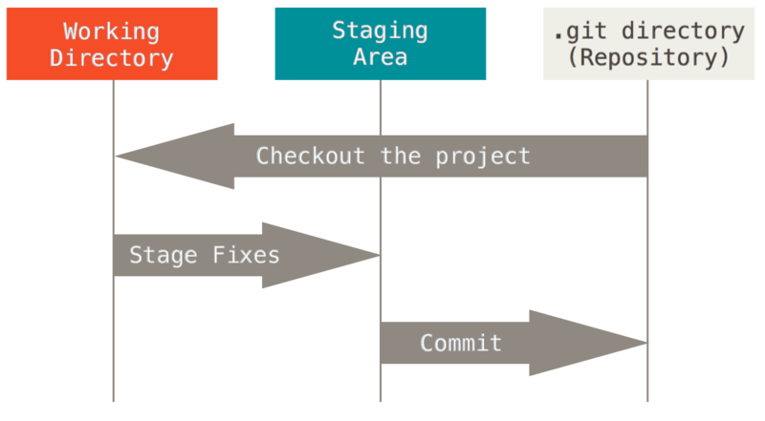
Git
https://git-scm.com/book/en/v2/book/01-introduction/images/areas.png
https://creativecommons.org/licenses/by/3.0/

Slide 7
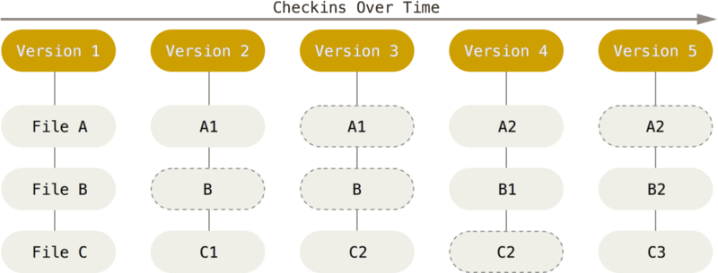
Git
https://git-scm.com/book/en/v2/book/01-introduction/images/snapshots.png
https://creativecommons.org/licenses/by/3.0/

Slide 8
GitHub
In addition to a local repository stored on the computer, Git supports the use of remote repositories from which we can push and pull changes
GitHub can serve as a remote repository

Slide 9
GitHub and Visual Studio
GitHub functionality is available in Visual Studio using the “GitHub Extension for Visual Studio” plug-in.
Use the Team Explorer to connect to GitHub, create a new repository, and add, commit, and push files.

