Slide 1
Neural Networks in OpenCL
Jakub Zárybnický

Slide 2
Implementation
My own subgoal: result in Haskell
CUDA
  nice API, pleasant bindings but not emulable
  lost access to Gent datacenter @Dec 10 due to renovations
Raw OpenCL first
OpenCL in Haskell (but then got uncomfortably close to the existing Grenade API)
Parallelizing an existing framework (Grenade)
  Adding an OpenCL backend

Slide 3
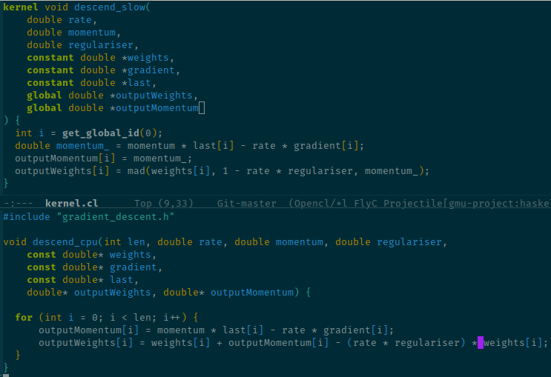
Parallel v. original gradient descent

Slide 4
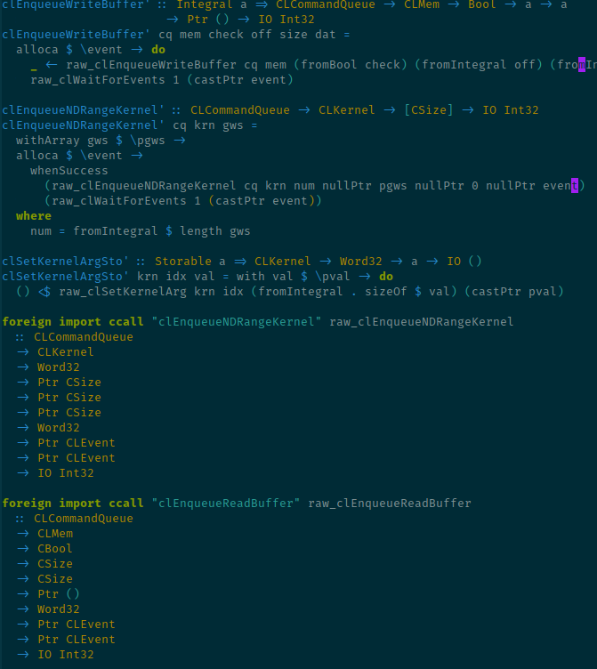
FFI API replacements

Slide 5
Technologies
Haskell
Nix
OpenCL bindings
Grenade NN framework
  Internally uses Hmatrix (= BLAS/LAPACK) for matrix operations
(formerly also CUDA, raw OpenCL, ...)

Slide 6
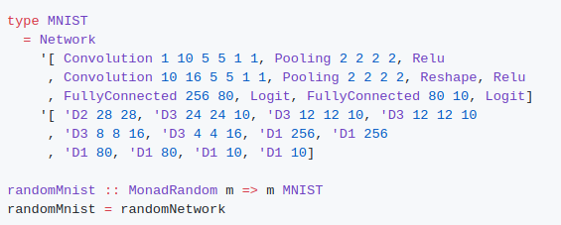
Desired interface

Slide 7
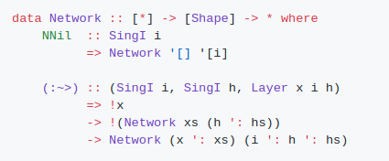
Network building block

Slide 8
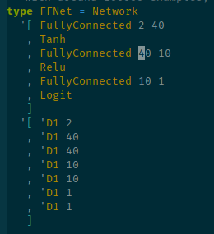
Test network

Slide 9
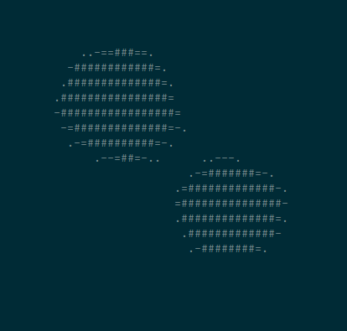
Test network API

Slide 10
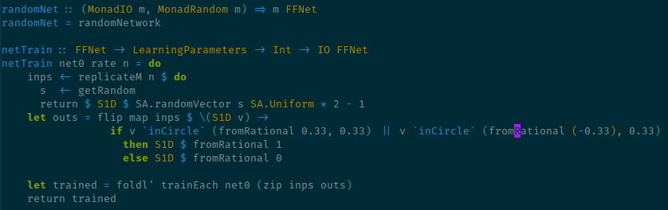
Training API

Slide 11
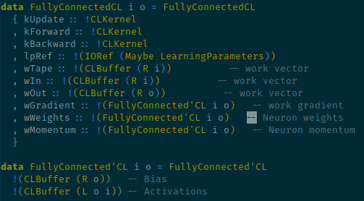
Accelerated layer internals

Slide 12
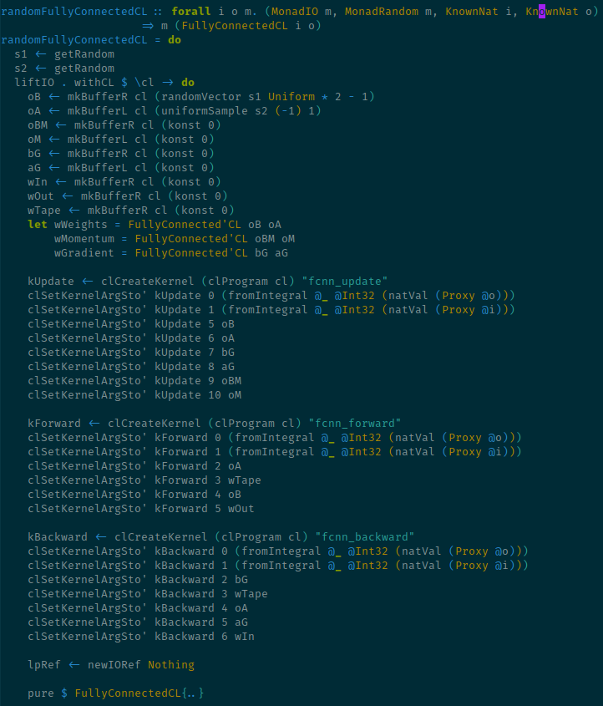

Slide 13
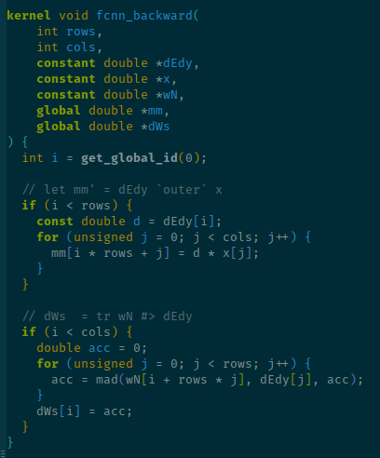
Backpropagation kernel

Slide 14
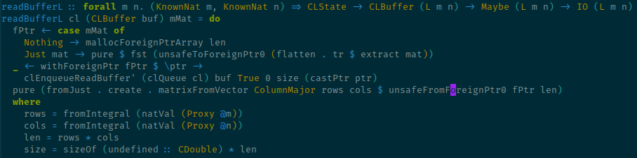
Bottleneck – readVectorFromBuffer

Slide 15
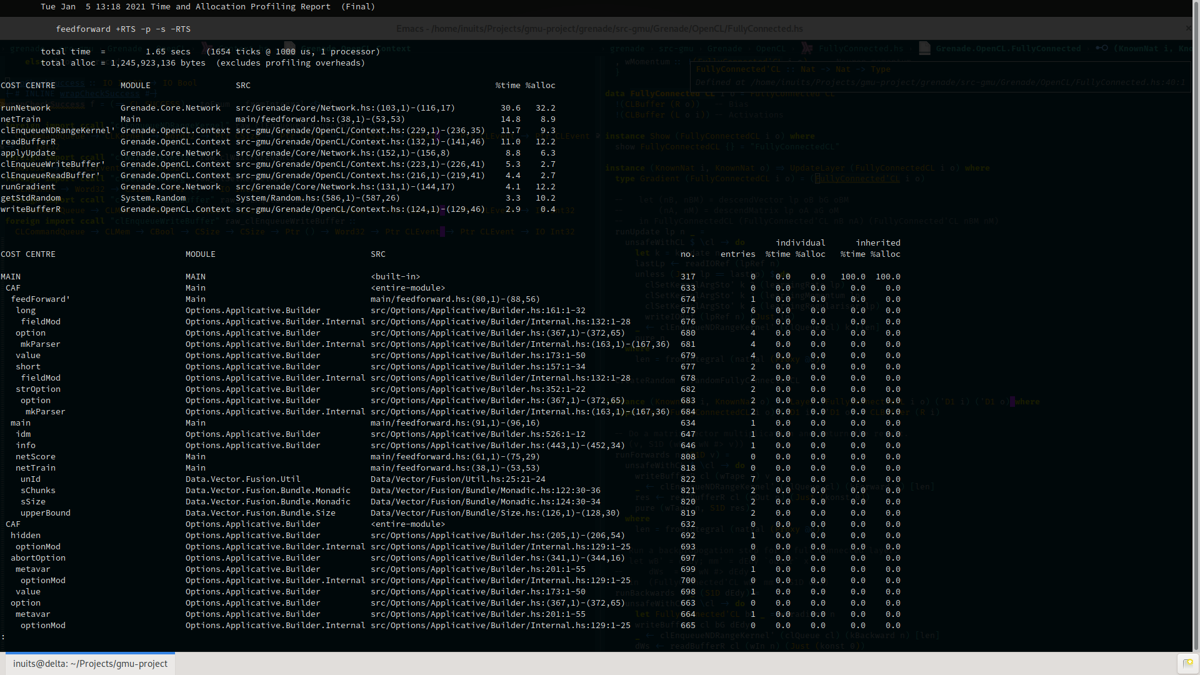

Slide 16
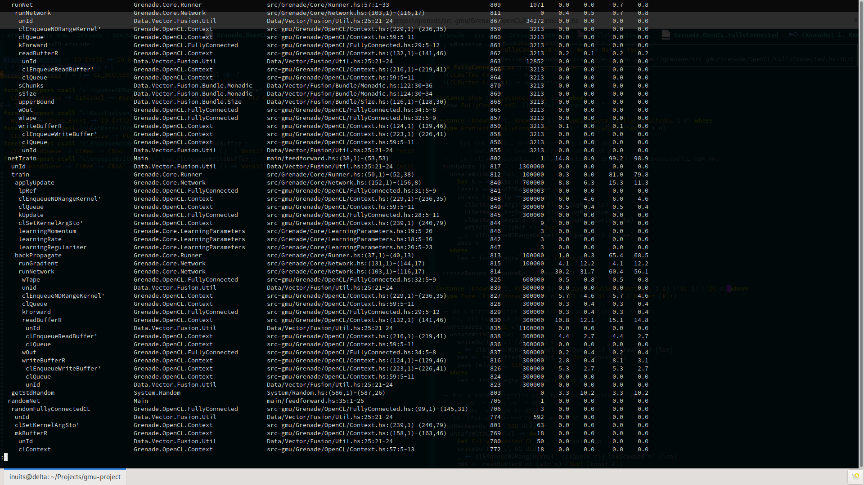

Slide 17
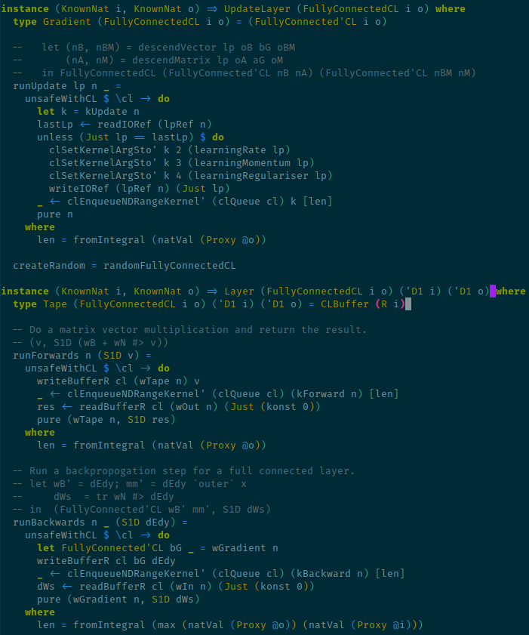

Slide 18
