Slide 1
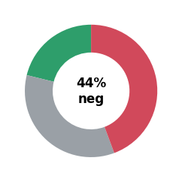
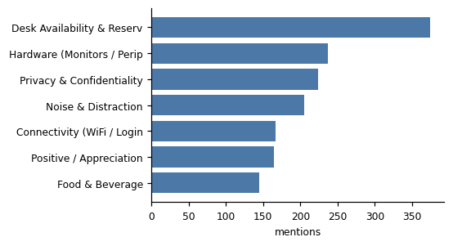
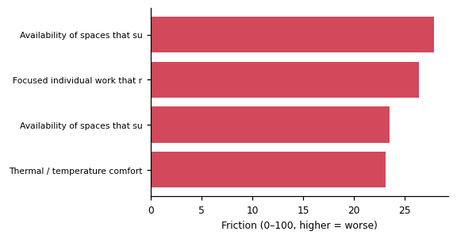
PulsePoint — IN-Indianapolis
1266 comments · 44% negative, 21% positive · top area: Physical Environment
Category | # comments | % neg | priority
Physical Environment | 631 | 48% | 73
Focused / Private Work | 371 | 53% | 67
Technology | 397 | 53% | 57
Workplace Operations | 294 | 43% | 41
Policy / Experience | 298 | 27% | 39
In their words:
“Reservations should be available more than 2 weeks out. It is very inconvenient that we can only schedule 2 weeks at a time.” — Director or Manager · Desk Availability & Reservations
“Often the monitors don't work and occasionally the video meetings don't work.” — Director or Manager · Hardware (Monitors / Peripherals)
“Lack of offices in which I can work all day. I am on meetings on sensitive topics, and working in general areas is not appropriate.” — Director or Manager · Privacy & Confidentiality

