Slide 1
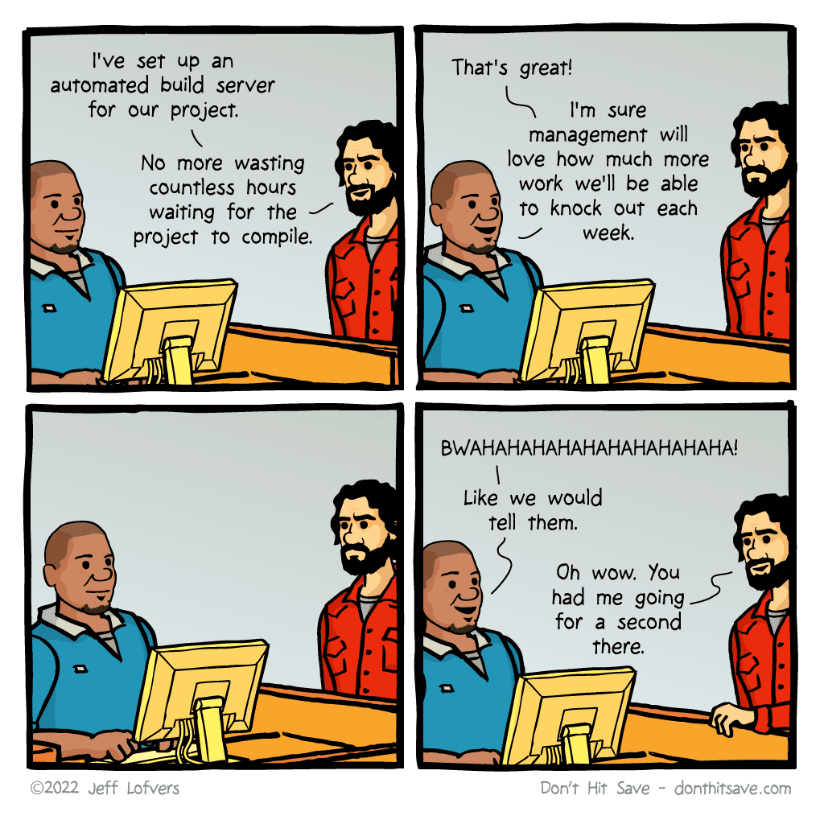
Git and GitHub for the Sysadmin

Slide 2




Andreas Sobczyk
Matt Zaske
CTGlobal
University of Minnesota
@Andreas_Sobczyk
AndreasSobczyk
cloudmechanic.net
@matt_zaske
zaskem
mzonline.com
Notes:
combined

Slide 3
Session Highlights
How to get started with Git
The five Git actions you need to know as a sysadmin
Working solo or with a team
Using Git and GitHub for documentation
Avoiding and fixing common mistakes
Security considerations
Advanced workflows and topics
Notes:
Matt

Slide 4
What this session…
…IS:
Judgement-free space to learn (ask questions)
Key actions to use Git/GitHub (with demos)
Building blocks for advanced automations
Examples that work and mistakes to avoid
…IS NOT:
Dive into Git internals (“how Git works”)
Developer-centric use of Git/GitHub
DevOps 101
Notes:
Matt

Slide 5
Audience Pulse
Where are you at on this journey?
Notes:
Matt

Slide 6
Why Git?
Source and version control
Why does a sysadmin need version control?
Automatic “backups” and easy distribution
Indirect/Implicit documentation
Platform and device independence
Save Future You from Today’s You
Notes:
Andreas

Slide 7



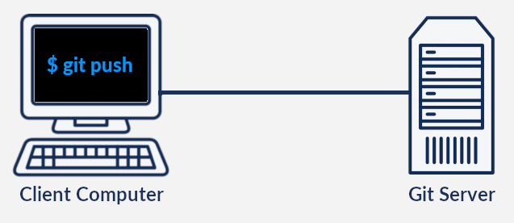
Git, GitHub, Azure DevOps…and all the others
Azure DevOps
Git
Notes:
Andreas

Slide 8
Getting Git and GitHub
Great – Where do I start?
Notes:
Matt

Slide 9
Git and GitHub Tools
Install Git – git-scm.com
GitHub.com account
GitHub Desktop – desktop.github.com
VS Code – code.visualstudio.com
VS Code Plugins
Git Bash
GitHub.dev
Notes:
Combined

Slide 10
Configuring Git
Enabling your first successful commit
Notes:
Matt

Slide 11

All you need are four actions
Obtain/Create a repository
Commit changes
Push to Git
Pull from Git
Notes:
Andreas

Slide 12


Working in Git with Visual Studio Code
GitHub or Azure DevOps
Local Computer
Working Dir
Staging
Area
Local
Repo
Remote Repo
Config
Snapshot:7a2c0637
Clone
Snapshot:7a2c0637
Add/change file
Add
Commit
Snapshot:7a2c0938
Push
Snapshot:7a2c0938
Snapshot:7a2c0960
Pull
Snapshot:7a2c0960
Add/change file
Add
Commit
Snapshot:7a2c1931
Snapshot:7a2c1931
Add/change file
Add
Commit
Snapshot:7a2c1983
Push
Snapshot: 7a2c1983
Notes:
Andreas

Slide 13
A Real Workflow
Using Git to distribute code
Notes:
Matt

Slide 14
A Real Workflow Demo References
https://github.com/zaskem/mms-miami-2023-github-demo
Demo GitHub Repository for this session
git config --global user.name “Your Name”
git config --global user.email “Your Email”
A tool like GitHub Desktop or VS Code can configure Git automatically without the command line
Notes:
Combined

Slide 15
The fifth useful action – Pull Request (PR)
Branch Strategies
A Pull Request is a branch merge action
PRs handle steps automatically and in a controlled manner
PRs automatically create implicit documentation
Differences between solo and team projects
Commit Philosophies
Learn Git Branching (demo visualization tool)
Notes:
Combined

Slide 16





Working with Git branches
Create branch
Merge branch
‘master’ branch
Pull Request
Feedback
Commit
Commit
Commit
Commit
Build
Validation
Notes:
Andreas

Slide 17
Working with PRs
Using Pull Requests like a Boss, or “How I learned to YOLO on my solo projects”
Notes:
Combined

Slide 18
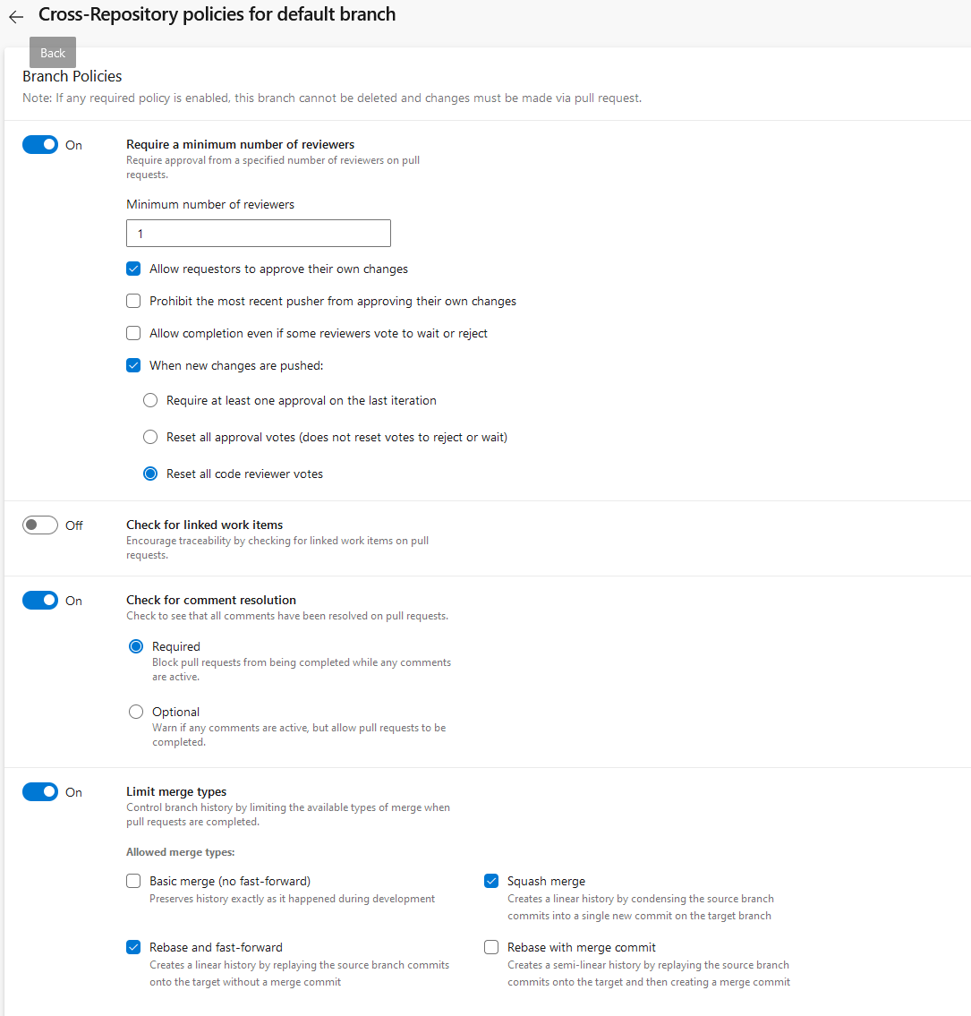
Branch policies

Slide 19
Branch policy: Github Flow
Main/Master must always be deployable
Create a branch in your repository. A short, descriptive branch name enables your collaborators to see ongoing work at a glance. For example, increase-test-timeout or add-code-of-conduct.
Commit and push your changes to your branch. Give each commit a descriptive message to help you and future contributors understand what changes the commit contains. For example, fix typo or increase rate limit. Ideally, each commit contains an isolated, complete change. This makes it easy to revert your changes if you decide to take a different approach
Create a pull request to ask collaborators for feedback on your changes. Pull request review is so valuable that some repositories require an approving review before pull requests can be merged. If you want early feedback or advice before you complete your changes, you can mark your pull request as a draft.
Delete your branch, after you merge your pull request, delete your branch.
Notes:
Andreas

Slide 20
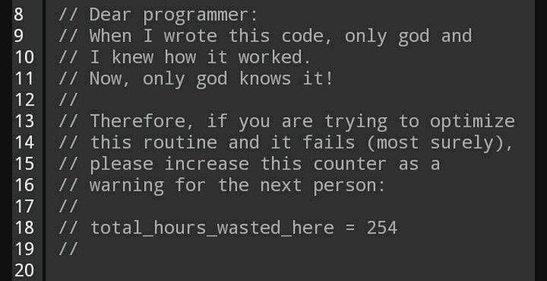
Git and GitHub for Documentation
It’s not always about code and source…
Notes:
Combined

Slide 21
Markdown is the Magic Sauce
Learn basic Markdown syntax
It’s also useful in Slack, Discord, GitHub, etc.
Markdown is small but mighty
README files
Microsoft Docs – learn.microsoft.com
VSCode Extensions for previewing and working with Markdown
Notes:
Combined

Slide 22
Markdown in Real Life
README files and Microsoft Docs
Notes:
Andreas

Slide 23
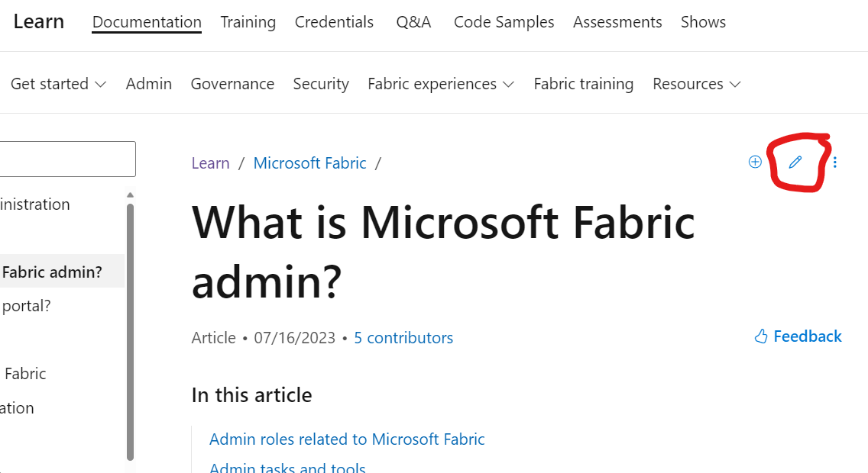
Markdown in Real Life Demo References
Edit Microsoft documentation by using the pencil icon on pages in learn.microsoft.com:
GitHub Flavored Markdown Cheatsheet (github.com)
Notes:
Combined

Slide 24
Markdown extensions
Excel to Markdown table
Markdown all in one
Markdown preview enchanced
Paste image
Draw.io

Slide 25
GitHub Pages
Built with Markdown content
Static content automatically built on a Push action to GitHub
Easy to use for internal or project documentation
Can be configured with your own CNAME (custom domain)
Notes:
Matt

Slide 26
Simple GitHub Pages
Updating a GitHub Pages site with revised content
Notes:
Matt

Slide 27
GitHub Pages Demo References
https://github.com/zaskem/mms-miami-2023-ghpages-demo
Demo/Source Repository
https://miamigithub.zaske.dev/
Live GitHub Pages site
GitHub Pages is an easy-to-understand way to learn about actions/pipelines
Notes:
Combined

Slide 28
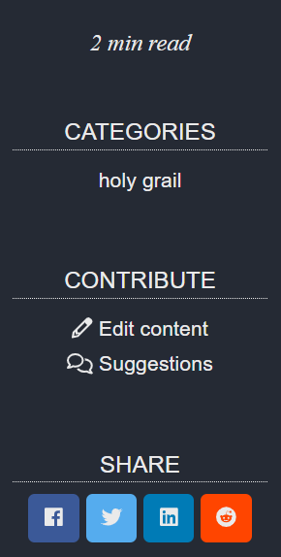
GitHub Pages Demo References
The Monty Python Script Repository Example:
https://github.com/zaskem/montypython-repository
Demo/Source Repository
https://python.mzonline.com/
Live GitHub Pages site
Encourages Edits/Comments/Sharing
Built into the theme configuration
Notes:
Combined

Slide 29
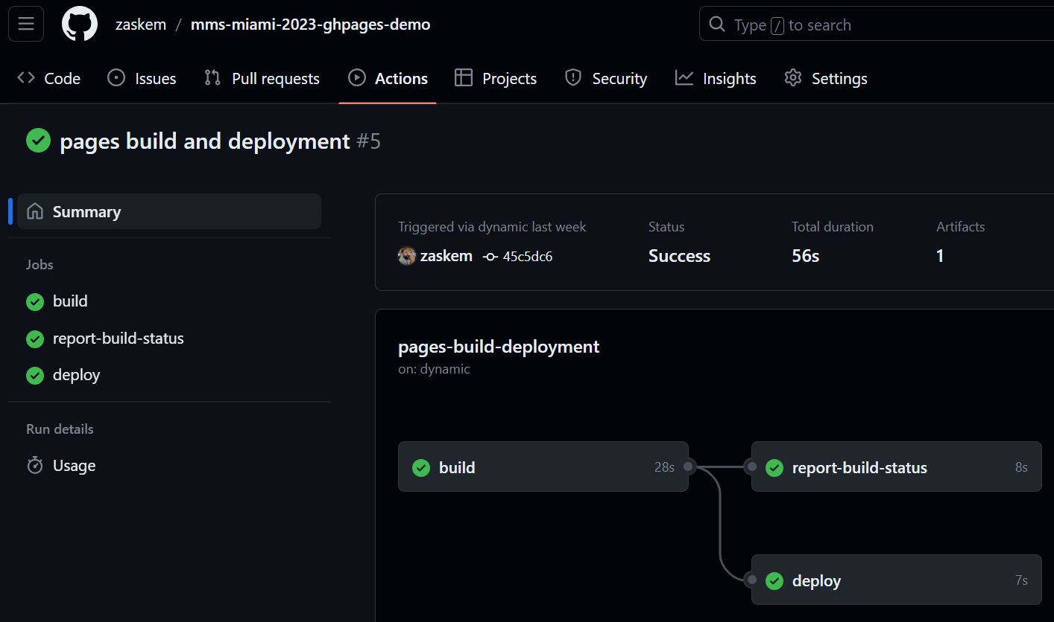
GitHub Pages Demo References
Build Action example from a push to the GitHub Pages branch:
Notes:
Combined

Slide 30
Fixing Your Mistakes
It’s not a matter of if, but when…and prevention is the best medicine
Notes:
Matt

Slide 31

Avoiding common mistakes
Stick to the basics – avoid complexity when possible
Commit responsibly – reverting commits is easy
Mistakes are easier to fix locally (before you push to GitHub)
Use branches judiciously
Let PRs merge branches or use a tool like GitHub Desktop to merge
Avoid the “Golden Repo” state, especially on solo repositories
Rebasing, like freebasing, is probably not what you want need
Especially on a solo project repository
Notes:
Matt

Slide 32
Fixing mistakes
Identify the breaking point
Git Log is your friend
VS Code plugins (GitLens) or GitHub Desktop are great visual tools
Git Reset
Committed/Pushed mistakes on team repos
ohshitgit.com
Notes:
Matt

Slide 33
Basic Troubleshooting
A look at Git history
Notes:
Matt

Slide 34
The Advanced Stuff
Congratulations for making it this far!
Notes:
Combined

Slide 35
Repository settings and access
Repo visibility, collaborators, and sharing
SSH keys and access tokens for passwordless access
Signing/Signed commits

Slide 36
Security is important, too
Powershell Execution Policy
Signed scripts
Copying/Pasting/Running code from the Internet
Reminder: have an understanding first…
Invoke-Expression(Invoke-RestMethod(https://github.com/path/to/file.ps1))
Notes:
matt

Slide 37
Now you can use advanced automations
Azure DevOps
Pipelines
GitHub Actions
Notes:
Andreas

Slide 39
Notes:
Speakers, please stay on this page for the second half of your session.

