Slide 1

Experimental Analysis of Popular Anonymous, Ephemeral, and End-to-End Encrypted Apps
UEOP 2016
Lucky Onwuzurike and Emiliano De Cristofaro
University College London https://emilianodc.com

Slide 2
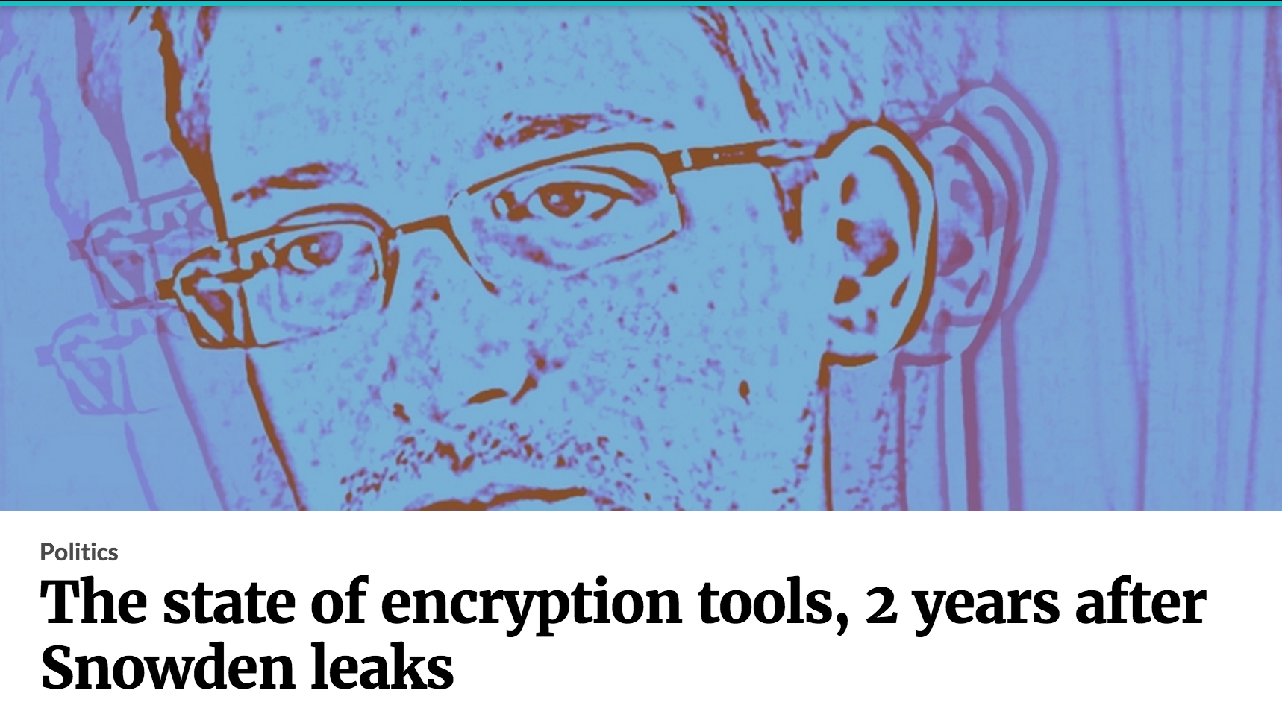

Slide 3
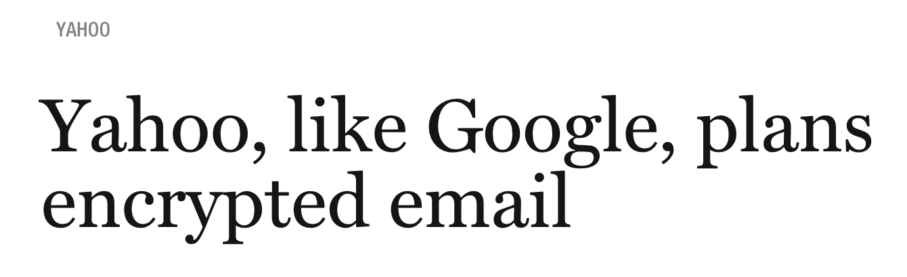
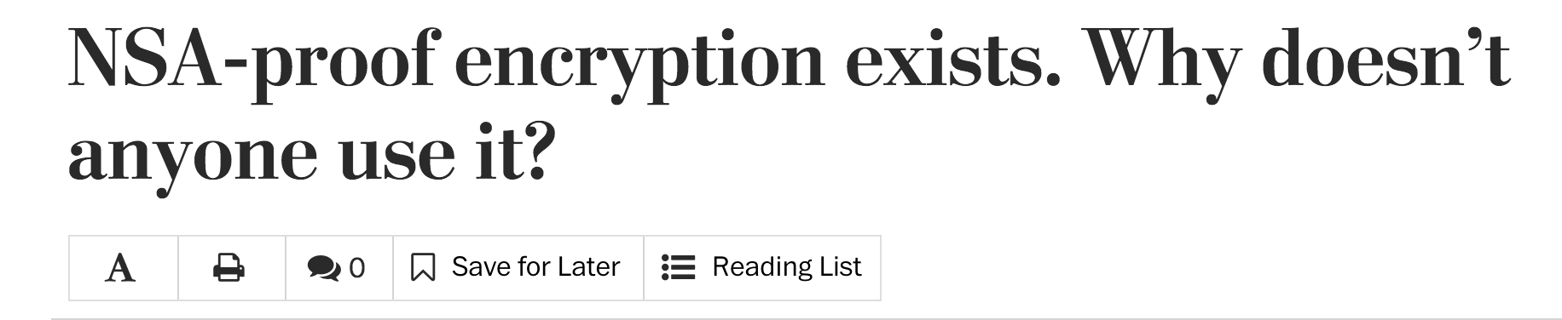

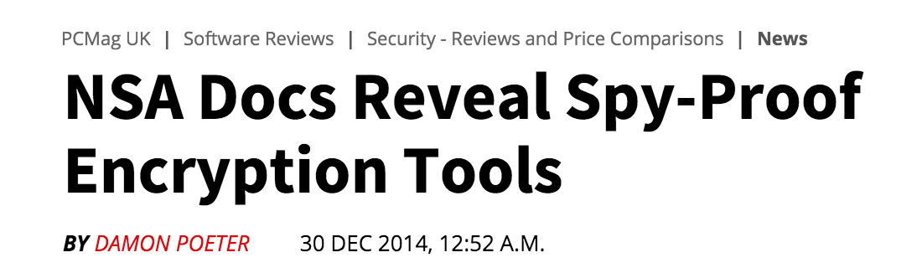

Slide 4
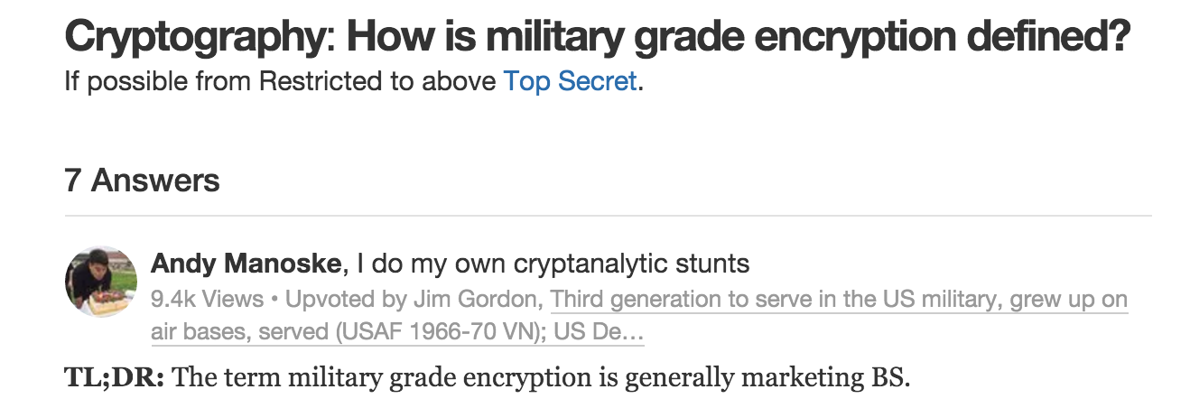

Slide 5
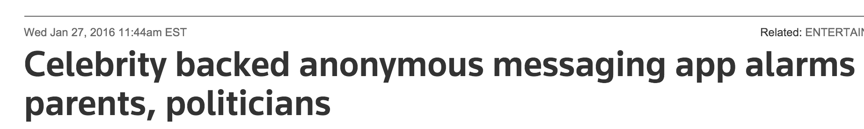
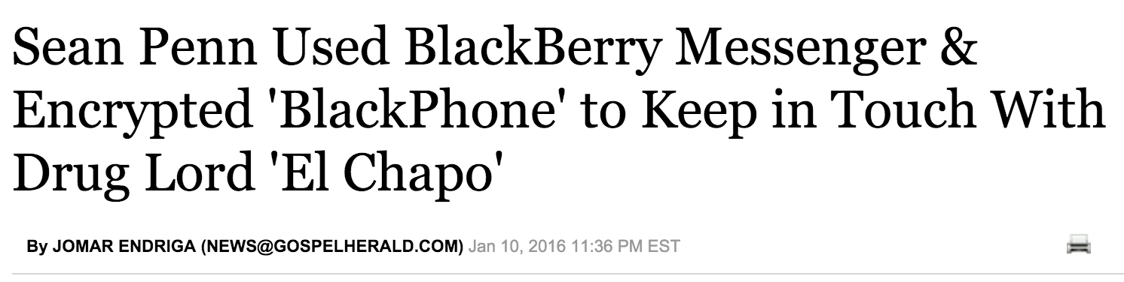
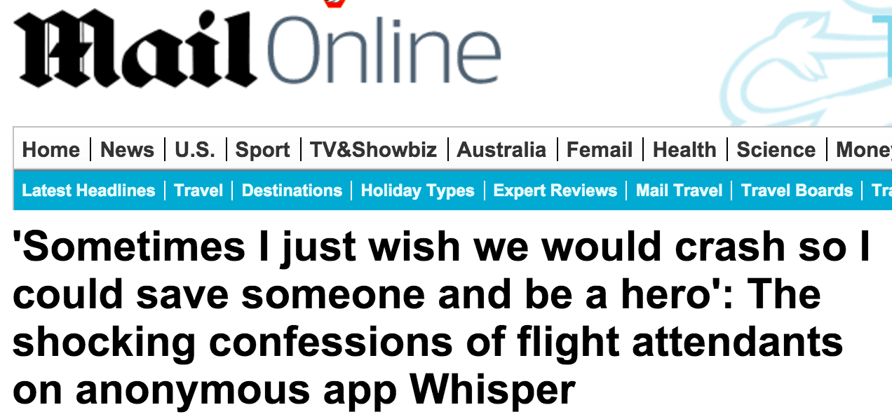
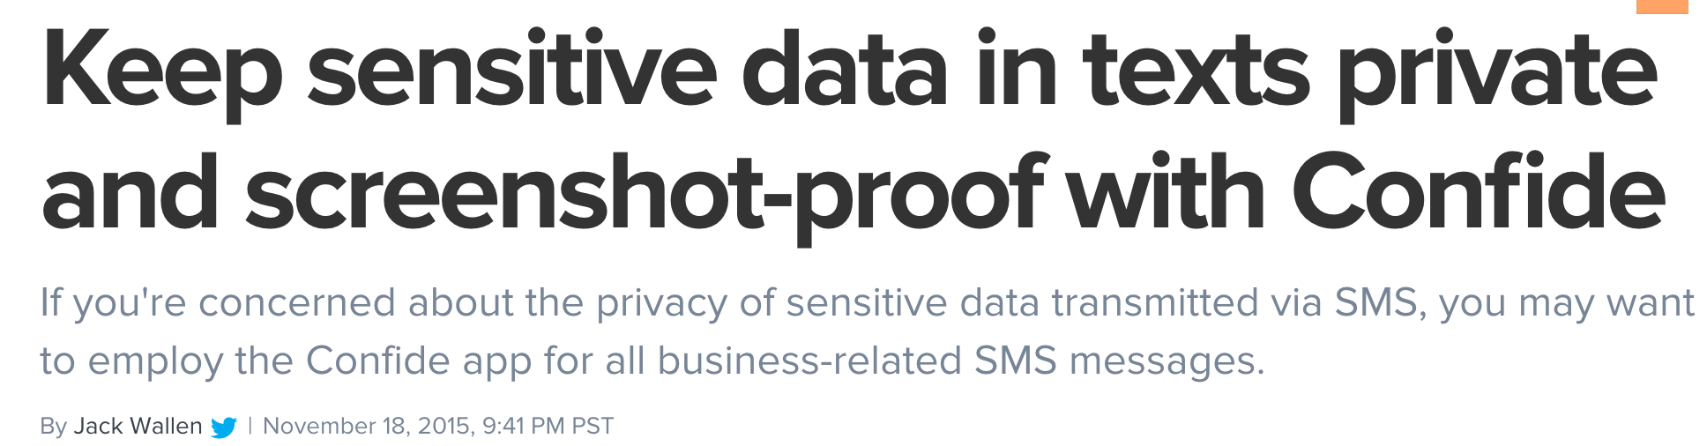

Slide 6
Our Work
More and more apps marketed as offering some privacy/anonymity properties…
But very little work has actually analyzed their property
We present a preliminary, experimental study of 8 popular apps, offering:
Anonymity
End-to-End Encryption (E2EE) and/or
Ephemeral Messaging
Main Goal:
Static and dynamic analysis “everyone” can do

Slide 7
Building an App Corpus
Build a list of “privacy” apps from:
Producthunt (“anonymous”)
Popular apps among friends and colleagues
Google Play’s similar apps
First list yields 18 apps, then we select based on:
Popular apps (100K+ downloads on Google Play)
Offering anonymity, E2EE, ephemerality
Exclude paid/business apps (e.g., TigerText, Silent Circle)

Slide 8
Apps (1/2)
1. Confide
E2EE & ephemeral chat, notification of screenshot attempts
Need to wand over messages, displaying one line at a time
2. Frankly Chat
Ephemeral chat, anonymous group chats
Messages deleted from server after 24 hours
3. Secret (discontinued)
Posting anonymously to nearby users, can chat privately
4. Snapchat
Chat with text and media disappearing after 1-10s

Slide 9
Apps (2/2)
5. Telegram
Supports E2EE “secret chats” with proprietary algorithm
6. Whisper
Anonymously share texts atop images, can respond with private chats
7. Wickr
E2EE and ephemeral chats
8. Yik Yak
Bulletin-board social network, post yik anonymously

Slide 10
Static Analysis
Decompiled the apps using dex2jar, looked for vulnerable interfaces:
TrustManager, HostnameVerifier, SSLSocketFactory, HttpsURLConnection
Frankly Chat (partly), Whisper, Wickr maybe vulnerable to Man in The Middle attacks
TrustManager and HostnameVerifier accept all certificates and hostnames
Certificate Pinning in
Confide, Frankly Chat (chat sockets), Whisper (from April 2015)

Slide 11
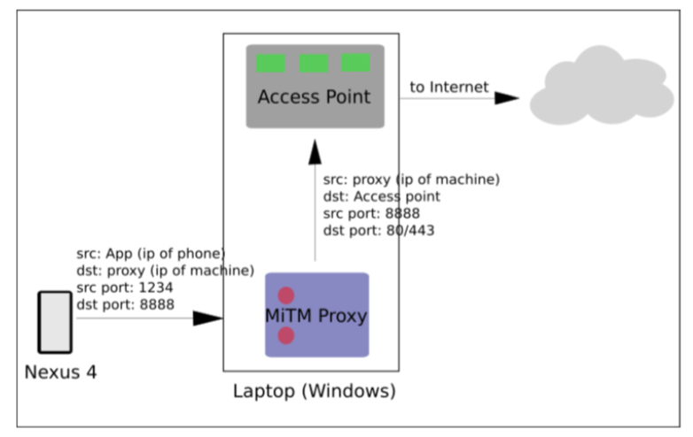
Dynamic Analysis: Fiddler

Slide 12
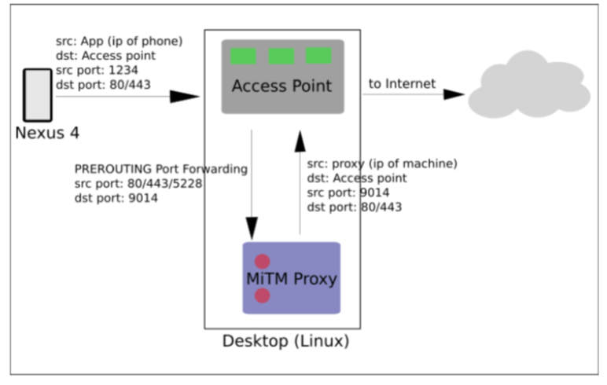
Dynamic Analysis: SSLsplit

Slide 13
Dynamic Analysis Feasibility 1/2
Confide
No connection with either Fiddler or SSLsplit due to pinning
Frankly Chat
Fiddler: Decrypted but chats not going through proxy
SSLsplit: No connection to the server when chat attempted
Secret
Fiddler: All TLS packets decrypted SSLsplit: Discontinued before we could experiment
Snapchat
Fiddler & SSLsplit: All TLS packets decrypted

Slide 14
Dynamic Analysis Feasibility 2/2
Telegram (Secret Chats)
Fiddler: Connects but chats not going through proxy
SSLsplit: Decrypts TLS but chats E2EE’ed
Whisper
Fiddler: No connection, SSLsplit: No connection
Wickr
Fiddler: Traffic does not go through the proxy
SSLsplit: TLS decrypted but E2EE is enabled
Yik Yak
Fiddler & SSLsplit: All TLS packets decrypted

Slide 15
Anonymity
W.r.t. other users:
All good but…in Whisper, one can link whispers to a display name while querying the distance to a target (also in IMC’14)
W.r.t. service provider:
All apps associate identifiers to its users, allowing to link each user across multiple sessions
Identifiers are persistent in Secret, Whisper, and Yik Yak even after uninstall
Apps also collect information like device ID, IP address, geo-location, which can be used to track users

Slide 16
Ephemerality
Messages do disappear from the apps interface
But, in Snapchat, previous chat messages part of the response received from the server (?!?)
Screenshot protection/notification works but obviously one can take a picture/video
Confide claims to offer “plausible deniability” (need to wand over messages, so can’t take snapshot)

Slide 17
E2EE
E2EE seems to work in Telegram & Wickr
Telegram uses homebrew encryption
Bounty program, no attack so far (other issues though…)
See http://motherboard.vice.com/read/encryption-app-telegram-probably-isnt-as-secure-for-terrorists-as-isis-thinks

Slide 18
Other Comments
Impersonation via SMS interception
Metadata often more relevant
Monetization?

Slide 19
Related Work 1/2
Measurement-based studies
Whisper vulnerability (recover Whispers)
Anonymity sensitivity & choices in Quora
Flaws
Reconstructing Snapchat’s user base
Linkability in Wickr
Security of E2EE cryptography

Slide 20
Related Work 2/2
Privacy Perceptions
Discrepancy between actual and desired privacy settings
Why use ephemeral messages?
Perceptions of privacy issues with apps and social networks

Slide 21
Ideas for Future Work
Larger, automated analysis of apps
Using PlayDrone’s metadata as corpus
Cryptanalysis of E2EE tools
Privacy analysis of metadata
Whatsapp and Signal

Slide 22
The End
Questions?
Acknowledgments: Balachander Krishnamurthy, Ruba Abu-Salma, PRESSID, Xerox’s University Affairs Committee, Marie Curie Program

