Slide 1
Full Stack JS Practice
based on QR login feature

Slide 2
Scope of practice
JavaScript
React
React Native
Node.js
JWT
QR codes
(bonus) Redis

Slide 3
WhatsClub
make clubs to send “whats up” to your peers

Slide 4
What is WhatsClub
Artificial application when Users can create clubs or audio chats to say “Whats Up” each other.
Users are a big company employees.
Main components:
Whatsclub Backend API on NodeJS (JS)
Whatsclub Mobile App on ReactNative (JS)
Whatsclub Web App on React (JS)

Slide 5
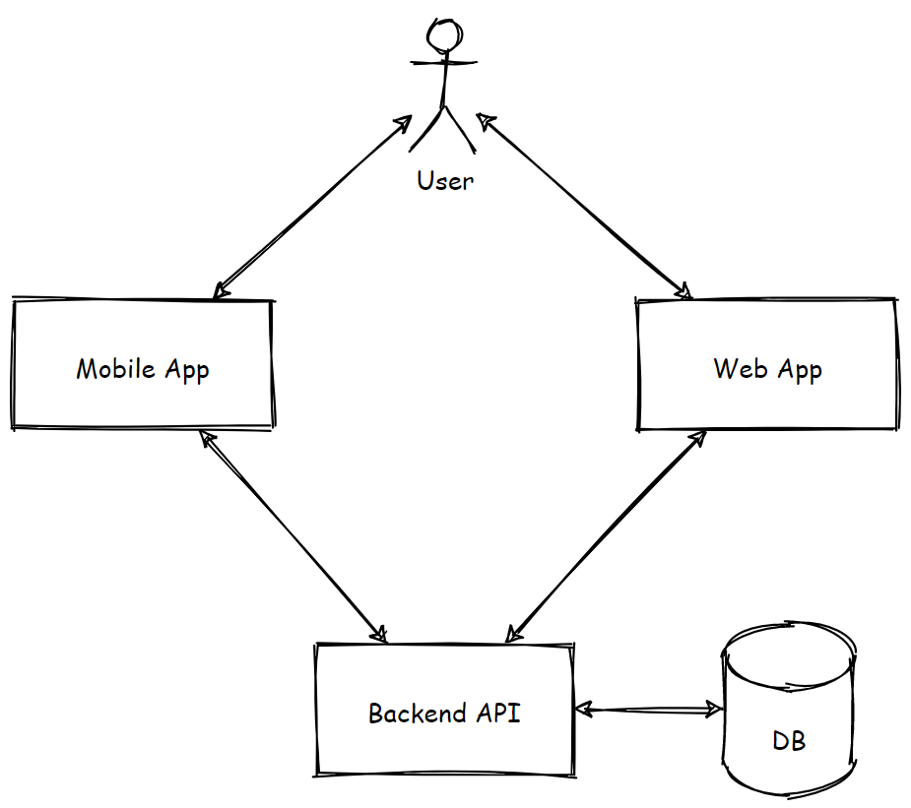
WhatsClub’s Architecture

Slide 6

Login into Web app

Slide 7
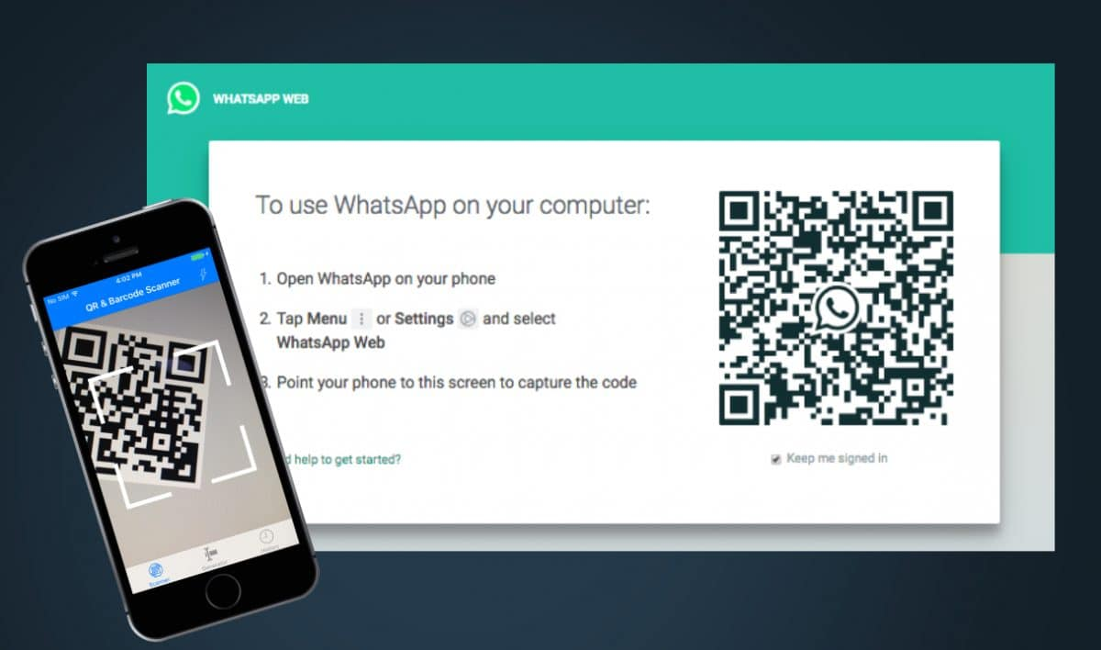
New Feature

Slide 8
Demo

Slide 9
Solution Design

Slide 10
Lets dive deeper

Slide 11
What about Production?
Scaling server side?
JavaScript -> TypeScript
Express -> Nest.js
+ Unit tests
+ React Component tests
+ E2E test

Slide 12
Q&A

