Slide 2
DataArt
Global Software Engineering Firm
23
4000+
22
years in operation
specialists
cities
<10%
11
31%
attrition rate
countries
women

Slide 3
Full Stack JavaScript Practice:
WhatsApp-like login via QR code
Vladimir Zatsepin
Solutions Architect

Slide 4
Scope of practice
JavaScript
React
React Native
Node.js
Express
Server-side events
JWT
QR codes
(bonus) Redis

Slide 5
Prologue

Slide 6
WhatsClubb
Artificial application when Users can create clubs a.k.a. audio chats to say “Whats Up” each other.
Main components:
  Backend API on Node.js (JS)
  Mobile App on ReactNative (JS)
  Web App on React (JS)

Slide 7
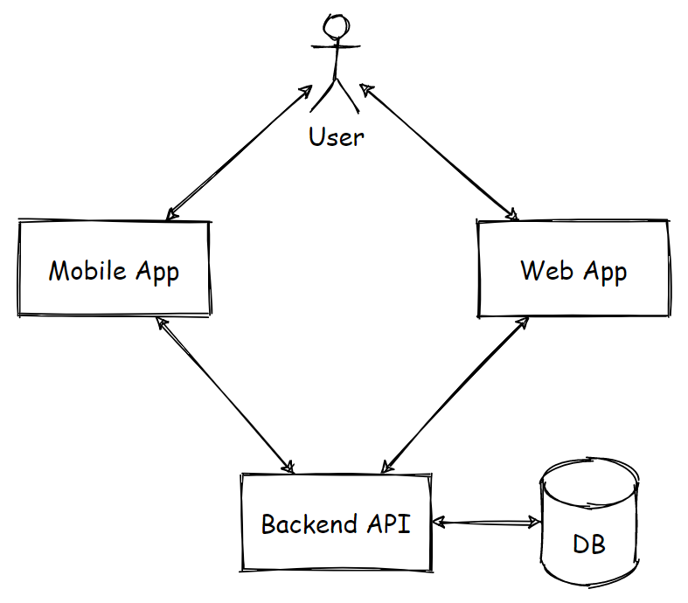
WhatsClubb Architecture

Slide 8
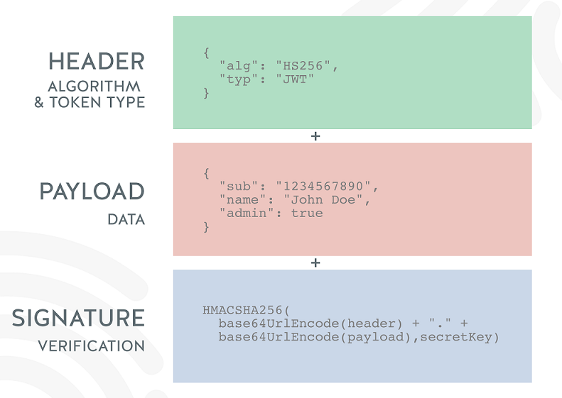
JWT

Slide 9
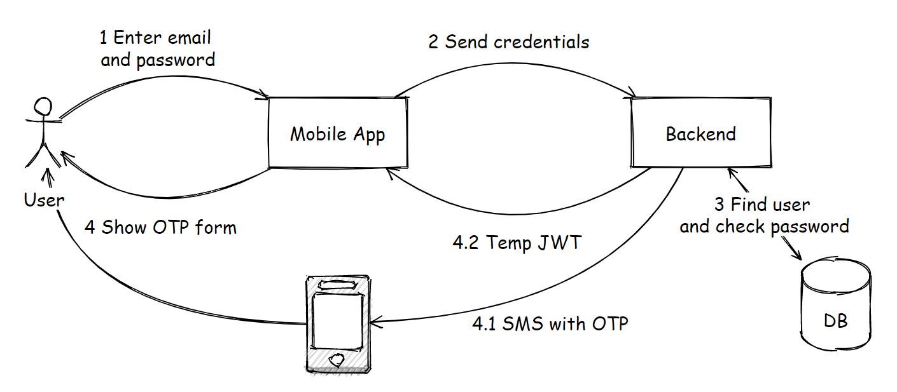
MFA Login

Slide 10
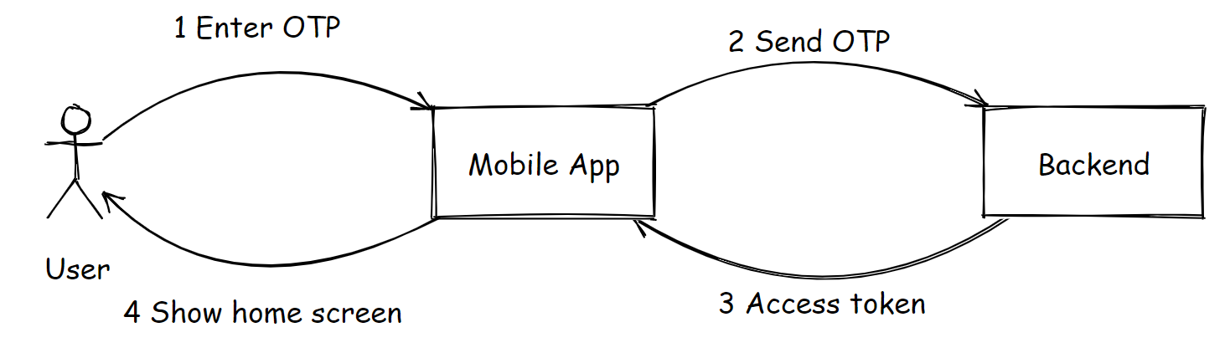
MFA Login

Slide 11
Part 1
The Feature

Slide 12

Login into Web app

Slide 13
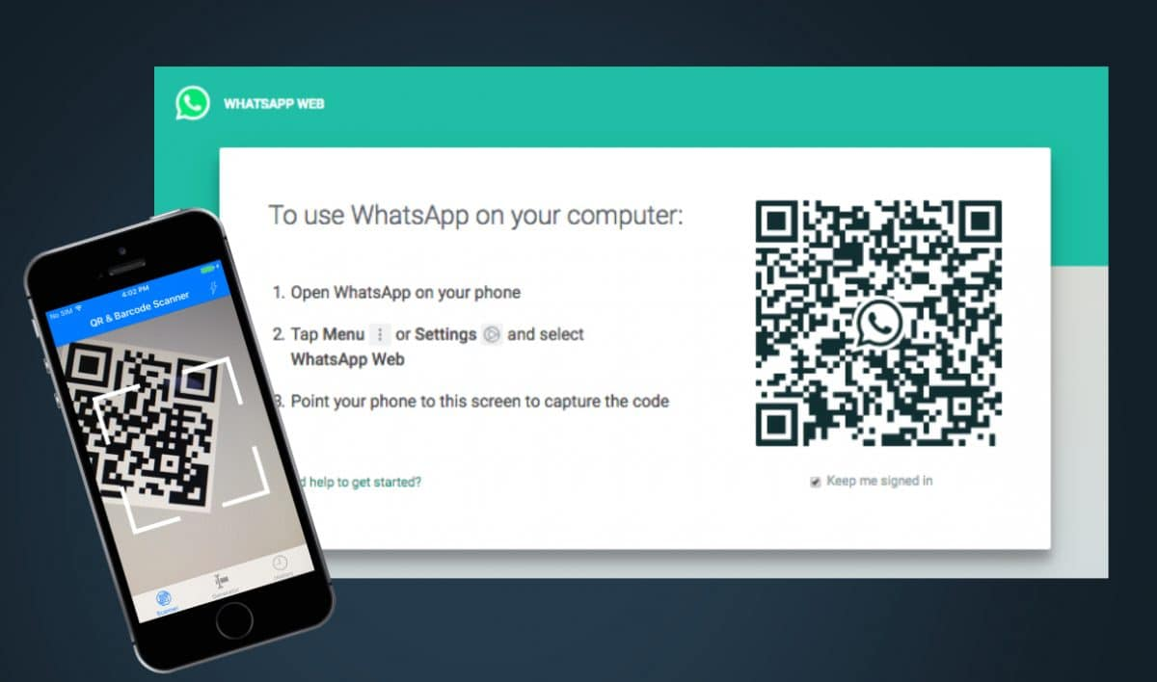
WhatsApp-like Login

Slide 14
Part 2
Solution Design

Slide 15
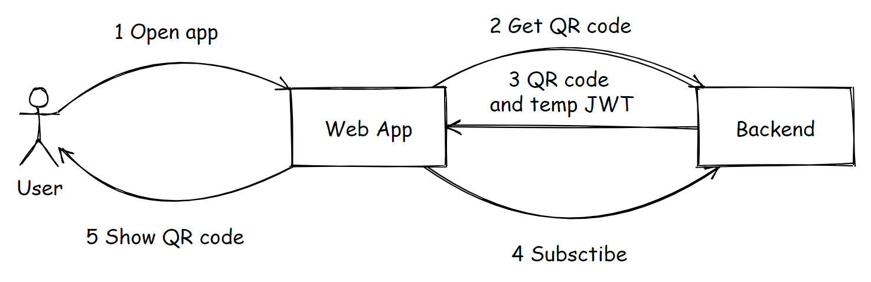
Solution Design

Slide 16
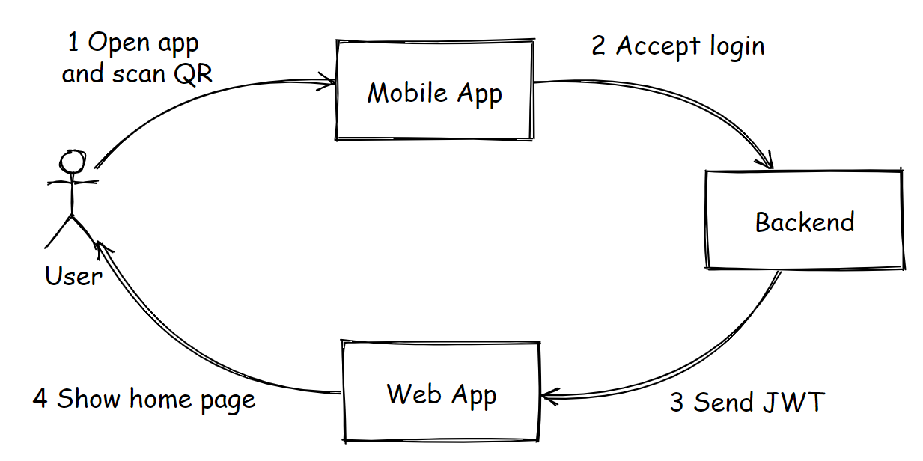
Solution Design

Slide 17
Part 3
PoC

Slide 18
Production Recommendations
Scaling server side
JavaScript -> TypeScript
Express -> Nest.js
+ Unit tests
+ React Component tests
+ E2E test

Slide 19
Part 4
Q&A

Slide 20
DataArt. Международная компания- разработчик программного обеспечения
23
4000+
22
года опыта
специалистов
центров разработки и продаж
<10%
11
31%
покидает компанию в течение года
стран
женщин

Slide 21
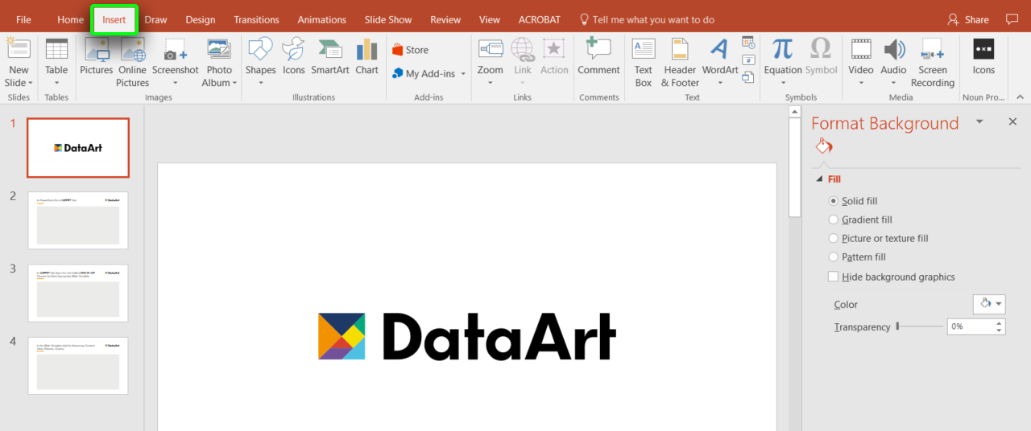
In PowerPoint go to Insert Tab

Slide 22
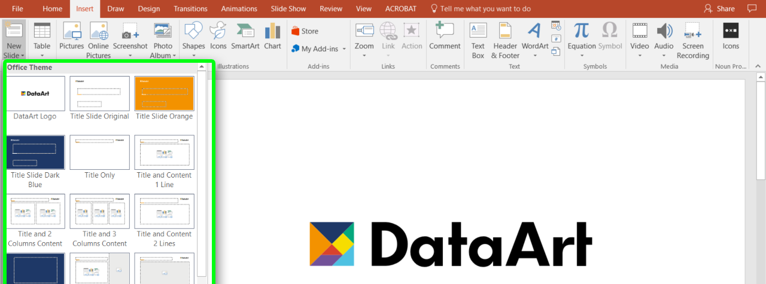
In Insert Tab open New Slide
Choose the most appropriate slide template

Slide 23
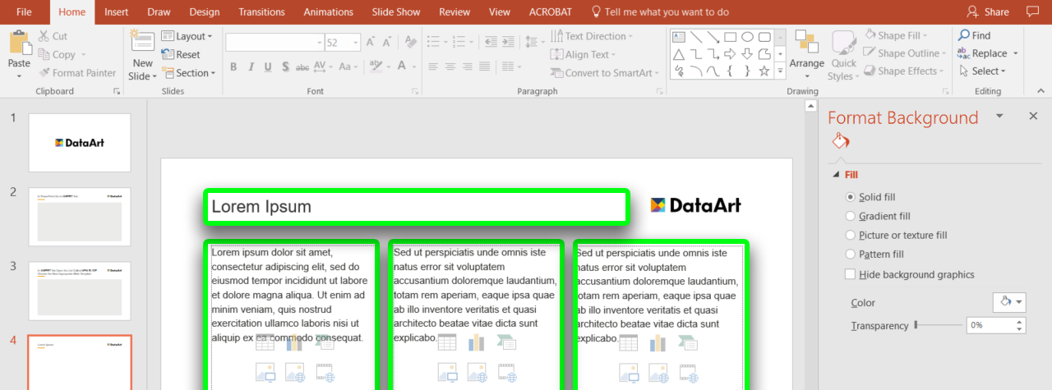
In the Slide add the necessary content (Text, Pictures, Charts)

