Slide 1
Passwordless login into Web app
based on WhatsClub app

Slide 2
What is WhatsClub
Artificial application when Users can create clubs or audio chats to say “Whats Up” each other.
Users are a big company employees.
Main components:
Whatsclub Backend API on NodeJS (JS)
Whatsclub Mobile App on ReactNative (JS)
Whatsclub Web App on React (JS)

Slide 3
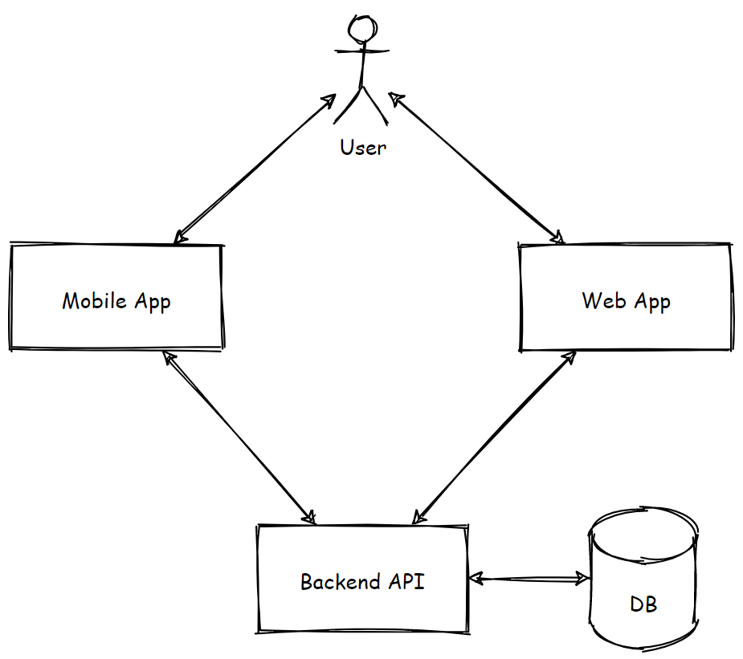
WhatsClub’s Architecture

Slide 4

Login into Web app

Slide 5
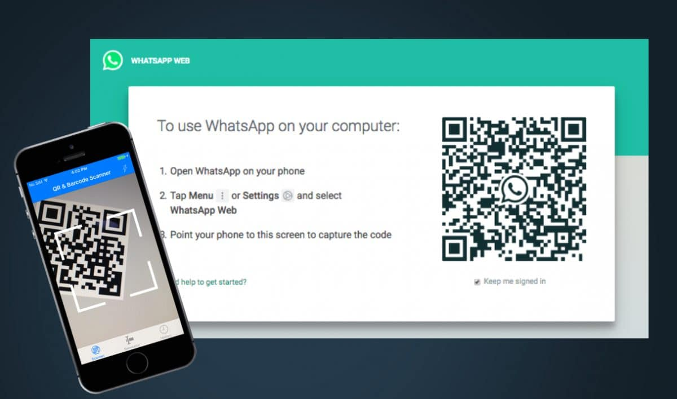
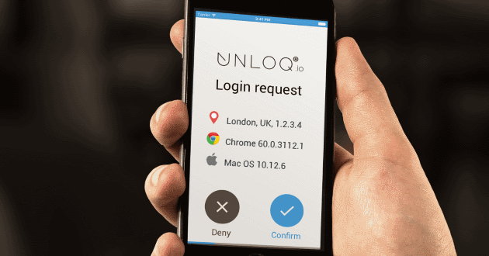
New Feature
QR code vs Push Notification

Slide 6
Assumptions
MFA is enabled to login into Mobile App
PoC

Slide 7
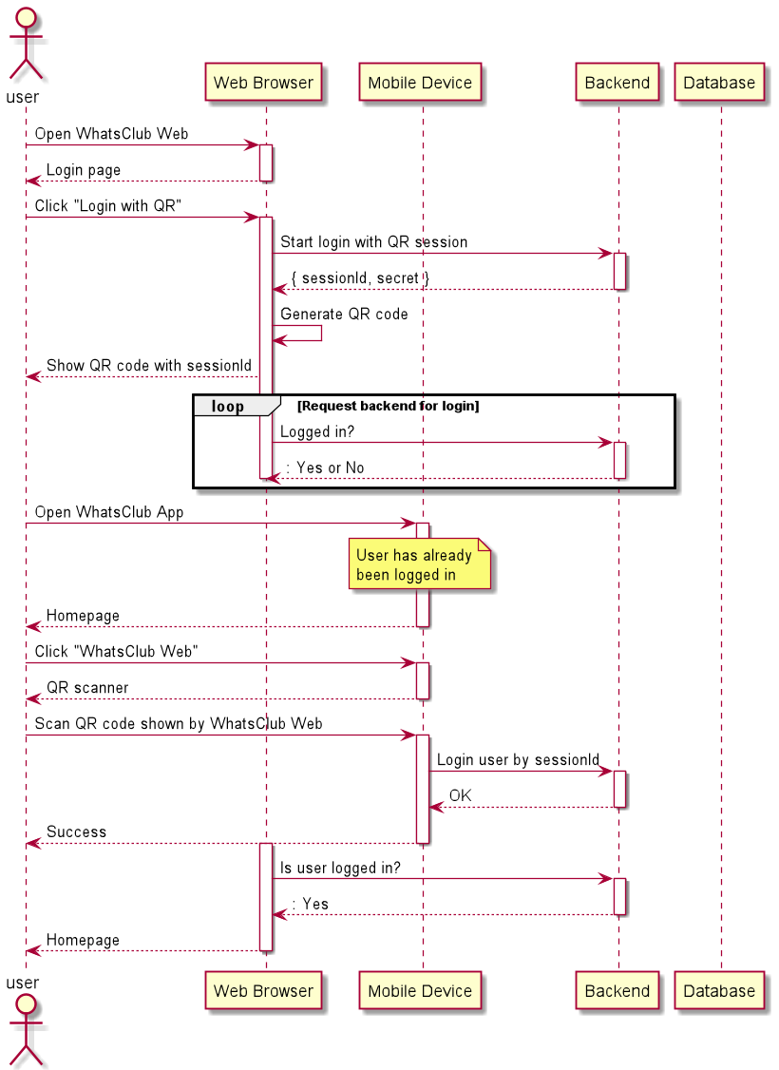
Solution Design: QR code

Slide 8
Solution Design: Push Notification

Slide 9
Implementation

Slide 10
Open Questions
How to scale backend horizontally?
How to protect against attacks of stealing the access token?

Slide 11
Q&A

