Slide 1
IoT in Azure
A Journey to Production

Slide 2


Slide 3
Allen Zaudtke
Architect at J. J. Keller & Associates, Inc.
Web and Cloud Applications
@alzaudtke
https://github.com/zaudtke

Slide 4
Agenda
Brief Overview of Application
Ingestion and Storage
Processing
Output
Future

Slide 5
What the application Does
Collect Engine Data
Submit to Cloud
Process and Store Data
Report via Web application

Slide 6
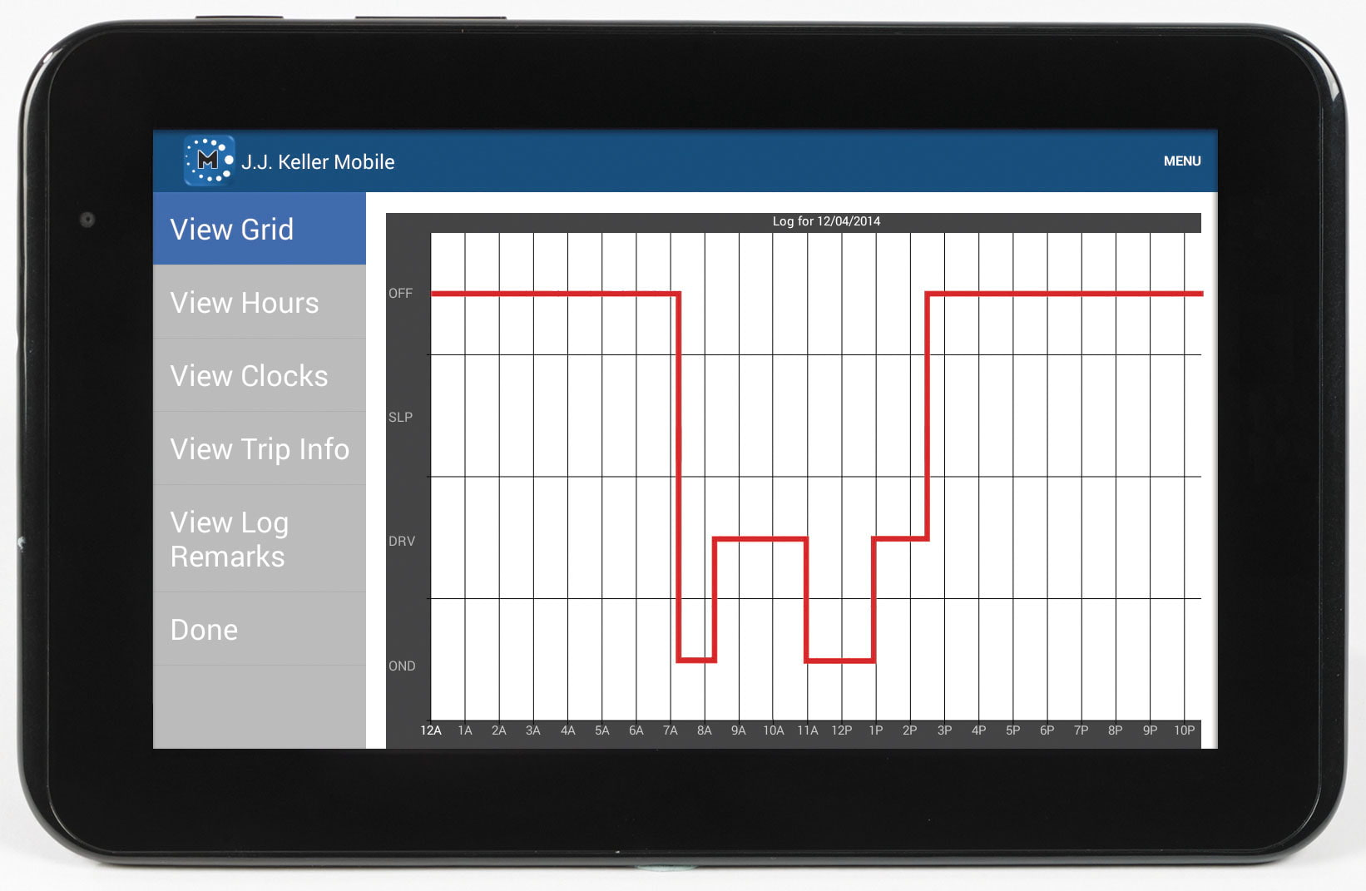
Example of use

Slide 7
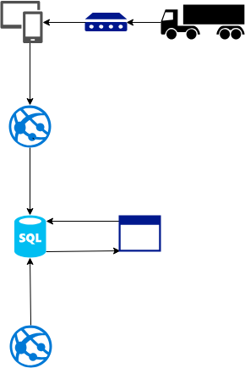
What it looked like

Slide 8
Why change it
Not Scalable
Synchronous
SQL Performance Issues with main Application
Tightly Coupled to main Application

Slide 9
Ingestion of Data - Concerns
Speed of Response to Device
Scalability
Security

Slide 10
Ingestion of Data – Custom API
All concerns could be handled
Newer and Better version of existing
Code and deployments for something that wasn’t doing much
Never truly considered

Slide 11
Ingestion of Data – Event Hub
What is Designed for
Service not Code
Routing and Endpoints
Security – Custom work would have been needed

Slide 12
Ingestion of Data – Iot Hub
All Concerns addressed
Service not Code
Security – Device Registration Proactive vs Reactive
Routing and Endpoints
Bonus - Ability to Send Messages to Device

Slide 13
Mobile Device changes
Used existing Endpoint of API to handle Registration
Using Mobile Device for this, not the Black Box
New Endpoints and new Http Helpers
Wrap objects in EventData with Custom Properties
No Logic changes beyond feature Toggles

Slide 14
Azure Functions to Process IoT HUb
Running on Service Plan not Consumption
Bindings for Event Hub Endpoints
Consumer Groups
Batch Processing

Slide 15
Routing and Endpoints
Routes are a Filter on Meta Data – messageType=‘eventdatarecords’
Sent to a Specific Endpoint
Endpoints can then be used to Know what Data Type
Which Leads to…..

Slide 16
Consumer Groups
Multiple Processors on the same data
Each keeps track of where it is in the data
Needs Storage Account to track it’s progress

Slide 17
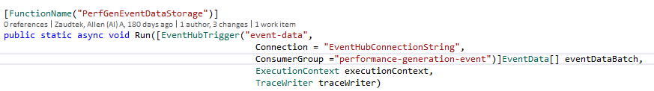
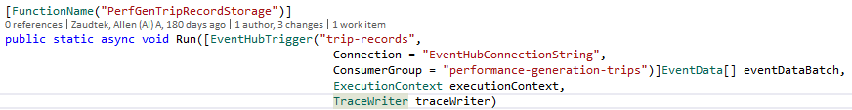
Function Declaration

Slide 18
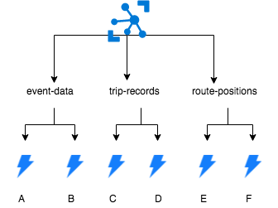
What this gives us

Slide 19
Azure Function Work
Mapping of Data
Simple Lookups from API or Cache using Redis
Save to Storage
Publish to Service Bus (With Deduplication)

Slide 20
Redis Caching
Same Devices Submitting All Day
Prevents Unnecessary Calls to API
Used across all Ingestion Routes
Used for Deduplication – Service Bus deduplication didn’t work for us.

Slide 21
Data Lake, Streaming Analytics, and Data Factory
Started Here
Felt Too Much like SSIS and Dump and Figure out Later
Not Running Real Time
Long Term vs Processing

Slide 22
Table Storage – The Good
Had Natural Row and Partition Keys
Cheap and Easy
Made Sense for the first Process

Slide 23
Table Storage – Not as Good
Purging Led to Table per Month Pattern
Eventually Needed Data in a Different Sort Order
Eventually Needed even more Querying Capability

Slide 24
CosmosDB SQL API – The Good
Actually NoSql (Formally DocumentDB)
With correct Partition Key Fully Scalable
Fully Queryable
Ability to use Stored Procedure for Batch Transactions
Time To Live (TTL)

Slide 25
COSMOSDB Sql API – Had to Work through
Choosing Partition Keys is Hard
Deployment – Not Completely doable by ARM. Custom Code
Collection != Table

Slide 26
Service Bus Queues
Just a Message Queue
Various Scheduled Times
Deduplication Issue

Slide 27
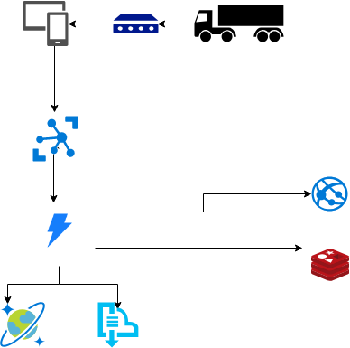
Ingestion Diagram

Slide 28
Processing
Differing Schedules
Different Work Loads
Ability to Keep Separated
Some Need Pre-Processing

Slide 29
Functions
Running on Service Plan not Consumption
Timer Trigger
Service Bus Trigger if Pre-Process Step
Error Path uses Another Service Bus Queue

Slide 30

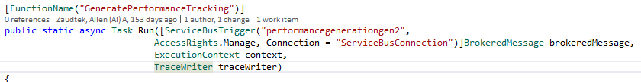
Function Declarations

Slide 31
USING FUNCTIONS - Thinking Differently
More About How to Code in Cloud than Using Cloud
Get Data Up Front Not On-Demand
Functional Concepts (Linq and Custom Projections)
Allowing for 1 Error to Not Stop the Process
No Dependency Injection

Slide 32
Errors Service Bus
Add to Special Queue
Keep Retry Count
Process When Function Started
Max Retries Notification

Slide 33
Redis
Prevent Unnecessary Calls to API
Shared across Processes

Slide 34
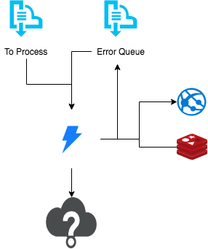
Processing

Slide 35
Output
Database Still On Premise
Have Express Route, but would have required shipping data across regions
Ongoing Work Limited Ability to Change Application
Multiple Approaches Taken

Slide 36
Approach 1
Service Bus Queue
Windows Service On Premise
Pull Model
Avoid Express Route

Slide 37
Approach 2
CosmosDB
Change Feed
Windows Service On Premise
Pull Model
Avoids Express Route
Deletes Not in Change Feed

Slide 38
Both Approaches
Allow us to more easily Insert in Batches
Allow us to Update in Batches
Less impact on Database than previous solution

Slide 39
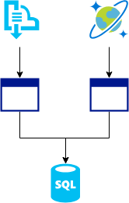
Output

Slide 40
Putting it all Together
Faster Response Times
Better separation between concerns
Less hammering away at existing Database
More Scalable

Slide 41
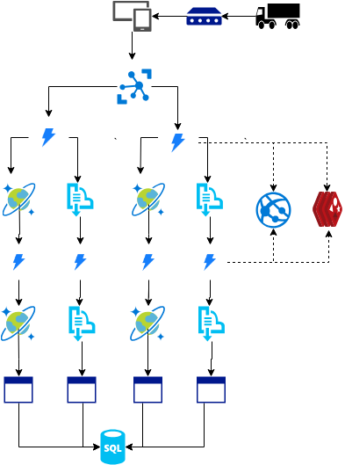
Overall

Slide 42
Future
1 Ingestion Function instead of 5
Remove Table Storage
Use Change Feed
Less Queues
More Streamlined
More Event Driven

Slide 43
Future Continued
Database now in Azure – Remove Windows Service
Push Model using Connectors

Slide 44
Long Term Future
Data Storage and API so no need to push to existing Database
Data Lake for Permanent Storage
ML over Data Lake
Expand to other Data Points

Slide 45
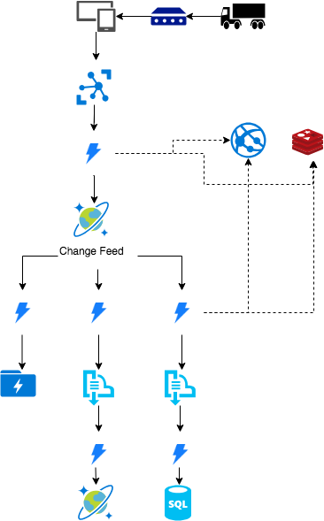
Long Term Solution

Slide 46
Conclusion
There are a lot of possible solutions
Start small and Proto Type
Distributed System Thinking

Slide 47

Questions

Slide 48
