Slide 1
Identifying and designing subsystems

Slide 2
Allen Zaudtke
Architect at J. J. Keller & Associates, Inc.
Web and Cloud Applications
@alzaudtke
https://github.com/zaudtke

Slide 3
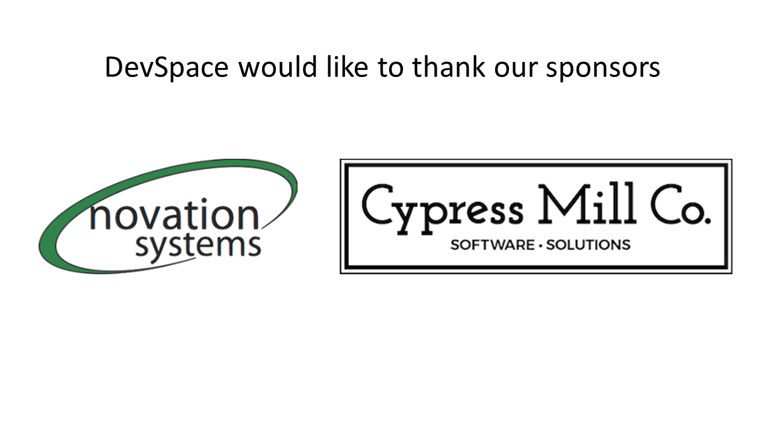

Slide 4
Agenda
Identify – What are they?
Define – What are they supposed to do?
Design – How are they going to be built?

Slide 5
What is a Subsystem?
Any process you need to write for your system, that doesn’t live on the happy path of application to data storage.

Slide 6
Identify
Necessary
Needs Code
Outside the Happy Path

Slide 7
External Systems
Customer Management and Billing
Email
Third Party Processor

Slide 8
Extract, Transform, Load (ETL)
Data Lake / Cold Storage
Reporting Database
Import/Export Process

Slide 9
Event Patterns (“Something Happened”)
Update Data Asynchronously
Move Data from Temporary to Permanent
Workflows or Pipelines

Slide 10
Admin or Support Functions
Override Business Rules
Special Audit Trail
PII Obfuscation

Slide 11
Temporary
Data Migration
Hot Fix

Slide 12
Technical Characteristics
Message Queues
Serverless
Scheduled Jobs
Console apps or Scripts

Slide 13
Next step
We’ve Identified something needs to be built.
Now, let’s Define it.

Slide 14
Define
What does this process do?
Is it part of the core domain/application?
What is the timing and/or lifetime?

Slide 15
Purpose
Look beyond the obvious.
Total Control vs Outside Dependency
Honest assessment of Importance

Slide 16
Read Only Purpose
Query -> Map -> Send
Time Based
Request Based

Slide 17
Writable purpose
Flags, Dates, Status vs Domain
Creating vs Updating
Deletes

Slide 18
Part of the Domain
Is this a single purpose thing?
Does this need to adhere to your existing business rules?
Is this an orchestration process?

Slide 19
Lifetime
Forever
Short-term Hack
One time fix

Slide 20
Timing
Event Based
Time Based

Slide 21
Next up
Identified something
Defined it. Purpose, lifetime, and it’s scope.
Now the hard part…. Designing it.

Slide 22
Design
Technology
Code Patterns
New Code or Existing Code

Slide 23
Scenarios
Take combination of scenarios discussed earlier
Talk about some less than ideal solutions
Talk about some better solutions

Slide 24
External Systems – Less than ideal
Api within system called by scheduled console app
Scheduled console app referencing domain libraries
Mobile Api tightly coupled to app and database

Slide 25
External Systems - Better
Use of Serverless functions if possible
Don’t reference libraries. Use an Api if necessary
Custom Sql, use a Schema
Completely split off, make it it’s own application

Slide 26
Read Only or ETL – Less than Ideal
Must use existing data access and entities
New models in wrong project or new dependency
Deployment tied to application

Slide 27
Read Only or ETL - Better
Custom SQL
Custom Models
Only dependency is database

Slide 28
Event Patterns – Less than ideal
Making it synchronous
Proc calling Proc
Database as Queue
Windows Service

Slide 29
Event Patterns - Better
True Queue System, true Event
Cloud Services
New Domain (Aggregate root) in new Project

Slide 30
Admin/Support – Less than Ideal
Part of application
Lack of Audit trail
If Checks everywhere
Manual SQL sent to DBA’s

Slide 31
Admin/Support – Better
Decorator Pattern within Existing
Separate App
Automate/Fix Manual things

Slide 32
Temporary – Less than Ideal
Over Architect
Needed a deployment
Never removed

Slide 33
Temporary - Better
Quick and Dirty
Manual Run if possible.
Contemplate removing Source Code as well

Slide 34
Cherry picked pet peeves
Flags, Status, Dates Must go through Domain
Refusal to use Set Based Sql
Firewalls. Cloud and On-Prem is hard

Slide 35
In closing
Avoid Distributed Monolith
Isolate when possible
Act sooner than later

Slide 36
Thank you, and enjoy the rest of your day!

