Slide 1
Embracing SQL

Slide 2
Allen Zaudtke
Architect at J. J. Keller & Associates, Inc.
Web and Cloud Applications
@alzaudtke
https://github.com/zaudtke

Slide 3


Slide 4
Agenda
Scenarios SQL better than ORM
Stored Procedures, things I like
JSON and Sql Server

Slide 5
This Is Not
ORM Bashing
Old Man Get off my Lawn and use Procs
Putting “Business Logic” in Database
Looking for a fight

Slide 6
Disclaimer
I am not an EF guru
I am using EF Core
I do really like parts of it

Slide 7
ORM Scenarios
Code I’ve seen and written
Workflows
Sometimes ORM wins ☺

Slide 8
Set Based Operations
Get List, change it, save as new list
Batch updates or deletes
Not always problematic at first

Slide 9
var newLookps = _context.Lookups
.Where(l => l.CompanyId == systemId)
.Select(lu => new Lookup
{
Id = Guid.NewGuid(),
Value = lu.Value,
CompanyId = companyId
}).ToList();
_context.Lookups.AddRange(newLookps);

Slide 10
insert into dbo.Lookup
select
newId()
,[Value]
,@companyId
from dbo.lookup
where companyId = @systemId

Slide 11
var newManager = _context.Employees
.Single(m => m.Id == newMangerId);
var employees = _context.Employees
.Where(e => e.ManagerId == previousManagerId).ToList();
foreach(var e in employees)
{
e.Manager = newManager;
}
_context.SaveChanges();

Slide 12
update dbo.Employees
set
ManagerId = @newManagerId
where
ManagerId = @previousManagerId

Slide 13
Bulk Insert
IoT Solution
First Chance to use ORM instead of Data Sets
Performance was DOA

Slide 14
ORM Version
Build Collection of objects
DBSet.AddRange
DBContext.SaveChanges
Wait 45 minutes

Slide 15
SqlBulkCopy
Build DataSet
SqlBulkCopy.WriteToServer
< 1 minute

Slide 16
Joins
Existing schema may conflict with DB Context
Still need joins
Lambda vs Query Expression

Slide 17
return await context.CompanyLevels
.Join(
context.Employees,
cl => cl.Id,
emp => emp.CompanyId,
(cl, emp) => new { cl, emp }
)
.Where(r => r.cl.CGRootId == cgRootId
&& r.emp.Id != employeeId
)
.AnyAsync();

Slide 18
var list = await (from userRole in _dbContext.UserRoles
join userRoleDef in _dbContext.UserRoleDefinitions
on userRole.UserRoleDefinitionId equals userRoleDef.Id
join compGroupCompLevel in _dbContext.CompanyGroupCompanyLevels
on userRole.CompanyGroupId equals compGroupCompLevel.CompanyGroupId
where userRole.UserId == userContext.Id
select new UserPermission(compGroupCompLevel.CompanyId, compGroupCompLevel.CompanyGroupId, userRoleDef.Permissions)).ToListAsync();

Slide 19
Projections
Expose DTOs, not Entities
Joins or Eager Loading
Func vs Expression

Slide 20
var mvrScoringCompany = await _context.MvrScoringCompany
.Where(c => c.CompanyId == request.CompanyId && c.MvrScoringId == request.Id)
.Include(e => e.MvrScoring)
.FirstOrDefaultAsync();

Slide 21
Func vs Expression
.Select 4 overloads 2 Expression, 2 Func
Func returns all fields
Expression generate correct Select in Sql

Slide 22
public static Expression<Func<Domain.EmployeeManagement.Employee , QueryResult>> MapFromDomain
{
get
{
return emp => new QueryResult
{
Id = emp.Id,
CompanyId = emp.CompanyId,
FullName = emp.EmployeeName.FullName,
EmployeeCode = emp.EmploymentData.EmployeeCode,
CompanyLevelName = emp.CompanyLevel.Name
};
}

Slide 23
return await _readOnlyContext.Employees
.Where(e => e.Code == searchTerm)
.Select(MapFromDomain)
.ToListAsync();

Slide 24
.Select( employee => new QueryResult
{
Id = employee.Id,
CompanyId = employee.CompanyId,
FullName = employee.EmployeeName.FullName,
EmployeeCode = employee.EmploymentData.EmployeeCode,
CompanyLevelName = employee.CompanyLevel.Name
});

Slide 25
select
e.Id
,e.FullName
,e.EmployeeCode
,cl.Name as CompanyName
from
dbo.Employee e
join dbo.CompanyLevel c
on e.CompanyLevelId = c.Id

Slide 26
Linq wins here
Previous DTO was a search result
Multiple Where clauses
Linq build where due to IQueryable
Sql loses due to AND/OR mess in where clause

Slide 27
var query = await _readOnlyContext.Employees;
if(!string.IsNullOrEmpty(searchCode))
query.Where(e => e.EmployeeCode == searchCode;
if(!string.IsNullOrEmpty(searchName))
query.Where(e => e.FirstName == searchName;
query
.Select(MapFromDomain)
.ToListAsync();

Slide 28
where
(@empCode is null or e.EmployeeCode = @empCode)
AND
(@lastname is null or e.LastName = @lastName)
AND
(@companyName is null or c.Name = @companyName)

Slide 29
Stored Procedures
Specific scenarios
Personal Preference
Beyond CRUD

Slide 30
Multiple Result Sets
Content Search with lots of types of data
Linq to DataSet

Slide 31
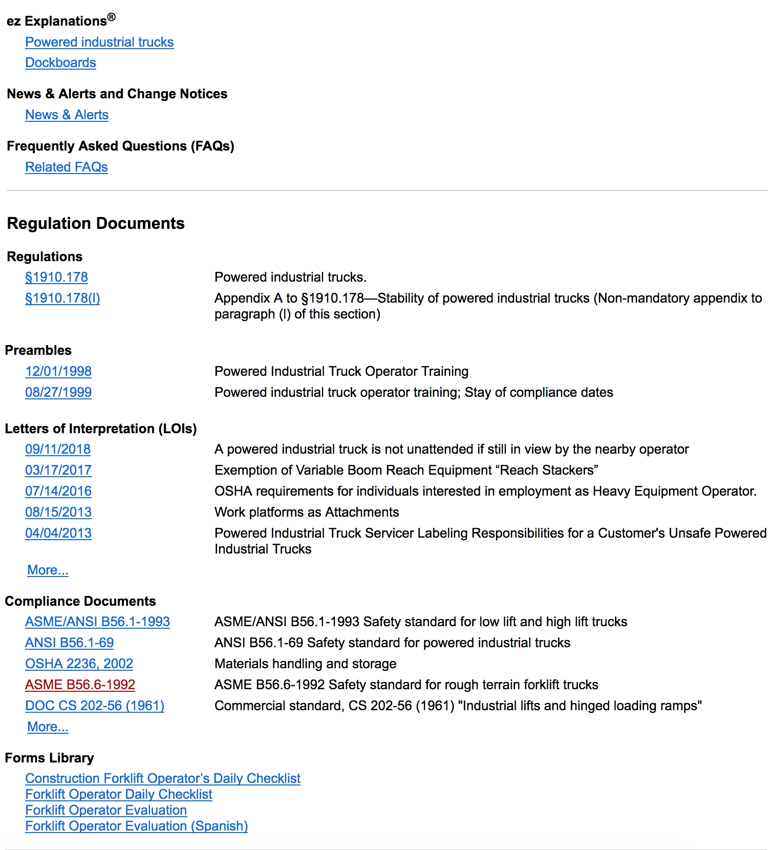

Slide 32
Table Value Parameters
Set Based (Again)
Select number of entities then operate on them
Can replace SQLBulkCopy for smaller workloads
Works well with Merge

Slide 33
create proc TerminateEmployees
@EmployeeList dbo.GuidList readonly,
@terminationDate date
as
update e
set
e.IsTerminated = 0,
e.TerminationDate = @terminationDate
from
dbo.Employee e
join @EmployeeList l
on e.Id = l.Id

Slide 34
External Processes
Is Processed
Remove from Queue
Get / Create Data outside of application.

Slide 35
JSON
Admittingly Sql Server’s is just XML rebranded
Postgres If wanted full capabiliites
Still viable in SQL Server

Slide 36
Why not use NoSql
Transactions – Your mileage may vary
Money
Not enough data
Another Backup to manage
Potentially complicates client code

Slide 37
JSON In Sql SErver
Basic. I’m not looking to use all features.
3 Storage Scenarios
Firehose reads

Slide 38
Full Document Storage
Not queryable beyond Id
Needed, but “useless”
Example: Custom Settings

Slide 39
Parent Child
Parent Matters
Children don’t
Example: Drivers Log with Log Events

Slide 40
Many to Many
Matters in DB Design
Doesn’t matter in Application
Example: Content Preferences

Slide 41
For JSON
Use For JSON to format query results as a string
Have API return the string as is, without mapping to object
I’ve only thought about this, haven’t used in production

Slide 42
Summary
ORMS are great for single object actions
SQL Still rules for Set and Bulk based operations
Mixing and Matching is probably the best solution
Simple JSON features keep everything together

Slide 43
Thank You

