Slide 1
Embracing SQL

Slide 2


Slide 3


Slide 4
Allen Zaudtke
Architect at J. J. Keller & Associates, Inc.
Web and Cloud Applications
@alzaudtke
https://github.com/zaudtke

Slide 5
Agenda
Scenarios SQL better than ORM
Stored Procedures, things I like
JSON and SQL Server

Slide 6
This Is Not
ORM Bashing (mostly)
Old Man Get off my Lawn and use Procs
Putting “Business Logic” in Database

Slide 7
Disclaimer
I am using EF Core
I do really like parts of it

Slide 8
ORM Scenarios
Code I’ve seen and written
Workflows
Sometimes ORM wins ☺

Slide 9
Set Based Operations
Get list, change it, save as new list
Batch updates or deletes
Not always problematic at first

Slide 10
var newLookps = _context.Lookups
.Where(l => l.CompanyId == systemId)
.Select(lu => new Lookup
{
Id = Guid.NewGuid(),
Value = lu.Value,
CompanyId = companyId
}).ToList();
_context.Lookups.AddRange(newLookps);
Notes:
Copy Lookups from System to new Company

Slide 11
insert into dbo.Lookup
select
newId()
,[Value]
,@companyId
from dbo.Lookup
where companyId = @systemId
Notes:
Copy lookups from system to company

Slide 12
Context Curveball
There are 15 or so of these tables
Due to hierarchy, there is another table involved sometimes
Small part of large transaction

Slide 13
var newManager = _context.Employees
.Single(m => m.Id == newMangerId);
var employees = _context.Employees
.Where(e => e.ManagerId == previousManagerId).ToList();
foreach(var e in employees)
{
e.Manager = newManager;
}
_context.SaveChanges();
Notes:
Update Employees from Jane who got promoted to Bob

Slide 14
update dbo.Employees
set
ManagerId = @newManagerId
where
ManagerId = @previousManagerId
Notes:
Now that’s readable

Slide 15
Bulk Insert
IoT Solution
First Chance to use ORM instead of Data Sets
Performance was DOA

Slide 16
ORM Version
Build Collection of objects
DBSet.AddRange
DBContext.SaveChanges
Wait 45 minutes

Slide 17
SqlBulkCopy
Build Typed DataSet
SqlBulkCopy.WriteToServer
< 1 minute

Slide 18
Joins
Existing schema may conflict with DB Context
Still need joins
Lambda vs Query Expression

Slide 19
return await context.CompanyLevels
.Join(
context.Employees,
cl => cl.Id,
emp => emp.CompanyId,
(cl, emp) => new { cl, emp }
)
.Where(r => r.cl.CGRootId == cgRootId )
.AnyAsync();
Notes:
Lambda Syntax

Slide 20
return await (
from cl in _dbContext.CompanyLevels
join emp in _dbContext.Employees
on cl.Id equals emp.CompanyId
where cl.CGRootId == cgRootId
).AnyAsync()
Notes:
Query expression syntax
I prefer this
While not SQL, it’s still Embracing it

Slide 21
Projections
Expose DTOs, not Entities
Joins or Eager Loading
Func vs Expression
Views

Slide 22
var mvrScoringCompany = await _context.MvrScoringCompany
.Where(c => c.CompanyId == request.CompanyId && c.MvrScoringId == request.Id)
.Include(e => e.MvrScoring)
.FirstOrDefaultAsync();
Notes:
Example of Include

Slide 23
Func vs Expression
.Select 4 overloads 2 Expression, 2 Func
Func returns all fields
Expression generate correct Select in SQL (sometimes)

Slide 24
public static Expression<Func<Employee,Result>> Map
{
get
{
return emp => new QueryResult
{
Id = emp.Id,
CompanyId = emp.CompanyId,
FullName = emp.EmployeeName.FullName,
EmployeeCode = emp.EmploymentData.EmployeeCode,
CompanyLevelName = emp.CompanyLevel.Name
};
}
Notes:
Expressoin

Slide 25
return await _readOnlyContext.Employees
.Where(e => e.Code == searchTerm)
.Select(Map)
.ToListAsync();
Notes:
Using expression in Select

Slide 26
.Select( employee => new QueryResult
{
Id = employee.Id,
CompanyId = employee.CompanyId,
FullName = employee.FullName,
EmployeeCode = employee.EmployeeCode,
CompanyLevelName = employee.CompanyLevel.Name
});
Notes:
Function

Slide 27
select
e.Id
,e.FullName
,e.EmployeeCode
,cl.Name as CompanyName
from
dbo.Employee e
join dbo.CompanyLevel c
on e.CompanyLevelId = c.Id
Notes:
sql

Slide 28
Views can be great
Nasty Joins
Indexed if needed
Not all Fields
Aliases
Notes:
Read-Only Context

Slide 29
Linq wins here
Multiple Where clauses
LINQ build where clause due to IQueryable
SQL loses due to AND/OR mess in where clause

Slide 30
var query = await _readOnlyContext.Employees;
if(!string.IsNullOrEmpty(searchCode))
query.Where(e => e.EmployeeCode == searchCode;
if(!string.IsNullOrEmpty(searchName))
query.Where(e => e.FirstName == searchName;
query
.Select(MapFromDomain)
.ToListAsync();
Notes:
Building where clauses

Slide 31
where
(@empCode is null or e.EmployeeCode = @empCode)
AND
(@lastname is null or e.LastName = @lastName)
AND
(@companyName is null or c.Name = @companyName)

Slide 32
Stored Procedures
Specific scenarios
Personal Preference
Beyond CRUD

Slide 33
Multiple Result Sets
Content Search with lots of types of data
LINQ to DataSet with multiple Tables

Slide 34
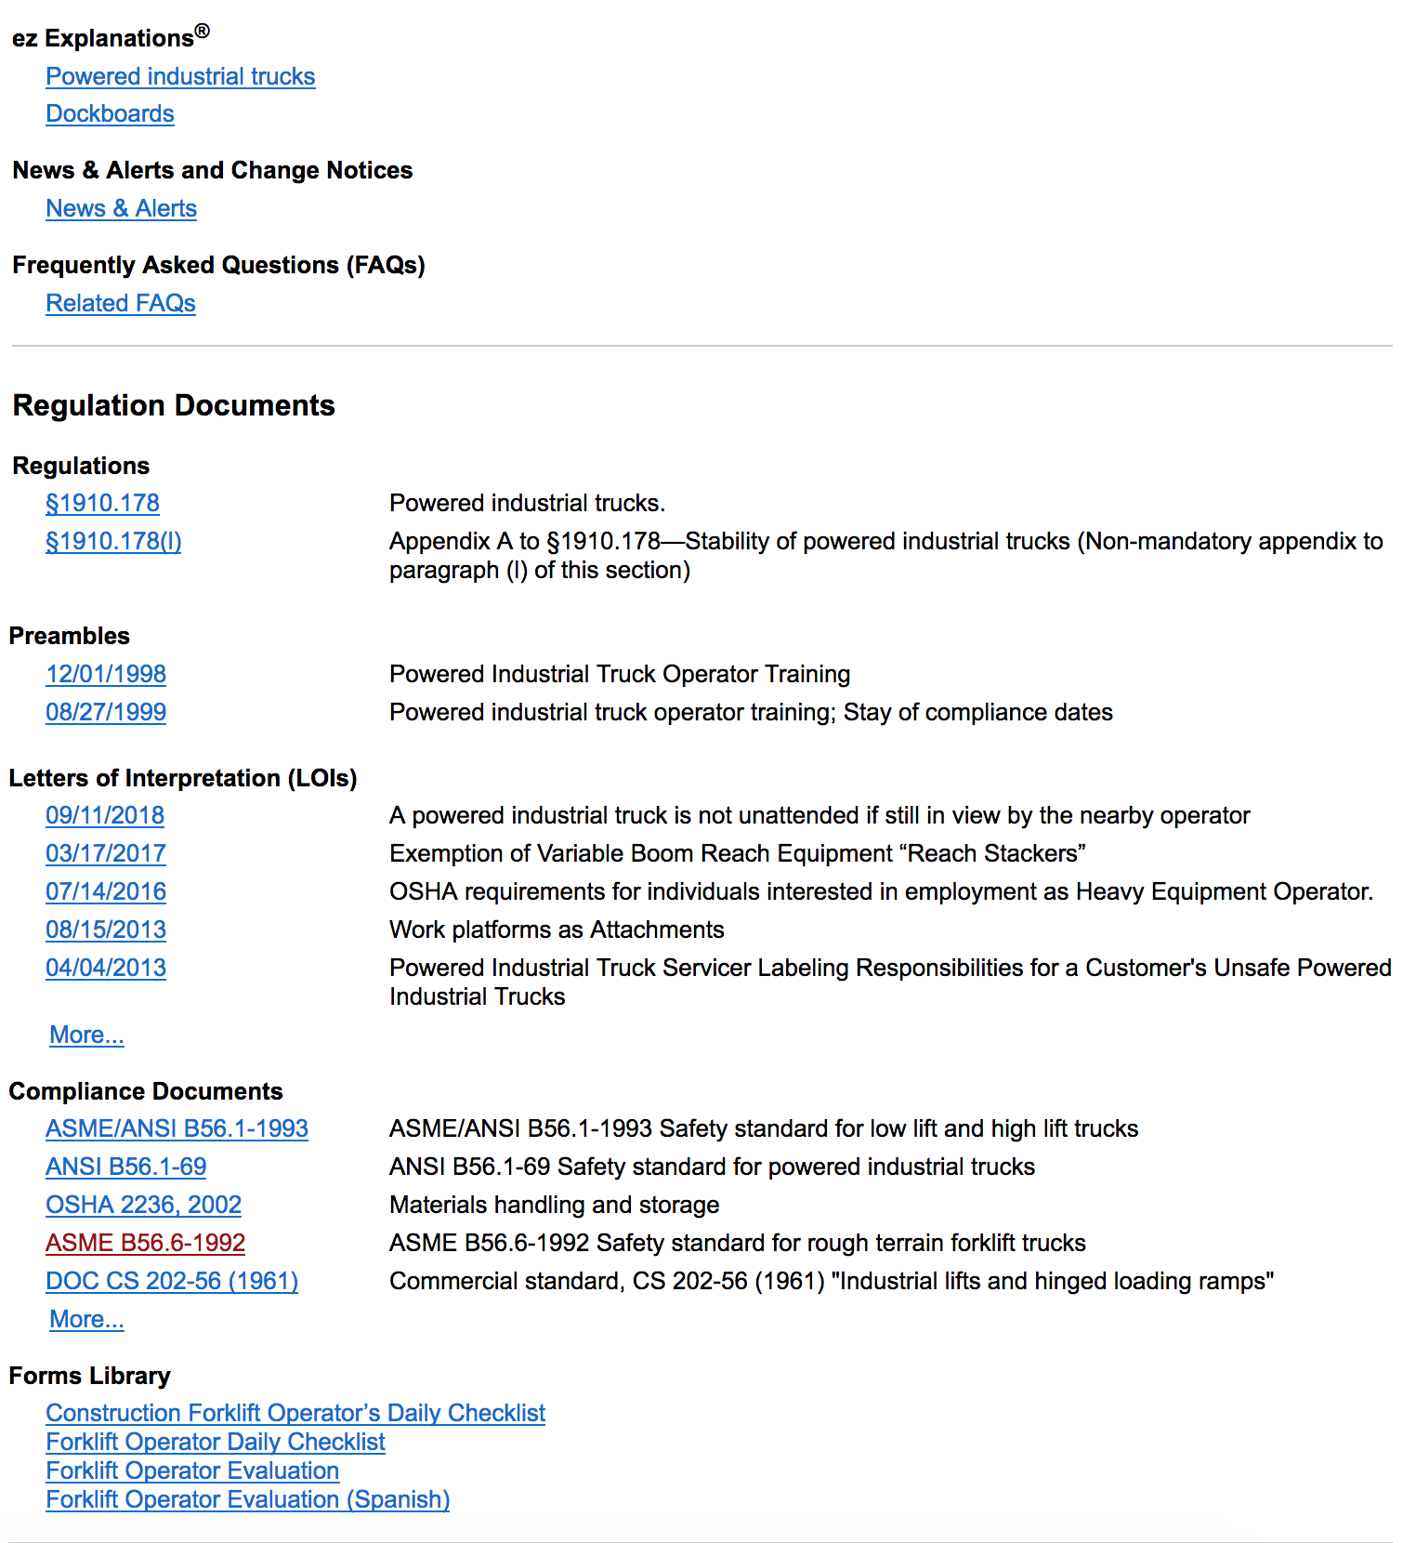

Slide 35
Table Value Parameters
Set Based (Again)
Select number of entities then operate on them
Can replace SQLBulkCopy for smaller workloads
Works well with Merge

Slide 36
DECLARE @pos int,
@tmpval varchar(8000)
SET @pos = charindex(@delimiter, @list)
WHILE @pos > 0
BEGIN
SET @tmpval = left(@list, charindex(@delimiter, @list) - 1)
INSERT @tbl ([str]) VALUES(@tmpval)
SET @list = substring(@list, @pos + 1, len(@list))
SET @pos = charindex(@delimiter, @list)
END
INSERT @tbl ([str]) VALUES(@list)
RETURN
Notes:
Previous incarnations of this concept. Custom Table builder.
1 column only

Slide 37
DECLARE @XML XML
SET @xml = N'<root><r>' + REPLACE(@list, @delimiter, '</r><r>') + '</r></root>'
INSERT INTO @tbl(RecordInt)
SELECT DISTINCT r.value('.','INT') AS Item
FROM @xml.nodes('//root/r') AS RECORDS(r)
RETURN
Notes:
Newer fancier version. Still 1 column. Can be expanded to pass in XML instead of comma delimited.

Slide 38
CREATE TYPE [dbo].[GuidList] AS TABLE(
[Id] [uniqueidentifier] NULL
)
GO
Notes:
Can add more columns, much easier

Slide 39
create proc TerminateEmployees
@EmployeeList dbo.GuidList readonly,
@terminationDate date
as
update e
set
e.IsTerminated = 1,
e.TerminationDate = @terminationDate
from
dbo.Employee e
join @EmployeeList l
on e.Id = l.Id

Slide 40
Common Table expression (CTE)
Summary Totals
Cleaner Top level Filter/Where
Prevents multiple over the wire queries
Notes:
Tomorrow’s talk

Slide 41
External Processes
Is Processed Fields
Remove from Queue or Outbox Table
Get / Create Data outside of application.
Notes:
Tomorrow’s talk

Slide 42
JSON
Admittingly SQL Server’s is not great
Postgres If wanted full capabilities
Still viable in SQL Server

Slide 43
Why not use NoSql
Transactions – Your mileage may vary
Money
Not enough data
Another Backup to manage
Potentially complicates client code

Slide 44
JSON In Sql SErver
Basic. I’m not looking to use all features.
3 Storage Scenarios
1Read Scenario - Maybe

Slide 45
Full Document Storage
Not queryable beyond Id or intentional fields
Needed, but “useless”
Example: Custom Settings

Slide 46
One to One
Avoid New Table
Avoid continuous New Columns
Example: Driver Log is a Mobile Log

Slide 47
One to Many
Parent Matters
Children don’t
Example: Drivers Log with Log Events

Slide 48
Many to Many
Matters in DB Design
Doesn’t matter in Application
Example: Students Classes
Notes:
Types of News. Workplace, Transport, HR, Construction

Slide 49
For JSON
Use For JSON to format query results as a string
Have API return the string as is, without mapping to object
I’ve only thought about this, haven’t used in production

Slide 50
Summary
ORMS are great for single object actions
SQL Still rules for Set and Bulk based operations
Mixing and Matching is probably the best solution
Simple JSON features keep everything together

Slide 51
Thank You

Slide 52


