Slide 1
Grpc on .NET – Beyond Greeter.SayHello
No rest bashing, or convincing you to use grpc

Slide 2


Slide 3


Slide 4
Allen Zaudtke
Architect at J. J. Keller & Associates, Inc.
@alzaudtke
https://github.com/zaudtke

Slide 5
This is not
An explanation of gRPC
Convincing you gRPC is better
Answer your questions on Hosting
Notes:
The web does a good job of explaining what gRPC is, and the various capabilities

Slide 6
So, what will be covered?
Scalar Values and Nullables
Dates and Times – They still suck
Returning Errors
Testing

Slide 7
Some Background Context
Personal Preference
Must conform to existing Api patterns
Must conform to existing testing expectations
Mostly flat objects

Slide 8
Scalar – First thing
No Guid
Use a string or build a type
I opted for string

Slide 9
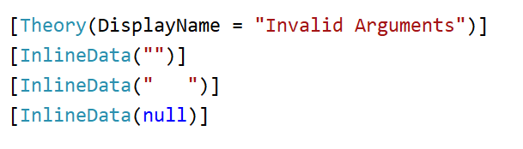
Scalar – Huh?
This threw an Exception

Slide 10
Ms docs
Scalar values always have a default value and can't be set to null. This constraint includes string and ByteString which are C# classes. string defaults to an empty string value and ByteString defaults to an empty bytes value. Attempting to set them to null throws an error.
Nullable wrapper types can be used to support null values.

Slide 11
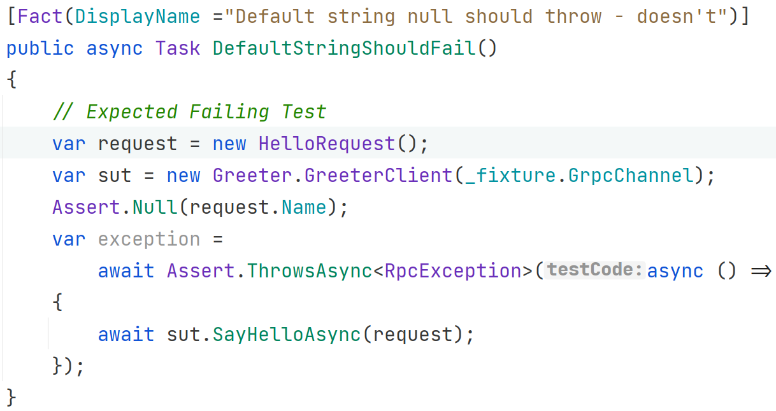
Confusion

Slide 12
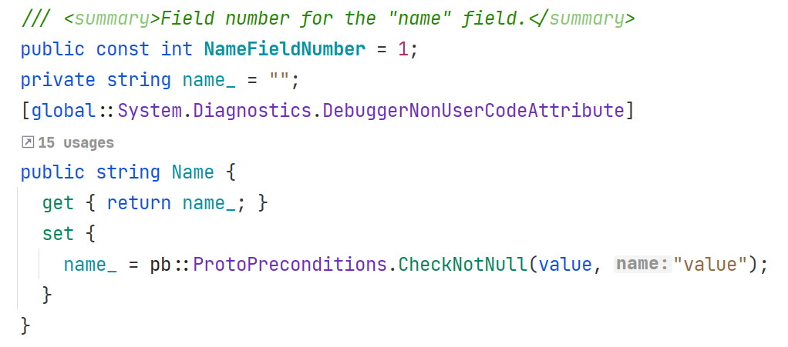
Generated Code

Slide 13
Ms docs
Scalar values always have a default value and can't be set to null. This constraint includes string and ByteString which are C# classes. string defaults to an empty string value and ByteString defaults to an empty bytes value. Attempting to set them to null throws an error.
Nullable wrapper types can be used to support null values.

Slide 14
Empty Strings
Empty strings no nulls, sign me up
Database – I can work around it

Slide 15
Defaults don’t always work
Age = 0
ExpectedSalary = 0
AgreeToTerms = false (added after launch)
StateId = “” (foreign key)
DepartmentId = 0 (foreign key)

Slide 16
First thought was a bad idea
Use oneof for nullable fields
Use google.protobuf.Empty
Lot of work

Slide 17
Ms docs
Scalar values always have a default value and can't be set to null. This constraint includes string and ByteString which are C# classes. string defaults to an empty string value and ByteString defaults to an empty bytes value. Attempting to set them to null throws an error.
Nullable wrapper types can be used to support null values.

Slide 18
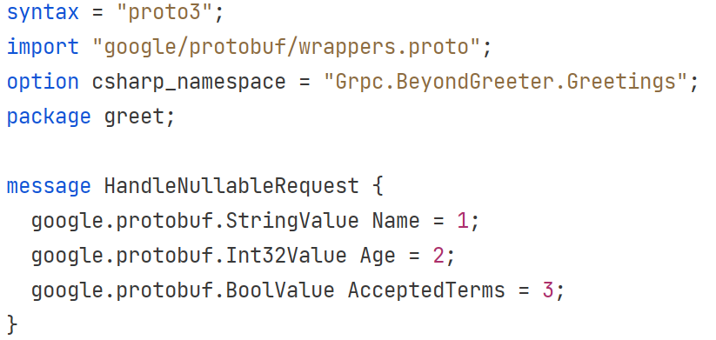
Wrappers.proto

Slide 19
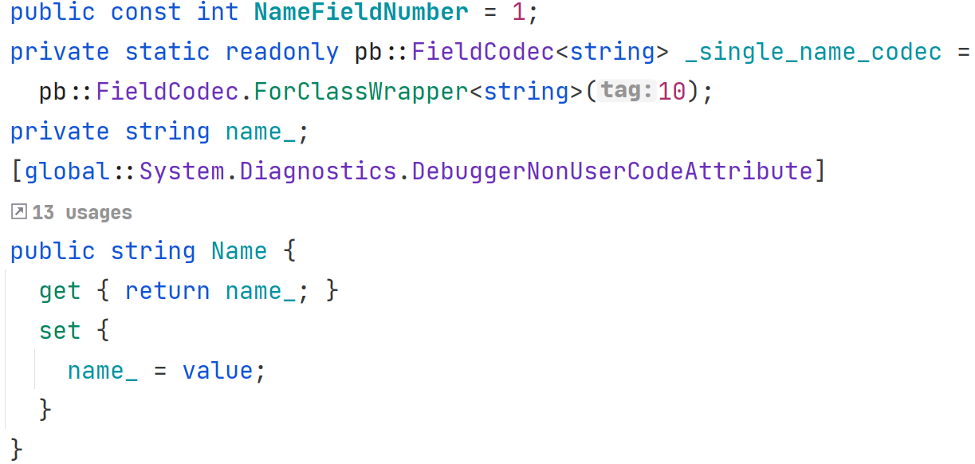
Nullable String

Slide 20
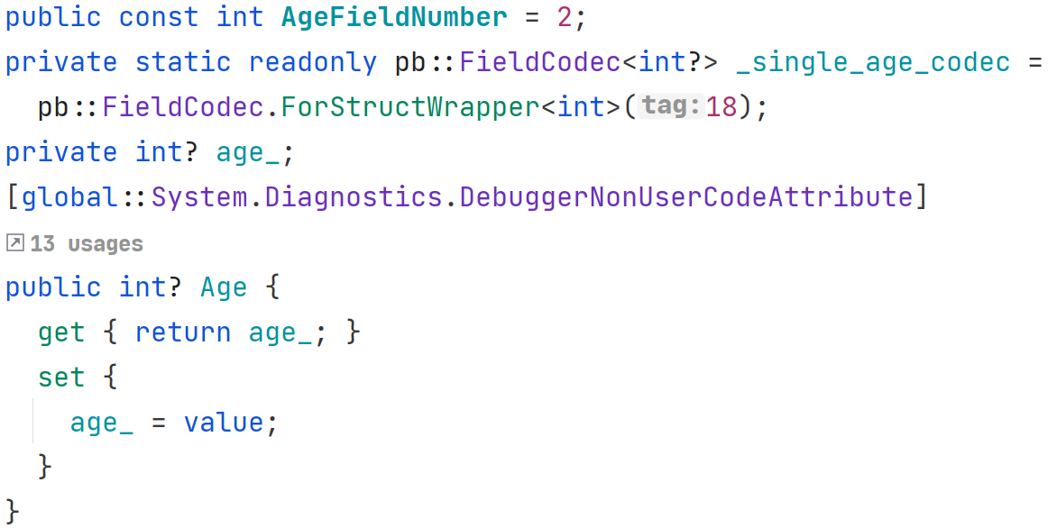
Nullable Int

Slide 21
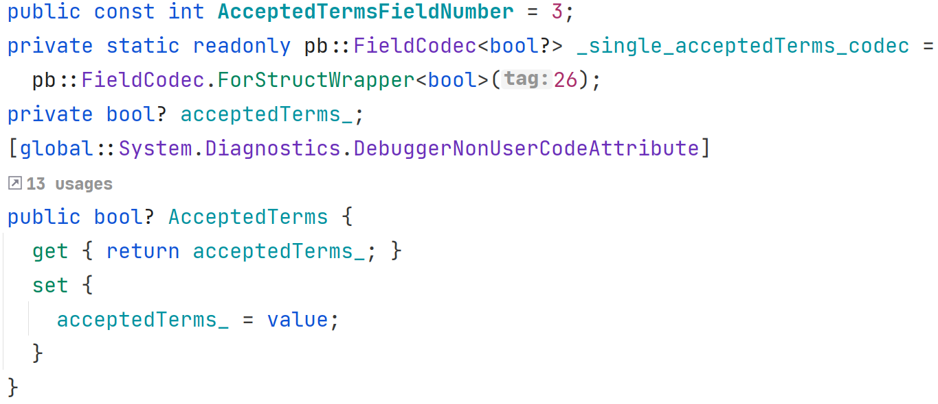
Nullable Bool

Slide 22
Sidebar
Optional in Protobuf 2
Removed in Protobuf 3
Brought back in Protobuf 3.15

Slide 23
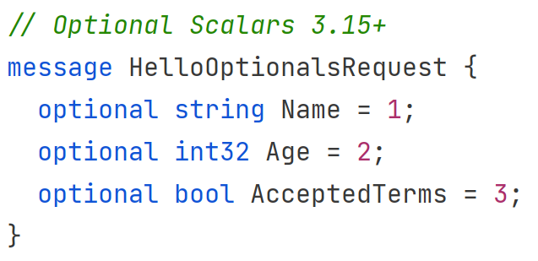
Optional

Slide 24
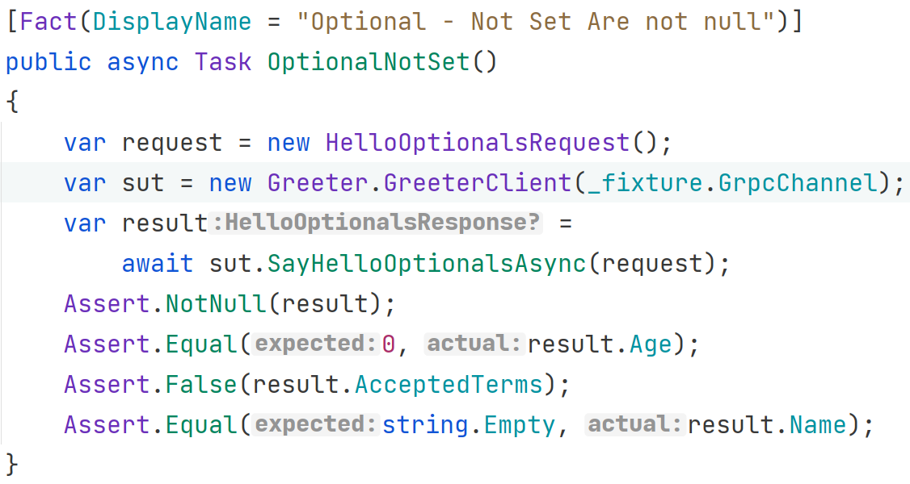
Optional Doesn’t mean Null

Slide 25
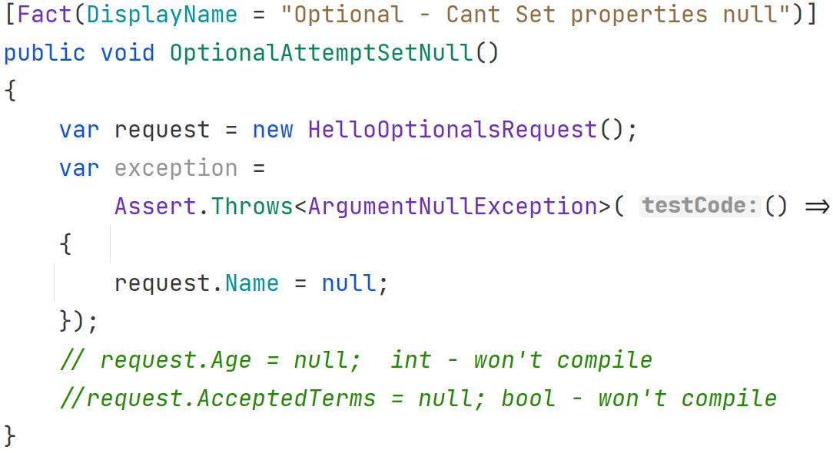
Optional – Can’t set null

Slide 26
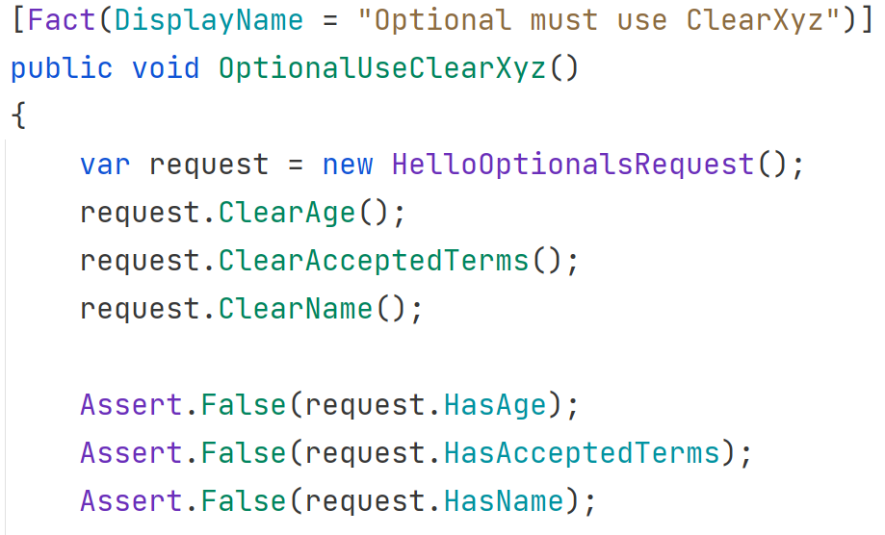
Optional Clear and Has

Slide 27
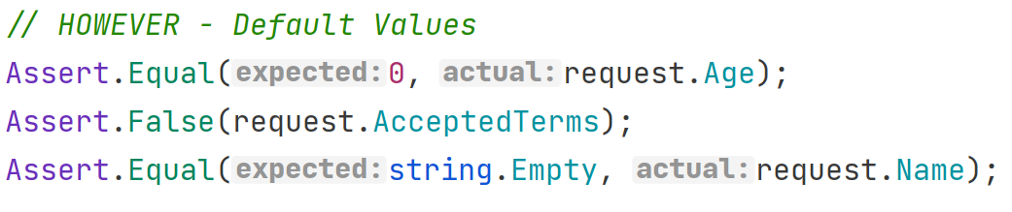
Optional - However

Slide 28
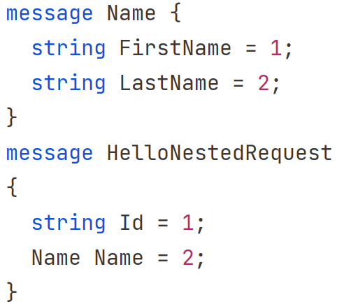
Nested Messages

Slide 29
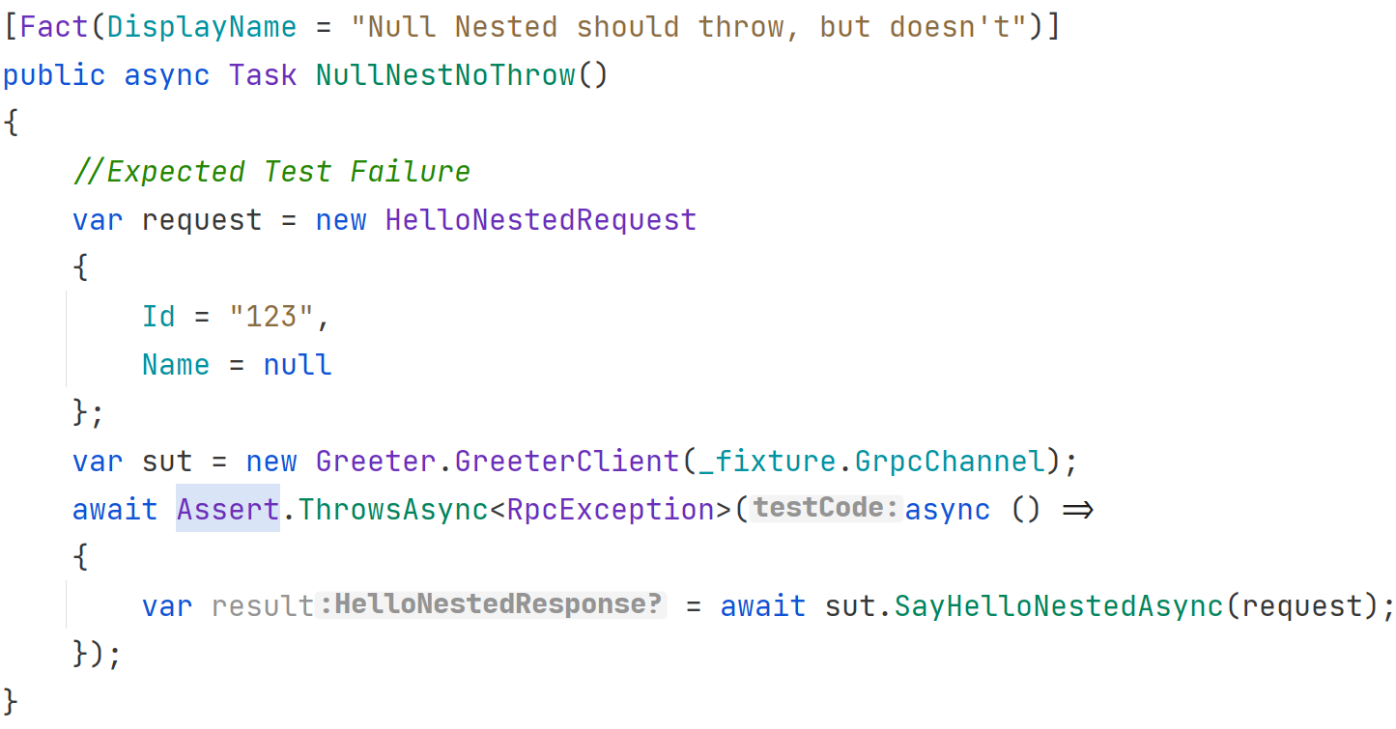
More Failing Tests

Slide 30
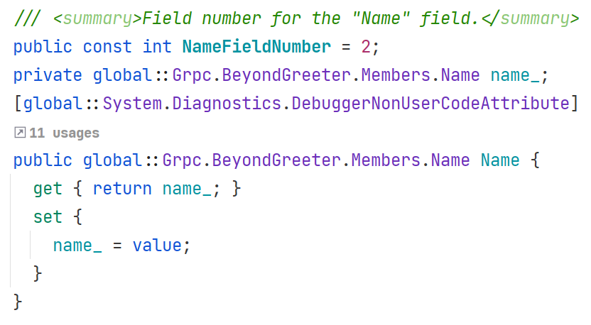
Nested Objects can be null

Slide 31
Nested objects
Scalar Rules still apply
I Avoid them if I can

Slide 32
Date and Time
Not in Protobuf
Well-Known Type
Type aka Lesser-Known Type

Slide 33
Well-Known Type
import “google/protobuf./timestamp.proto”
import “google/protobuf/duration.proto”
Timestamp is only UTC
.NET Type | Protobuf Well-Known Type
DateTimeOffset | google.protobuf.Timestamp
DateTime | google.protobuf.Timestamp
TimeSpan | google.protobuf.Duration

Slide 34
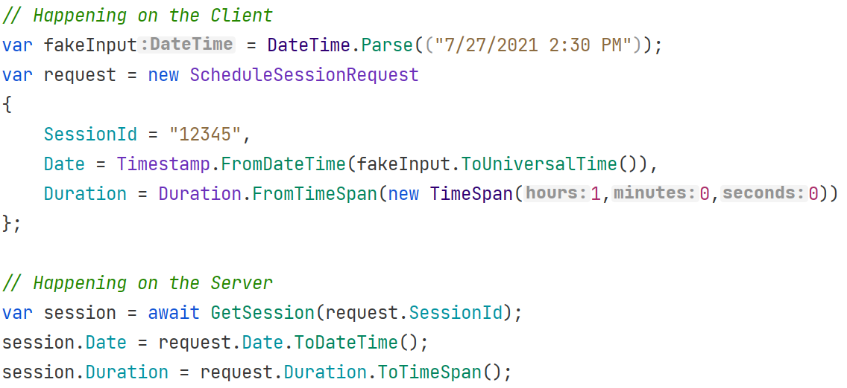
Client and Server

Slide 35
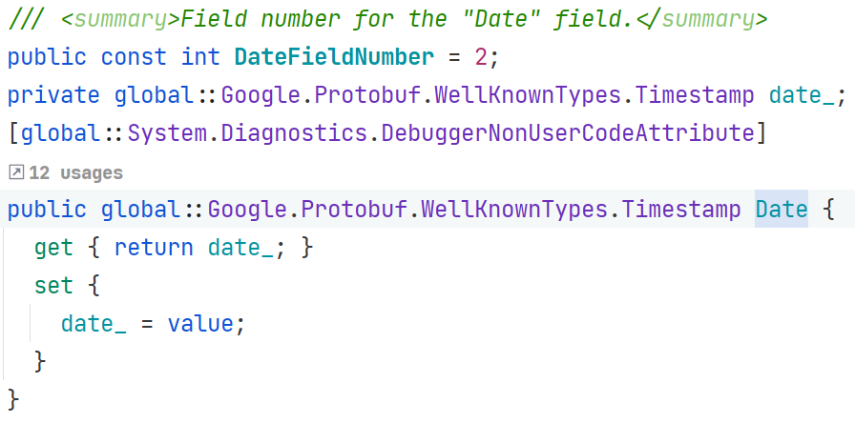
Timestamp – Can be Null

Slide 36
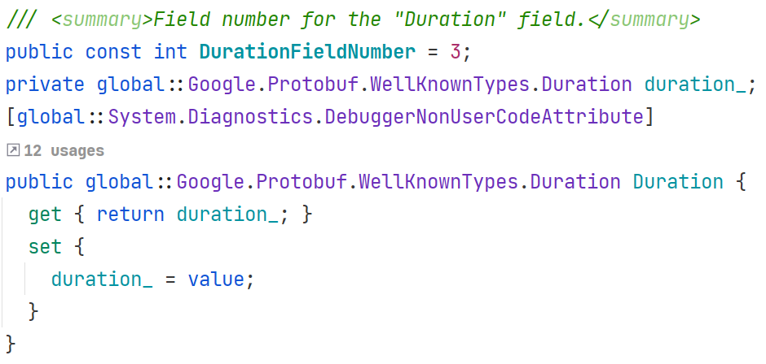
Duration – Can be Null

Slide 37
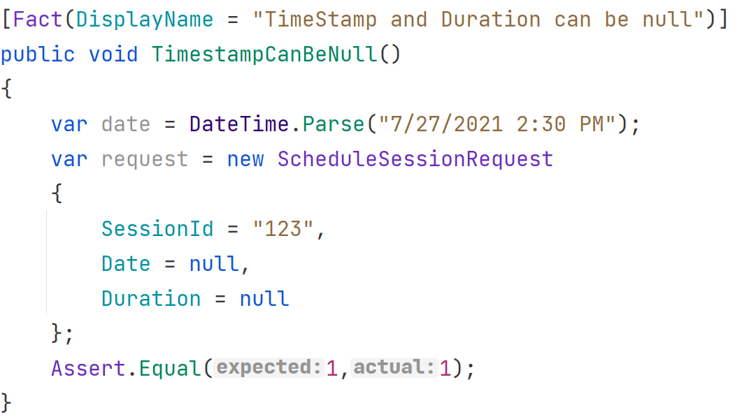
Null Tests

Slide 38
When UTC is helpful
Session Time displayed in browser
Manually need to handle Time Zone
Instance in Time aka Date and Time Together

Slide 39
When UTC Gets in the way
Time doesn’t matter: Birthdate, Hire Date, etc.
Date doesn’t matter: Store Hours, Recurring Dates (alarms, meetings)
Overhead of thinking about it
Notes:
.Date in C#

Slide 40
Google Types “Lesser Known”
date.proto
timeofday.proto
Must copy locally – Almost equivalent to Build Your Own

Slide 41
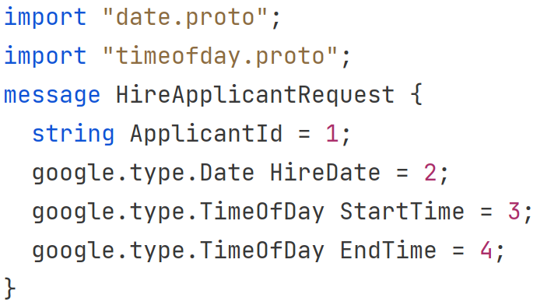
Protobuf

Slide 42
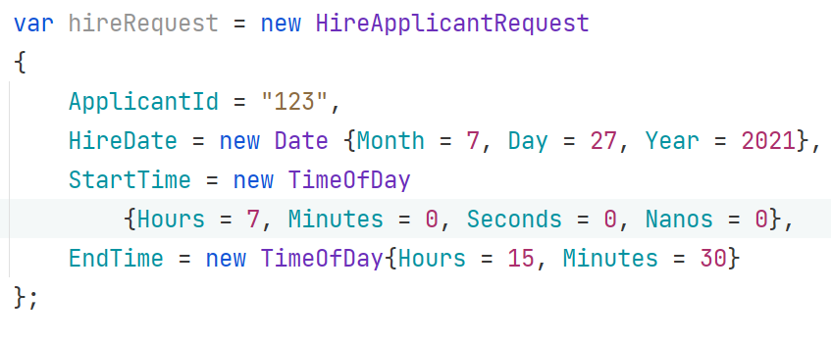
C#
Notes:
No Helper functions

Slide 43
Coming soon
https://devblogs.microsoft.com/dotnet/date-time-and-time-zone-enhancements-in-net-6/
The DateOnly type is a structure that is intended to represent only a date. In other words, just a year, month, and day. Here’s a brief example:
We also get a new TimeOnly type, which is a structure that is intended to represent only a time of day. If DateOnly is one half of a DateTime, then TimeOnly is the other half. Here’s a brief example:

Slide 44
Returning Errors
RPC Exceptions, Status, and Trailers
Custom Return Type
“Richer” Error Model – Not available in .NET at this time
Code Demo

Slide 45
Testing
Code Demo

Slide 46
Summary
Lot of time on messages and data
Breaking away from DateTime together
Returning Errors
Testing

Slide 47


Slide 48
Resources
Thank You
https://github.com/zaudtke

