Slide 1
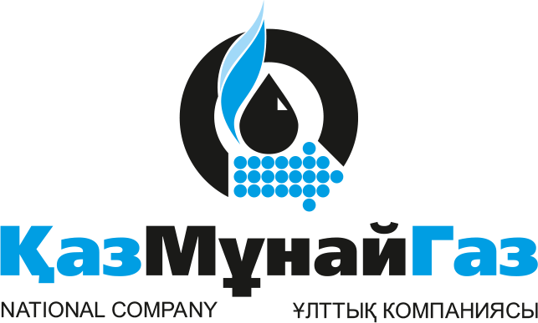
SWOT
Zaure Nurlan IT-1902

Slide 2
National Company "KazMunayGas"
Kazakhstan's national operator for exploration, production, refining and transportation of hydrocarbons, representing the state in Kazakhstan's petroleum sector. Its trunklines are used to transport 56% of Kazakhstan's oil and 79% of gas.
The Group of JSC “National Company “KazMunayGas”, founded in 2002, includes over 180 entities.

Slide 3



STRENGHTS
Available in 3 languages.
Simple and user-friendly interface
Transparency
Leading positions in oil and gas transportation
Integration into international projects
Significant foreign currency earnings
High customer satisfaction with product quality
Number of gas stations in Kazakhstan
Rate from the survey: 4/5

Slide 4
WEAKNESSES
Customer awareness of existence of the website
Target is not based on customers
Strategy of rivals
Raw materials’ processing
Satisfaction with service quality

Slide 5
OPPORTUNITIES
KMG team vacancy
Operator/AI operator
Processing of oil
Expand market
Bonus programs
Hire more workers in big cities
IT technologies
Examination of product quality

Slide 6
THREATS
Abundance of information
depletion of oil and gas available reserves
environmental degradation
Competitors attract customers with bonus programs

Slide 7
SUMMARY
KMG is a gas and oil transportation leader in Kazakhstan. This company provides consumers with high quality product. However, website or marketing doesn’t focus on advertising local gas station in order to attract more people. KMG has a variety of the competitors, but it can take advantage of processing hydrocarbons and make astonishing progress for its company and Kazakhstan’s market. Therefore, KMG should find way to prevent ecological issues.

Slide 8
RECOMMENDATIONS
KMG became national leader. However, it needs to focus more on processing oil in order to reach cutting edge in this industry. Also, it should change targeting of its advertisement to expand market coverage. Moreover, oil and gas resources are not infinite. That is why KMG should develop future strategy (energy from sun, wind, etc.) to prevent bankruptcy even in its heyday.

Slide 9
Literature
National Company "KazMunayGas". (n.d.). Retrieved June 09, 2020, from https://www.kmg.kz/eng/
Life Sci J 2013;10(11s):189-192] (ISSN:1097-8135). http://www.lifesciencesite.com. 32 (http://www.lifesciencesite.com/lsj/life1011s/)
Also, I’ve made survey in order to get a view of consumers.

Slide 10
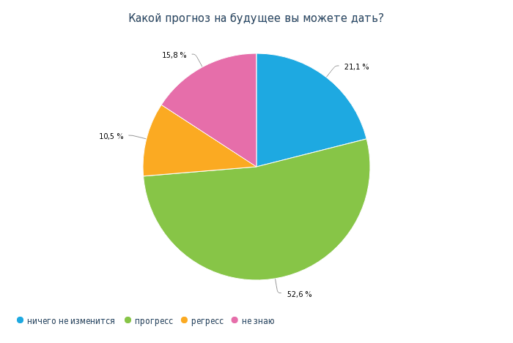
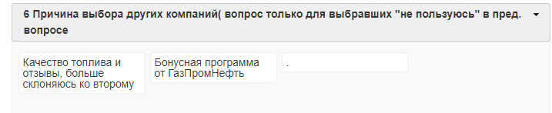
THANK YOU!

