Slide 1
SQL Development. DML Statements.

Slide 2
This Lecture
More SQL
INSERT, UPDATE, and DELETE
The Information Schema
Further Reading
Database Systems, Connolly and Begg, Chapter 6.
10

Slide 3
INSERT, UPDATE, DELETE
INSERT - add a row to
a table
UPDATE - change
row(s) in a table
DELETE - remove row(s) from a table
UPDATE and DELETE should make use of ‘WHERE clauses’ to
specify which rows to
change or remove
BE CAREFUL with these
- an incorrect or absent WHERE clause can destroy lots of data

Slide 4
INSERT
Inserts rows into the database with the specified values
INSERT INTO
table-name
The number of columns and the number of values must be the same
If you are adding a value to every column, you don’t have to list them
If you don’t list columns, be careful of the ordering
(col1, VALUES
(val1,
col2, …)
val2, …);

Slide 5
INSERT
INSERT INTO Employee (ID, Name, Salary) VALUES
(2, ‘Mary’, 26000);
Employee
INSERT INTO Employee (Name, ID)
VALUES (‘Mary’, 2);
INSERT INTO Employee VALUES
(2, ‘Mary’, 26000);
ID | Name | Salary
1 | John | 25000

Slide 6
INSERT
Employee
INSERT INTO Employee (ID, Name, Salary) VALUES
(2, ‘Mary’, 26000);
ID | Name | Salary
1 | John | 25000
2 | Mary | 26000
Employee
Employee
ID | Name | Salary
1 | John | 25000
INSERT INTO Employee (Name, ID)
VALUES (‘Mary’, 2);
ID | Name | Salary
1 | John | 25000
2 | Mary
INSERT INTO Employee VALUES
(2, ‘Mary’, 26000);
Employee
ID | Name | Salary
1 | John | 25000
2 | Mary | 26000

Slide 7
UPDATE
Changes values in specified rows based on WHERE conditions
All rows where the condition is true have the columns set to the given values
If no condition is given all rows are changed so BE CAREFUL
Values are constants or can be computed from columns
UPDATE
table-name
SET col1 [,col2
[WHERE
= val1
= val2…]
condition]

Slide 8
UPDATE
UPDATE Employee
SET Salary
Name =
WHERE ID =
= 15000,
‘Jane’
4
Employee
ID | Name | Salary
1 | John | 25000
2 | Mary | 26000
3 | Mark | 18000
4 | Anne | 22000
UPDATE Employee SET Salary =
Salary *
1.05

Slide 9
UPDATE
UPDATE Employee
SET Salary
Name =
WHERE ID =
= 15000,
‘Jane’
4;
Employee
ID | Name | Salary
1 | John | 25000
2 | Mary | 26000
3 | Mark | 18000
4 | Anne | 22000
UPDATE Employee SET Salary =
Salary *
1.05;

Slide 10
UPDATE
Employee
ID | Name | Salary
1 | John | 25000
2 | Mary | 26000
3 | Mark | 18000
4 | Jane | 15000
UPDATE Employee
SET Salary
Name =
WHERE ID =
= 15000,
‘Jane’
4;
Employee
ID | Name | Salary
1 | John | 25000
2 | Mary | 26000
3 | Mark | 18000
4 | Anne | 22000
Employee
ID | Name | Salary
1 | John | 26250
2 | Mary | 27300
3 | Mark | 18900
4 | Anne | 23100
UPDATE Employee SET Salary =
Salary *
1.05;

Slide 11
DELETE
Removes all rows, or those
which satisfy a condition
DELETE FROM
table-name [WHERE
condition]
If no condition is given then ALL rows are deleted - BE CAREFUL
You might also use TRUNCATE TABLE which is like DELETE FROM without a WHERE but is often quicker

Slide 12
DELETE
DELETE FROM
Employee
WHERE
Salary > 20000;
Employee
ID | Name | Salary
1 | John | 25000
2 | Mary | 26000
3 | Mark | 18000
4 | Jane | 15000
DELETE FROM Employee;
Or
TRUNCATE TABLE
Employee;

Slide 13
DELETE
Employee
ID | Name | Salary
3 | Mark | 18000
4 | Jane | 15000
DELETE FROM
Employee
WHERE
Salary > 20000;
Employee
ID | Name | Salary
1 | John | 25000
2 | Mary | 26000
3 | Mark | 18000
4 | Jane | 15000
DELETE FROM Employee;
Or
TRUNCATE TABLE
Employee;
Employee
ID | Name | Salary

Slide 14
SQL SELECT
SELECT is the type of query you will use most
often.
Queries one or more tables and returns the result as a table
Lots of options, which will be covered over the
next few lectures
Usually queries can be achieved in a number of ways

Slide 15
Simple SELECT
columns can be
A single column
A comma-separated list
of columns
* for ‘all columns’
SELECT
FROM
columns
table-name;

Slide 16
Sample SELECTs
SELECT
* FROM
Student;
Student
sID | sName | sAddress | sYear
1 | Smith | 5 Arnold Close | 2
2 | Brooks | 7 Holly Avenue | 2
3 | Anderson | 15 Main Street | 3
4 | Evans | Flat 1a, High Street | 2
5 | Harrison | Newark Hall | 1
6 | Jones | Southwell Hall | 1

Slide 17
Sample SELECTs
SELECT
sName
FROM
Student;
50

Slide 18
Sample SELECTs
SELECT
sName
FROM
Student;
sName
Smith
Brooks
Anderson
Evans
Harrison
Jones

Slide 19
Sample SELECTs
SELECT
FROM
sName, sAddress
Student;

Slide 20
Sample SELECTs
SELECT
FROM
sName, sAddress
Student;
sName | sAddress
Smith | 5 Arnold Close
Brooks | 7 Holly Avenue
Anderson | 15 Main Street
Evans | Flat 1a, High Street
Harrison | Newark Hall
Jones | Southwell Hall

Slide 21
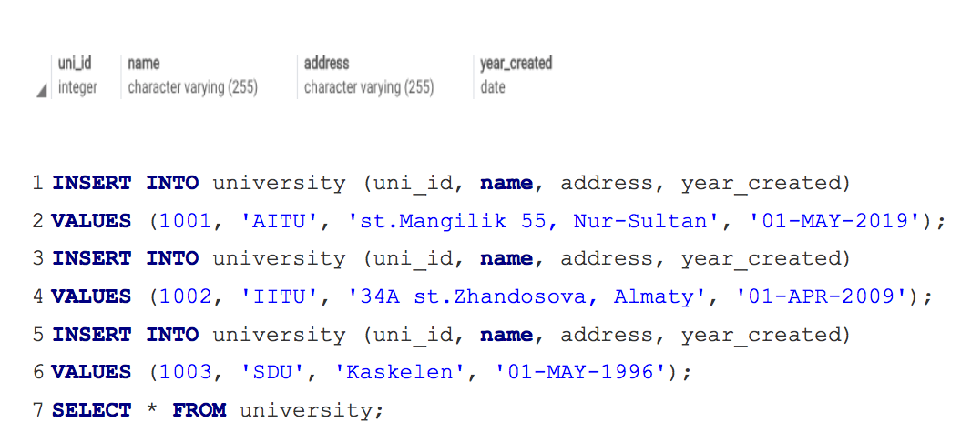
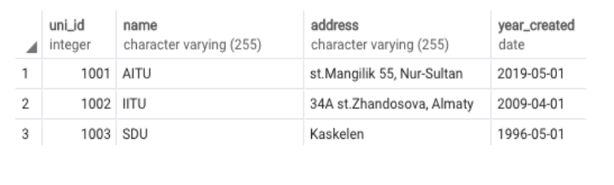
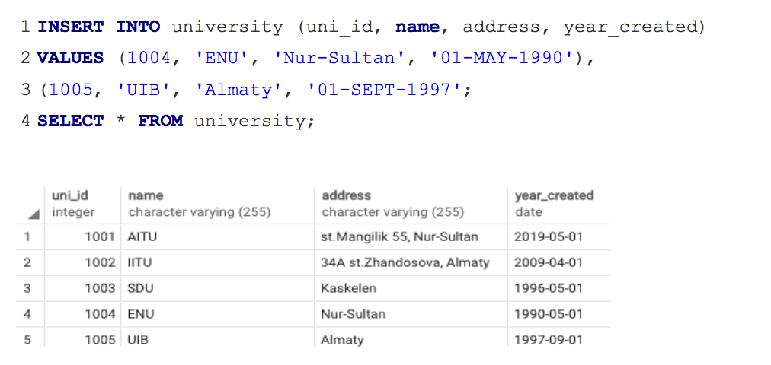
Example

Slide 22
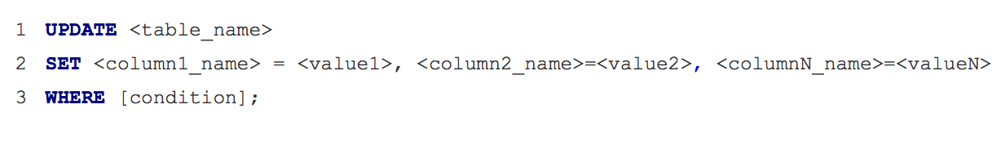
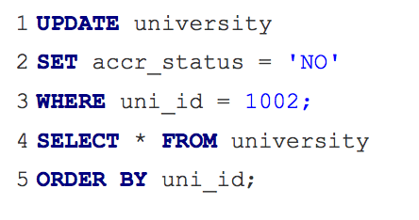
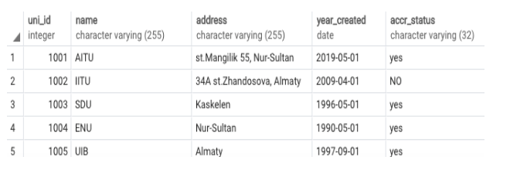
Example

Slide 23
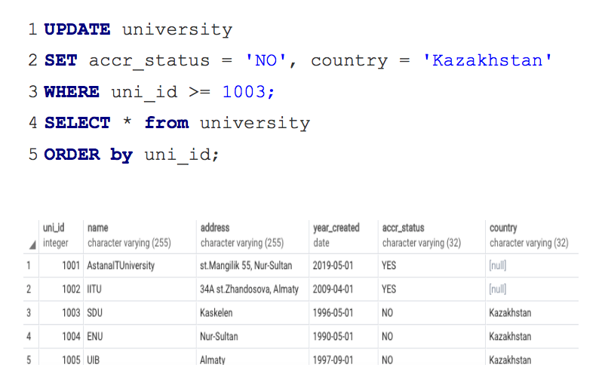
Example

Slide 24
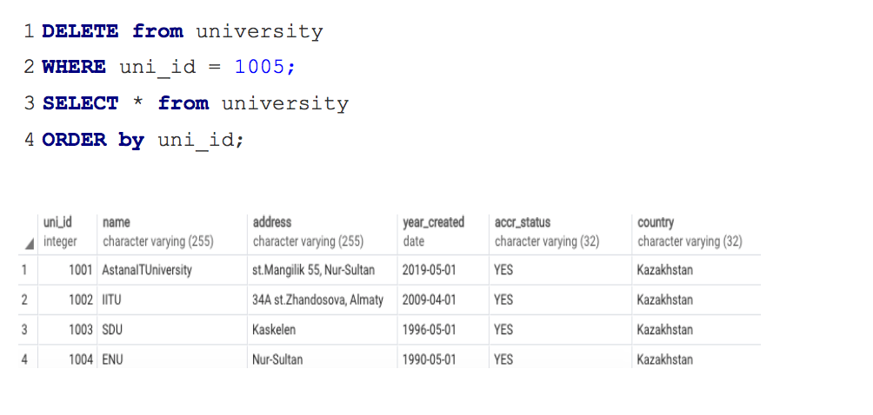
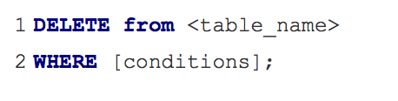
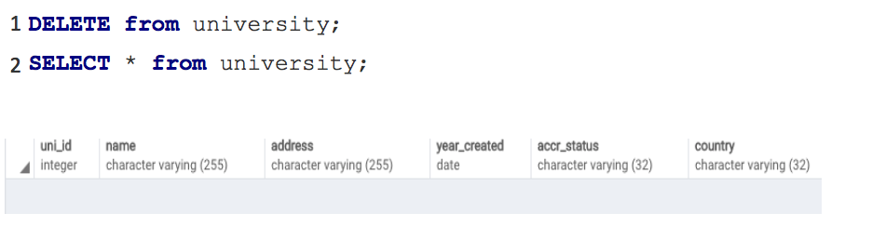
Example

Slide 25
Thank you for your attention!

