Slide 1
SQL Data Definition

Slide 2
This Lecture
SQL
The SQL language
SQL, the relational model, and E/R diagrams
CREATE TABLE
Columns
Primary Keys
Foreign Keys
Further Reading
Database Systems, Connolly & Begg, Chapter 7.3

Slide 3
Learning Outcomes
Introduce the SQL language and its basic
commands to create database tables
Understand how terminology and keywords change throughout the different topics covered in the module
Familiarise with SQL terms and practice elementary queries

Slide 4
Last Lecture
Entity Relationship
Diagrams
Entities
Attributes
Relationships
Example
Students take many Modules
Modules will be taken by
many Students
Student
Takes
Module

Slide 5
Removing M:N Relationships
Many to many relationships are difficult to represent in a database
We can split a many to many relationship into two one to many relationships
An additional entity is created to represent the M:N relationship
Student
Student
Has
Takes
Enrolment
In
Module
Module

Slide 6
Last Lecture
sName
sNum
sID
Student
sYear
Entity Relationship
Diagrams (ERD)
Entities
Attributes
Relationships
Primary keys (PKs)
PKs are underlined attributes in ERD
Has
sID
Enrolment
mCode
In
mCode
Module
mCredits
mTitle

Slide 7
SQL
SQL is a language based on the relational model
Actual implementation is provided by a DBMS
SQL is everywhere
Most companies use it for
data storage
All of us use it dozens of times per day
You will be expected to know it as a software developer
SQL provides
A Data Definition Language (DDL)
A Data Manipulation Language (DML)
A Data Control Language
(DCL)

Slide 8
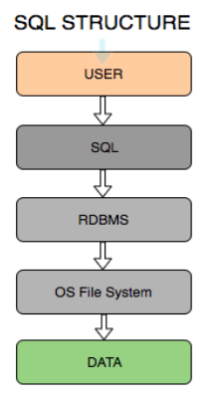
SQL- Structured Query Language
- Query language for Relational Database.
- It runs as an interpreter not a database system.
- SQL takes calls from the user or a program and turns them into actions.
- Those actions involve "calling" an RDBMS with database commands.

Slide 9
Provided Languages
Data Definition Language (DDL)
Specify database format
Data Manipulation Language (DML)
Specify and retrieve database contents
Data Control Language (DCL)
Specify access controls (privileges)
Which are often all one piece of software
E.g. SQL

Slide 10
DDL
DDL – is used to define database objects.
- Create Table – Create a new Table in database.
- Alter Table – Changes at existing table(s).
- Drop Table – Removes Table from database.
Other DDL: View, Index, Trigger, Procedure, Function and etc.

Slide 11
Database Management Systems
A DBMS is a software system responsible for allowing users access to data
A DBMS will usually
Allow the user to access data using SQL
Allow connections from other programming languages
Provide additional functionality like concurrency
There are many DBMSs, some popular ones include:
Oracle
DB2
Microsoft SQL Server
Ingres
PostgreSQL
MySQL
Microsoft Access (with SQL
Server as storage engine)
Notes:
DBMS- access

Slide 12
SQL Case
SQL statements will be written in BOLD
•
COURIER FONT
SQL keywords are not case-sensitive, but we’ll write SQL
keywords in upper case for emphasis
Table names, column names etc. are case sensitive
For example:
SELECT
* FROM
Student
WHERE
sName
= 'James';

Slide 13
SQL Strings
Strings in SQL are surrounded by single quotes:
'I AM A STRING'
Single quotes within a string are doubled or escaped using \
• 'I''M
• 'I\'M
A STRING' A STRING'
'' is an empty string
In MySQL, double quotes also work (this isn’t the
ANSI standard)

Slide 14
Non-Procedural Programming
SQL is a declarative (non-procedural) language
Procedural – tell the computer what to do using specific successive instructions
Non-procedural – describe the required result (not the way to compute it)
Example: Given a
database with tables
Student with attributes sID, sName
Module with attributes
mCode, mTitle
Enrolment with attributes sID, mCode
Get a list of students who take the module ‘Database Systems’

Slide 15
Example
Find the instance of Module with the title ‘Database Systems’
Find instances of the Enrolment entity with the same Code as the result of (1)
For each instance of Enrolment in the result of (2) find the corresponding student
sID
Student
sName
Has
sID
Enrolment
mCode
In
mCode
Module
mTitle

Slide 16
Procedural Programming
Set M to be | the | first | Module Record | /* | Find module code for | */
Code = '' |  |  |  | /* | 'Database Systems' | */
While (M is | not | null) | and (Code = '')
If (M.Title = 'Database Systems') Then Code = M.Code
Set M to be the next Module Record Set NAMES to be empty
Set S to be the first Student Record
/* A list of student names */
While S is not Set E to be While E is If (E.ID
null
the first Enrolment not null
/* For each student...
*/
Record
/* For each enrolment... */
/* If this student is */
/* enrolled in DB Systems */
/* add them to the list */
= S.ID) And
= Code) Then
= NAMES + S.NAME
(E.Code
NAMES
Set E to Set S to be
Return NAMES
be the next Enrolment Record the next Student Record

Slide 17
Non-Procedural (SQL)
SELECT sName
FROM
Student,
Enrolment
WHERE
(Student.sID
AND
= Enrolment.sID)
(Enrolment.mCode =
(SELECT mCode FROM
Module WHERE
mTitle = ‘Database
Systems’));

Slide 18
Relations, Entities and Tables
The terminology changes from the Relational Model
through to SQL, but usually means the same thing

Slide 19
Relations, Entities and Tables
The terminology changes from the Relational Model
through to SQL, but usually means the same thing
Relations
E/R Diagrams
SQL
Relation | Entity | Table
Tuple | Instance | Row
Attribute | Attribute | Column or Field
Foreign Key | 1:N Relationship | Foreign Key
Primary Key | Attribute | Primary Key

Slide 20
Implementing E/R Diagrams
Name
Number
Given an E/R design
ID
Student
Year
The entities become SQL tables
Attributes of an entity become columns in the corresponding table
We can approximate the domains of the attributes by assigning types to each column
Relationships may be represented by foreign keys
Has
ID
Enrolment
Code
In
Code
Module
Credits
Title

Slide 21
CREATE DATABASE
First, we need to create a database
CREATE DATABASE database-name;

Slide 22
CREATE TABLE
table-name(
col-def-1,
col-def-2,
CREATE TABLE
col-name-1 col-name-2
You supply
A name for the table
A name and definition / type for each column
A list of constraints
(e.g. Keys)
:
col-name-n col-def-n, constraint-1,
:
constraint-k
);

Slide 23
Column Definitions
col-name
[NULL |
col-def
NOT NULL]
Each column has a
name and a type
Most of the rest of the column definition is optional
There’s more you can add, like storage and index instructions
[DEFAULT
default_value]
[NOT NULL | NULL] [AUTO_INCREMENT] [UNIQUE [KEY] | [PRIMARY] KEY]
([] optional, | or)

Slide 24
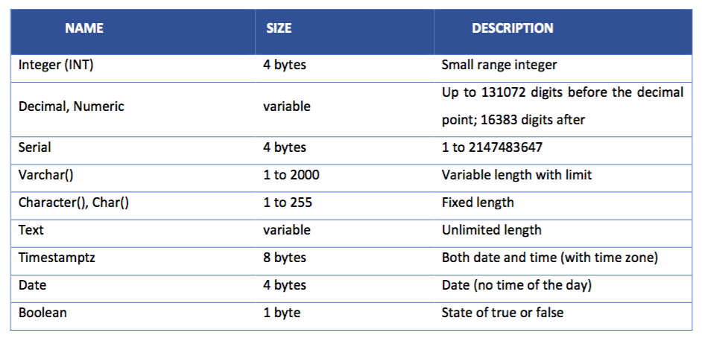
Data Types
While creating table(s) in PostgreSQL, each column must be specified by data types that identify what kind of data would be stored in that table

Slide 25
Column Definitions
Columns can be specified as NULL or NOT NULL
NOT NULL columns cannot have missing values
NULL is the default if you do not specify either
Columns can be given a
default value
You just use the keyword DEFAULT followed by the value, e.g.:
col-name INT
DEFAULT 0,

Slide 26
Example
Write the SQL statement to create a table for Student with the attributes listed below, where the sID number and the Student name cannot be null and, if not otherwise specified, students are in Year 1.
sName
sNum
sID
Student
sYear

Slide 27
Example
CREATE
sID
TABLE
Student (
NULL,
INT NOT
sName
VARCHAR(50) NOT
NULL,
sNum
INT ,
DEFAULT 1
sYear INT
);
sName
sNum
sID
Student
sYear

Slide 28
AUTO_INCREMENT
If you specify a column as AUTO_INCREMENT, a value (usually max(col) + 1) is automatically inserted when data is added.
For example:
col-name INT AUTO_INCREMENT,
When it comes to inserting values, you should use NULL, 0 or nothing to ensure you don’t override the automatic value
Note: If the table auto_increment value isn’t recalculated
during deletes, you might want to reset it using:
ALTER TABLE table-name AUTO_INCREMENT=1;

Slide 29
Example
CREATE TABLE Student ( sID INT NOT NULL,
sName VARCHAR(50) NOT NULL,
sNum INT AUTO_INCREMENT, sYear INT DEFAULT 1
);
sName
sNum
sID
Student
sYear
CREATE TABLE
...
);
Module (
mCode
Module
mCredits
Tips:
Every module has a 6 characters code (e.g. G64DBS)
Every module usually gives 10 credits
mTitle

Slide 30
Example
CREATE TABLE Student ( sID INT NOT NULL,
sName VARCHAR(50) NOT NULL,
sNum INT AUTO_INCREMENT, sYear INT DEFAULT 1
);
sName
sNum
sID
Student
sYear
CREATE TABLE Module ( mCode CHAR(6) NOT NULL,
mCode
Module
mCredits
mCredits TINYINT NOT NULL DEFAULT 10,
mTitle VARCHAR(100) NOT
NULL
mTitle
);

Slide 31
Constraints
CONSTRAINT
name
type details
PostgreSQLConstraints
PRIMARY KEY
UNIQUE
FOREIGN KEY
INDEX
Each constraint is given a name. If you don’t specify a name, one will be generated
Constraints which refer to single columns can be included in their definition

Slide 32
Primary Keys
A primary key for each table is defined through a constraint
PRIMARY KEY also automatically adds UNIQUE and NOT NULL to the relevant column definition
The details for the Primary Key constraint are the set of relevant columns
CONSTRAINT
name
PRIMARY KEY
(col1,
col2, …)

Slide 33
Unique Constraints / CKs
As well as a single
primary key, any set of columns can be specified as UNIQUE
This has the effect of making candidate keys in the table
The details for a unique constraint are a list of columns which make up the candidate key (CK)
CONSTRAINT UNIQUE
name
(col1, col2, …)

Slide 34
Example
CREATE TABLE Student (
sID INT PRIMARY KEY,
sName VARCHAR(50) NOT NULL,
sNum INT AUTO_INCREMENT,
sYear INT DEFAULT 1
);
sName
sNum
sID
Student
sYear
CREATE TABLE Module (
mCode CHAR(6) NOT NULL,
mCode
Module
mCredits
mCredits TINYINT NOT NULL DEFAULT 10,
mTitle VARCHAR(100) NOT
NULL,
... ADD PRIMARY KEY
mTitle
);

Slide 35
Example
CREATE TABLE Student (
sID INT PRIMARY KEY,
sName VARCHAR(50) NOT NULL,
sNum INT AUTO_INCREMENT, sYear INT DEFAULT 1
);
sName
sNum
sID
Student
sYear
CREATE TABLE Module (
mCode CHAR(6) NOT NULL,
mCode
Module
mCredits
mCredits TINYINT NOT NULL DEFAULT 10,
mTitle VARCHAR(100) NOT NULL,
CONSTRAINT mod_pk PRIMARY KEY (mCode)
mTitle
);

Slide 36
Relationships
The Enrolment table
Will have columns for the student ID and module code attributes
Will have a foreign key to Student for the ‘has’ relationship
Will have a foreign key to Module for the ‘in’ relationship
sName
sNum
sID
Student
sYear
Has
sID
Enrolment
mCode
In
mCode
Module
mCredits
mTitle

Slide 37
Foreign Keys
Foreign Keys are also
defined as constraints
You need to provide
The columns which make up the foreign key
The referenced table
The columns which are referenced by the foreign key
You can optionally provide reference options
CONSTRAINT
name
FOREIGN
(col1,
KEY
col2,
...)
REFERENCES
table-name
(col1, col2,
...)
ON UPDATE ON DELETE
ref_opt ref_opt
ref_opt:
CASCADE
RESTRICT |
| SET
NULL
| SET
DEFAULT

Slide 38
Set Default (Column Definition)
If you have defined a DEFAULT value you can use it with referential integrity
When relations are updated, referential integrity might be violated
This usually occurs when a referenced tuple is updated or deleted
There are a number of
options when this occurs:
RESTRICT – stop the user from doing it
CASCADE – let the changes flow on
SET NULL – make
referencing values null
SET DEFAULT – make referencing values the default for their column

Slide 39
Example
CREATE TABLE Enrolment ( sID INT NOT NULL,
mCode CHAR(6) NOT NULL,
CONSTRAINT en_pk
PRIMARY KEY (sID, mCode),
CONSTRAINT en_fk1 FOREIGN KEY (sID)
REFERENCES Student (sID) ON UPDATE CASCADE
ON DELETE CASCADE,
CONSTRAINT en_fk2 FOREIGN KEY (mCode)
REFERENCES Module (mCode) ON UPDATE CASCADE
sName
sNum
sID
Student
sYear
Has
sID
Enrolment
mCode
In
mCode
Module
mCredits
ON DELETE NO ACTION
);
mTitle

Slide 40

DDL ALTER
DDL ALTER is utilized to add, delete or change columns and constraints in existing table.
a. The ALTER TABLE syntax to ADD a new column to the existing table.
ALTER TABLE
<table name>
ADD <column name> <data_type>;

Slide 41


ALTER TABLE
A new column is added to the table "student"
ALTER TABLE student ADD membership_id INT;
The ALTER TABLE syntax to DROP COLUMN from an existing table.
ALTER TABLE <table name>
DROP COLUMN <column name>;
ALTER TABLE student DROP COLUMN grad_year;

Slide 42
ALTER TABLE
The ALTER TABLE syntax to add a NOT NULL constraint to a column in an existing table.
ALTER TABLE <table name> alter <column_name> set NOT NULL;
ALTER TABLE student alter student_name set NOT NULL;
The ALTER TABLE syntax to add a PRIMARY KEY constraint to the table.
ALTER TABLE <table_name>
ADD CONSTRAINT MyPK
PRIMARY KEY (<column_name>);
ALTER TABLE student
ADD constraint id_pk
PRIMARY KEY(student_id);

Slide 43
ALTER TABLE
The ALTER TABLE syntax for DROP constraint
ALTER TABLE <table_name> DROP CONSTRAINT MyPK;
ALTER TABLE <student> DROP CONSTRAINT id_pk;
DDL DROP – is utilized to remove a table, and all data & constraints associated with that table.
The DROP TABLE syntax for removing an existing table
DROP TABLE <table_name>;
DROP TABLE student;

Slide 44
Thank you for your attention!

