Slide 1
SQL SELECT

Slide 2
This Lecture
SQL SELECT
WHERE Clauses
SELECT from multiple tables
Join operators

Slide 3
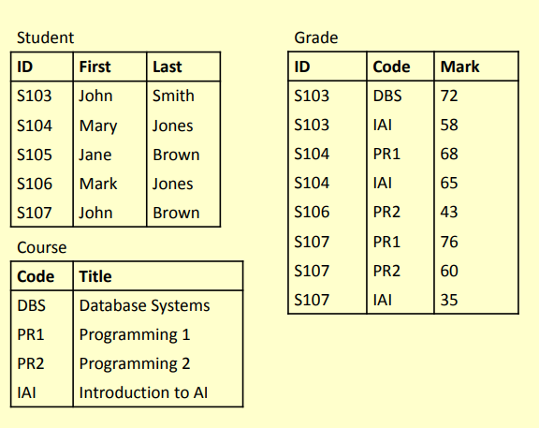
Example Tables

Slide 4
SQL SELECT
SELECT is the type of query you will use most
often.
Queries one or more tables and returns the result as a table
Lots of options, which will be covered over the
next few lectures
Usually queries can be achieved in a number of ways

Slide 5
Simple SELECT
columns can be
A single column
A comma-separated list
of columns
* for ‘all columns’
SELECT
FROM
columns
table-name;

Slide 6
Sample SELECTs
SELECT
* FROM
Student;
Student
sID | sName | sAddress | sYear
1 | Smith | 5 Arnold Close | 2
2 | Brooks | 7 Holly Avenue | 2
3 | Anderson | 15 Main Street | 3
4 | Evans | Flat 1a, High Street | 2
5 | Harrison | Newark Hall | 1
6 | Jones | Southwell Hall | 1

Slide 7
Sample SELECTs
SELECT
sName
FROM
Student;
50

Slide 8
Sample SELECTs
SELECT
sName
FROM
Student;
sName
Smith
Brooks
Anderson
Evans
Harrison
Jones

Slide 9
Sample SELECTs
SELECT
FROM
sName, sAddress
Student;

Slide 10
Sample SELECTs
SELECT
FROM
sName, sAddress
Student;
sName | sAddress
Smith | 5 Arnold Close
Brooks | 7 Holly Avenue
Anderson | 15 Main Street
Evans | Flat 1a, High Street
Harrison | Newark Hall
Jones | Southwell Hall

Slide 11
SQL SELECT Overview
SELECT
[DISTINCT | ALL] column-list
FROM table-names
[WHERE condition]
([] optional, | or)

Slide 12
Example Tables
Student
Grade
ID | First | Last
S103 | John | Smith
S104 | Mary | Jones
S105 | Jane | Brown
S106 | Mark | Jones
S107 | John | Brown
ID | Code | Mark
S103 | DBS | 72
S103 | IAI | 58
S104 | PR1 | 68
S104 | IAI | 65
S106 | PR2 | 43
S107 | PR1 | 76
S107 | PR2 | 60
S107 | IAI | 35
Course
Code | Title
DBS | Database Systems
PR1 | Programming 1
PR2 | Programming 2
IAI | Introduction to AI

Slide 13
DISTINCT
Sometimes you end up with duplicate entries
Using DISTINCT removes duplicates
SELECT
FROM
DISTINCT
Student;
Last
Last
Smith
Jones
Brown

Slide 14
WHERE Clauses
In most cases returning all the rows is not necessary
A WHERE clause restricts
rows that are returned
It takes the form of a condition – only rows that satisfy the condition are returned
Example conditions:
Mark < 40
First = ‘John’
• First <> ‘John’
First
(First =
= Last
‘John’)
=
AND (Last
‘Smith’)
(Mark
(Mark
< 40) OR
> 70)

Slide 15
WHERE Examples
SELECT
WHERE
* FROM
Grade
SELECT
FROM WHERE
DISTINCT ID
Mark
>= 60;
Grade Mark
>= 60;

Slide 16
WHERE Examples
SELECT
WHERE
* FROM
Grade
SELECT
FROM WHERE
DISTINCT ID
Mark
>= 60;
Grade Mark
>= 60;
ID | Code | Mark
S103 | DBS | 72
S104 | PR1 | 68
S104 | IAI | 65
S107 | PR1 | 76
S107 | PR2 | 60
ID
S103
S104
S107

Slide 17
WHERE Examples
Given the table:
Grade
Write an SQL query to find a list of the ID numbers and Marks for students who have passed (scored 50% or more) in IAI
ID | Code | Mark
S103 | DBS | 72
S103 | IAI | 58
S104 | PR1 | 68
S104 | IAI | 65
S106 | PR2 | 43
S107 | PR1 | 76
S107 | PR2 | 60
S107 | IAI | 35
ID | Mark
S103 | 58
S104 | 65

Slide 18
Solution
SELECT ID, Mark WHERE (Code
FROM Grade
= ‘IAI’)
AND (Mark >=
50);
10

Slide 19
WHERE Examples
Given the table:
Grade
Write an SQL query to find a list of the ID numbers and Marks for students who have passed with Marks (Marks in [60, 69])
ID | Code | Mark
S103 | DBS | 72
S103 | IAI | 58
S104 | PR1 | 68
S104 | IAI | 65
S106 | PR2 | 43
S107 | PR1 | 76
S107 | PR2 | 60
S107 | IAI | 35
ID | Mark
S104 | 68
S104 | 65
S107 | 60

Slide 20
Solution
SELECT
ID, Mark
FROM
>=60
Grade
WHERE (Mark
AND Mark < 70);

Slide 21
BETWEEN AND
SELECT
ID, Mark
FROM
Grade
WHERE
Mark BETWEEN
60 AND 69;

Slide 22
WHERE Examples
Given the table:
Grade
Write an SQL query to find a list of the students IDs for both the IAI and PR2 modules
ID | Code | Mark
S103 | DBS | 72
S103 | IAI | 58
S104 | PR1 | 68
S104 | IAI | 65
S106 | PR2 | 43
S107 | PR1 | 76
S107 | PR2 | 60
S107 | IAI | 35
ID
S103
S104
S106
S107
S107

Slide 23
WHERE Examples
Given the table:
Grade
Write an SQL query to find a list of the students IDs for both the IAI and PR2 modules
ID | Code | Mark
S103 | DBS | 72
S103 | IAI | 58
S104 | PR1 | 68
S104 | IAI | 65
S106 | PR2 | 43
S107 | PR1 | 76
S107 | PR2 | 60
S107 | IAI | 35
ID
S103
S104
S106
S107
S107

Slide 24
Solution
SELECT
ID FROM
(Code
Grade
WHERE
= ‘IAI’
OR Code
= ‘PR2’);

Slide 25
SELECT from Multiple Tables
Often you need to combine information from two or more tables
You can produce the effect of a Cartesian product using:
SELECT * FROM Table1,
Table2
If the tables have columns with the same name, ambiguity will result
This can be resolved by referencing columns with the table name:
TableName.ColumnName

Slide 26
SELECT from Multiple Tables
Student
SELECT
First, FROM
ID
First
Last
S103
S104 Mar
ID
S105 Jane
S103
S106 Mar
S107
Last,
Mark
John
Smith
Grade
y Jones
Code
Mark
Brow
n
Student, WHERE
DBS IAI PR1 IAI PR2 PR1 PR2 IAI
72
58
68
65
43
76
60
35
Grade
k Jones
S103 S104 S104 S106 S107 S107 S107
John
Brow
n
(Student.ID
= Grade.ID)
AND (Mark
>= 40);

Slide 27

SELECT from Multiple Tables
SELECT ... FROM Student, Grade WHERE ...
ID | First | Last | ID | Code | Mark
S103 | John | Smith | S103 | DBS | 72
S103 | John | Smith | S103 | IAI | 58
S103 | John | Smith | S104 | PR1 | 68
S103 | John | Smith | S104 | IAI | 65
S103 | John | Smith | S106 | PR2 | 43
S103 | John | Smith | S107 | PR1 | 76
S103 | John | Smith | S107 | PR2 | 60
S103 | John | Smith | S107 | IAI | 35
S104 | Mary | Jones | S103 | DBS | 72
S104 | Mary | Jones | S103 | IAI | 58
S104 | Mary | Jones | S104 | PR1 | 68
S104 | Mary | Jones | S104 | IAI | 65

Slide 28
SELECT from Multiple Tables
SELECT ... FROM Student, Grade
WHERE (Student.ID = Grade.ID) AND ...
ID | First | Last | ID | Code | Mark
S103 | John | Smith | S103 | DBS | 72
S103 | John | Smith | S103 | IAI | 58
S104 | Mary | Jones | S104 | PR1 | 68
S104 | Mary | Jones | S104 | IAI | 65
S106 | Mark | Jones | S106 | PR2 | 43
S107 | John | Brown | S107 | PR1 | 76
S107 | John | Brown | S107 | PR2 | 60
S107 | John | Brown | S107 | IAI | 35
20

Slide 29
SELECT from Multiple Tables
SELECT ... FROM Student, Grade
WHERE (Student.ID = Grade.ID) AND (Mark >= 40)
ID | First | Last | ID | Code | Mark
S103 | John | Smith | S103 | DBS | 72
S103 | John | Smith | S103 | IAI | 58
S104 | Mary | Jones | S104 | PR1 | 68
S104 | Mary | Jones | S104 | IAI | 65
S106 | Mark | Jones | S106 | PR2 | 43
S107 | John | Brown | S107 | PR1 | 76
S107 | John | Brown | S107 | PR2 | 60

Slide 30
SELECT from Multiple Tables
SELECT First, Last, Mark FROM Student, Grade WHERE (Student.ID = Grade.ID) AND (Mark >= 40)
First | Last | Mark
John | Smith | 72
John | Smith | 58
Mary | Jones | 68
Mary | Jones | 65
Mark | Jones | 43
John | Brown | 76
John | Brown | 60

Slide 31
SELECT from Multiple Tables
When selecting from multiple tables, it is almost always best to use a WHERE clause to find common values
SELECT *
From
Student,
Course
WHERE
Grade,
Student.ID = Grade.ID
AND
Course.Code = Grade.Code

Slide 32
SELECT from Multiple Tables
Student
Grade
Course
ID | First | Last | ID | Code | Mark | Code | Title
S103 | John | Smith | S103 | DBS | 72 | DBS | Database Systems
S103 | John | Smith | S103 | IAI | 58 | IAI | Introduction to AI
S104 | Mary | Jones | S104 | PR1 | 68 | PR1 | Programming 1
S104 | Mary | Jones | S104 | IAI | 65 | IAI | Introduction to AI
S106 | Mark | Jones | S106 | PR2 | 43 | PR2 | Programming 2
S107 | John | Brown | S107 | PR1 | 76 | PR1 | Programming 1
S107 | John | Brown | S107 | PR2 | 60 | PR2 | Programming 2
Student.ID = Grade.ID
Grade.Code = Course.Code

Slide 33
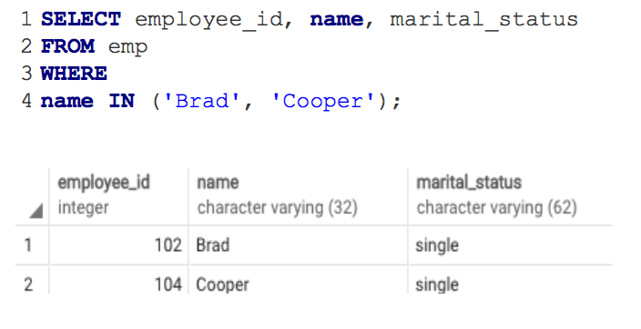
Examples
Example of using WHERE clause with IN operator. It returns any string matches string in a list.

Slide 34
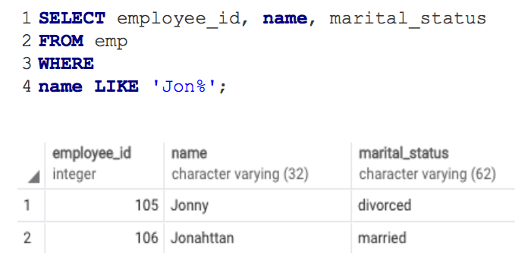
Examples
Example of using WHERE clause with LIKE operator. It returns any string that matches a specified pattern. "%" - it returns all employees whose name starts with string "Jon".

Slide 35
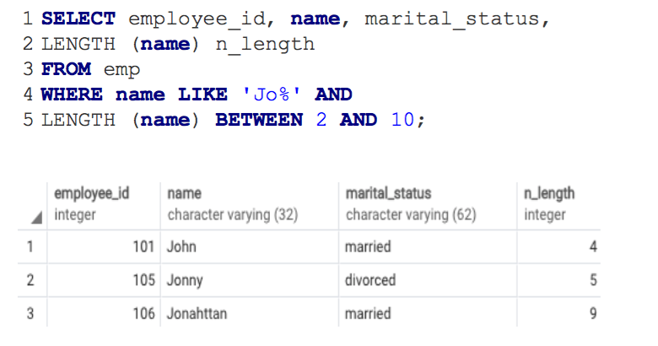
Examples
Example of using WHERE clause with BETWEEN operator. "Length ()" function is used to return the number of the characters of the string "name".

Slide 36
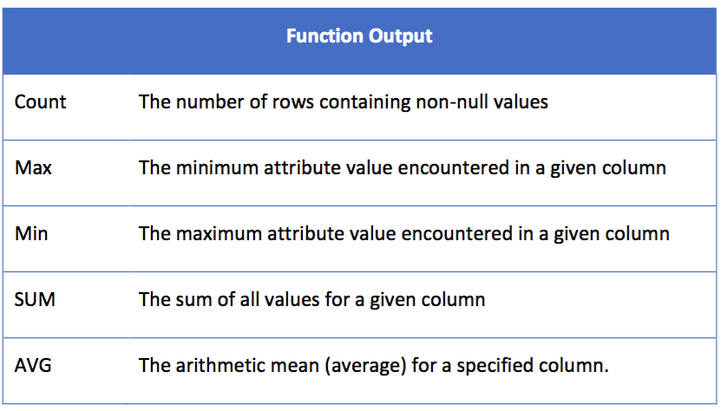
SQL Aggregate Functions

Slide 37
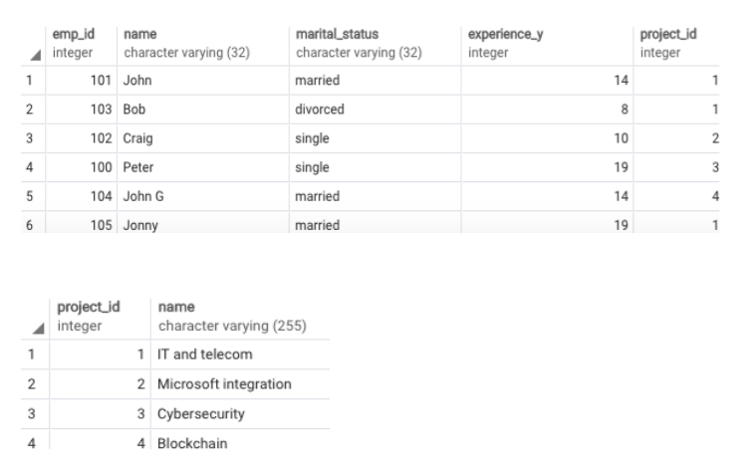
Examples

Slide 38
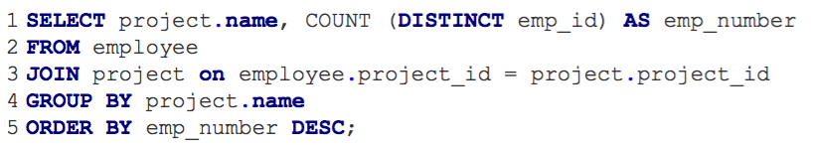
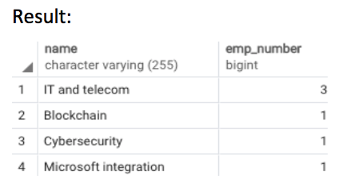
Examples

Slide 39
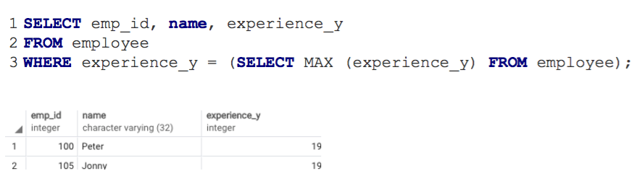
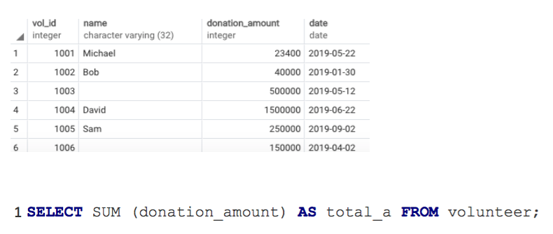
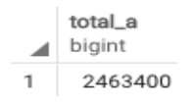
Examples

Slide 40
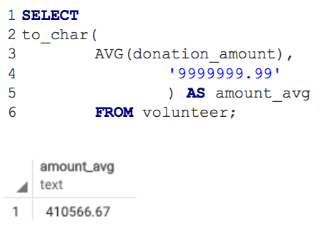
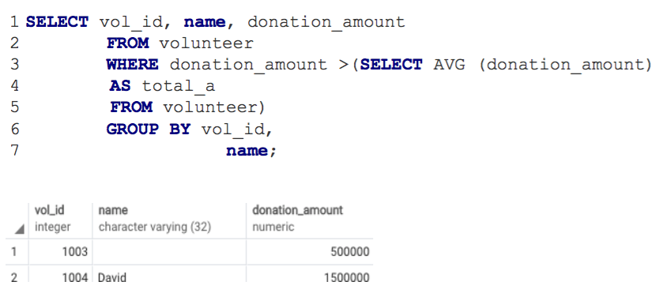
Examples

Slide 41
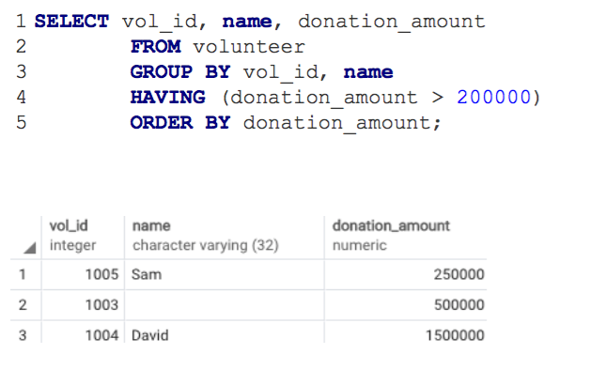
Examples

Slide 42
Join
PostgreSQL JOINs operators are used to retrieve data from two or multiple tables which are joined in a SQL statement. The followings are types of JOINS:
- PostgreSQL INNER JOIN (sometimes called simple join)
- PostgreSQL LEFT JOIN
- PostgreSQL RIGHT JOIN
- PostgreSQL FULL JOIN

Slide 43
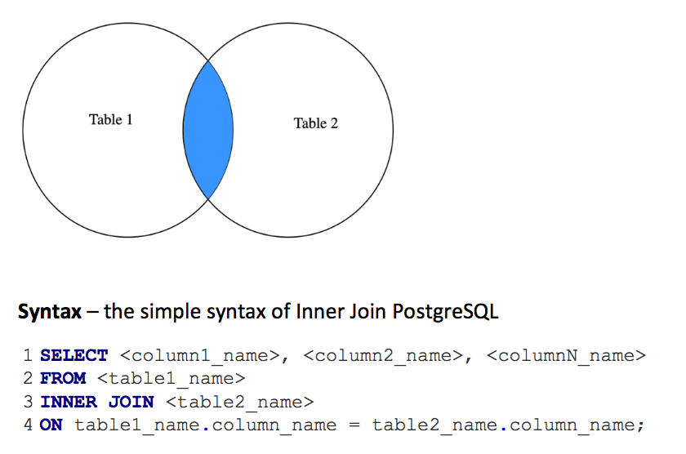
Inner Join
Inner Join – it returns the records where table 1 and table 2 intersect.

Slide 44
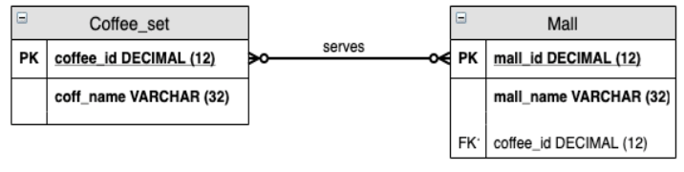
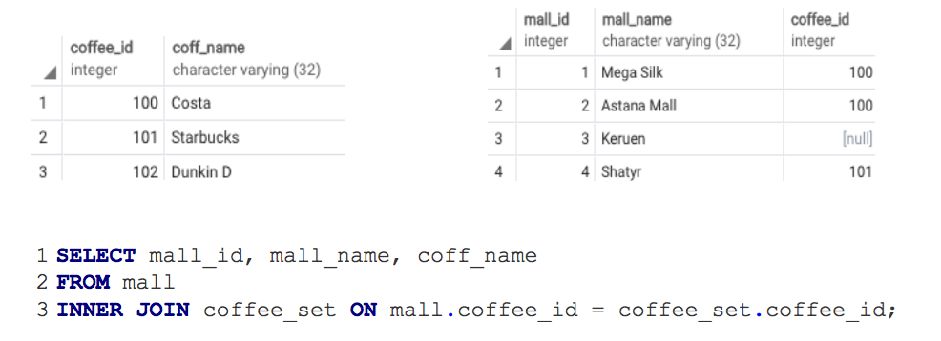
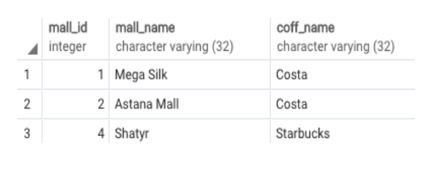
Inner Join

Slide 45
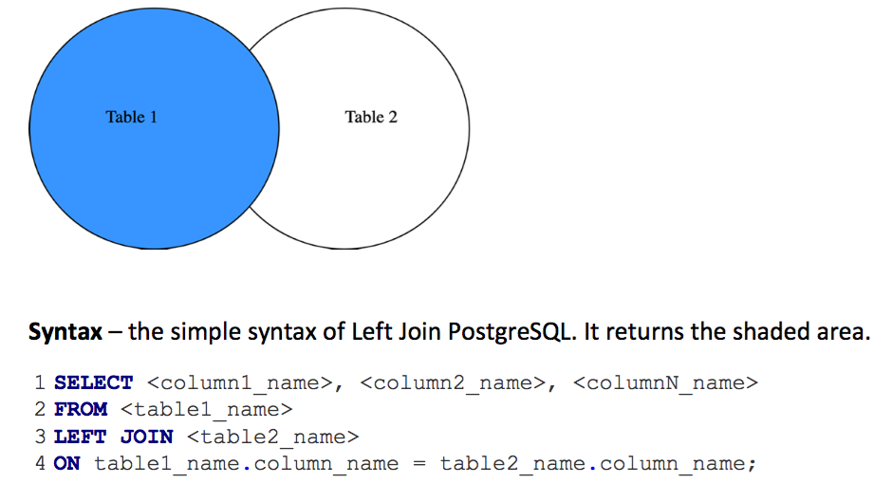
Left Join
LEFT JOIN - returns all rows from the LEFT-hand table1 specified in the ON condition and only those rows from the other table2 where the joined fields are equal.

Slide 46
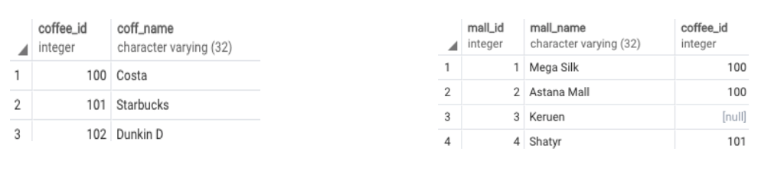
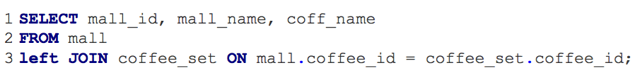
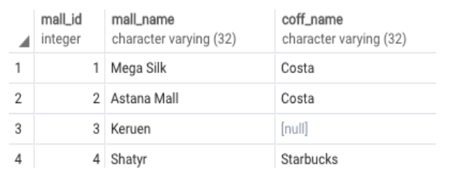
Left Join

Slide 47
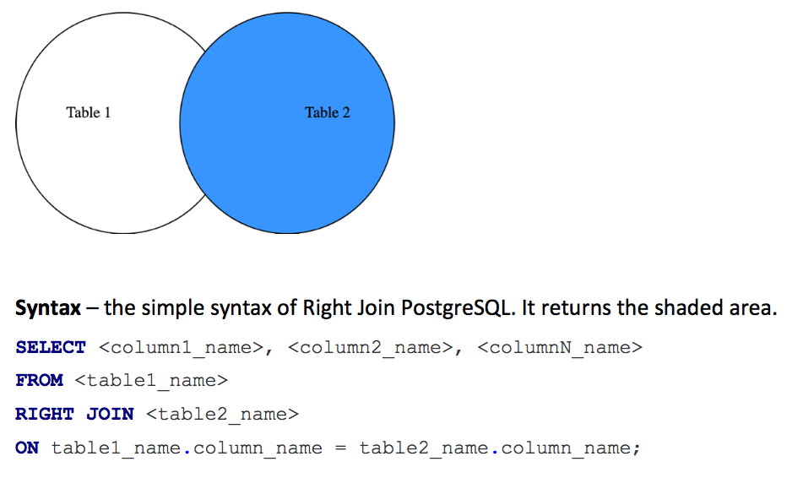
RIGHT JOIN
RIGHT JOIN – it returns all rows from the RIGHT-hand table2 specified in the ON condition and only those rows from the other table2 where the joined fields are equal.

Slide 48
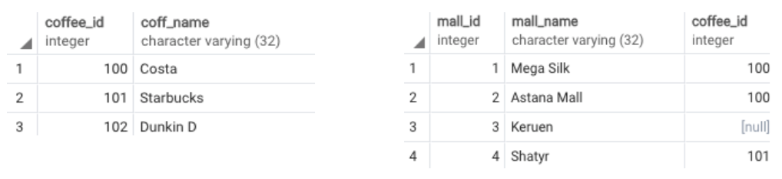
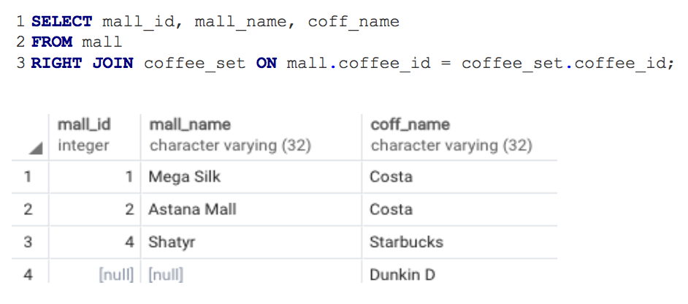
Right Join

Slide 49
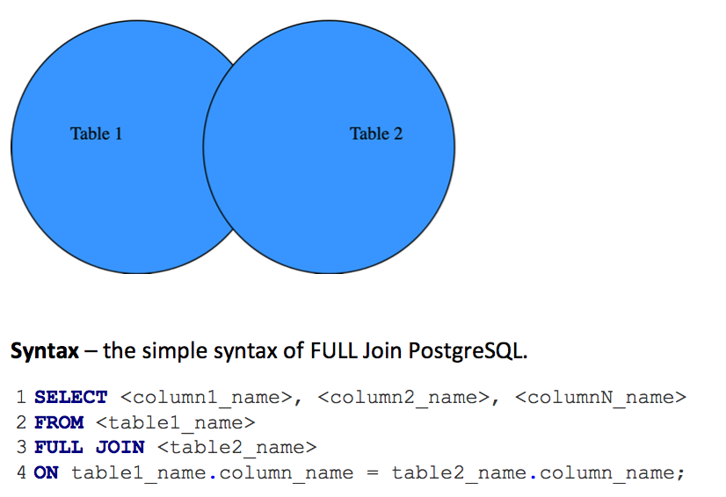
Full Join
FULL JOIN - returns all rows from the LEFT-hand table1 and RIGHT-hand table2 with nulls in place where the join condition is not met.

Slide 50
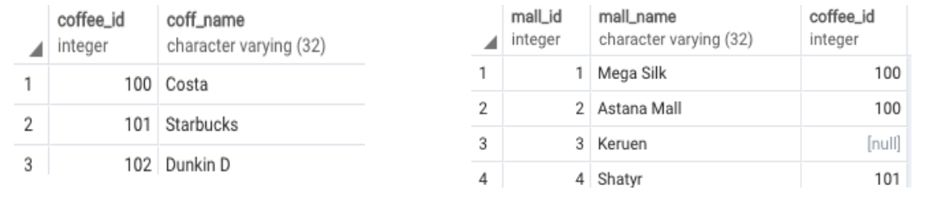
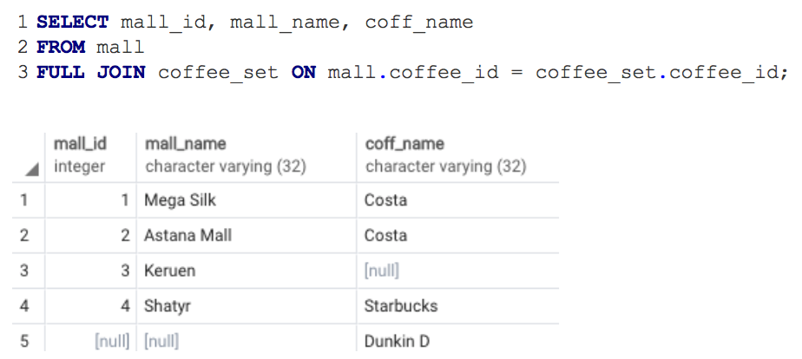
Full Join

Slide 51
Thank you for your attention!

