Slide 1
Log analysis project. CI with GitHub Actions.
Presented by Valentyn Zakharov

Slide 2
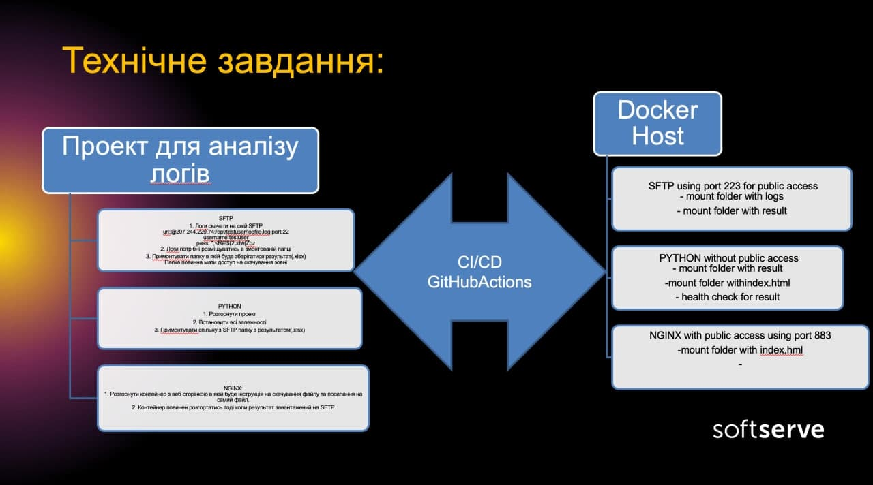

Slide 3

Docker compose
Containers
sshpass
python
Volumes
logs
result
sftp
nginx
Remote server

Slide 4





Network
Dynamic DNS
(NoIp)
Port Forwarding
192.168.0.101:883
192.168.0.133:883
883:80
192.168.0.101:223
192.168.0.133:223
223:22
Docker-compose.yml
sftp:
ports:
-”223:22”
nginx:
ports:
-”883:80”

Slide 5


