Slide 1
11. FLOW TOXICITY AND LIQUIDITY IN A HIGH-FREQUENCY WORLD
Research Seminar
Group N
DAVID EASLEY, MARCOS LÓPEZ DE PRADO AND MAUREEN O'HARA
Review of Financial Studies 25(5), 2012
Name Surname · Name Surname · Name Surname
Notes:
Fill in the group number and names. Timing (15 min): problem 2 · method 3 · results and reproduction 5 · critique 3 · next steps 2. Then 10 minutes of questions.

Slide 2
Why toxic order flow matters
Research Seminar
• Market makers (today mostly high-frequency firms) earn a tiny spread on many trades and avoid directional bets.
• They lose when the other side knows more. Order flow is toxic when it adversely selects them, often before they notice.
• When toxicity rises they widen quotes or leave. With no one absorbing orders, prices gap. The paper links the 6 May 2010 flash crash to this.
• Question: can toxicity be measured in real time, from trades alone, early enough to act?
One-sided, informed order flow
Market makers lose on their inventory
They widen quotes or withdraw
Liquidity gap → extreme volatility
Notes:
Problem, ~1 min. Market makers earn the spread; adverse selection = trading with someone who knows more. Toxic flow drains them; they withdraw; liquidity vanishes; prices gap. The paper's question: can we see this coming from the trade record alone?

Slide 3
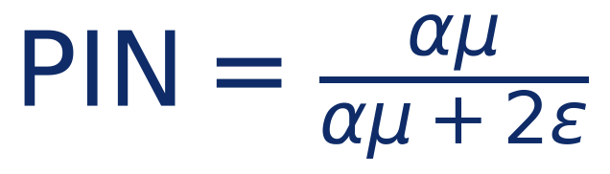
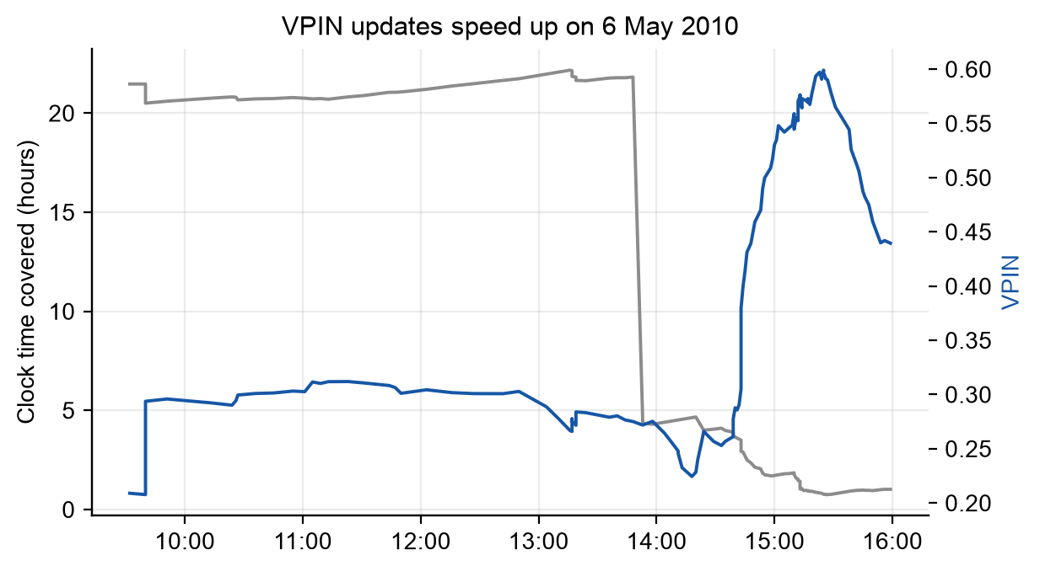
Method: from PIN to VPIN, measured in volume time
Research Seminar
• PIN (Easley et al. 1996): the share of orders that come from informed traders
• α: chance of news, μ: informed arrivals, ε: uninformed arrivals per side. Needs maximum likelihood: slow and unstable at high frequency.
• VPIN: |buys − sells| estimates αμ, total volume estimates αμ + 2ε. No parameters to fit.
• Volume clock: cut trading into buckets of equal volume (1/50 of a day). Busy, news-heavy periods get more updates.
Notes:
Method, ~1 min. PIN is the share of orders from informed traders in the sequential-trade model (Easley et al. 1996). Estimating it needs maximum likelihood on daily counts — slow and fragile. VPIN replaces the parameters by observable volume: |buys − sells| estimates alpha*mu, total volume estimates alpha*mu + 2 epsilon. Updated after every equal-volume bucket. The figure is our data: on 6 May 2010 the same 50 buckets covered less and less clock time as trading sped up. Source: results/reproduction/figures/fig2_time_gap.png.

Slide 4
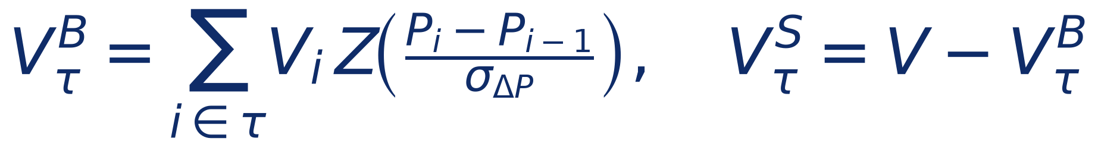
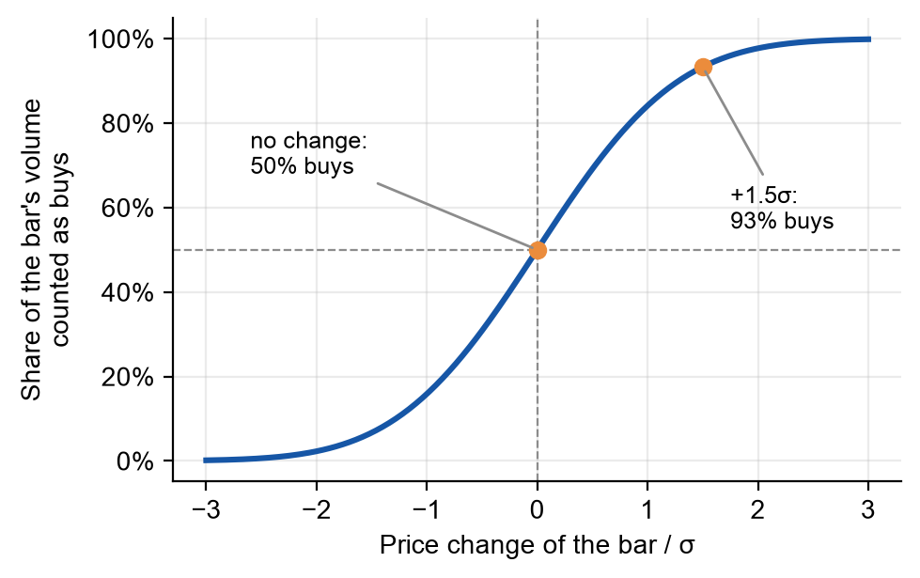
Method: bulk volume classification
Research Seminar
• Group trades into one-minute bars; split each bar's volume by its standardized price change.
• No price change → 50/50. A rise of 1.5σ → 93% buys. Z is the standard normal CDF; σ is the standard deviation of bar price changes.
• Robust to order splitting and cancellations, cheap to compute.
• But: the imbalance it produces grows with |price change|, by construction.
Notes:
Method, ~1 min. Trade-by-trade signing (Lee-Ready, tick rule) struggles with order splitting, cancellations and millions of quote updates. The paper classifies whole one-minute bars: the share of a bar's volume counted as buys is the normal CDF of the bar's standardized price change. This is the step our extension E1 tests against the truth.

Slide 5
What is estimated, what is chosen, what is evaluated
Research Seminar
Step | Objective | Data used
Estimate PIN (original model) | Maximise the likelihood of a Poisson mixture: α, μ, ε, δ | daily buy and sell counts
Estimate VPIN | Nothing is fitted: average |sell − buy volume| / V, a moment estimate of αμ / (αμ + 2ε) | the last n buckets
Inputs σ and V | Standard deviation of one-minute price changes; average daily volume / 50 | paper: whole sample · ours, real-time: previous 250 days
Choose buckets/day and n | Paper: grid cell with the highest corr(ln VPIN, next |return|) (Fig. 10) or true-positive rate (Table 5) | paper: the evaluation sample itself · ours: 2009–11, then frozen
Evaluate | Corr with next |return|; P(VPIN high | big move); true positives. We add lift and ΔR² over volatility | paper: in sample · ours: 2011–26, out of sample
• VPIN has no training objective. The paper's only optimisation is the parameter search, and it maximises the statistic it then reports, on the same data. We select on 2009–11 and evaluate on 2011–26.
Notes:
Method, ~45 s. Anticipates 'what was the objective?'. VPIN is not trained: it is a moment estimator (average absolute imbalance over volume) of the PIN ratio, so it has no loss function. The only optimisation in the paper is the choice of bucket size and window: they scan grids and report the best cell, i.e. the selection objective IS the evaluation statistic, on the same data. We separate the two: select on 2009-11, evaluate on 2011-26.

Slide 6
Data and our replication setup
Research Seminar
Set-up | Paper | Ours
Market | E-mini S&P 500 and WTI crude futures | IVE (S&P 500 Value ETF) ticks with quotes; BTCUSDT for extensions
Period | Jan 2008 – Aug 2011 (incl. 2008 crisis) | 2009-09-28 – 2011-08-15; out of sample to Sep 2026
Trading hours | almost 24 hours | 09:30–16:00 New York
Classification | bulk, one-minute bars | same, plus 10-second bars and Lee-Ready
Settings | V = ADV/50, n = 50, whole-sample σ and CDF | identical
• Main deviations: ETF instead of futures; regular hours only; our sample starts in Sep 2009 (no 2008 crisis); 42 IVE trades at prices like $0.08 that the exchanges cancelled on 6 May 2010 are removed. 29% of IVE one-minute bars have no price change, and bulk classification splits them 50/50.
• ± on our numbers: block bootstrap over calendar months (1,000 replications), because VPIN windows overlap and volatility clusters.
Notes:
Data, ~1 min. CME data are paid, so we use the only free tick history with quotes we found: IVE from Kibot, which covers the flash crash. Binance BTC data give the true aggressor side, which the paper never had. This table compares set-ups, not results. All deviations with reasons: DEVIATIONS.md.

Slide 7
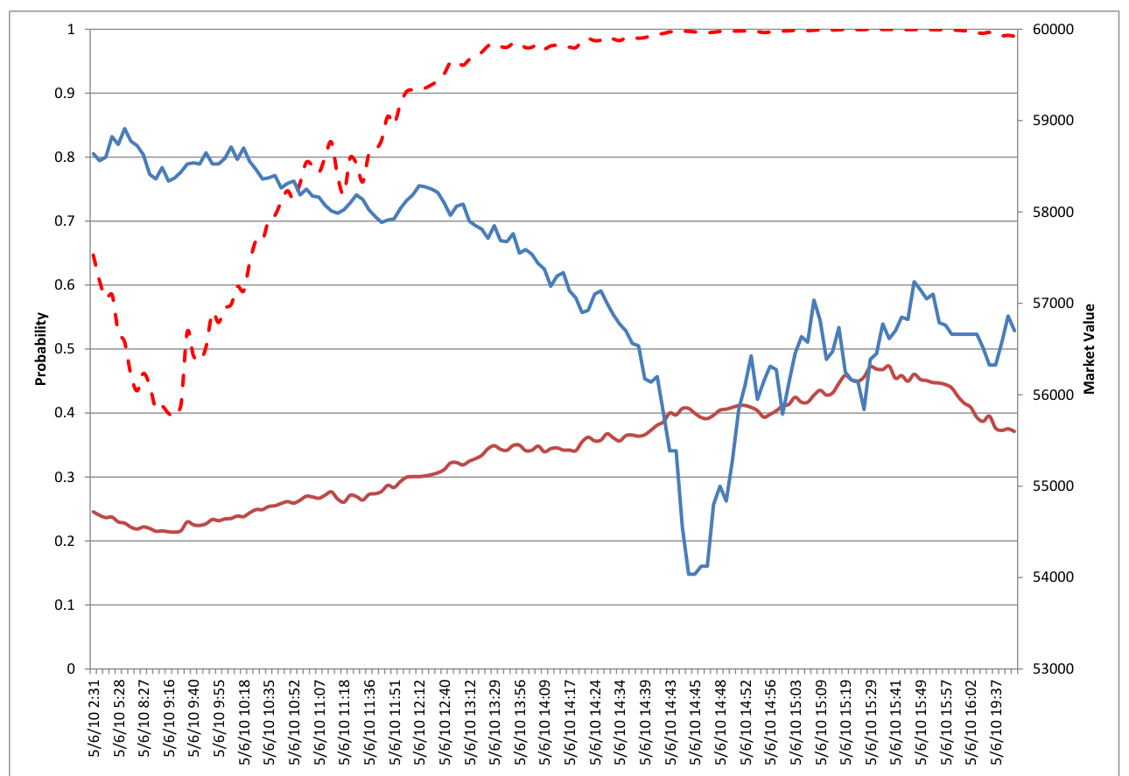
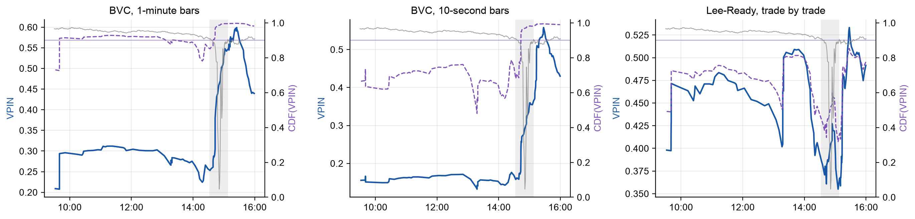
Result 1: the flash crash, paper vs ours
Research Seminar
Ours: IVE, 6 May 2010, three classification schemes
Paper, Fig. 4(a): E-mini, one-minute bars
• One-minute bars: CDF > 0.9 from 09:40, 4.9 h before the fall, as the paper says.
• 10-second bars: first above 0.9 at 14:43, during the fall. Lee-Ready: never (max CDF 0.85).
• One event: no ± possible. The warning depends on the classification choice.
Notes:
Results, ~1 min. Paper Fig. 4(a): CDF(VPIN) crossed 0.9 at least two hours before the crash. Ours, one-minute bars: CDF above 0.9 from 09:40, 4.9 h before 14:32. With 10-second bars it crosses only during the crash, and with Lee-Ready never. One event, so no ± is possible; the point is that the warning depends on the classification choice. Source: results/reproduction/flash_crash.csv.

Slide 8
Result 2: the volume clock and the stability of VPIN
Research Seminar
Paper: E-mini, 2008–11
Ours: IVE, 2009–11 (± s.e.)
50 draws a day | Clock | Volume
Kurt | 34.25 | 20.52
J-B* | 40.69 | 12.82
L-B* | 40.73 | 24.84
White* | 0.10 | 0.04
Max | 20.83 | 12.26
50 draws a day | Clock | Volume | P(volume lower)
Kurt | 13.12 ± 3.96 | 9.05 ± 1.81 | 0.947
J-B* | 4.27 ± 3.11 | 1.53 ± 0.89 | 0.947
L-B* | 23.13 ± 32.34 | 43.03 ± 25.23 | 0.313
White* | 0.28 ± 0.10 | 0.16 ± 0.06 | 0.995
Max | 13.08 ± 2.29 | 9.86 ± 1.51 | 0.977
• Ours: volume time is significantly lower on 1 of the 4 test statistics at 50 draws a day and 2 of 4 at 100; tails and White* clearly improve, autocorrelation (L-B*) does not at 50.
• Stability (Fig. 5): restarting the buckets 0, 1, …, 999 bars later changes VPIN by 3.7% of its mean on IVE; the paper reports 6.5% for the E-mini.
Notes:
Results, ~1 min. Two separate tables: the paper's Table 1 and ours. Ours drops 6 May 2010 (IVE fell to about half its price for minutes; one change of ~100 sigma sets the kurtosis) and overnight changes (a 24-hour futures market has none). Last column: in how many paired bootstrap replications volume time has the lower value; green = at least 95%. Sources: results/reproduction/table1_*_bootstrap.csv, summary.json (stability).

Slide 9
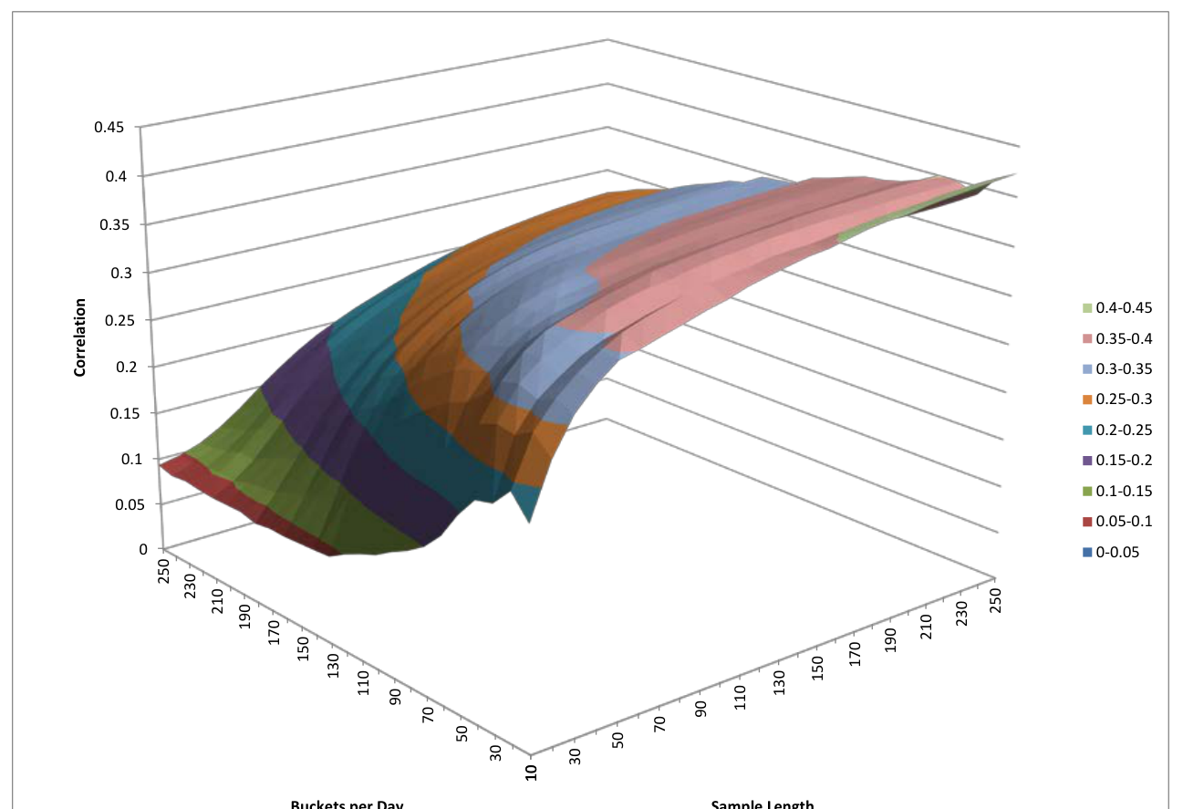
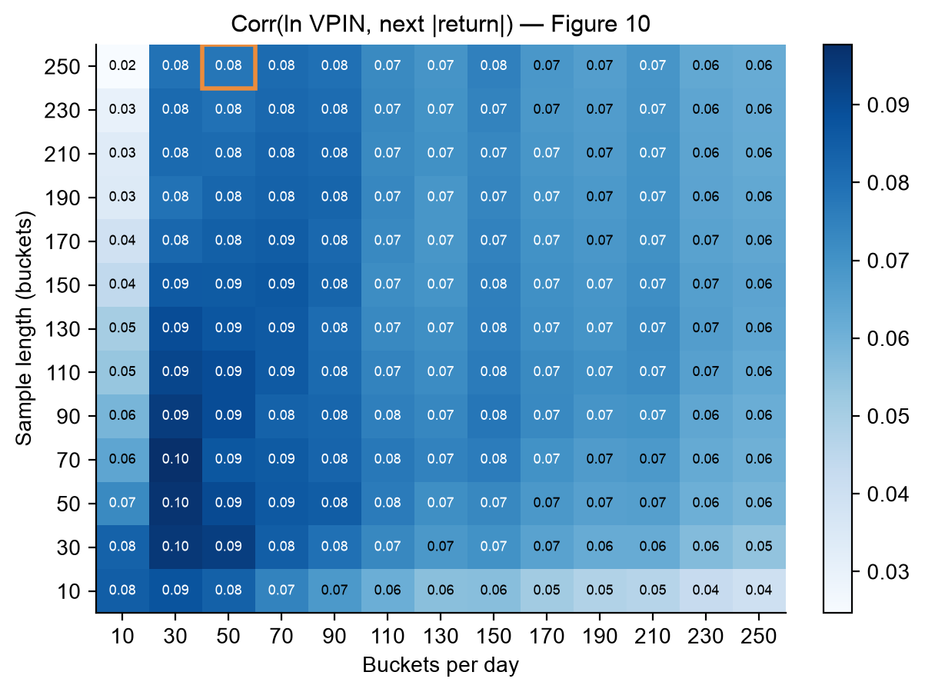
Result 3: does VPIN predict the next bucket's volatility?
Research Seminar
On IVE
Same sign; 0.40 is outside our interval.
About the ±
An iid interval would give ours as [0.07, 0.09]: overlapping windows make it far too narrow.
Paper (E-mini): 0.40 at (50, 250), 95% CI [0.392, 0.408] (iid)
Ours (IVE): 0.08 ± 0.05 at (50, 250), 95% CI [0.04, 0.22]
Notes:
Results, ~1 min. Paper Fig. 10 vs the same computation on IVE. Each caption gives its own source's number. The paper's interval (footnote 29) treats buckets as independent; neighbouring VPIN values share almost all of their window, so it is far too narrow. With the same iid formula ours would be [0.07, 0.09]; month blocks give [0.04, 0.22]. Source: results/reproduction/parameter_grid.csv, summary.json.

Slide 10
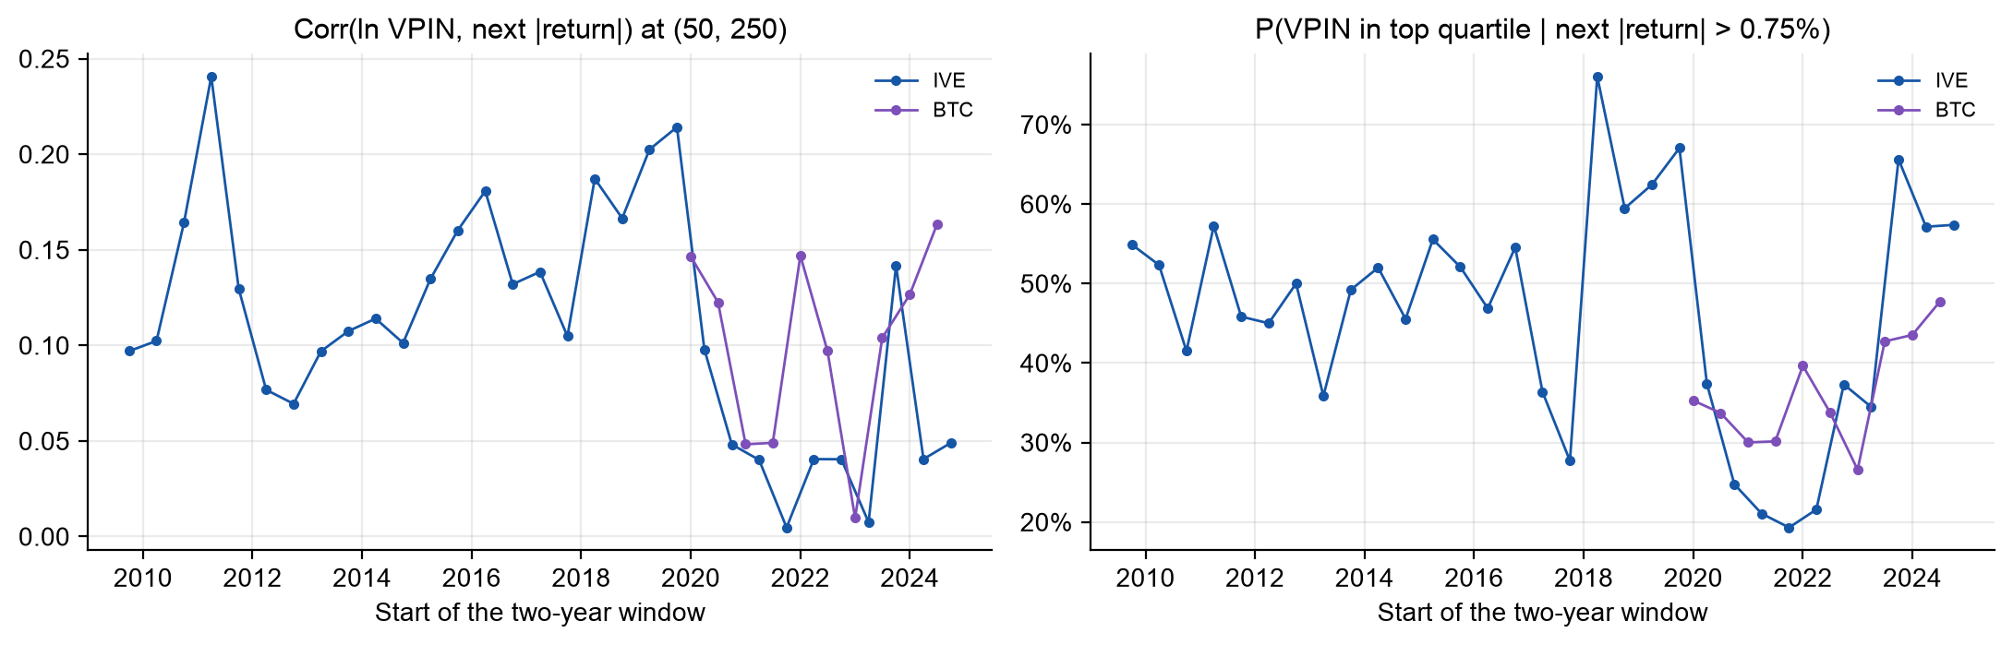
Result 4: the paper's predictive claims on every two-year window
Research Seminar
Paper reports (E-mini, 2008–11)
• corr 0.40; P(top quartile | big move) > 84%
Our reading
• No window on either market reaches the paper's numbers.
• Our reproduction could detect any correlation ≥ 0.13 (80% power): the gap is not a matter of power.
• IVE: corr 0.00 to 0.24; P(top quartile | big move) 19% to 76%.
• BTC: corr 0.01 to 0.16; P(top quartile | big move) 27% to 48%. Big moves are routine on BTC, so low VPIN scores as many true positives.
Notes:
Results, ~45 s. The paper's exact in-sample method on every two-year window, starting each January and July: 31 windows of IVE, 10 of BTC. Every window is shown; none was selected. This analysis was run once as an exploration before we wrote the pre-registration, and we say so. Not a power problem: the reproduction can detect any correlation of 0.13 or more with 80% power. Source: results/extensions/windows/.

Slide 11
Reproduction scorecard
Research Seminar
Paper reports: E-mini, 2008–11
Ours: IVE, 2009–11
# | Claim | Reported
1 | VPIN does not depend on where the bucket sequence starts (std / mean across 1,000 starts) | 6.5%
2 | Volume time is closer to normal than clock time: Kurt, J-B*, L-B*, White* lower | 4 of 4 at 50 and at 100 draws a day
3 | CDF(VPIN) > 0.9 at least 2 h before the flash crash: BVC, one-minute bars | ≥ 2 h
4 | ... BVC, 10-second bars | ≥ 2 h
5 | ... Lee-Ready, trade by trade | ≥ 2 h
6 | Low VPIN (bottom quartile) → next |return| < 0.25% | > 90%
7 | Corr(ln VPIN, next |return|) at (50, 250) | 0.40 [0.392, 0.408]
8 | P(VPIN in top quartile | next |return| > 0.75%) at (50, 250) | > 84%
9 | P(move > 0.75% while VPIN stays in the top quartile) at (50, 250) | 51.8%
10 | ... at (10, 350) | 78.6%
# | Ours (± s.e.) | 95% interval | Verdict
1 | 3.7% | – | reproduced
2 | 1 of 4 / 2 of 4 significant | P ≥ 0.95 | partly
3 | 4.9 h | – | reproduced
4 | only during the fall | – | not reproduced
5 | never (max CDF 0.85) | – | not reproduced
6 | 96.1% ± 0.5% | [95.0%, 97.2%] | reproduced
7 | 0.08 ± 0.05 | [0.04, 0.22] | weaker
8 | 51% ± 13% | [19%, 71%] | weaker
9 | 34% ± 4% | [26%, 43%] | weaker
10 | 60% ± 12% | [37%, 85%] | inconclusive
Notes:
Summary. Left: what the paper reports. Right: what we find on IVE, with ± and a verdict that uses only our own data: reproduced if the paper's value is inside our 95% interval and the effect's direction is significant; inconclusive if inside but not significant; weaker if outside but the direction holds; not reproduced otherwise. Rule in scripts/make_report.py. Sources: results/report/scorecard_*.csv.

Slide 12
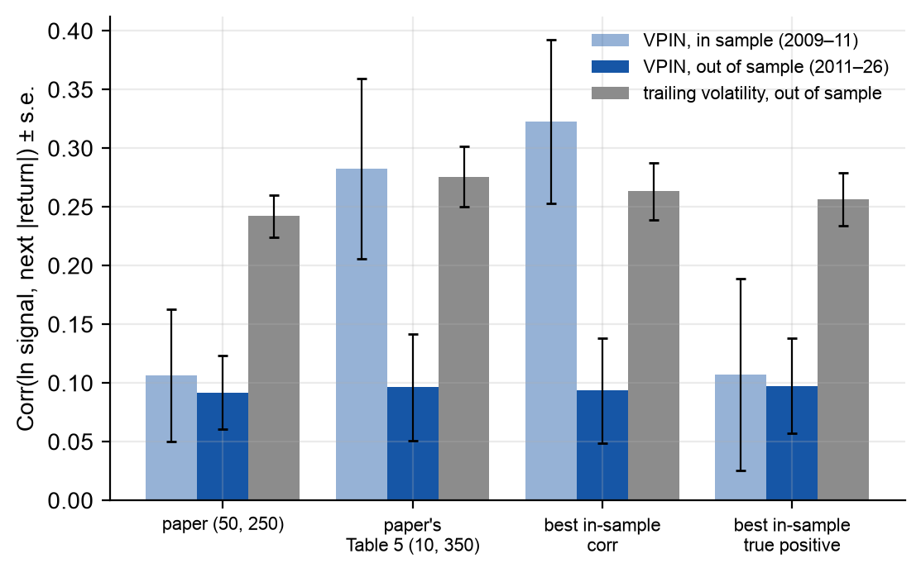
How could these results be overfit?
Research Seminar
In the paper
• The CDF of VPIN is built from the whole sample, future included.
• Bucket size and window are picked by scanning grids on the same data (Figs. 10, 12, 14); Table 5 reports the best cell.
• No out-of-sample period; its ± assumes independent buckets. One flash crash = one observation.
Our check
• Real-time VPIN: σ, V and CDF from past data only; parameters frozen in 2009–11, tested on 2011–26.
• Best in-sample true-positive pair (20, 500): 92% ± 5% → 45% ± 3% out of sample (bottom quartile: 47% ± 4%).
Notes:
Critique, ~1.5 min (required slide). Four ways the paper's numbers can be too good, and our check: a real-time pipeline (sigma, bucket size and CDF from the past only) with parameters frozen on the paper's period and tested on 2011-2026. Error bars are ± one bootstrap standard error. Source: results/extensions/ive_oos_comparison.csv.

Slide 13
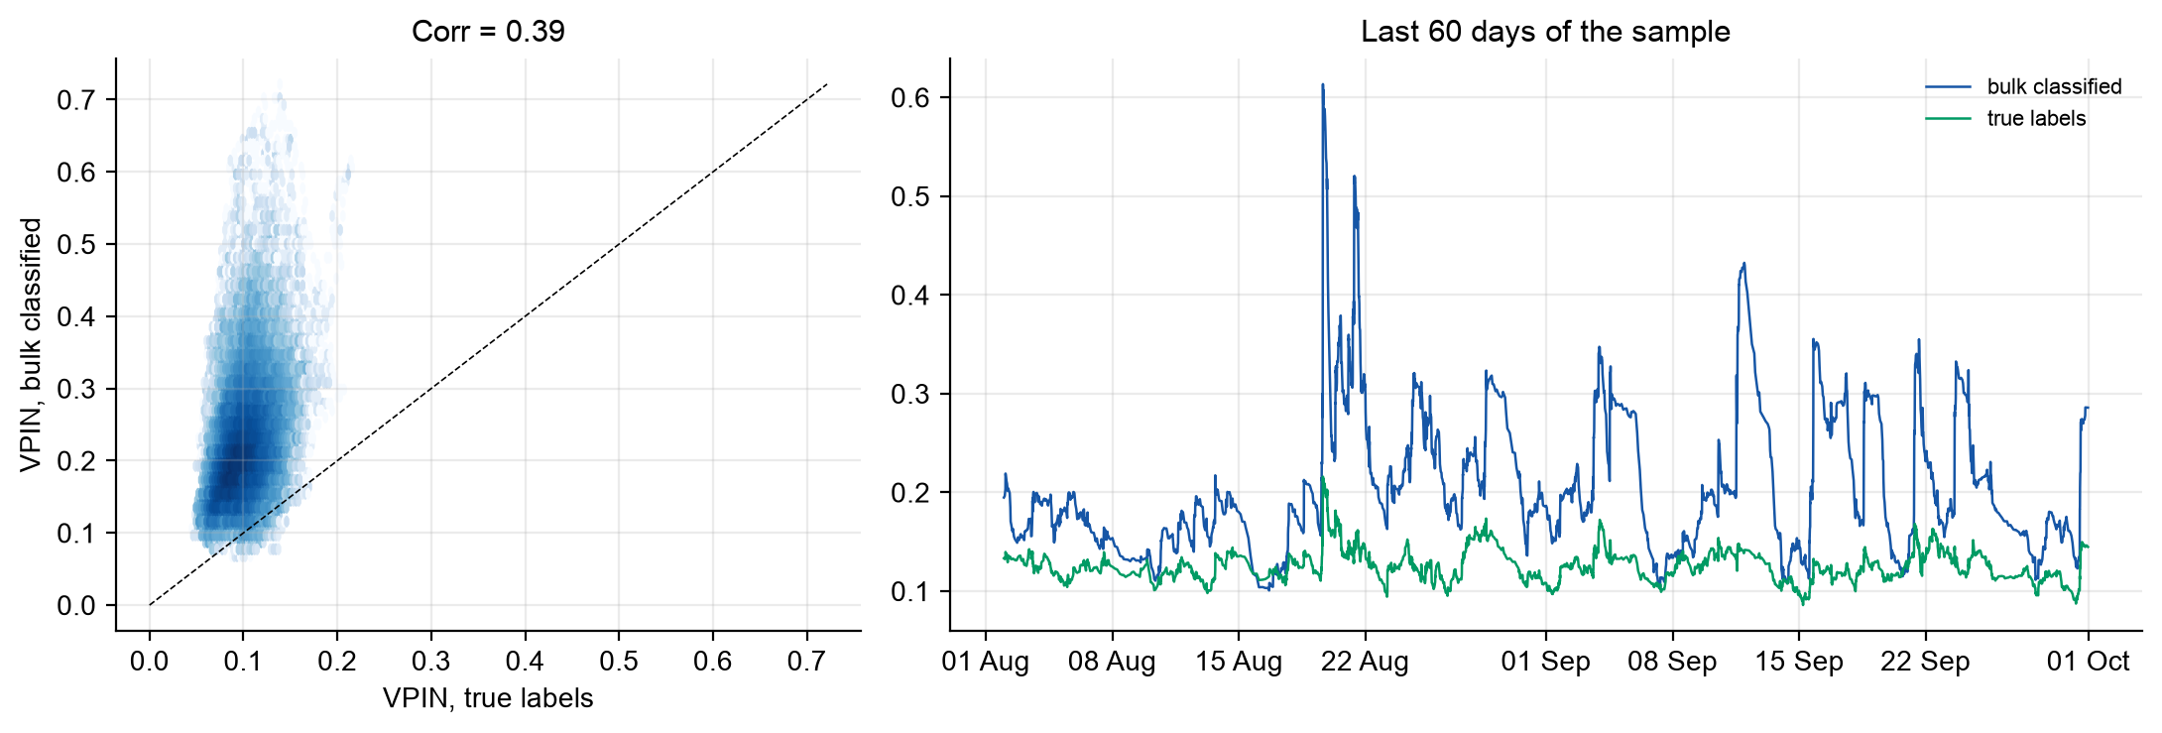
Extension 1: is bulk classification right? A ground-truth test
Research Seminar
On 5 days with every trade
• Tick rule: 93%–97% of volume classified right.
• Bucket imbalance vs truth: tick rule ≥ 0.99, BVC 0.51–0.74 (1-min bars).
• Ranges are across the 5 days. Caveat: Binance aggregates the fills of one order, which helps the tick rule.
• The paper's claim that bulk beats trade-by-trade classification does not hold here.
• Bars: BVC gets the sign right for 82.1% ± 0.2% of volume.
• Buckets: BVC inflates |imbalance| 2.2×; the two VPINs correlate only 0.39 ± 0.04.
Notes:
Upgrade, ~1 min. Binance BTCUSDT data mark the aggressor of every trade, so we know the true buy volume that BVC estimates — the paper never could. Same buckets, two classifications. ± by month blocks; the trade-day ranges are across 5 days. Sources: results/extensions/summary.json, btc_bars_bvc_vs_truth.csv, btc_trade_days.csv.

Slide 14
Extension 2: is VPIN more than volatility?
Research Seminar
BTCUSDT 2020–26, 50 buckets/day, n = 50 | Corr with next |return| | P(top quartile | move > 0.75%) | Time in top quartile | Lift
VPIN (bulk classified) | 0.13 ± 0.02 | 41% ± 3% | 27% | 1.53 ± 0.08
VPIN (true labels) | -0.12 ± 0.02 | 17% ± 3% | 29% | 0.61 ± 0.08
RV (trailing volatility) | 0.36 ± 0.03 | 40% ± 7% | 12% | 3.31 ± 0.28
• VPIN from true labels is negatively related to the next move; bulk-classified VPIN is positive; trailing volatility wins.
• BVC imbalance moves with the bucket's own |return| (0.44 ± 0.01 vs 0.29 ± 0.02 for the truth): BVC builds volatility into VPIN.
• Regression with volatility and trade-intensity controls: VPIN adds ΔR² = 0.0010 ± 0.0005 on BTC, 0.0025 ± 0.0011 on IVE out of sample.
Notes:
Upgrade, ~1 min. One data source (BTC), three signals. Lift = hit rate divided by how often the alarm is on; a signal that is always on has lift 1. With true labels VPIN has no positive link to future volatility; with BVC it does, because BVC turns price moves into imbalance. Trailing volatility beats both. Andersen and Bondarenko (2014) made this argument; we confirm it with ground truth. Sources: btc_signal_comparison.csv, regressions.csv.

Slide 15
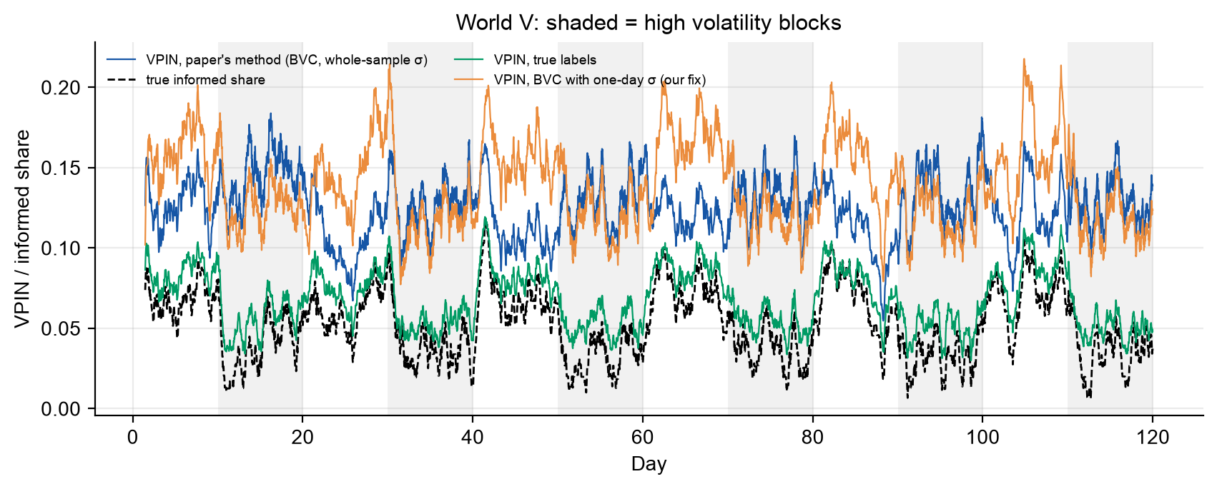
Extension 3: a known-answer test of VPIN — design (pre-registered)
Research Seminar
• Gap in the paper: its Monte Carlo (Appendix A.2) uses correctly labelled trades and no prices; its VPIN uses bulk classification, which needs prices.
• Our model: the paper's PIN model, plus a price: Δp = λ (buys − sells) + public noise. Informed flow moves the price; public noise does not involve any trader.
• Worlds: T = more informed trading in some blocks; V = more volatility and uninformed volume, informed trading unchanged; TV = both; 0 = neither.
• Same pipeline, truth known, 200 replications per world, rules fixed before running.
World V: the paper's VPIN (blue) stays high in volatile blocks while the true informed share (dashed) falls.
Notes:
Upgrade, ~1 min. The gap: the paper validates VPIN (Appendix A.2) with buys and sells drawn straight from the PIN model: correct labels, no prices. Its empirical VPIN uses bulk classification, which needs prices, so that validation does not cover the method it uses. We simulate the paper's own model with a price and run the exact pipeline where the truth is known. Hypotheses, metrics and decision rules were written in docs/preregistration.md before the first run; its hash is in the run manifest.

Slide 16
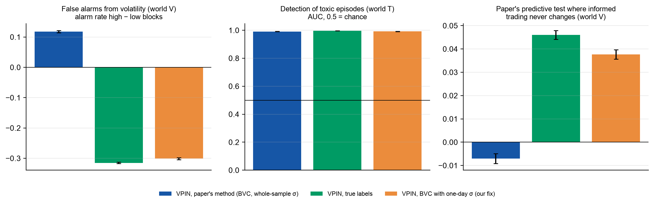
Extension 3: results of the known-answer test
Research Seminar
Tracking of the true informed share, world V
• paper's VPIN 0.03
• true labels 0.96
• one-day σ (fix) 0.83
• When volatility changes, the paper's VPIN stops measuring informed trading.
Rule | Pre-registered statement | Result | Verdict
D1 | true labels track informed trading | 0.98 | holds
D2 | paper's VPIN: false alarms from volatility | +0.118 ± 0.002 | holds
D3 | paper's predictive test fooled by volatility | -0.007 ± 0.001 | does not hold
D4 | one-day σ: fewer false alarms, same detection | -0.301; AUC 0.992 | holds
Notes:
Upgrade, ~1 min. D2: in world V the paper's VPIN raises more alarms in volatile blocks, although informed trading never changes; true-label VPIN goes the other way (extra uninformed volume dilutes informed trading), the same sign as on real BTC. In world V the paper's VPIN tracks the true informed share at corr ~0.03. D3 did not hold: the paper's predictive statistic is not fooled in this calibration, because two effects cancel. D4: one-day sigma fixes the bias and keeps detection. ± = Monte Carlo s.e. Source: results/extensions/simulation/.

Slide 17
Extension 4: the fix on real data
Research Seminar
Market (real-time, 50 buckets/day) | Signal | Corr with next |return| | Lift
BTC | VPIN, standard BVC | 0.127 ± 0.020 | 1.53 ± 0.08
BTC | VPIN, local-sigma BVC (fix) | 0.051 ± 0.017 | 1.27 ± 0.07
BTC | trailing volatility | 0.359 ± 0.032 | 3.31 ± 0.28
BTC | VPIN, true labels | -0.123 ± 0.024 | 0.61 ± 0.08
IVE 2011-26 | VPIN, standard BVC | 0.092 ± 0.031 | 1.57 ± 0.20
IVE 2011-26 | VPIN, local-sigma BVC (fix) | 0.007 ± 0.023 | 1.30 ± 0.24
IVE 2011-26 | trailing volatility | 0.242 ± 0.018 | 2.76 ± 0.28
Closer to the truth (BTC)
• corr with true-label VPIN: fix 0.47 vs standard 0.39 (+0.08 ± 0.02)
Less volatility in disguise
• its correlation with the next move collapses: the paper's predictive power came from the bias
What remains beyond volatility
• IVE: t = 8.3, ΔR² = 0.0029; BTC: negative (t = -4.3)
Notes:
Upgrade, ~1 min. Pre-registered rule D5, run because D4 held. Bulk classification with sigma from the previous day only, in the same real-time buckets. On BTC, where the truth is known, it tracks true-label VPIN better. And once the volatility bias is gone, most of VPIN's correlation with future volatility disappears: the paper's predictive power came from the bias. A small signal beyond volatility remains on IVE, none on BTC. Source: results/extensions/local_sigma/.

Slide 18
Inference: placebo, stability, power and every test
Research Seminar
Placebo: VPIN with the direction of every imbalance shuffled
Ledger of every test
• 26 tests behind our claims
• supported after Benjamini–Hochberg: 17
• after Bonferroni: 13
• significant but on the wrong side: 3 (reported as not supported)
• New tests pre-registered before running; every later change logged.
Sample | Corr, real VPIN | Corr, direction shuffled | Kept
IVE 2009-11, paper's method (50, 250) | 0.078 | 0.078 ± 0.002 | 101%
IVE 2011-26 (50, 250) | 0.092 | 0.090 ± 0.001 | 98%
BTC 2020-26 (50, 50) | 0.127 | 0.128 ± 0.001 | 101%
• The direction of trading carries almost none of VPIN's predictive power: the size of price moves does.
• Leave one year out: 0 sign flips across 5 signal–sample pairs.
• Power: the reproduction detects any correlation ≥ 0.13; the paper's 0.40 would not be missed.
Notes:
Upgrade, ~1 min. The placebo keeps each one-minute imbalance's size and draws its direction at random. If VPIN's predictive power came from informed traders on one side, the placebo would lose it; it keeps ~100%. On IVE 2011-26 the real VPIN is detectably better by 0.002 — still 97% kept. Ledger: a claim counts as supported only if significant and on the claimed side. Sources: results/extensions/inference/, results/report/ledger.csv, docs/preregistration.md.

Slide 19
What our work adds to the paper
Research Seminar
• 1. Closes the paper's validation gap. Its Monte Carlo never runs bulk classification. Our known-answer simulation of its own model shows that VPIN, as the paper computes it, stops measuring informed trading when volatility changes.
• 2. Locates where VPIN's predictive power comes from. With true labels VPIN does not predict volatility (BTC); with shuffled directions it predicts as well as the real VPIN (IVE, BTC). It is the size of price moves, not toxicity.
• 3. A fix that works where it can be checked. Measuring price changes against the previous day's volatility makes VPIN track true toxicity better on BTC, and removes the volatility artefact.
• 4. An honest evaluation. Real-time, out of sample 2011–2026, all 41 two-year windows, pre-registration, ± on every metric, and a ledger with multiple-testing control. The paper's predictive numbers do not appear anywhere.
Confirms on new data: Andersen & Bondarenko (2014, 2015); Chakrabarty, Pascual & Shkilko (2015).
Notes:
~1 min. Be explicit about what is new and what confirms others. The ground-truth and volatility critiques confirm Andersen and Bondarenko (2014, 2015; the latter uses perfect trade classification on E-mini) and Chakrabarty, Pascual and Shkilko (2015, bulk vs trade-by-trade classification), on new data. The known-answer simulation that closes the paper's own validation gap, and the one-day-sigma fix tested against ground truth, are our additions, as far as we know.

Slide 20
Critique and next steps
Research Seminar
Critique
• Bulk classification builds volatility into VPIN; with true labels the predictive link disappears.
• Whole-sample CDF and grid-searched parameters: look-ahead and selection with no out-of-sample test.
• Main evidence is one event (6 May 2010); on IVE the warning depends on bar size and classifier.
• No baseline: the paper never compares VPIN with plain volatility, which wins in our tests.
• Its ± treats overlapping buckets as independent: far too narrow.
• The authors hold a patent on VPIN and disclose a financial interest.
With three more months
• E-mini futures with exchange aggressor flags (e.g. CME MDP 3.0): the paper's market, with ground truth.
• VPIN as a filter for a market-making strategy: does it reduce adverse-selection losses after costs?
• Correct the grid search for multiple testing (White's reality check, deflated statistics).
• Combine with HAR volatility forecasts and test VPIN's incremental value out of sample.
Notes:
Critique ~1 min, next steps ~2 min. Keep it to what we tested. The authors disclose a patent on VPIN and a financial interest in it (title page).

Slide 22
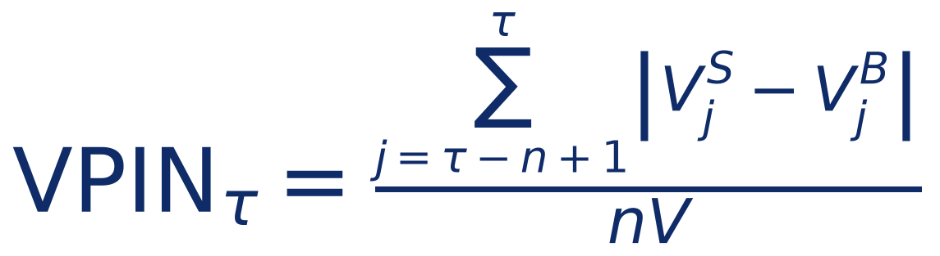
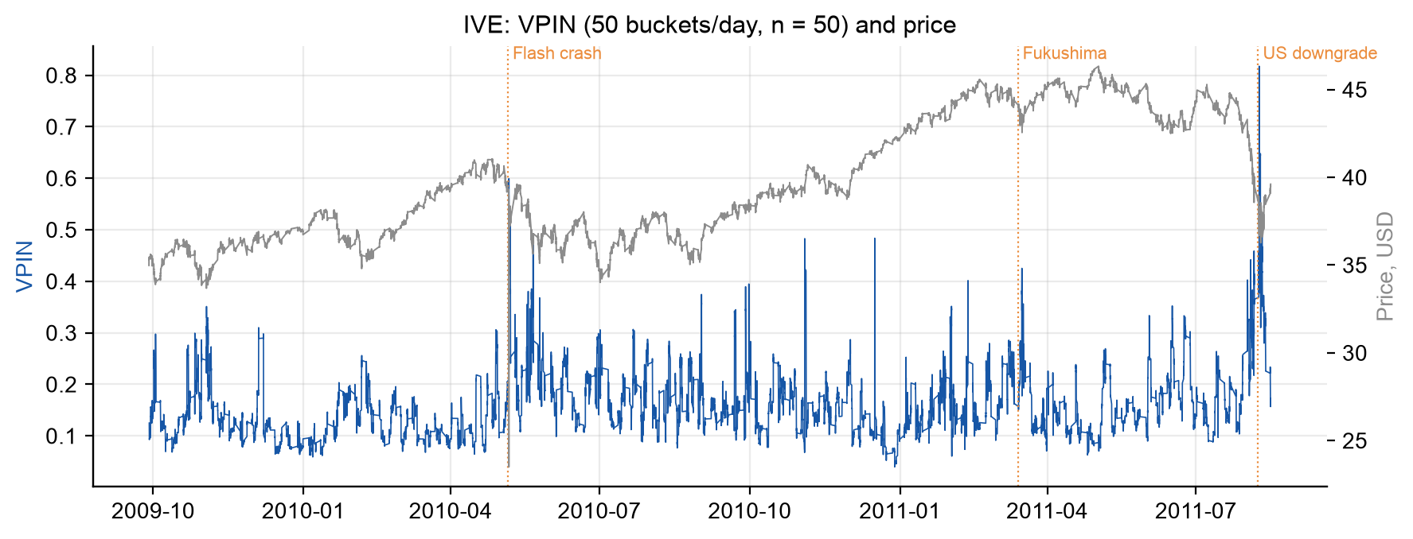
Backup: the VPIN metric and how it is read
Research Seminar
• Bucket size V = average daily volume / 50; window n = 50 buckets ≈ one day.
• Updated after every bucket: on busy days many times per hour.
• Levels depend on classification and settings, so the paper reads CDF(VPIN) over the whole sample. Alarm: CDF > 0.9.
• Claim: high VPIN warns of toxicity-induced volatility.
Notes:
Method, ~1 min. Baseline: V = average daily volume / 50 and n = 50, so VPIN is about one day of trading, updated 50 times a day. The paper reads VPIN through its CDF over the whole sample; an alarm is CDF above 0.9. Note for Q&A: a whole-sample CDF uses future data (see the overfitting slide).

Slide 23
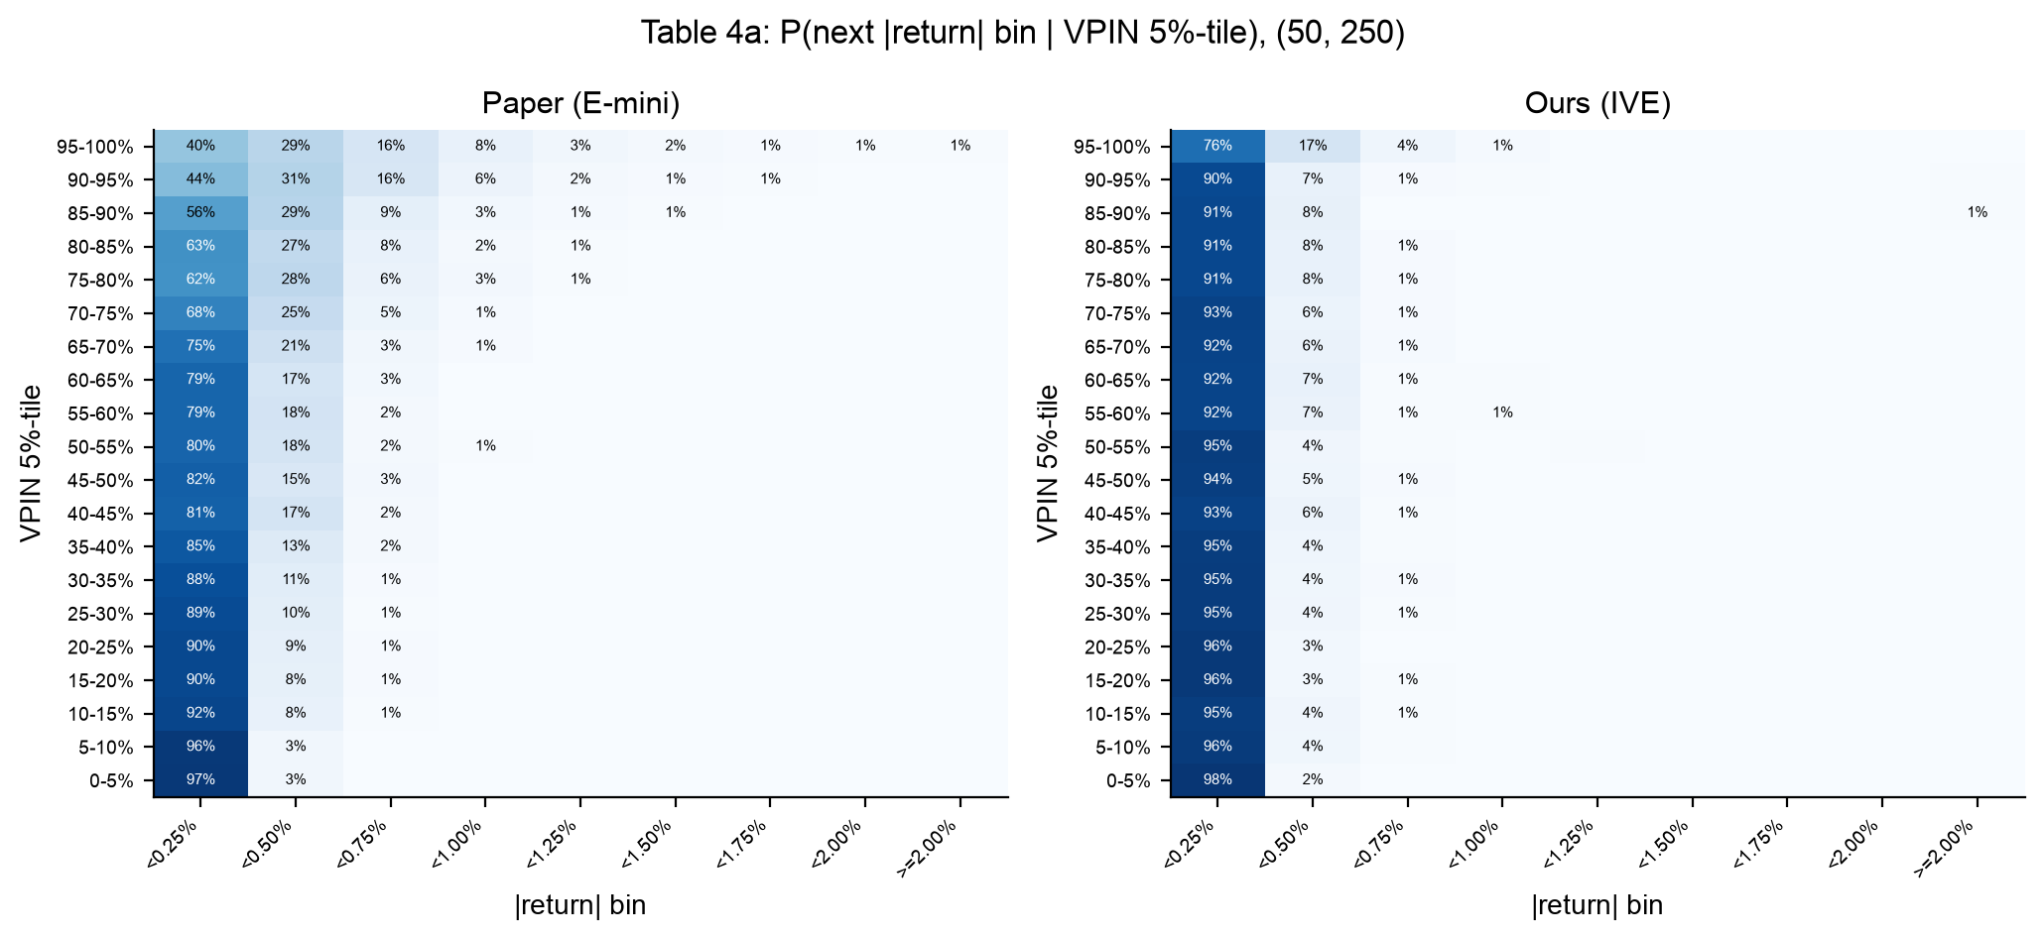
Backup: high VPIN and large moves (Tables 4 and 5)
Research Seminar
Paper reports (E-mini)
• Bottom-quartile VPIN → next |return| < 0.25%: > 90%
• P(VPIN top quartile | move > 0.75%): > 84%
• Big move while VPIN stays high, (10, 350): 78.6%
On IVE (± s.e.)
• Bottom quartile → < 0.25%: 96.1% ± 0.5%
• P(top quartile | move > 0.75%): 51% ± 13%
• Big move while VPIN stays high, (10, 350): 60% ± 12%, 95% CI [37%, 85%]
• Low VPIN = calm reproduces; the warning value is weaker or uncertain.
Notes:
Results, ~1 min. The heat maps are two separate panels: the paper's Table 4a and ours. Low VPIN does mean calm in both. The warning claims are weaker on IVE; the Table 5 number is consistent with ours only because our interval is wide (few stays in the top quartile at 10 buckets a day). Sources: results/reproduction/table4a.csv, table5.csv, summary.json (uncertainty).

Slide 24
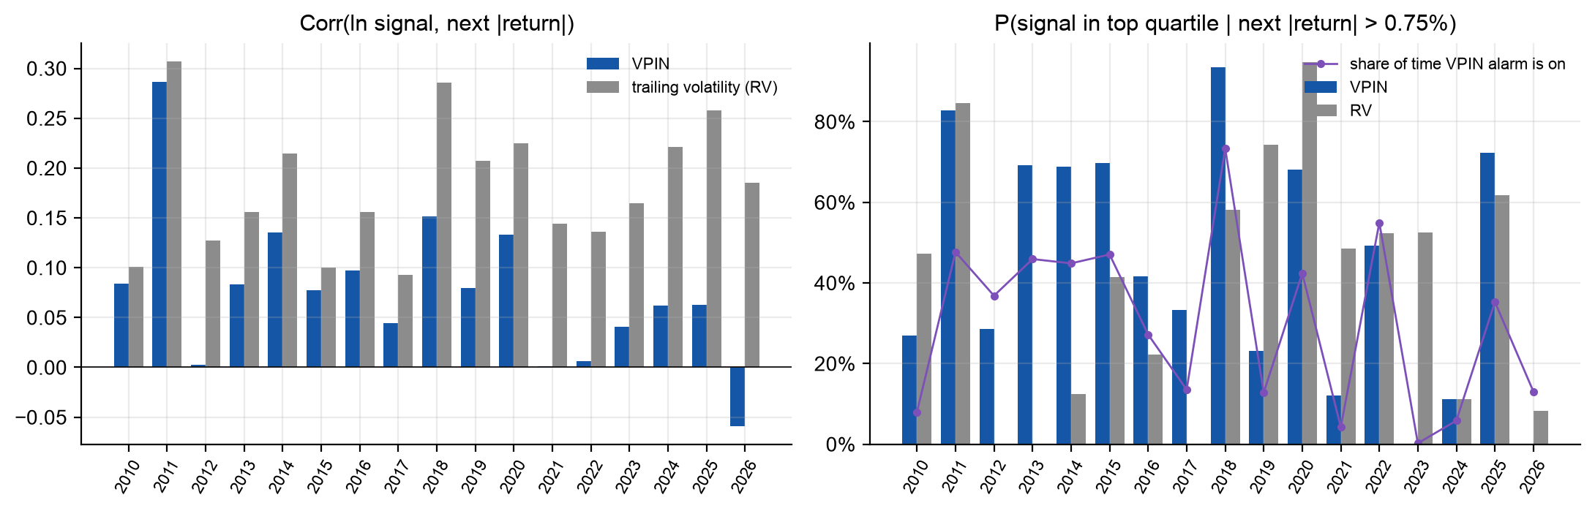
Backup: real-time VPIN out of sample, year by year
Research Seminar
• Paper's (50, 250), 2011–26: corr VPIN 0.09 ± 0.03 vs trailing volatility 0.24 ± 0.02; lift 1.57 ± 0.20 vs 2.76 ± 0.28.
Notes:
Upgrade, ~1 min. Fifteen years after the paper, one data source. Year by year, VPIN's correlation with the next move is small and unstable, trailing volatility is higher almost every year, and the share of time the VPIN alarm is on drifts a lot — a CDF from the past does not fit the future. Source: results/extensions/ive_by_year.csv, ive_oos_comparison.csv.

Slide 25
Backup: crashes after the paper
Research Seminar
Market | Day | Largest 1-hour fall | VPIN alarm | VPIN alarm, true labels | Volatility alarm
BTC | 2021-05-19 | -22.9% | on | off | off
BTC | 2024-08-05 | -8.9% | off | off | off
BTC | 2025-10-10 | -11.6% | off | on | off
IVE | 2011-08-08 | -3.2% | on | – | on
IVE | 2015-08-24 | -5.1% | on | – | on
IVE | 2018-02-05 | -2.7% | on | – | off
IVE | 2020-03-16 | -4.6% | on | – | on
IVE | 2024-08-05 | -1.0% | on | – | off
 | Alarm | Hits | On overall | p
BTC | VPIN | 1 of 3 | 10% | 0.261
BTC | VPIN, true labels | 1 of 3 | 14% | 0.355
BTC | Volatility | 0 of 3 | 3% | 1.000
IVE | VPIN | 5 of 5 | 15% | < 0.001
IVE | Volatility | 3 of 5 | 9% | 0.006
• p: chance of that many hits if the alarm were on at random with its overall rate (falls treated as independent).
• IVE: VPIN on at every fall. BTC: nothing reliable. Few events.
Notes:
Upgrade, ~45 s. Was the real-time alarm (CDF >= 0.9) on when each day's largest one-hour fall began? Compare hits with how often the alarm is on overall. The binomial p-value assumes falls are independent draws, which they are not (several fall inside weeks of turmoil, e.g. Aug 2011, Mar 2020), so it is a rough guide. On IVE VPIN's alarm was on at every fall — the extension result most favourable to VPIN. Source: results/extensions/crash_events.csv, crash_alarm_summary.csv.

Slide 26
Backup: repository and how to run it
Research Seminar
src/vpin/
data.py IVE ticks, BTC klines and trades; cancelled trades
bars.py time bars, within-day price changes
classify.py BVC, tick rule, Lee-Ready
buckets.py equal-volume buckets
metric.py VPIN, full-sample and real-time CDF
analysis.py Tables 1–5, Figures 10–14
realtime.py no-look-ahead pipeline
paper_numbers.py the paper's numbers with pages
scripts/ download, reproduce, extensions, report, slides
tests/ unit tests (incl. Table 1 formula check)
DEVIATIONS.md every deviation and silent decision
Run
pip install -r requirements.txt
pytest -q
python scripts/download_kibot.py
python scripts/download_binance.py
python scripts/reproduce.py
python scripts/extensions.py
python scripts/make_report.py
Free data: 942,321 IVE trades in the paper's period; BTCUSDT 2020–2026.
Notes:
Code is ours, written from scratch. One command per stage; every number in the README and these slides is read from results/. Raw data are downloaded by scripts, not committed.

