Slide 1
COLLEGE LIBRARY PANEL
PROJECT NAME:

Slide 2
ZAVED ALAM (53)
SUBMITTED BY:
TRAINING CENTRE:
RITUSHA CONSULTANTS PRIVATE LIMITED (RCPL), KANPUR

Slide 3
PROJECT GOAL
Our main goal of this project is to create a library panel or software which will save time of students as well as department employee.
On the other hand it will improve delivery of information in various print and non-print formats for resource sharing, and through this advanced system, improve education objectives.

Slide 4
I Chose Python Because Of Many Reasons: .Demand for python developers .Python shop: one of the largest internet company in the world .Simple, flexible,open sourse,supports different platform .User-friendly data structures
Why We Chose Python?

Slide 5

SOFTWARE REQIREMENTS
Python2.X
Pycharm
Mysql

Slide 6

Python is a widely used general-purpose, high level programming language. It was initially designed by Guido Van Rossum in 1991 and developed by python software foundation.
It was developed mainly for emphasis on code readability, and its syntax allows programmers to express concepts in fewer lines of code.

Slide 7
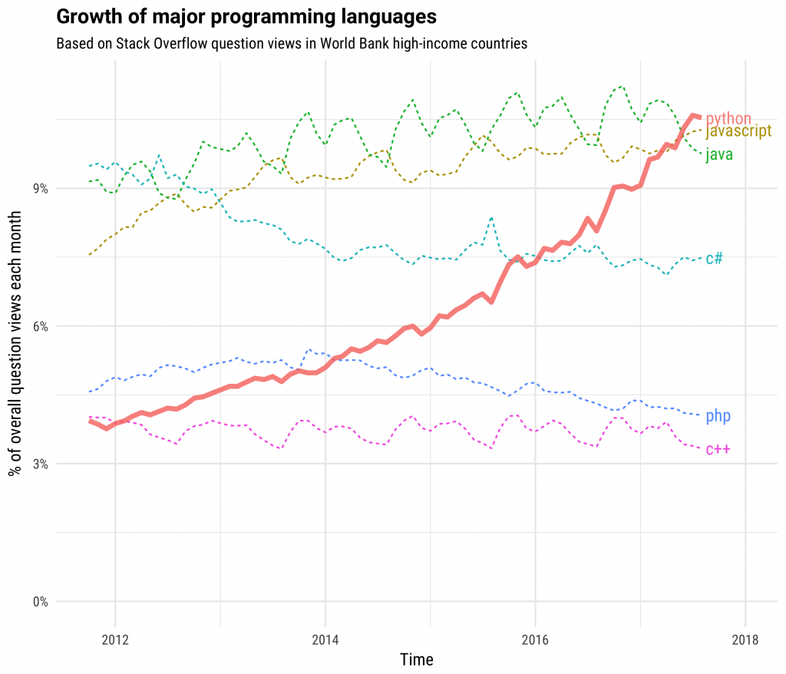
Amazing growth rate of python:

Slide 8

DESCRIPTION: ROLE
Employee: Employee is the administrator of the Library Panel to control the entire management
Student: Student is the accessor or user of the library panel.
DESCRIPTION: FUNCTIONALITY
SignUp/Registration.
SignIn/Login.
Add Book Details.
Delete Book From Record.
View Books List.
Search Book.
Issue Book to Student.

Slide 9
FUNCTIONALITY: Student
SignUp/Registration.
SignIn/Login.
View Books List.
Search Book.
DESCRIPTION: DATABASE TABLES
Login: lid(PK)(rollno, empid), pass, name, role(emp, stu)
Books: bid(PK), title, subject, author, status(avail/issued)
Stu_detail: empid(PK), name, dept, doj, salary
Issue_detail: bid, issueto(rollno), issueby(empid)

Slide 10



Project Analysis
According to our project goal we have following modules:
FirstScr.py
FunLib.py
LoginScr.py
Register.py
stp_python.sql

Slide 11

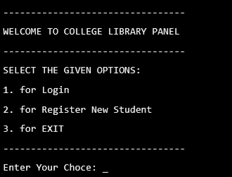
FIRST SCREEN

Slide 12
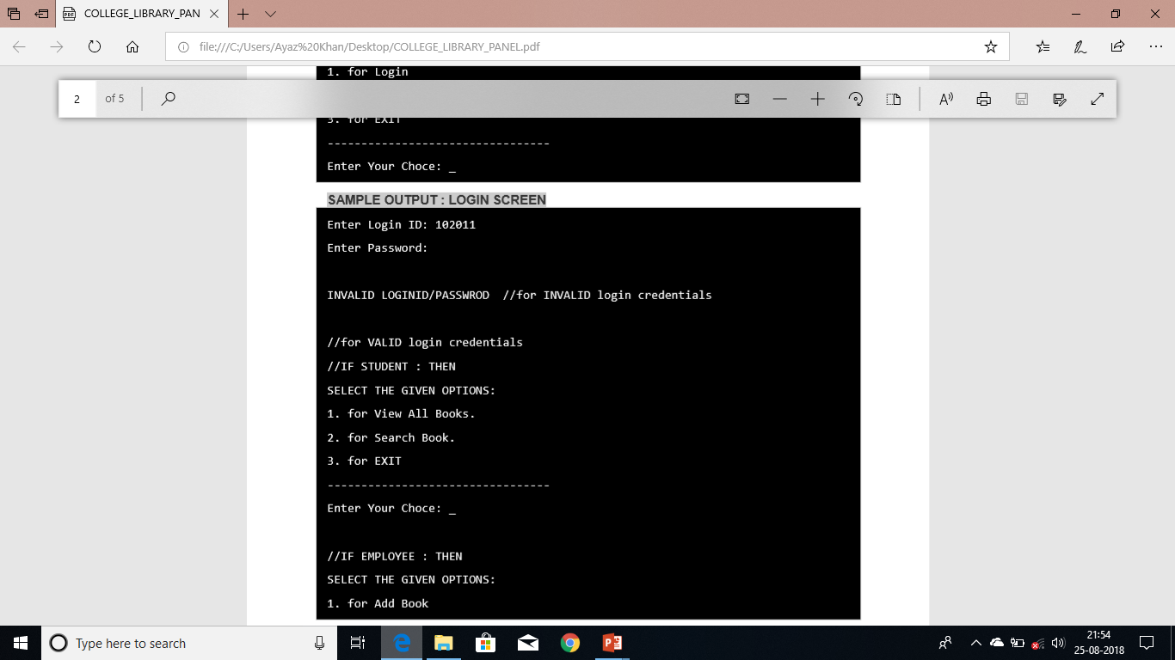
SAMPLE OUTPUT : LOGIN SCREEN

Slide 13
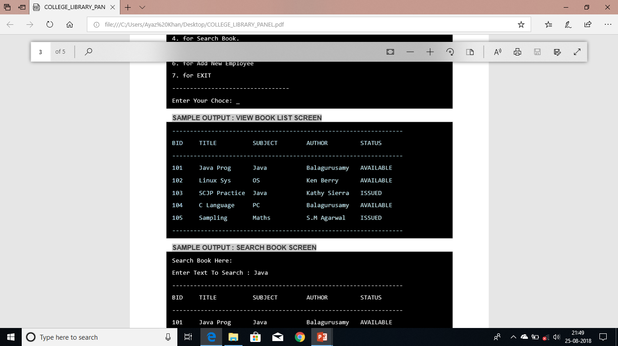
SAMPLE OUTPUT : VIEW BOOK LIST SCREEN

Slide 14
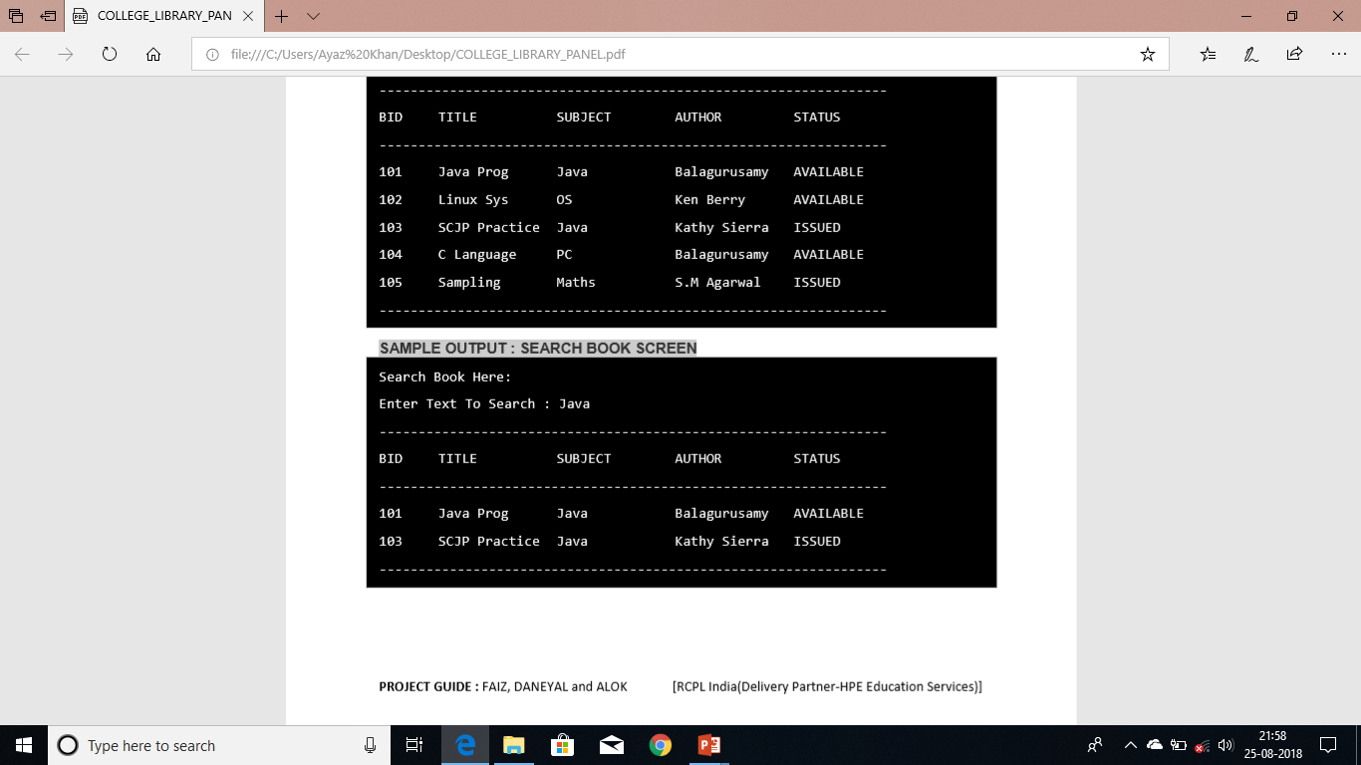
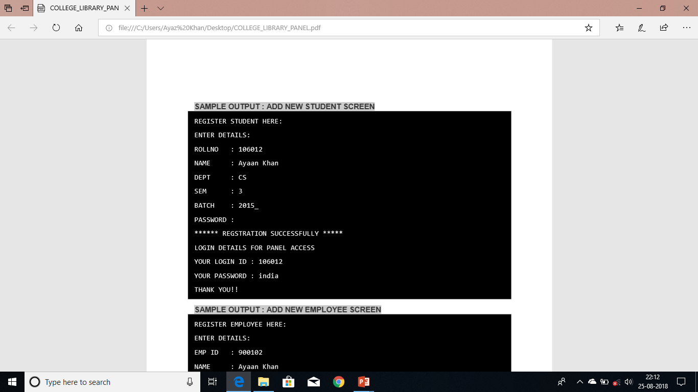
SAMPLE OUTPUT : SEARCH BOOK SCREEN &ADD NEW STUDENT

Slide 15
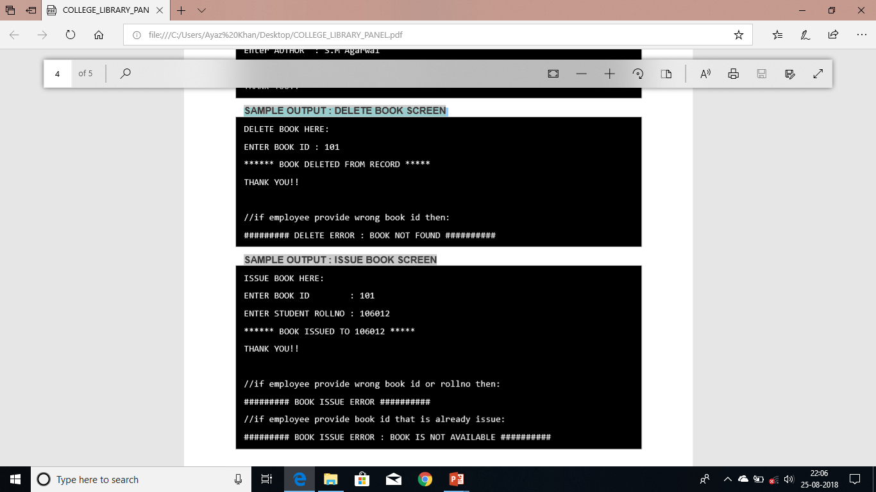
SAMPLE OUTPUT : DELETE &ISSUE BOOK SCREEN

Slide 16
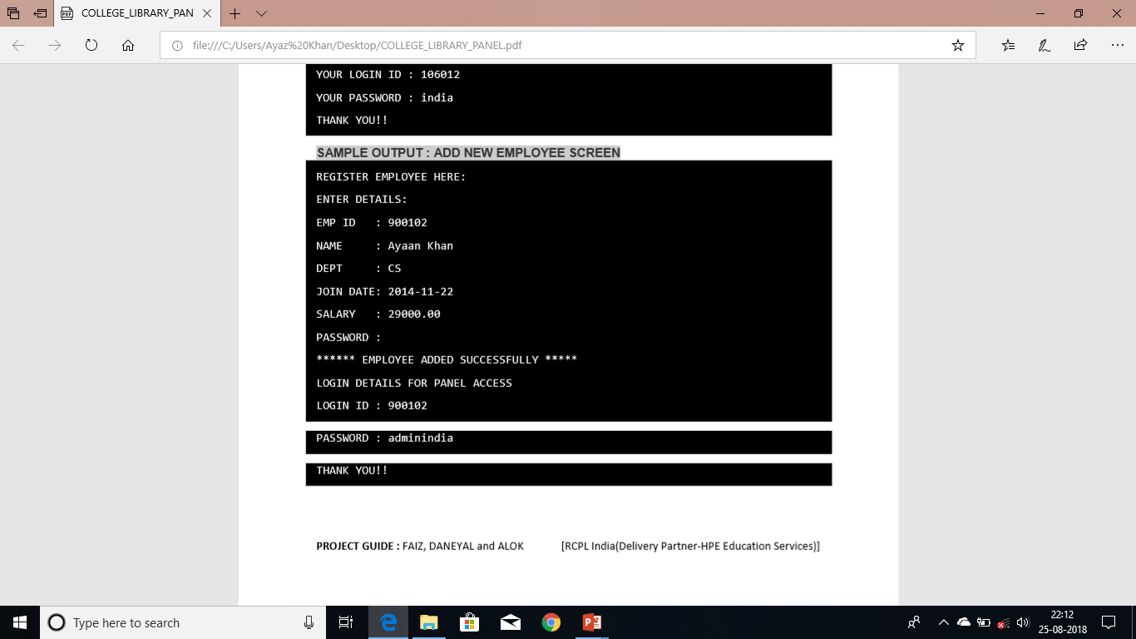
SAMPLE OUTPUT : ADD NEW EMPLOYEE SCREEN

Slide 17
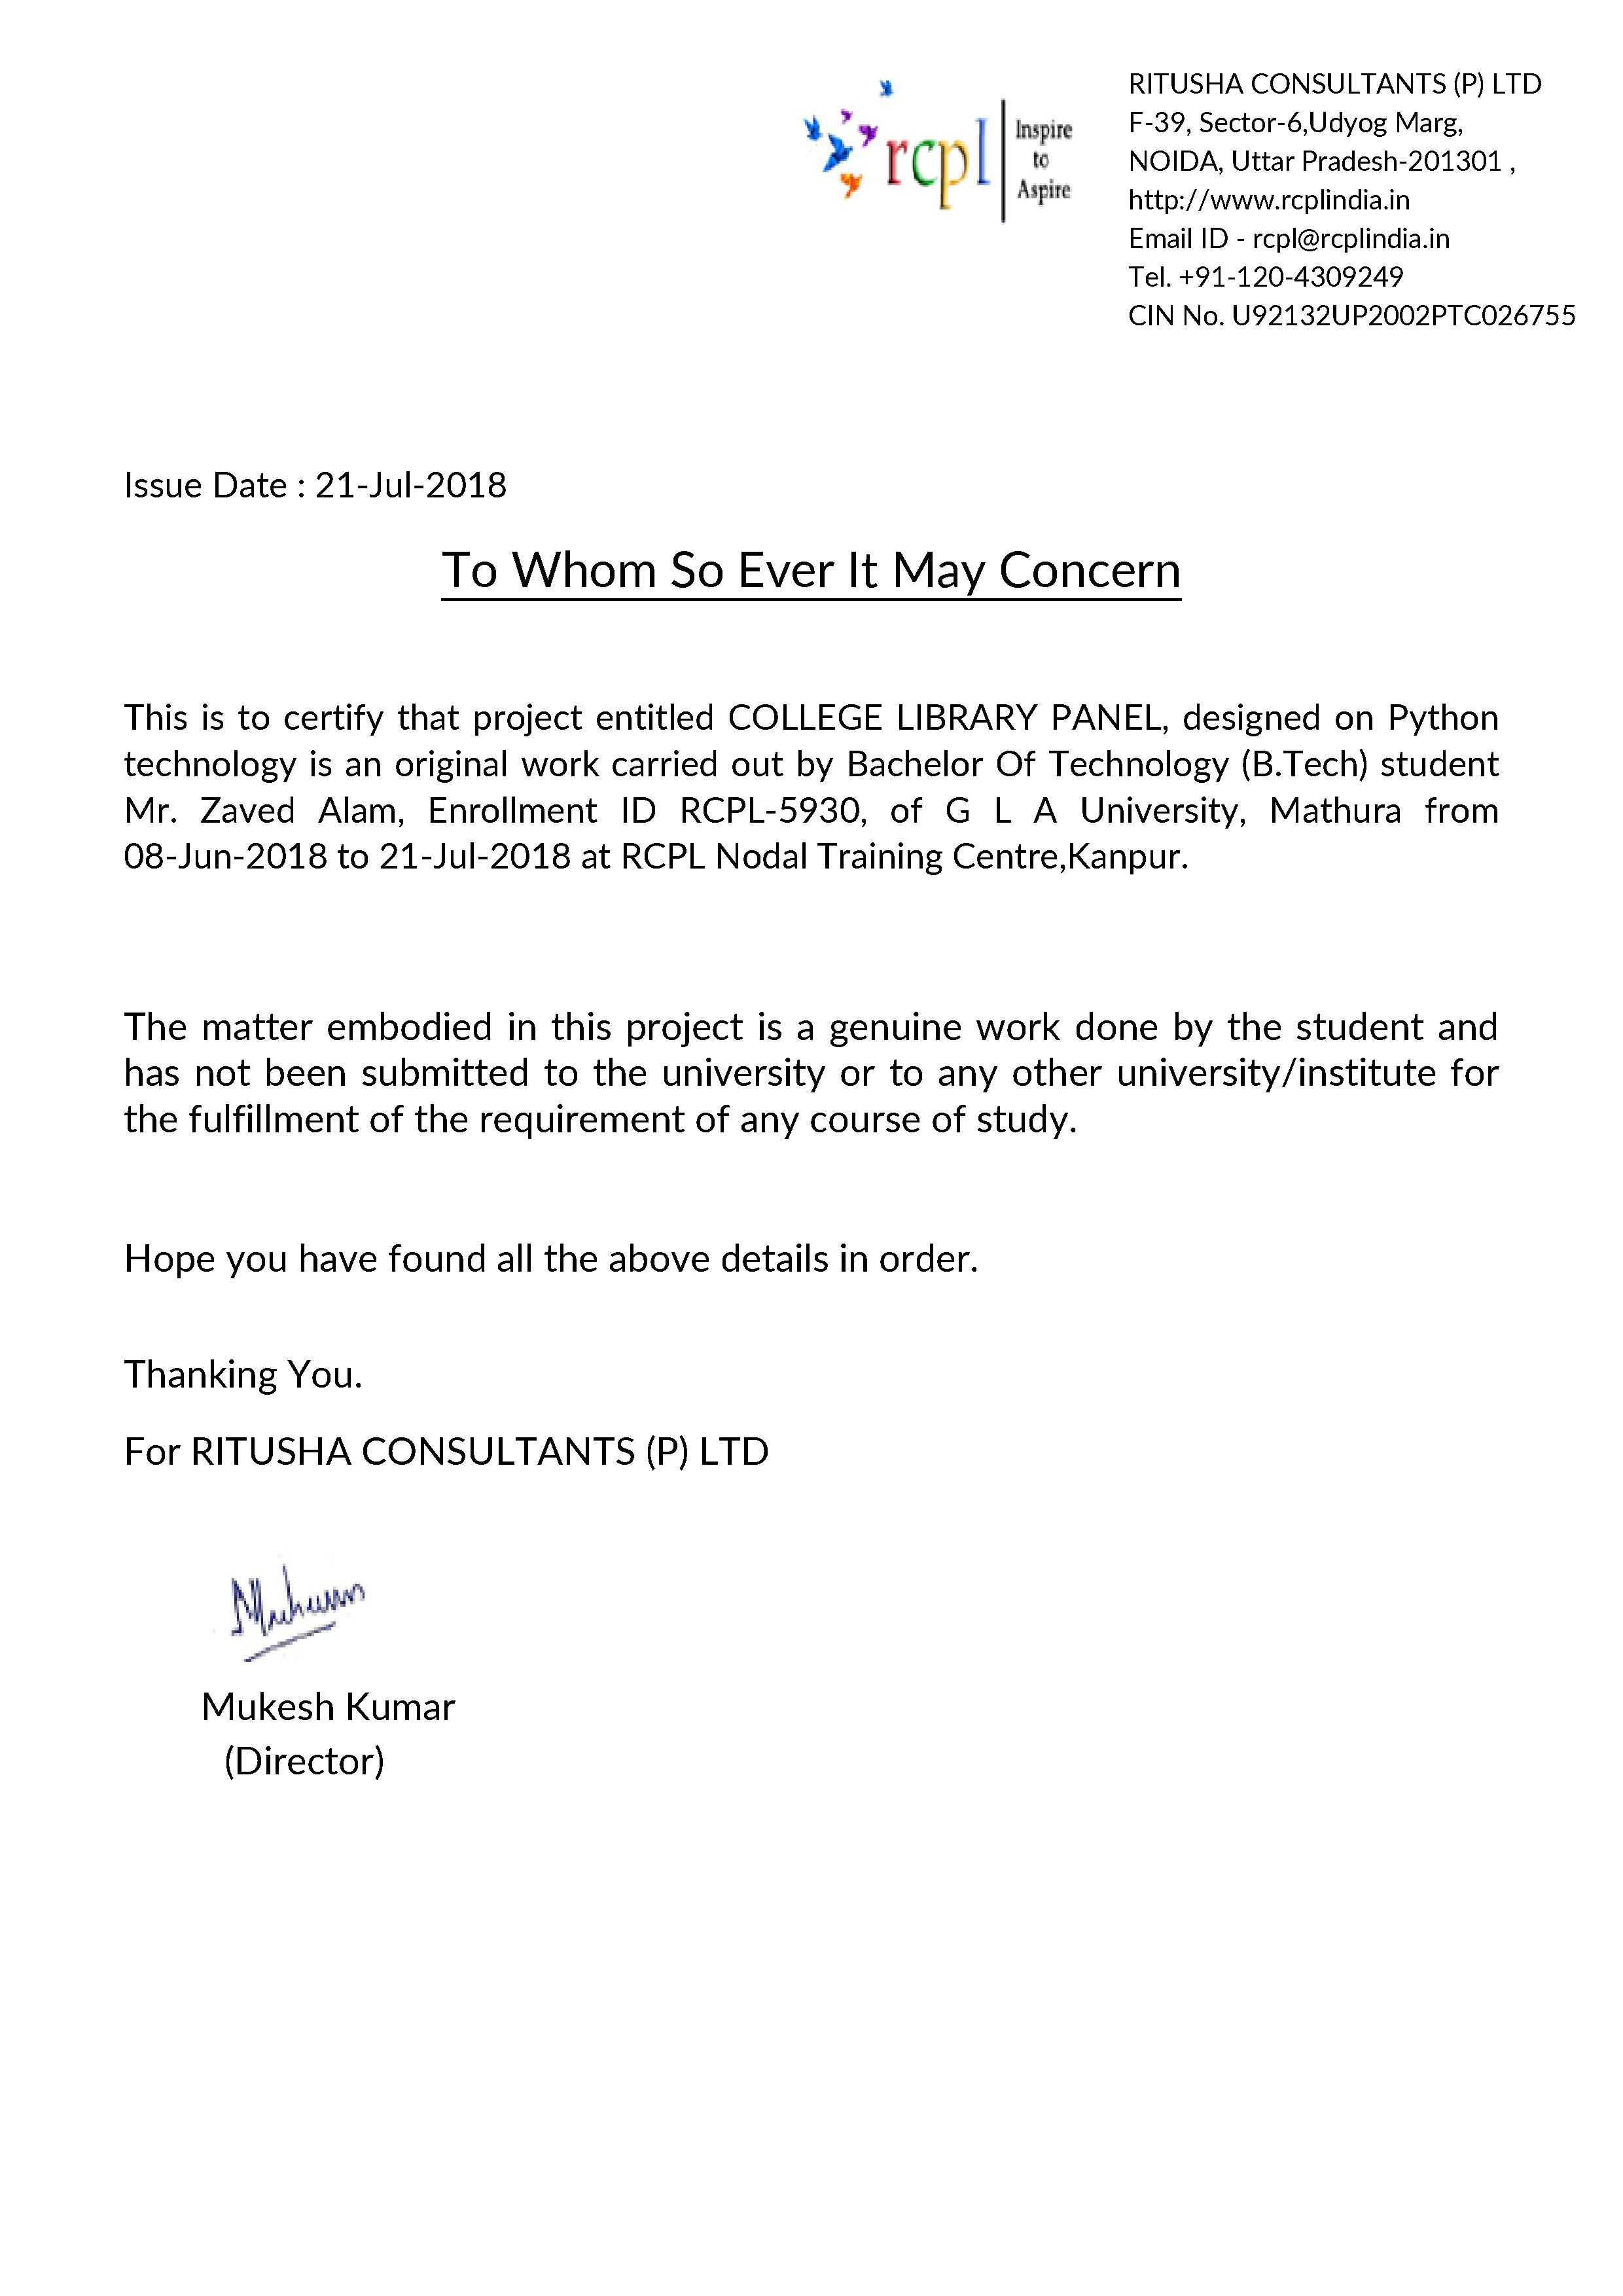

Slide 18


Slide 19

Thank You
Thank You

