Slide 1

MINI PROJECT II
2019
Design and implementation of Android
Application for easy driving

Slide 2
Supervised By
Mr. Neeraj Khanna
Assistant professor
Training Department of Computer Engineering & Applications
Team Members
Ayaz Khan (161500154)
Honey Vishwakarma (161500243)
Shivangi Tripathi (161500278)
Zaved Alam (161500646)

Slide 3
INTRODUCTION
What is the Actual problem?
Carrying all the documents and certificates daily is challenging. so we tend to keep the documents inside the vehicle. Sometimes people lose or forget them to carry. Suppose the vehicle is stolen, we lose our documents too a Driving a vehicle is a very careful task. It requires a level of expertise and license along with the documents. As a vehicle owner, you are responsible for keeping your vehicle in roadworthy condition as well as presenting it for roadworthiness testing. It requires documents certificate for proof.

Slide 4
To develop an android application for the necessary documents requires. By the help of this application we won’t need to worry about carrying and thus losing our documents. We could also save our time and money to obtain a new document.
SOLUTION

Slide 5
FEATURES
This digital wallet for all transport related documents will be available On Android plateform.
This would also offers option to add multiple Beneficiary. Therefore all the Person who are registered as Beneficiary can also use someone’s
Vehichle ,which is legally verified by RTA under Drivezy Wallet.
Motorist can show Drivezy application on their smartphones to police or
Road Transport Authority(RTA) authorities during checking.

Slide 6
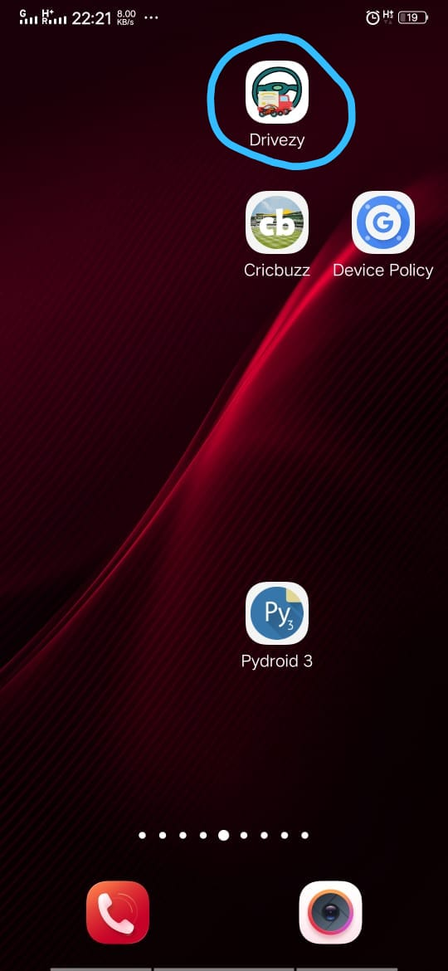
SNAPSHOT
The blue marked item represent the Drivezy application ,on clicking it would open the application Which result the creation of main activity.

Slide 7
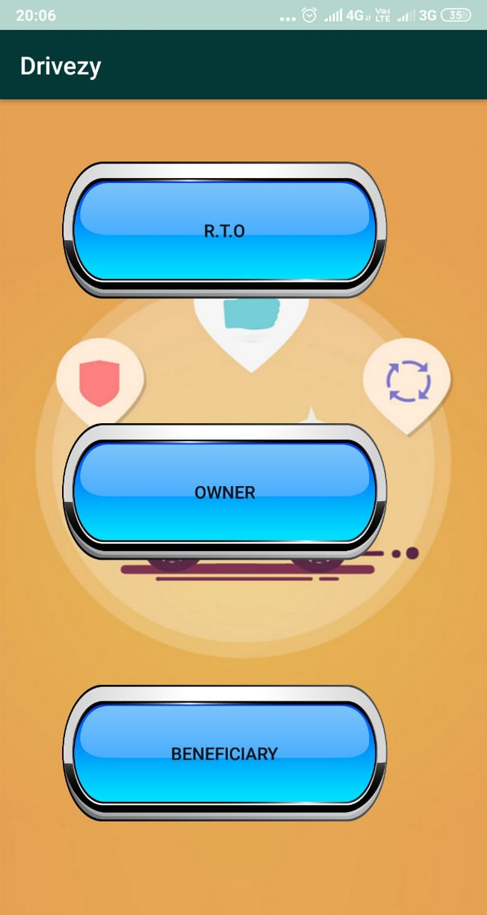
SNAPSHOT(CONTINUED)
This is the first screen or activity of the project output in which we have three options -
RTO
OWNER
BENEFICIARY

Slide 8
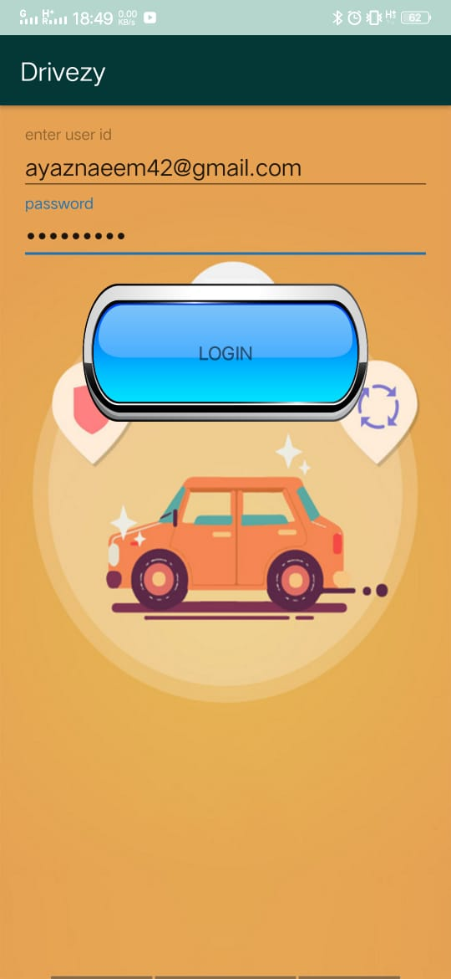
SNAPSHOT(CONTINUED)
After app main activity launched if user click on RTO Button of device,the RTO login screen will be appeared.

Slide 9
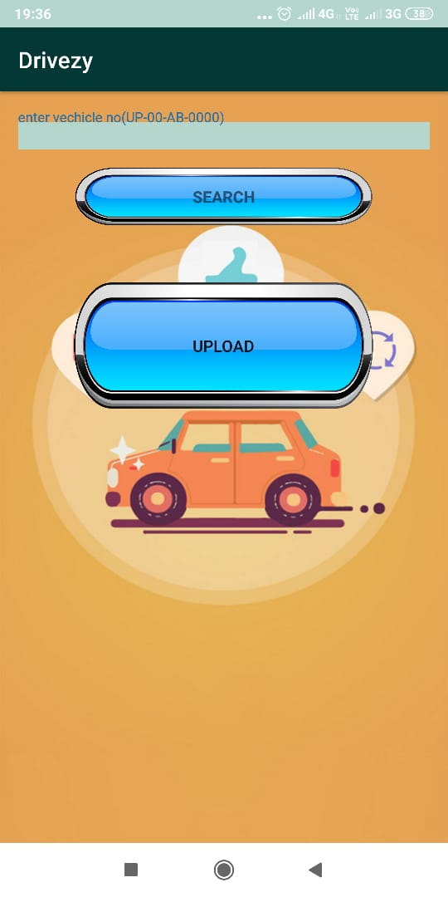
SNAPSHOT(CONTINUED)
After successfully login you may have two options -
Search
Upload

Slide 10
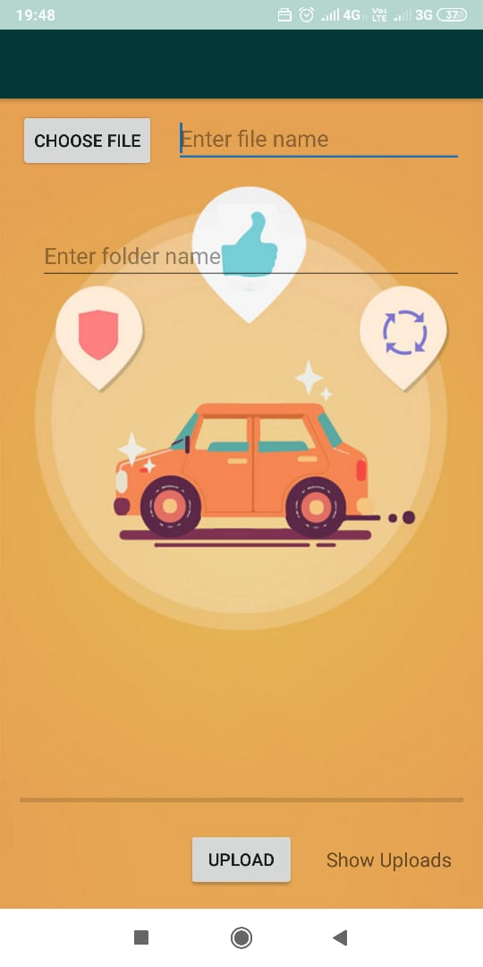
SNAPSHOT(CONTINUED)
With the help of choose file button you can select documents and upload that document in a particular folder.

Slide 11
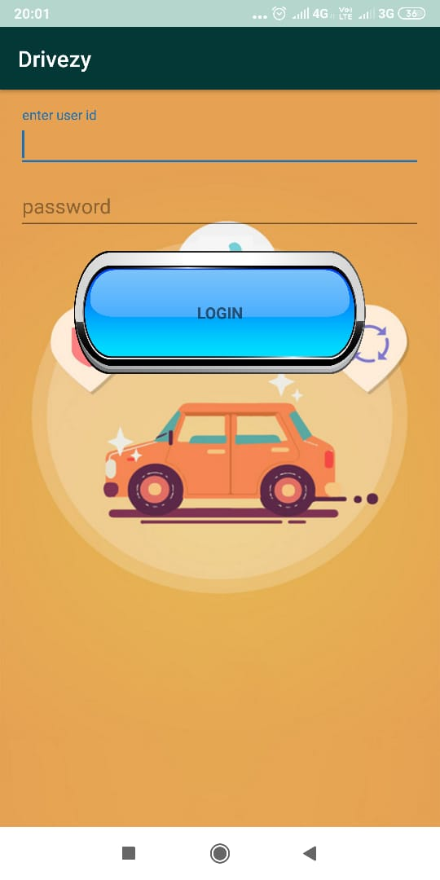
SNAPSHOT(CONTINUED)
If user click on OWNER Button of device,the Owner login screen will be appeared.

Slide 12
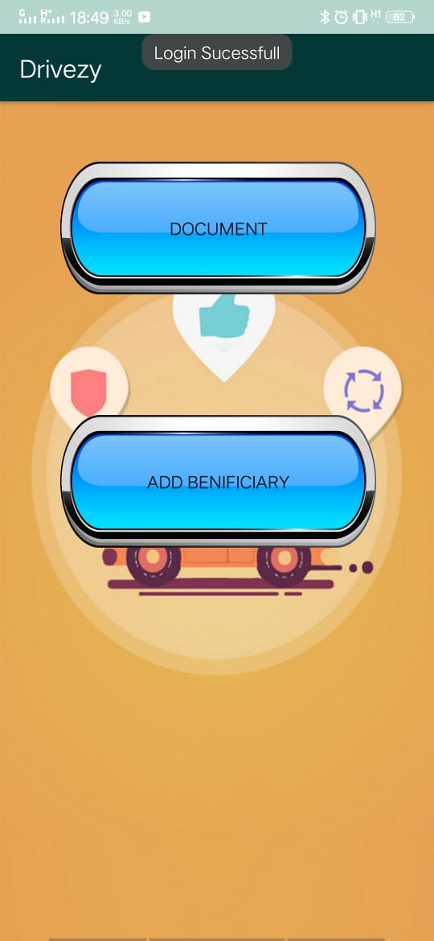
SNAPSHOT(CONTINUED)
After successfully login owner may have two options -
Document
Add Beneficiary

Slide 13
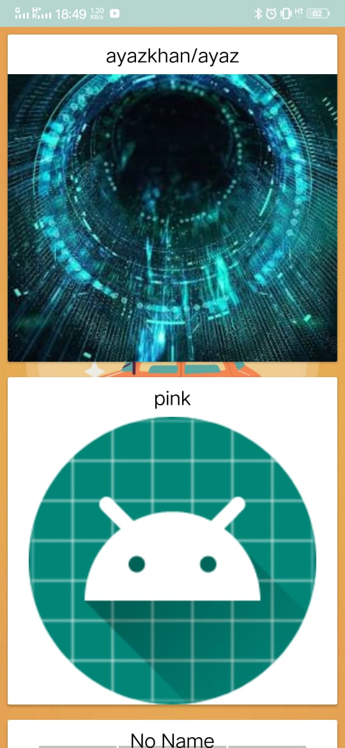
SNAPSHOT(CONTINUED)
Now, In this activity owner can see their own documents related to their vehicles.

Slide 14
FUTURE SCOPE
This is helpful for people as well as RTO and Police stations investigating a lost vehicle. The road worthiness certificates are easy to check as it would be readily available.
This project helps in saving time effort and money. It also helps in detection of fake documents and stolen vehicles.

Slide 15
CONCLUSION
People face problem as stated. We have come up with an innovative and effective solution which would solve the given social problem.

