Slide 1
The Impact of Docker Containers on Service Latency
答辩人： 章佐铭
指导教师： 李超
专业：计算机科学与技术

Slide 2
Contents
1
Background & Motivation
2
Experiment & Results
3
Conclusion & Insufficiency
4
Future Work

Slide 3
Background
Virtual Machine
vs Docker Container
APP
APP
APP
Bins/Libs
Bins/Libs
Bins/Libs
Guest OS
Guest OS
Guest OS
APP
APP
APP
Bins/Libs
Bins/Libs
Bins/Libs
Hypervisor
Docker Engine
Hypervisor
Host Operating System
Host Operating System
Infrastructure
Infrastructure

Slide 4
Related Works
IBM’s report (Felter et al., 2015)
Measurement | Workload |  | Native | Docker | KVM
CPU | PXZ (MB/s) |  | 76.2 [±0.93] | 73.5 (-4%) [±0.64] | 59.2 (-22%) [±1.88]
Random memory access | RandomAccess |  | 0.0126 [±0.00029] | 0.0124 (-2%) [±0.00044] | 0.0125 (-1%) [±0.00032]
Memory bandwidth | Stream (GB/s) | Add | 45.8 [±0.21] | 45.6 (-0%) [±0.55] | 45.0 (-2%) [±0.19]
 |  | Copy | 41.3 [±0.06] | 41.2 (-0%) [±0.08] | 40.1 (-3%) [±0.21]
 |  | Scale | 41.2 [±0.08] | 41.2 (-0%) [±0.06] | 40.0 (-3%) [±0.15]
 |  | Triad | 45.6 [±0.12] | 45.6 (-0%) [±0.49] | 45.0 (-1%) [±0.20]
Measurement | Workload |  | Native | Docker | KVM
CPU | PXZ (MB/s) |  | 76.2 [±0.93] | 73.5 (-4%) [±0.64] | 59.2 (-22%) [±1.88]
Random memory access | RandomAccess |  | 0.0126 [±0.00029] | 0.0124 (-2%) [±0.00044] | 0.0125 (-1%) [±0.00032]
Memory bandwidth | Stream (GB/s) | Add | 45.8 [±0.21] | 45.6 (-0%) [±0.55] | 45.0 (-2%) [±0.19]
 |  | Copy | 41.3 [±0.06] | 41.2 (-0%) [±0.08] | 40.1 (-3%) [±0.21]
 |  | Scale | 41.2 [±0.08] | 41.2 (-0%) [±0.06] | 40.0 (-3%) [±0.15]
 |  | Triad | 45.6 [±0.12] | 45.6 (-0%) [±0.49] | 45.0 (-1%) [±0.20]

Slide 5
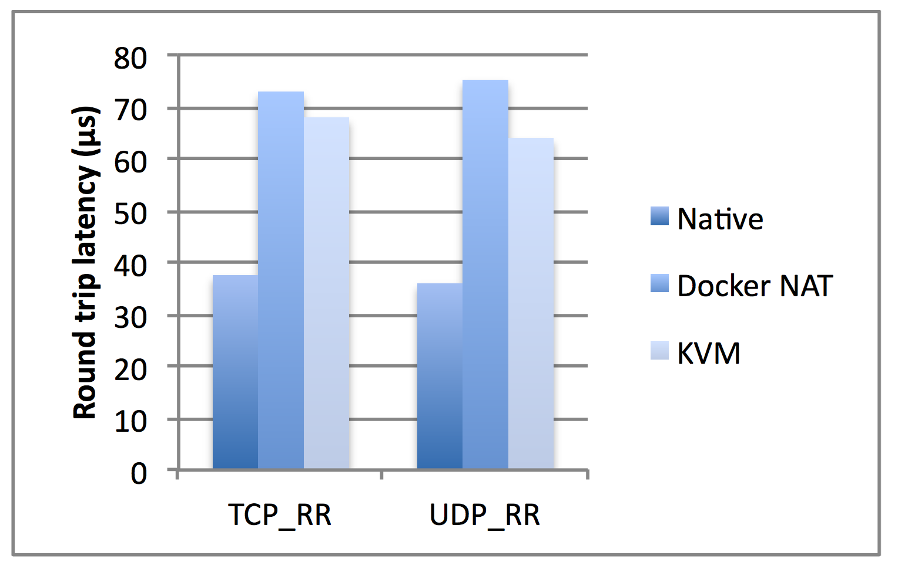
Related Works
IBM’s report (Felter et al., 2015)
80%
Network latency —— netperf

Slide 6
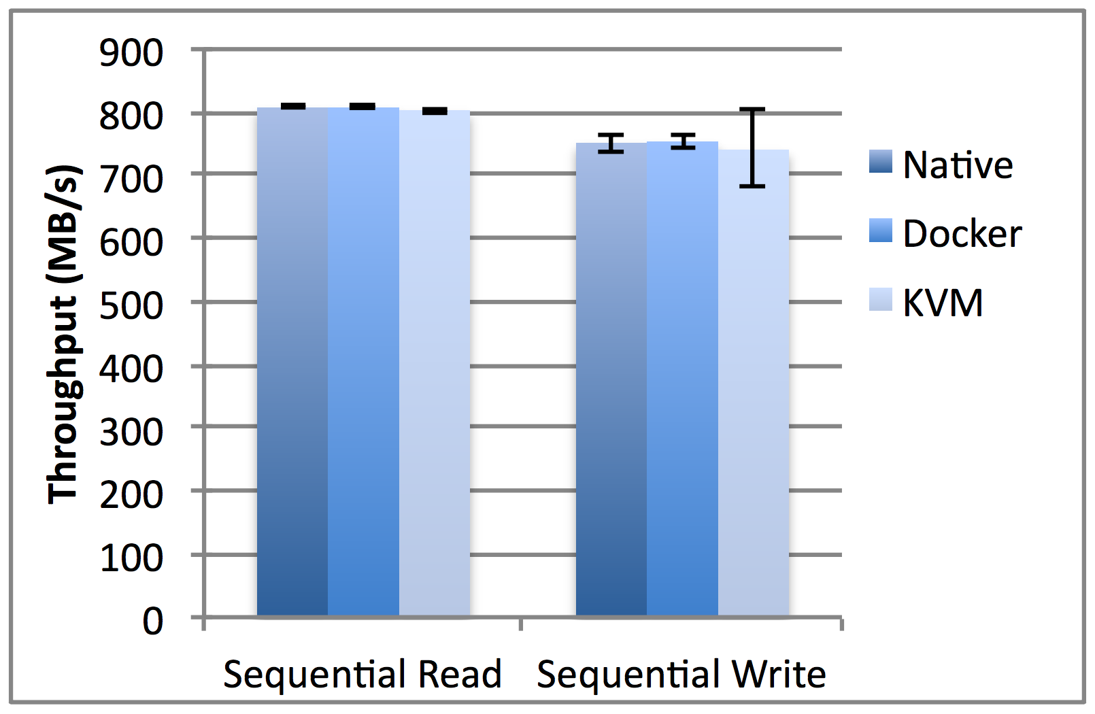
Related Works
IBM’s report (Felter et al., 2015)
Block I/O —— fio

Slide 7
Motivation
Increasing number of web applications
Deployment on cloud services
Overhead of traditional virtual machines
Tail latency
Container —— Lightweight virtual machine
Previous works focus on throughput

Slide 8
Experimental Methodology
Apache Thrift
Client
Server
Your Code
Your Code
Your Code
Your Code
FooService.
Client
FooService.
Server
FooService.
Client
FooService.
Server
Foo.
Write()/read()
Foo.
Write()/read()
Foo.
Write()/read()
Generated Code
Foo.
Write()/read()
TProtocol
TProtocol
TProtocol
TProtocol
TTransport
TTransport
TTransport
TTransport
Underlying
I/O
Underlying
I/O
Underlying
I/O
Underlying
I/O

Slide 9
Experimental Methodology
Two HP MicroServer nodes
Intel Xeon E3-1220L(2.3GHz)
RAM 4GB
RPC Call (Using Apache Thrift)
Python

Slide 10
Containerizing & Resource Limitation
Add isolcpus=3 to kernel boot option
Disable all interrupts on CPU #3
Client: task set –c 3
Server: cpuset-cpus=3

Slide 11
Experiment Aspects
CPU
Server
Network
Client
Memory
Disk I/O

Slide 12
Experiment Aspects
CPU
Server
Network
Client
Memory
Disk I/O

Slide 13
cpu-shares
Container A: cpu-shares=1024
Container B: cpu-shares=512
2
1

Slide 14
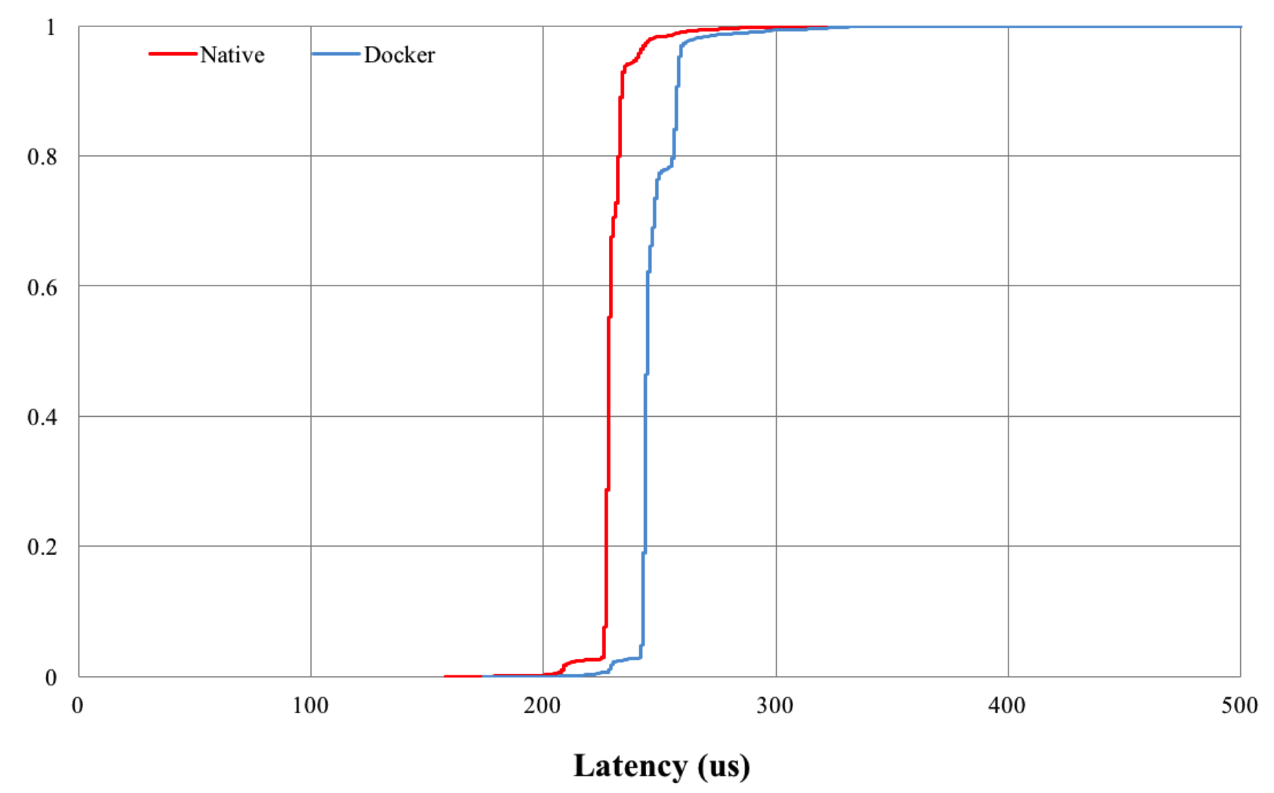
cpu-shares
CDF: cpu-shares=1024 vs Native (1,000,000 times)
 | Mean (us) | Median (us) | 99th-percentile (us)
Bare metal | 240.7 | 241.0 | 278.0
Docker container | 255.2 | 255.0 | 295.0

Slide 15
cpu-quota & cpu-period
cpu-period=10000
cpu-quota=1000, 1500, 2000, 2500, 3000, 4000
5000, 7000, 10000
quota(us) | mean(us) | median(us) | p99(us) | # > 1,000us | # × quota
1000 | 1035.4 | 307.0 | 7556.0 | 104996 | 104996000
1500 | 579.5 | 258.0 | 5816.0 | 68221 | 102331500
2000 | 489.0 | 281.0 | 4765.0 | 50187 | 100374000
2500 | 361.7 | 260.0 | 3232.0 | 37334 | 93335000
3000 | 291.9 | 259.0 | 1741.0 | 14273 | 42819000
4000 | 258.0 | 253.0 | 331.0 | 39 | 156000
5000 | 263.2 | 255.0 | 341.0 | 0 | 0
7000 | 256.7 | 250.0 | 341.0 | 0 | 0
10000 | 262.6 | 255.0 | 333.0 | 0 | 0

Slide 16
CPU Interference
Another container runs on the same CPU
Matrix multiplication 512 x 512
quota_{latency} + quota_{matrix} = period = 10000 us

Slide 17
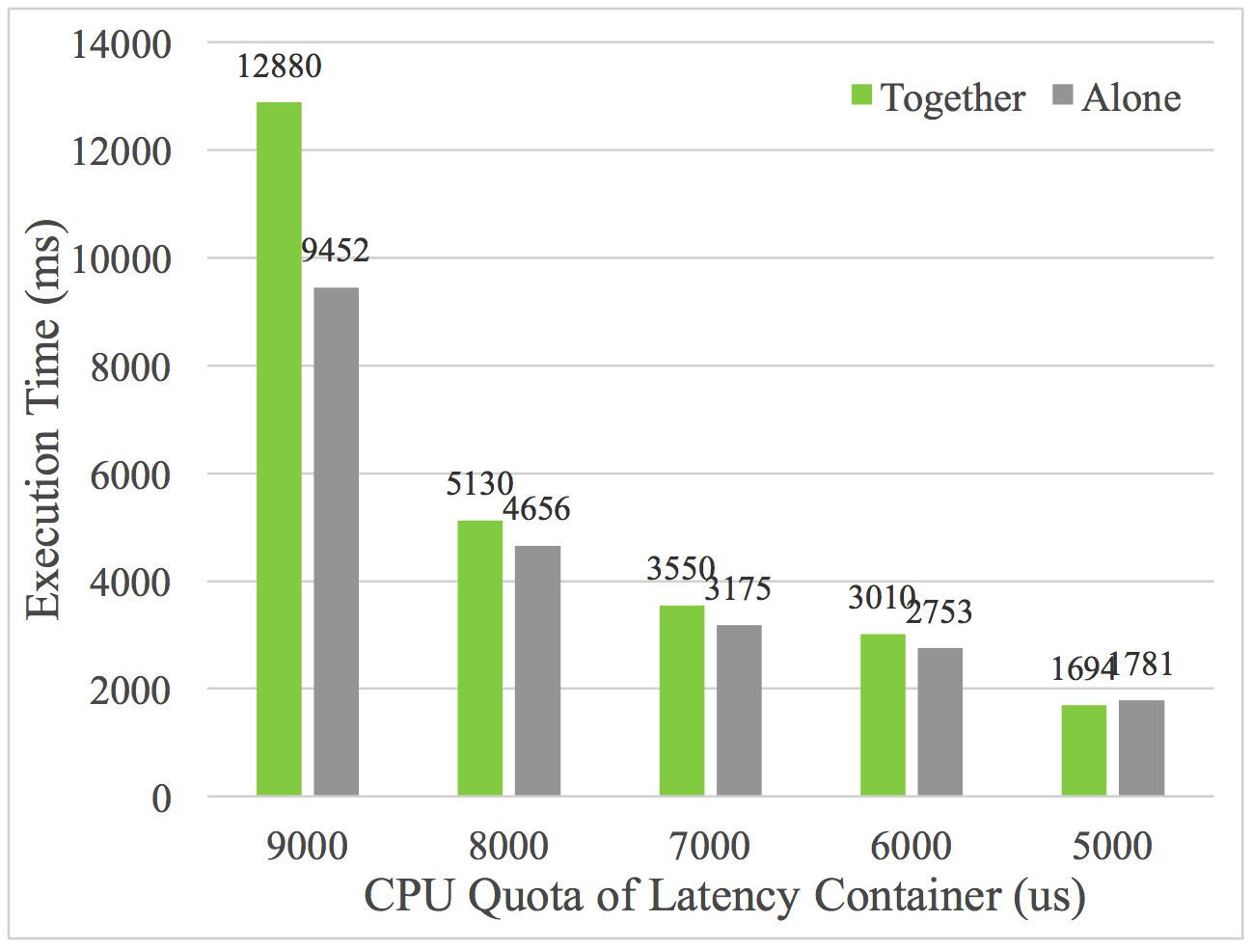
CPU Interference
Execution time of matrix multiplication

Slide 18
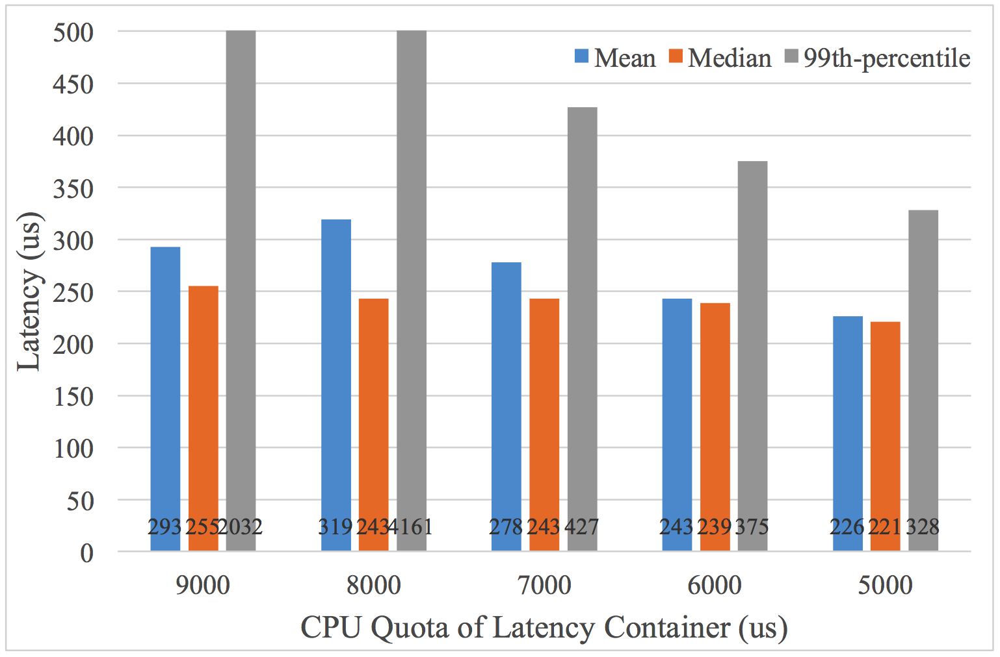
CPU Interference
Mean, median & p99 of the requests running together
 | Mean (us) | Median (us) | 99th-percentile (us)
Bare metal | 240.7 | 241.0 | 278.0
Docker container | 255.2 | 255.0 | 295.0

Slide 19
CPU Interference
Affect of context switch
No need to wait the matrix container
CPU frequency

Slide 20
Experiment Aspects
CPU
Server
Network
Client
Memory
Disk I/O

Slide 21
Network Isolation
SPECWeb2009 sizes(KB): 1, 4, 10, 30, 50, 70, 100
Server receives & sends data
Compare between using host & NAT

Slide 22
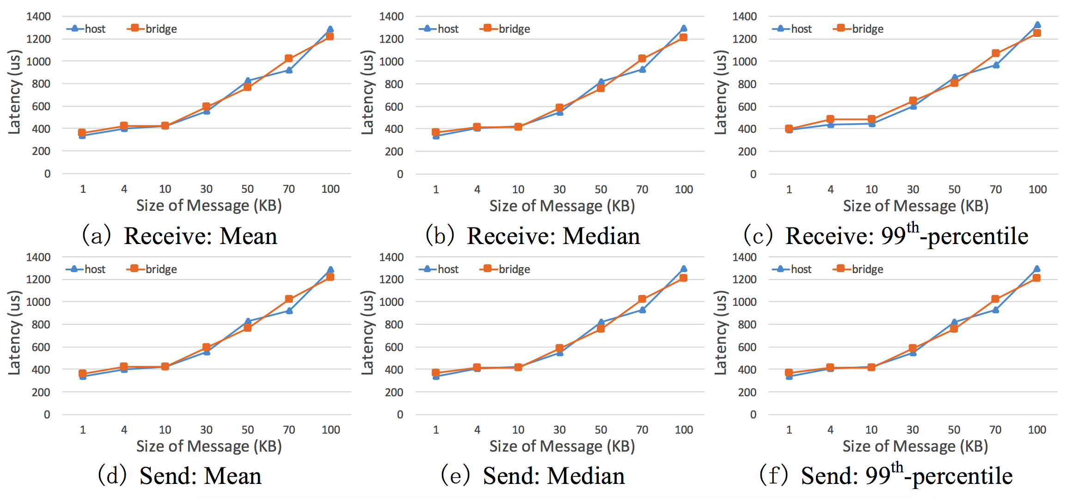
Network Isolation
Mean, median & p99 latency

Slide 23
Related Works
IBM’s report (Felter et al., 2015)
80%
Network latency —— netperf

Slide 24
Network Isolation
Mean, median & p99 latency

Slide 25
Network Isolation
IBM’s work
My work
80% slowdown
Slightly, fix-length latency
200 B
No less than 1 KB
Both in containers
Only server in container

Slide 26
Experiment Aspects
CPU
Server
Network
Client
Memory
Disk I/O

Slide 27
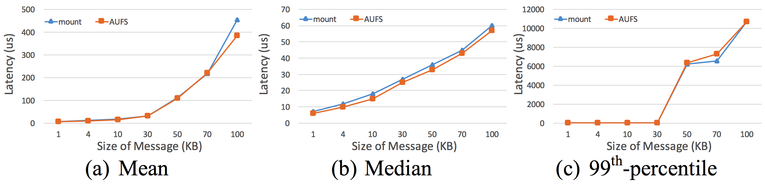
Sequential write
Message size(KB): 1, 4, 10, 30, 50, 70, 100
File already open
10,000 times execution
flush() after each iteration

Slide 28
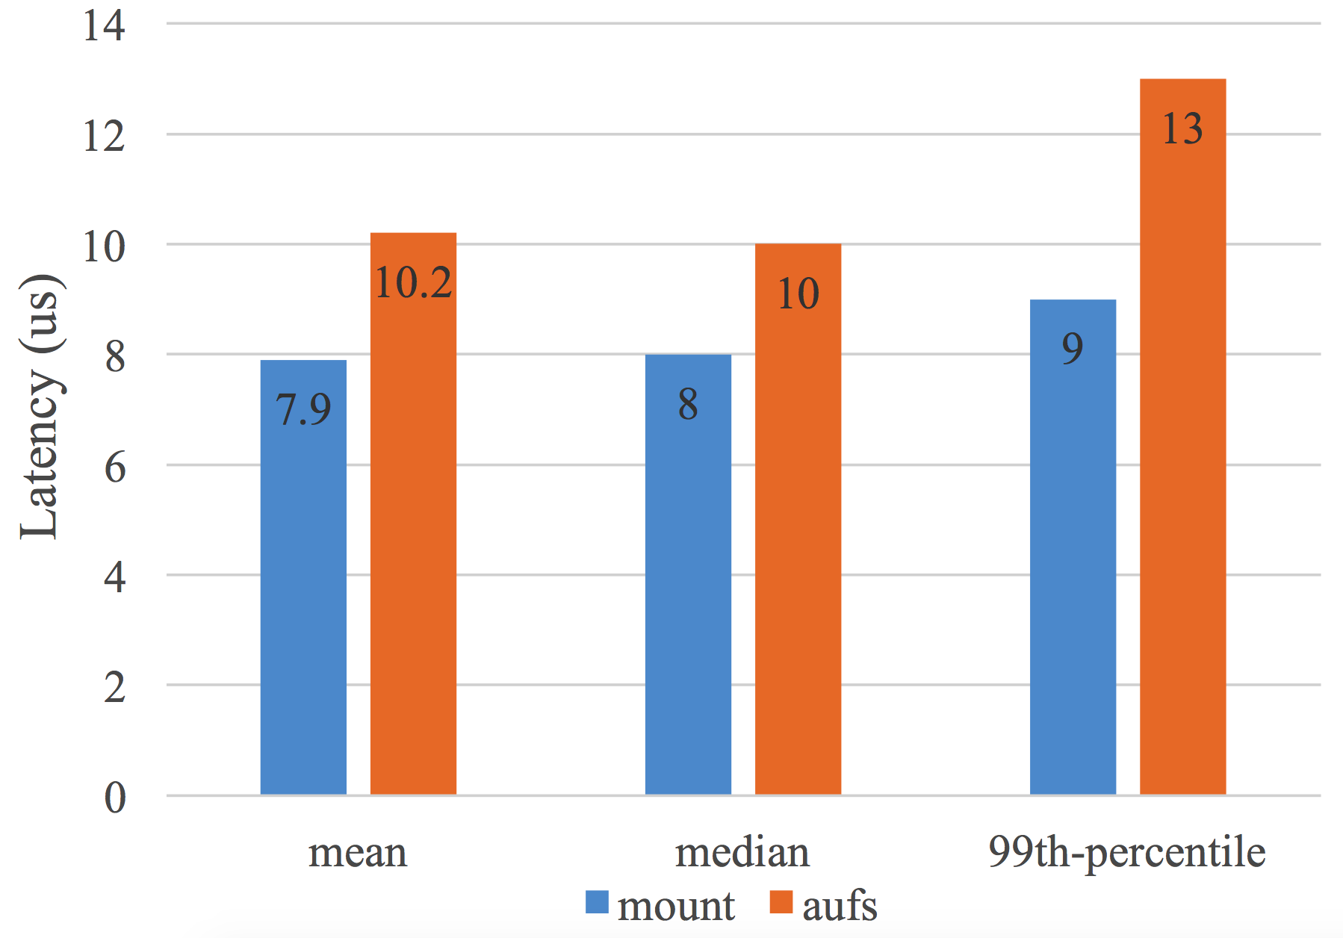
Open File
Message size(KB): 1, 4, 10, 30, 50, 70, 100
File already open
10,000 times execution
flush() after each iteration

Slide 29
ls -R
Each layer is Linux kernel source file
Ranging from 1 layer to 32 layers
100 times execution

Slide 30
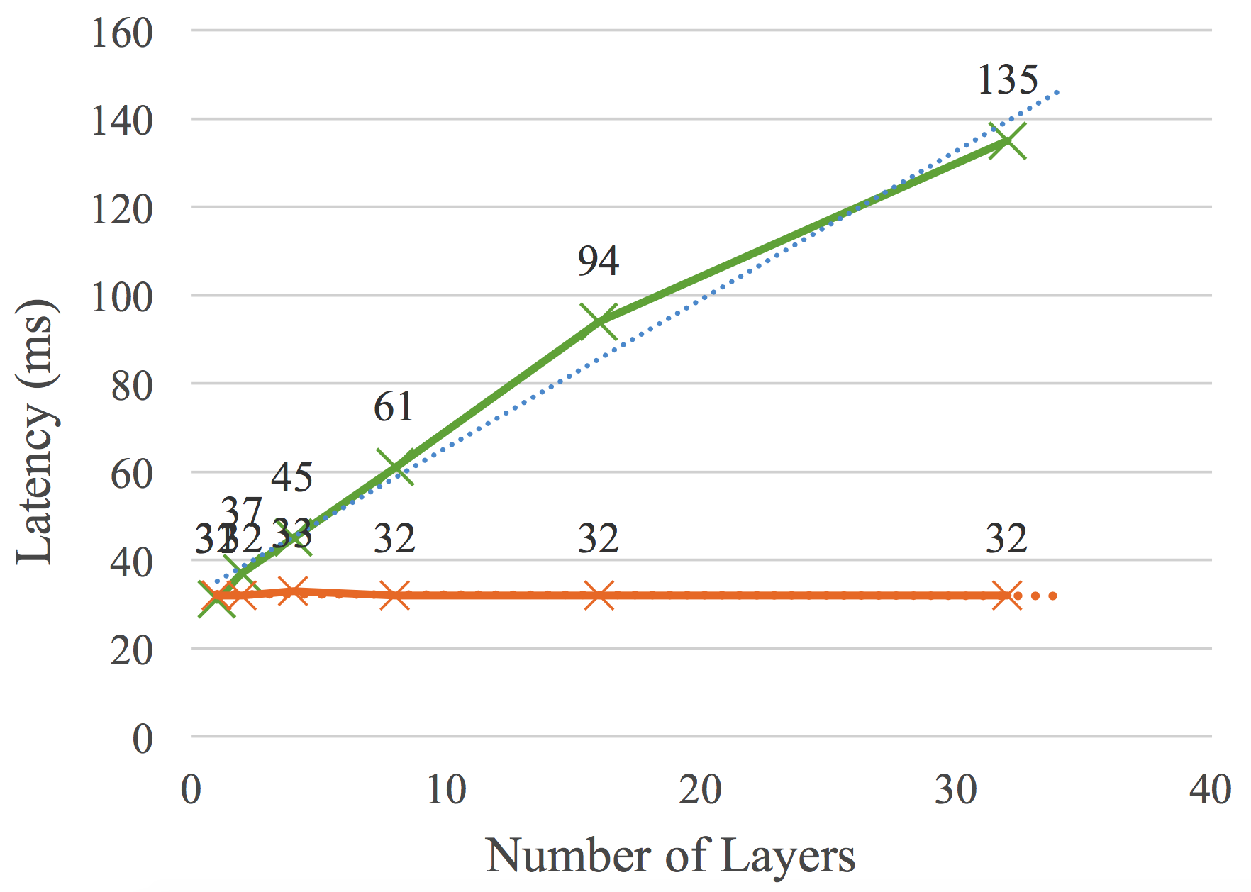
ls -R
latency measurement of different layers

