Slide 1
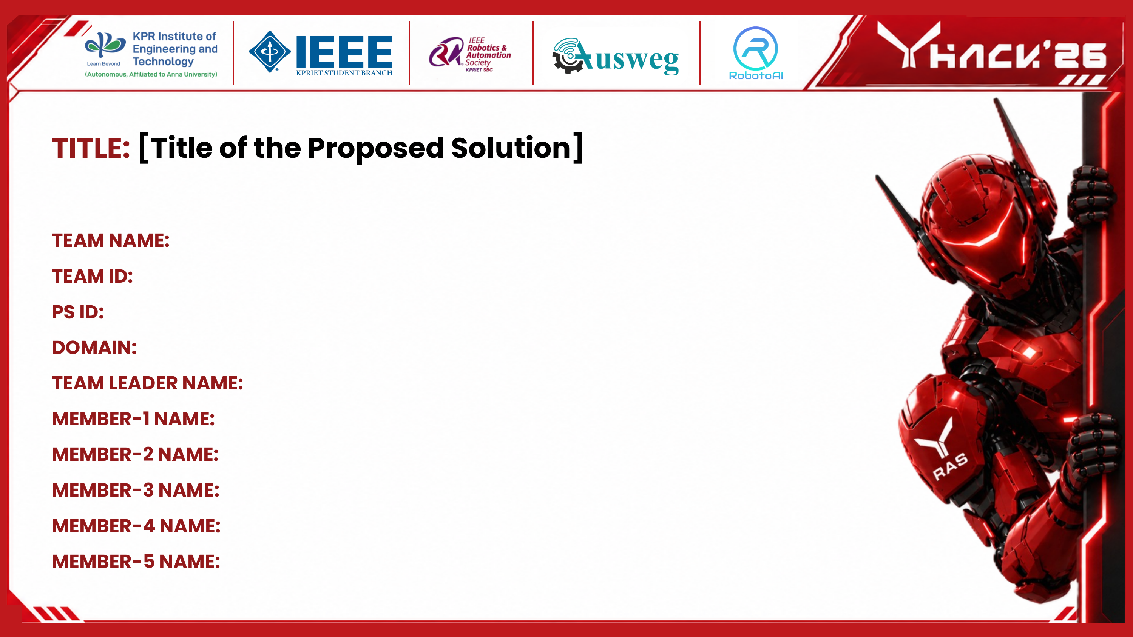
TITLE: AI Based Multi-Format Content Transformation System
TEAM NAME: Byte Forge
TEAM ID: YS637
PS ID: 25
DOMAIN: Artificial Intelligence and Automation
TEAM LEADER NAME: Vikhash.I
MEMBER-1 NAME: Noon Thavheeth.A
MEMBER-2 NAME: Dharsan Sri T.K
MEMBER-3 NAME: Harshan Muthaiya.M
MEMBER-4 NAME: Salai Sivapackiyan.S
MEMBER-5 NAME: Dhuvaragesh.V

Slide 2

Information comes in different forms like reports, articles, images and videos.
Creating separate content for each platform takes more time and effort.
Different versions can have mismatched facts, figures and details.
There is no single system to convert one source into multiple formats consistently.

Slide 3

The proposed system takes in the source material, whether it is text, a document, an image, a video or a written prompt, and organizes the important facts, people and context into one structured record, so the same information does not have to be re-entered for each format.
The user selects the audience, tone, language, purpose and level of detail once, and these settings are applied while every output format is being prepared.
Separate modules are used to prepare the presentation, social media post, advisory, video script and infographic. All of them refer back to the same structured record, so the information stays consistent across formats.
Before any output is finalized, the system checks it against the original information to catch figures or statements that do not match.
The user can review, edit and download each format from one place. Earlier versions are kept so that any changes can be tracked later.

Slide 4

To reduce the time spent manually converting one piece of information into several different formats.
To keep facts and context accurate and consistent across every format that is generated from the same source.
To allow the audience, tone, language, purpose and level of detail to be set separately for each output.
To accept source material in different forms, including text, documents, images and video.
To let the user review and edit the generated content before it is shared or published.

Slide 5
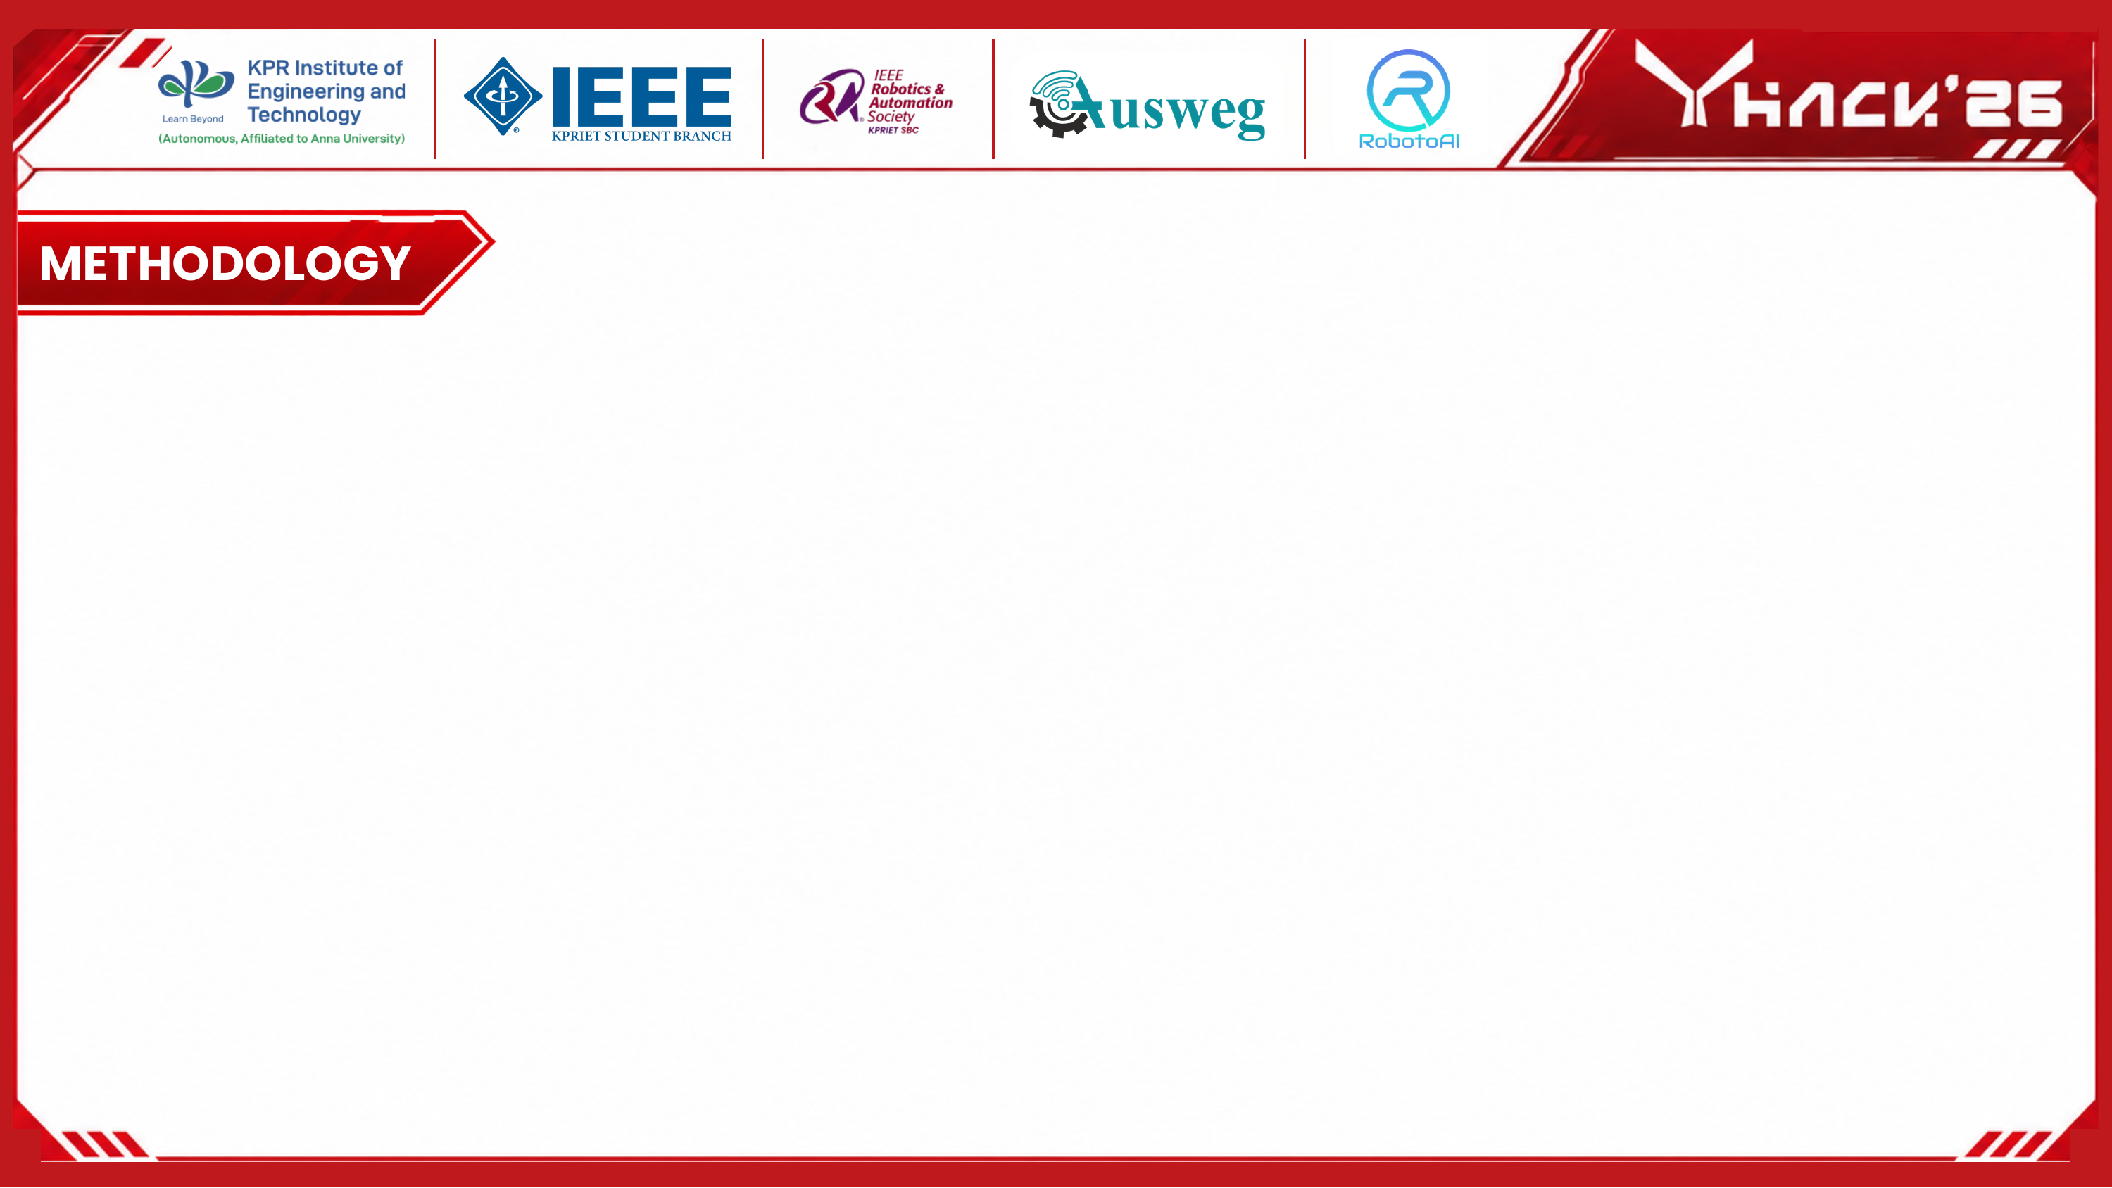
1
Collecting and reading the input. Text is read directly from documents, audio and video are converted to text, and any text inside images is pulled out using OCR.
2
Understanding the content. The important facts, people and relationships in the material are identified and stored in a structured form.
3
Setting the requirements. The audience, tone, language, purpose and level of detail chosen by the user are recorded and used to guide how each format is written.
4
Generating each format. The presentation, post, advisory, video script and infographic are created separately, based on the same stored information.
5
Checking for consistency. Each generated format is compared against the stored information to catch any mismatched facts or figures.
6
Review and approval. The user goes through each format, makes any changes needed, and approves it before it is shared.

Slide 6
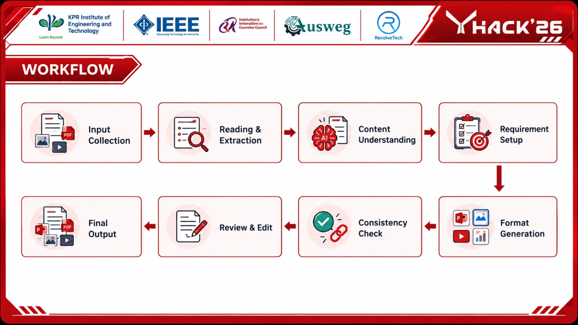

Slide 7
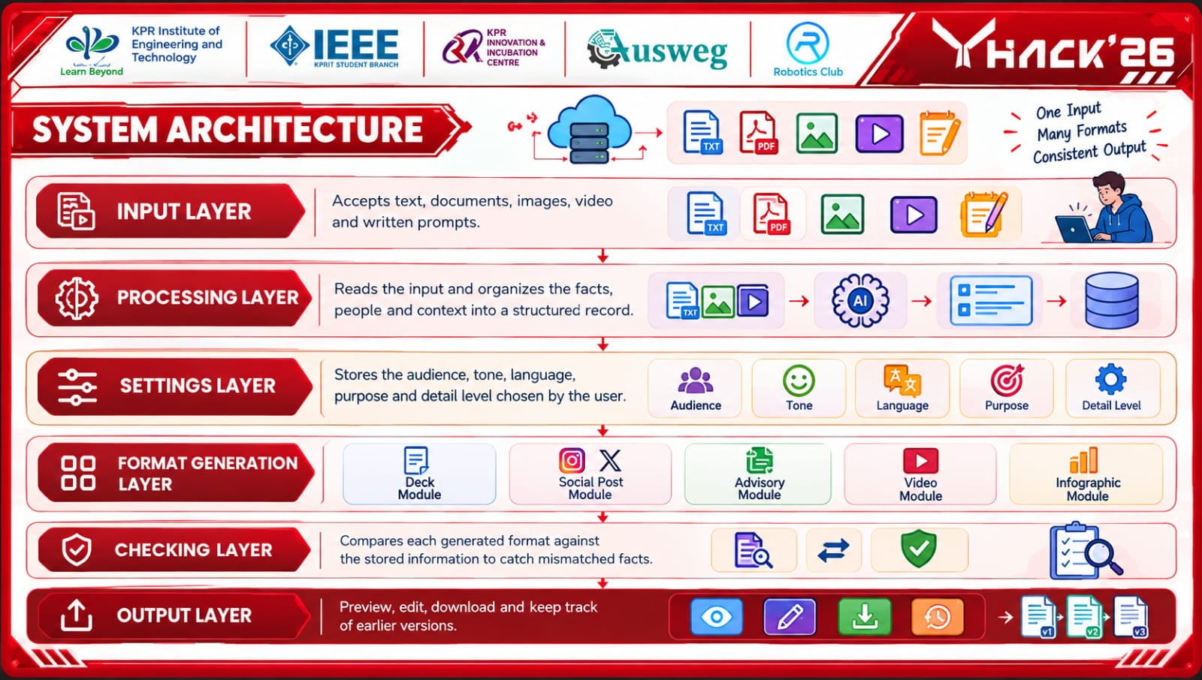

INPUT LAYER. Accepts text, documents, images, video and written prompts.
PROCESSING LAYER. Reads the input and organizes the facts, people and context into a structured record.
SETTINGS LAYER. Stores the audience, tone, language, purpose and detail level chosen by the user.
FORMAT GENERATION LAYER
Deck
Module
Social Post
Module
Advisory
Module
Video
Module
Infographic
Module
OUTPUT LAYER. Preview, edit, download and keep track of earlier versions.

Slide 8

Reading Input Files
Apache Tika, Tesseract OCR, OpenAI Whisper
Understanding Content
GPT-4 / Claude, spaCy for entity recognition, Pinecone or Weaviate, Neo4j for storing relationships
Managing Requirements
LangChain / LlamaIndex, prompt templates, FastAPI backend
Generating Formats
pptxgenjs / python-pptx for slides, Jinja2 templates for posts and advisories, Remotion with ElevenLabs for video, SVG / Canva API for infographics
Interface & Deployment
React with Tailwind CSS, Docker and Kubernetes, AWS S3 and CloudFront

Slide 9
New output formats can be added later without changing the rest of the system, since each format is handled by its own separate module.
The consistency check looks at the meaning of the generated text, not just the words used, so it can catch cases where the wording has changed but a fact or figure no longer matches.
Generated content can be translated into other languages while keeping the same structure and tone.
The user can edit any generated format directly, preview it, and export it as a document, image, video or plain text file.
Every version of every generated file is saved, which can be useful for advisories or incident reports where a record of changes may be required.

Slide 10


