Slide 1
Android Introduction Day1

Slide 2
http://192.168.204.200:6666/
Eclipse + ADT Plug-in
android eclipse bundle
http://developer.android.com/index.html

Slide 3
https://www.genymotion.com/
https://www.mobizen.com/
UI/UX, Network, Offline, GPS & Map, BLE

Slide 4
Learning resources
http://developer.android.com/index.html

Slide 5
Context / Activity / Service
File -> Settings -> Editor -> Color & Fonts -> Font -> [Save As]

Slide 6
XML tag rule
<a>content</a>
<b></b> => <b/>

Slide 7
Apk path
Build -> Build Apk
C:\Users\user\AndroidStudioProjects\Demo01\app\build\outputs\apk
刪除模擬器中App
拖曳apk到模擬器中

Slide 8
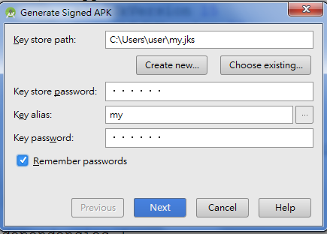
Generate Signed APK
Build -> Generate Signed APK
Create New -> …. -> …. -> Next ->…. -> Finish
Signed APK Path : C:\Users\user\AndroidStudioProjects\Demo01\app

Slide 9
Prototype / Wireframe / Storyboard / Layout 畫面切版
https://www.iconfinder.com/
https://www.fluidui.com (App wireframe online)
https://popapp.in/

Slide 10
Home plus case study
https://www.youtube.com/watch?v=fGaVFRzTTP4

Slide 11
LinearLayout Lab
New -> XML -> Layout XML File : activity_main2.xml
res/values/strings.xml 新增設定
修改 res/layout/activity_main2.xml 參照 strings.xml
修改MainActivity.java setContentView(R.layout.activity_main2);

Slide 12
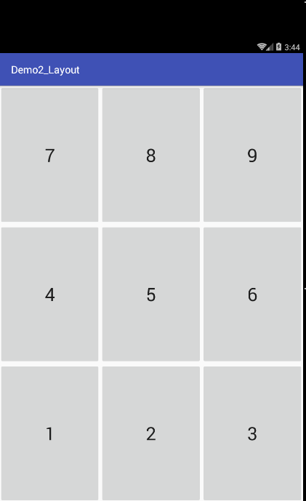

LinearLayout Lab (Nested Layout)

Slide 13
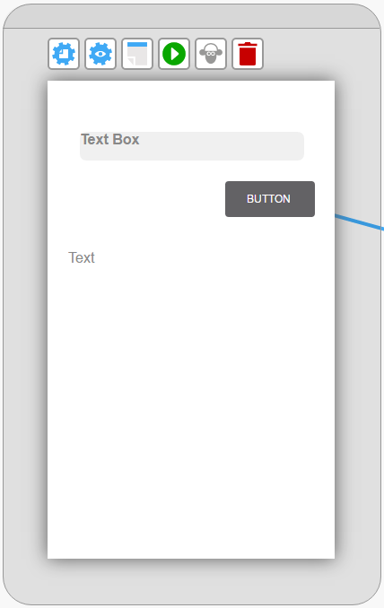
EditText
Button
TextView

