Slide 1

CSE 712 Fall 2021 Paper Presentation Investigating label suggestions for opinion mining in German Covid-19 social media
Submitted By (Group 16)
Name: ID:
Arnob Kumar Dey 21166011
Junaid Bin Kibria 21166022
Zawad Alam 21166035
Shifat Zaman 21366024
A. N. M. Sajedul Alam 21366032
Submitted To
Annajiat Alim Rasel
Sr. Lecturer and Deputy Director,
Institutional Quality Assurance Cell,
Department of Computer Science & Engineering

Slide 2
Introduction
Social media allows researchers to conduct opinion analysis on a larger scale than with traditional methods.
Data annotation is more efficient by using automated label suggestions.
Label suggestions are more viable solution than active learning.
One major difficulty with label suggestions is the danger of biasing annotators towards possibly erroneous suggestions.
Conducting a comparative annotation study using a recent state-of-the-art model to generate label suggestions.

Slide 3
Related Works
Label Suggestions
Introduction of annotation tools such as WebAnno.
Amharic POS tagging and German named entity recognition.
Bias
One possible source of bias is due to the different decision making process triggered by label suggestions.
Using label suggestions from a model that is trained on data from a different domain than the annotated data.
Using BERT

Slide 4
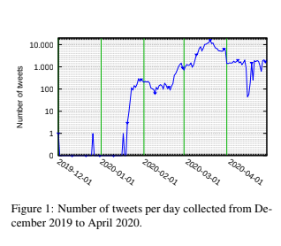
Annotation Task
Language: German
Social Media platform: Twitter
Experiment time: December 2019 to April 2020
Challenges: Heterogenous Statements, Hashtags

Slide 5
Annotation Scheme
Data:
Search queries (pandemic, corona, social distance etc)
16.5 million tweets
Removal of duplicates
Scheme:
Tweets are categorized into 4 groups -
Unrelated | Comment | support | Refute

Slide 6
Study Setup
Goals
Study the effects of label suggestions in non-expert annotation scenarios.
Collect a novel dataset that can be used by social science researchers

Slide 7
Study Setup
Expert Annotations
Provided by the researchers
200 tweets were sampled
Result -
Same label selected in 50% tweets
Same label selected by at least 3 researchers in 75% tweets
Disagreement in 25% - ambiguities in the data source,

Slide 8
Study Setup
Student Annotations
Conducted with a group of 21 German-speaking university students
Divided in three groups (G1, G2 & G3) and Splitted into two rounds
No label suggestions (G1)
Static label suggestions (G2)
Interactive label suggestions (G3).

Slide 9
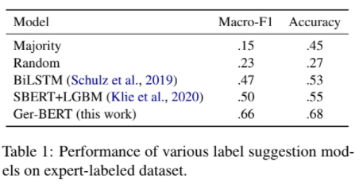
Study Setup
Label Suggestion Model
Used Projects/Solutions
INCEpTION - integrate label suggestions using recommendation models.
German version of BERT (Ger-BERT) - obtain label suggestions

Slide 10
Study Setup
Label Suggestion Model
Model comparison
Interactive training routine.

Slide 11
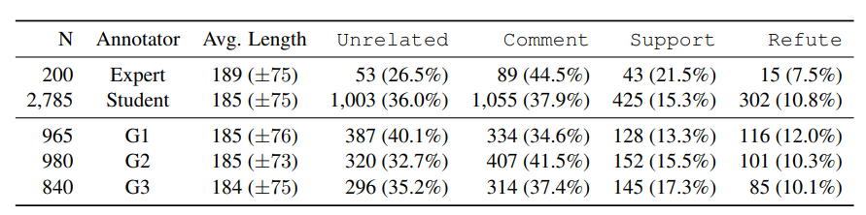
Study Evaluation

Slide 12
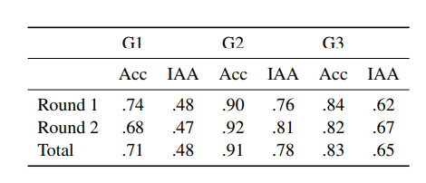
Study Evaluation

Slide 13
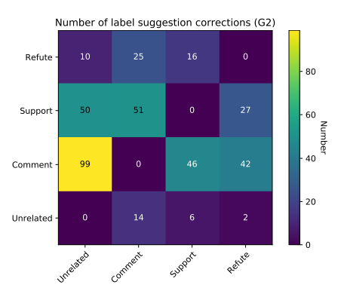
Study Evaluation

Slide 14
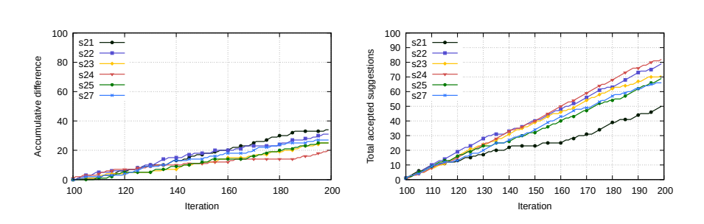
Study Evaluation

Slide 15
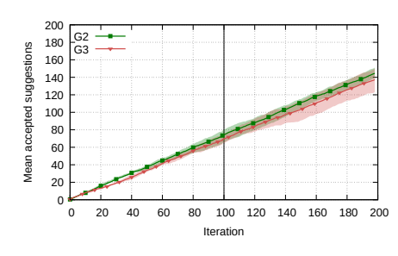
Study Evaluation

Slide 16
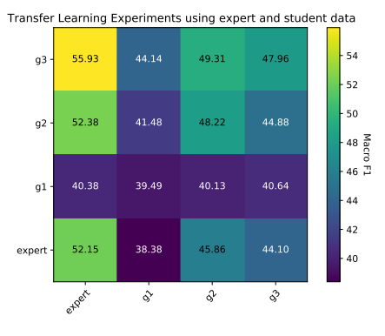
Study Evaluation

Slide 17
Conclusion and Future Work
Analysed the usefulness of providing label suggestion.
Improving annotation quality.
Interactively updated label suggestions need to be considered carefully.
Leverage their setup to annotate tweets from a larger time span.

