Slide 1

REVIEW PRESENTATION • COMPUTER ARCHITECTURE
BIT MANIPULATION
in Assembly Language
How programs read, set, and transform individual bits at the hardware level — and why it still matters.
01001010 01000010 01010100 01000011 01001111 01000100 01000101

Slide 2

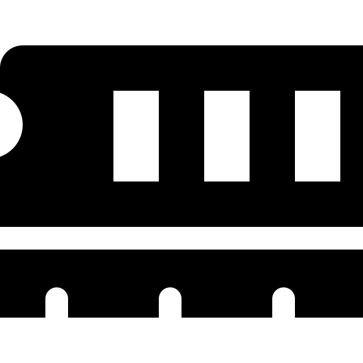

Why Bit Manipulation Matters
The bit is the atomic unit of digital information
Performance
Bit manipulation is the direct inspection, setting, clearing, and transformation of individual bits within a machine word.
It has been central to programming since the earliest computers, when scarce memory made packing information into individual bits a practical necessity.
Even as high-level languages introduced booleans, structs, and flags, assembly-level bit manipulation persisted — remaining essential wherever performance, memory footprint, or direct hardware access matter most.
Single-instruction bitwise operations avoid costly arithmetic and branching.
Memory Efficiency
Packing flags and fields into individual bits conserves scarce storage.
Hardware Control
Peripheral and register configuration is expressed directly as bit patterns.
Bit Manipulation in Assembly Language
02

Slide 3

Fundamental Bitwise Operations
Four logical operations, plus shifts and rotates, underlie every technique
Logical Operations
A | B | AND | OR | XOR | NOT A
0 | 0 | 0 | 0 | 0 | 1
0 | 1 | 0 | 1 | 1 | 1
1 | 0 | 0 | 1 | 1 | 0
1 | 1 | 1 | 1 | 0 | 0
Shifts & Rotates
SHL / LSL
Shift left, fill with 0 — multiply by 2 per position.
SHR / LSR
Shift right (logical), fill with 0.
AND sets a bit only where both operands are 1 — used to clear or mask bits.
OR sets a bit where either operand is 1 — used to set bits.
XOR sets a bit where operands differ — used to toggle bits.
SAR / ASR
Shift right, filling with the sign bit — signed divide by 2.
ROL / ROR
Circular shift — bits leaving one end re-enter the other.
Bit Manipulation in Assembly Language
03

Slide 4
Assembly Instructions: x86 vs. ARM
Shared logical primitives, different approaches to bit fields
x86 (Intel / AMD)
ARM (AArch32 / AArch64)
AND · OR · XOR · NOT
AND · ORR · EOR · MVN
Core logical operations
Core logical operations
SHL · SHR · SAR
LSL · LSR · ASR · ROR
Logical and arithmetic shifts
Shift and rotate
ROL · ROR · RCL · RCR
BFI · BFC
Rotate, with/without carry
Insert / clear a bit field in one step
BT · BTS · BTR · BTC
UBFX · SBFX
Test / set / reset / complement a bit
Extract a bit field, unsigned / signed
BSF · BSR
CLZ
Find lowest / highest set bit
Count leading zeros
POPCNT · TZCNT · LZCNT
RBIT
Hardware-accelerated bit counting
Reverse bit order in one instruction
Bit Manipulation in Assembly Language
04

Slide 5
Worked Example: Counting Set Bits
Kernighan's algorithm: n & (n − 1) clears the lowest set bit each step
Step | n (before) | n AND (n−1)
1 | 1011 0110 | 1011 0100
2 | 1011 0100 | 1011 0000
3 | 1011 0000 | 1010 0000
4 | 1010 0000 | 1000 0000
5 | 1000 0000 | 0000 0000
5
SET BITS
Each iteration clears the least-significant set bit of n, so the number of iterations needed to reach zero equals the number of 1-bits originally present — an algorithm whose cost depends on data content, not word width.
in 1011 0110 (0xB6, decimal 182)
On processors with SSE4.2, this entire result is produced in one cycle by POPCNT.
Bit Manipulation in Assembly Language
05

Slide 6





Real-World Applications
Bit-level efficiency still underlies performance-critical software
Cryptography
Graphics
Embedded Systems
Bit permutations and XOR-based key mixing secure ciphers such as AES and DES.
Masking and shifting pack RGB(A) color channels into a single pixel word.
Setting/clearing register bits configures timers, GPIO, and peripherals.
Networking
OS Kernels
Data Compression
Header flags, offsets, and checksums rely on bitwise parsing.
Page-table flags and atomic bit-test-and-set enable synchronization.
Huffman coding and run-length flags depend on precise bit packing.
Bit Manipulation in Assembly Language
06

Slide 7

Key Takeaways
Four logical operations — AND, OR, XOR, NOT — combined with shifts and rotates, form the basis of every bit-manipulation technique.
x86 and ARM expose these operations through dedicated instructions, and modern extensions (BMI2, RISC-V “B”) add hardware acceleration.
Masking idioms — set, clear, toggle, test, extract — remain foundational to compiler intrinsics and high-level bitwise code alike.
From cryptography to embedded systems, efficient bit manipulation continues to underlie performance-critical software.
Thank you

