Slide 1


COMP5310 Project Stage 2
Ethereum (ETH):
ETH-Value
GPU (Graphics card of PC):
*GPU-Value
Processor
Memory_capacity
Unikey: yche3494
Name : Yichen chen
*GPU-Value – We want to predict

Slide 2
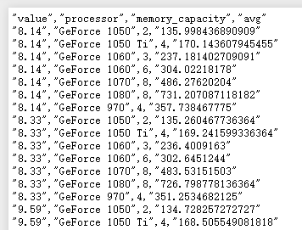
COMP5310 Project Stage 2
Ethereum (ETH):
ETH-Value
GPU (Graphics card of PC):
*GPU-Value
Processor
Memory_capacity
Unikey: yche3494
Name : Yichen chen
*GPU-Value – We want to predict

Slide 3
COMP5310 Project Stage 2
Question 1 :
To determine the effect of ETH value on the GPU value:
H0 : ETH value are not related to GPU VALUE, i.e R == 0
H1 : There is a significant evidence that ETH VALUE are related to GPU VALUE, etc. R != 0.
Find how processor and memory capacity influence this relation.
Question 2 :
Establish models, provide decision support for consumers to buy GPU via two different models, compare and select better models
Unikey: yche3494
Name : Yichen chen

Slide 4
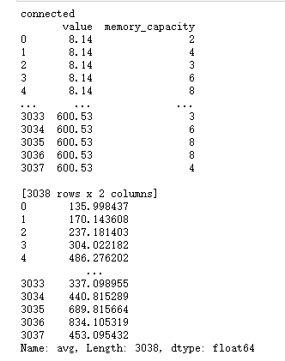
COMP5310 Project Stage 2
Question 1 :
To determine the effect of ETH value on the GPU value:
Question 2
Approach: Build multiple linear regression
Remove processor for it is not a continuous data.
Regard GPU value as target data.
Unikey: yche3494
Name : Yichen chen

Slide 5
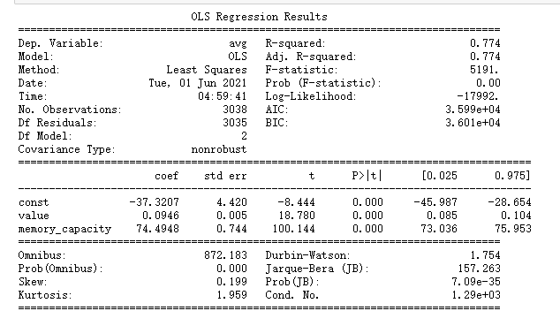
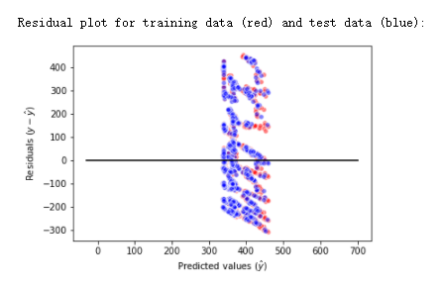
COMP5310 Project Stage 2
Question 1 :
To determine the effect of ETH value on the GPU value:
Question 2
R-squared and p value are ideal.
But coefficients show that ETH value is useless for this regression.
That’s not an acceptable result to reject H0.
Unikey: yche3494
Name : Yichen chen

Slide 6
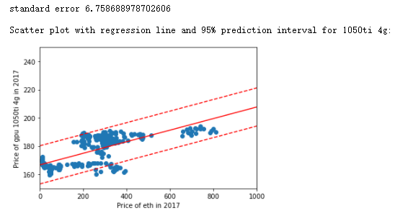
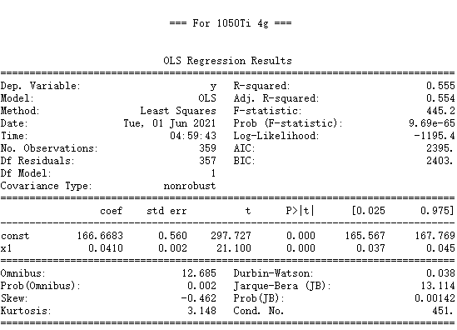
COMP5310 Project Stage 2
Modification for question 1:
What will happen if I remove the influence of memory capacity on the model and select a fixed GPU type?
Maintained a medium level
linear correlation
Unikey: yche3494
Name : Yichen chen

Slide 7
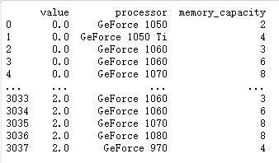
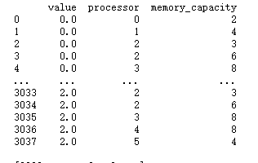
COMP5310 Project Stage 2
Question 1
Question 2 :
Establish models, provide decision support for consumers to buy GPU via two different models, compare and select better models
Approach: 1. Build Logistic regression
2. Build decision trees
Preprocessing: Transform processor and ETHvalue, GPUvalue to categorical variable.
For GPU: Simply 0: Low value – Buy it
1: High value – Don’t buy

Slide 8
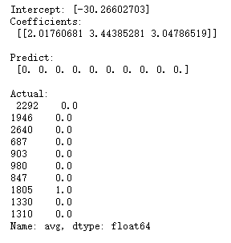
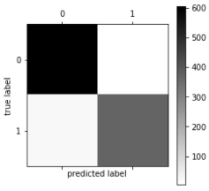
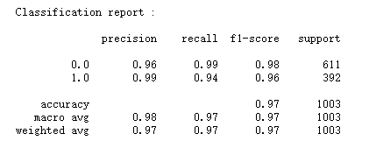
COMP5310 Project Stage 2
Question 1
Question 2 :
Establish models, provide decision support for consumers to buy GPU via two different models, compare and select better models
Approach: 1. Build Logistic regression
2. Build decision trees
The evaluation result show that this model
is acceptable.

Slide 9
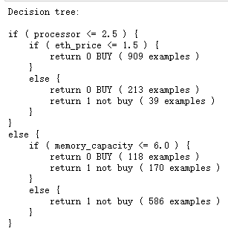
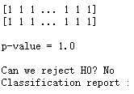
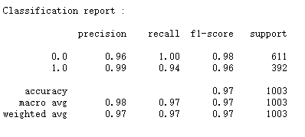
COMP5310 Project Stage 2
Question 1
Question 2 : Establish models, provide decision support for consumers to buy GPU via two different models, compare and select better models
Approach: 1. Build Logistic regression
2. Build decision trees
For decision trees, the result is also ideal.
To compare with logistic regression, the accuracy is different but not reliably so. So, we retain the hypothesis that we can choose either model.
Unikey: yche3494
Name : Yichen chen

Slide 10
COMP5310 Project Stage 2
Thanks for your attention.
Unikey: yche3494
Name : Yichen chen

