Slide 1
GPU Monte Carlo Code Project
Jennan Wang

Slide 2
Introductions
Monte Carlo numerical method is discretized by particles
The above mechanism is great for GPU computation, because it is intrinsically parallelized.
This code is a practice to compute particle transportation on Nvidia GPU by CUDA

Slide 3
Particle move
Fly out
Position check
Out of field
In field
Decide interactions
Scatter
+tally
Collision
+tally

Slide 4
Problem description
Total XS: 1 cm⁻¹
Geometry: sphere, radius=0.5cm
Point source: sphere center
Interaction: isotropic scattering, absorption

Slide 5
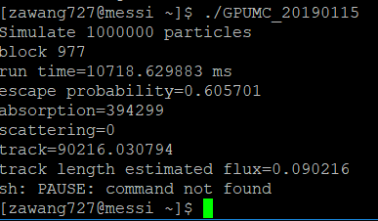
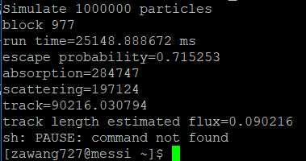

$\frac{Σ_{a}}{Σ_{tol}}=$1
$\frac{Σ_{a}}{Σ_{tol}}=0.5$

Slide 6
Future work
Task distribution in GPU (parallel) – this code one particle declare one thread
Verification – this code didn’t verify scattering
Refactoring code

