Slide 1
R Basics Series: Vectors and Subsetting
Zaw Myo Tun

Slide 2



Who am I?
Zaw Myo Tun (MBBS, PhD)
Epidemiologist and medical doctor
Research manager at a non-profit organization
I have been using R for work and for hobby projects since 2016
Contacts
Email: zawmyotun11@gmail.com
www.linkedin.com/in/zawmyotun11
@zawmtun
@zawmtun

Slide 3
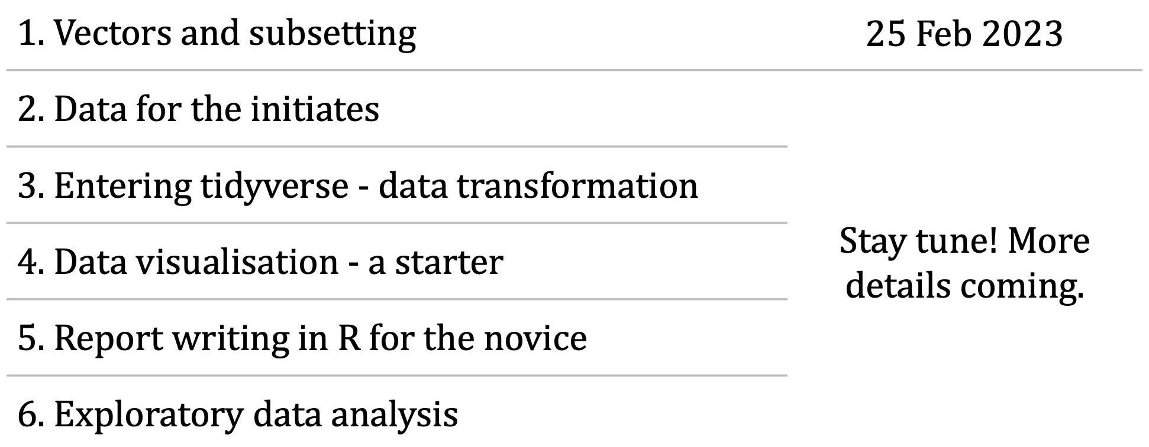
R Basics Series
Stay tuned! More details coming.

Slide 4
To follow along the exercises
Have R and RStudio installed in your computer
Downloaded and extracted the GitHub repository for this session
https://github.com/zawmtun/MRUG-R-Basics

Slide 5
Vectors and Subsetting

Slide 6
Vectors and data types
Basic data type in R
Types
Logical: TRUE or FASLE
Numeric: Either integer or double (real)
Character (add double quote "dog" (more common) or single quote 'dog')
Complex
Raw

Slide 7
Vectors and data types
Functions for vectors
Attributes
length(), class(), str(), typeof()
Add more elements using c()
Manually convert variable types
as.logical(), as.numeric(), as.double(), as.integer(), as.character()
Other data structures
Lists
Matrices
Data frames
Factors
Arrays

Slide 8
Subsetting vectors
It means extracting elements and use them create a new vector
Two ways to subset a vector
Use indices: sequence of elements in a vector
Indices always start at 1
animals <- c("mouse", "rat", "dog", "cat")
1 2 3 4
Use logical vector
Can manually define a logical vector
More commonly, create the vector from logical tests

Slide 9
Missing data
Represented as NA
Feeding vectors with NAs to most functions will return NA making the user consciously remove the NAs (by adding argument na.rm = TRUE) in their operations.
Functions worth remembering when dealing with NAs.
is.na()
na.omit()
complete.cases()

Slide 10
RStudio Projects (.Rproj)

Slide 11
RStudio Projects
Project root folder – look for .rproj file
Advantages
Relative paths: Project folder is portable and the code just works on any computer
Ability to configure project-specific setting without modifying global settings

Slide 12
References
Data Carpentry: https://datacarpentry.org/R-ecology-lesson/index.html
RStudio Projects: https://support.posit.co/hc/en-us/articles/200526207-Using-RStudio-Projects

