Slide 1
R Club: Starting with data
Zaw Myo Tun

Slide 2
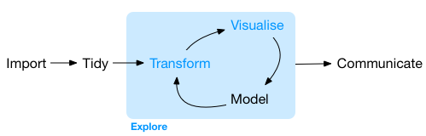
Data analysis workflow

Slide 3
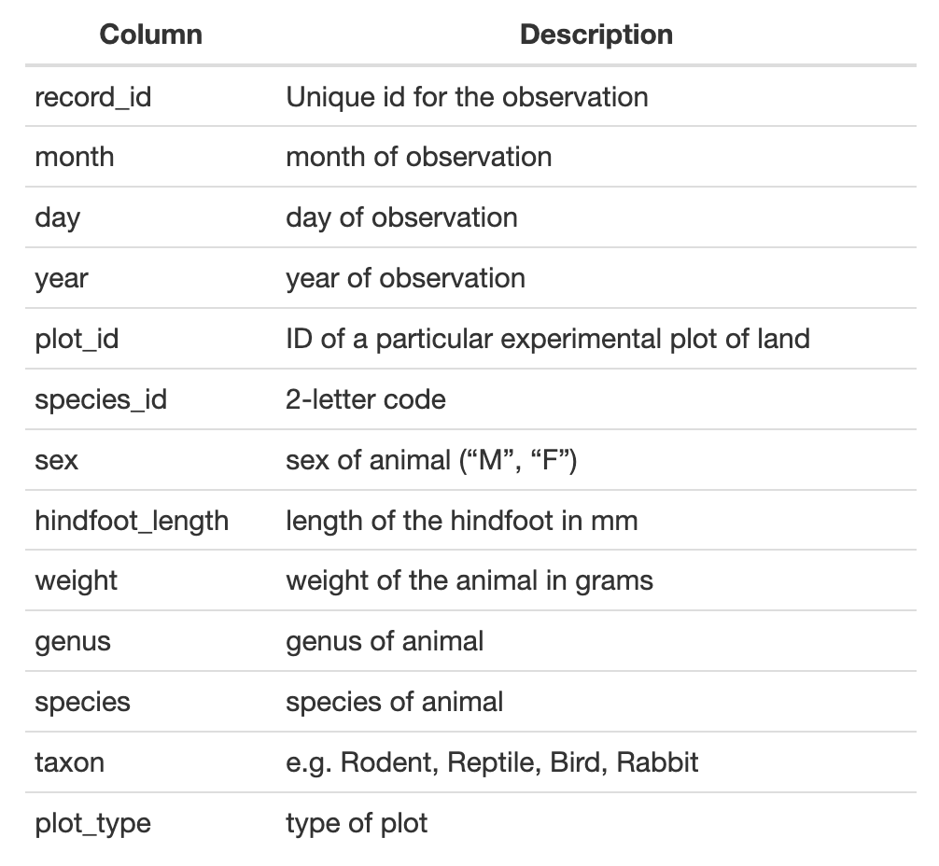
Example dataset
Download: download.file()
Read file: read_csv()
View data:
view()
Place mouse cursor on the dataframe name and press F2

Slide 4
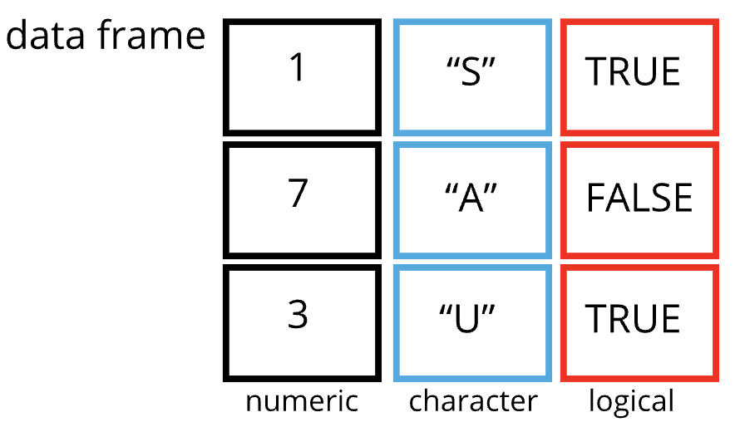
Data frames
read_csv() stores data as tibble, a special kind of data frame
De facto data structure for most tabular data
Columns are vectors (logical, numeric, character)
All vectors have the same length

Slide 5
Subsetting data frames
Two ways of subsetting a dataframe:
By indices of rows and columns
DF[row, column]
DF[row,] # All columns, selected rows
DF[, column] # All rows, selected cols
Column names
surveys[“species_id”]
surveys[row, “species_id”]
surveys[, “species_id”]
surveys[c(“species_id”, “sex”)]
surveys[, c(“species_id”, “sex”)]
A few tibble rules
DF[“var”] single bracket always returns a dataframe
DF[[“var”]] double brackets always return a vector
DF$var returns a vector

Slide 6
Formatting dates
R stores dates in “YYYY-MM-DD” format by default
Use str() or class() to check whether a vector is a date
Use lubridate package
Installed as part of tidyverse
Not loaded when loading tidyverse, so have to load it separately
We will use ymd() for today’s exercise

Slide 7
Factors
A special class for working with categorical data
Contain a pre-defined set of values: levels
Levels are integers attached with labels
While behave like character vector, R treats factors as integer
Can specify the order of the categories in a variable
R sorts character vectors in alphabetical order (e.g., during plotting)
Use factor() to convert to factor data type

