Slide 1
R Clud: Manipulating data
Zaw Myo Tun

Slide 2
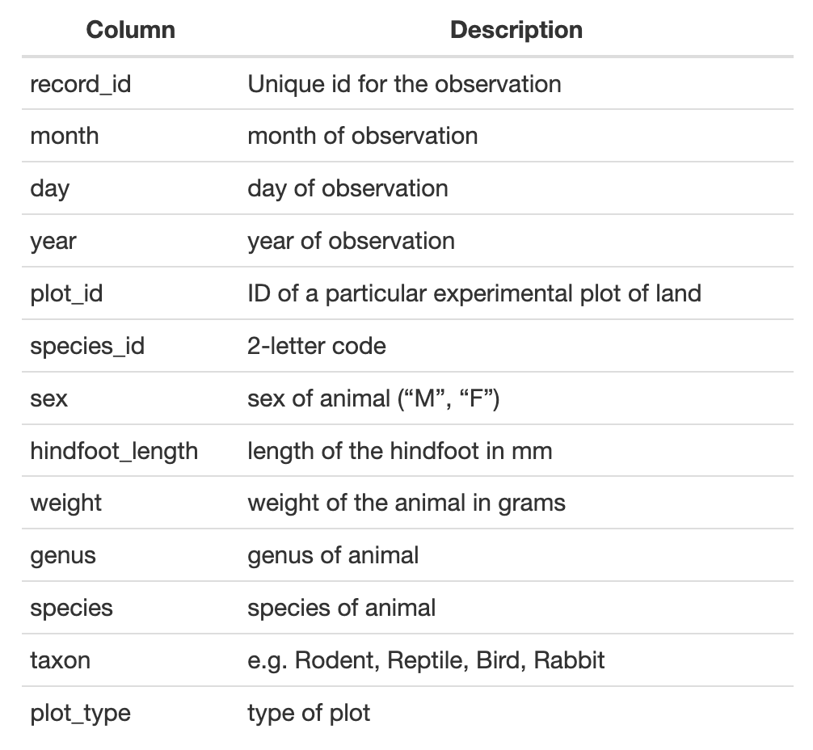
Example dataset
Download: download.file()
Read file: read_csv()
View data:
view()
Place mouse cursor on the dataframe name and press F2

Slide 3
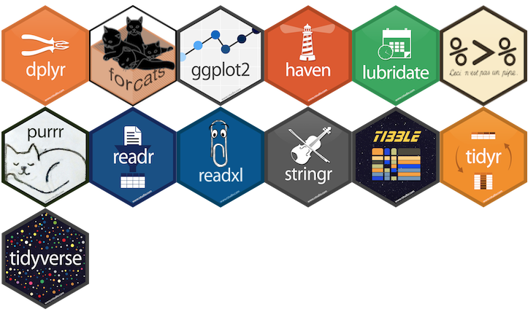
Data tidying
Data tidying
Meta-package

Slide 4
Why tidyverse?
All packages in tidyverse follow tidy data principles (next slide)
The results from a base R function sometimes depend on the type of data.
Dataframe VS tibble
R expressions are used in non-standard way, which can be confusing for new learners
Default argument values are not natural to most people
read.csv VS read_csv

Slide 5
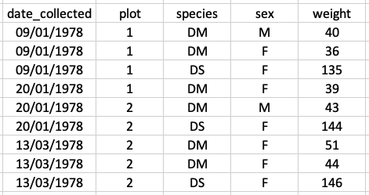
Tidy data
Principles
Each variable has its own column
Each observation has its own row
Each value must have its own cell
Each type of observational unit forms a table

Slide 6
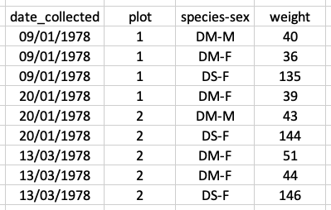
Untidy data

Slide 7
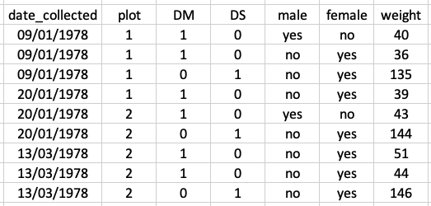
Untidy data

Slide 8
dplyr

Slide 9
dplyr functions
Function | Description
select() | Subset columns
filter() | Subset rows on conditions
mutate() | Create new columns by using information from other columns
group_by(), summarize() | Create summary statistics on grouped data
arrange() | Sort results
count() | Count discrete values

Slide 10
Pipe
|> or %>%
Base R pipe or magrittr pipe
Configure RStudio shortcut for pipe
Normal function call | Piped function call
fn1(x) | x |> fn1()
fn4(fn3(fn2(fn1(x)))) | x |> fn1() |> fn2() |> fn3() |> fn4()
filter(select(data, col1, col2), col1 == 1) | data |> select(col1, col2) |> filter(col1 == 1)

Slide 11
tidyr

Slide 12
Reshaping data
Long to wide
pivot_wider()
Wide to long
pivot_longer()

Slide 13
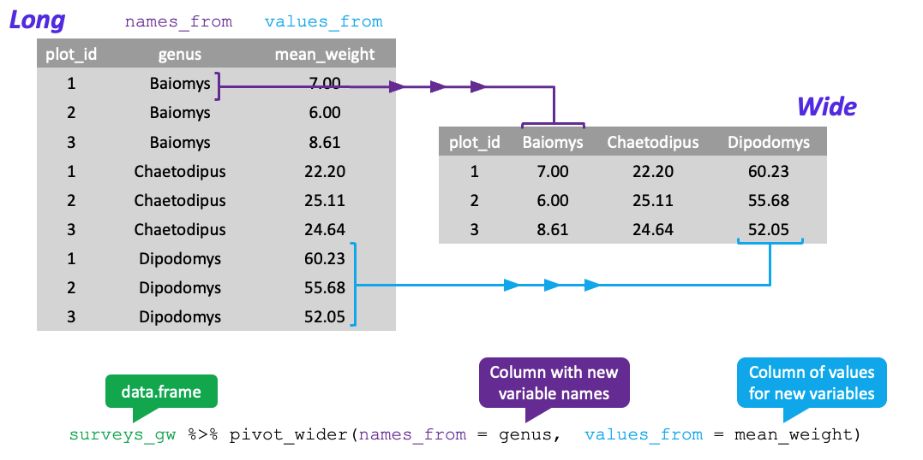
Long to wide

Slide 14
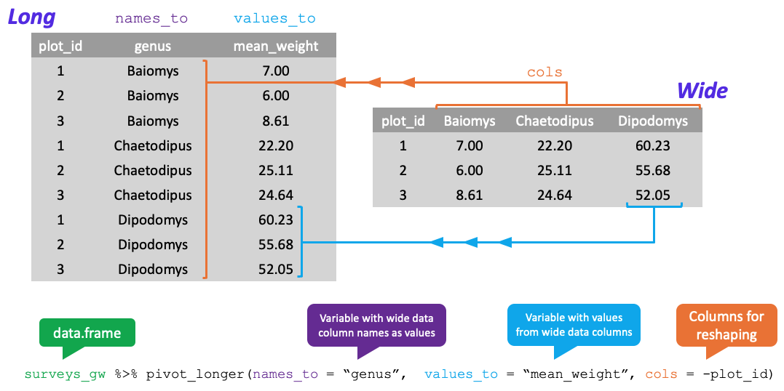
Wide to long

Slide 15
Exporting data

Slide 16
Exporting data
write_csv(my_data, file = "data/my_data.csv")

