Slide 1
R Clud: Manupilating data
Zaw Myo Tun

Slide 2
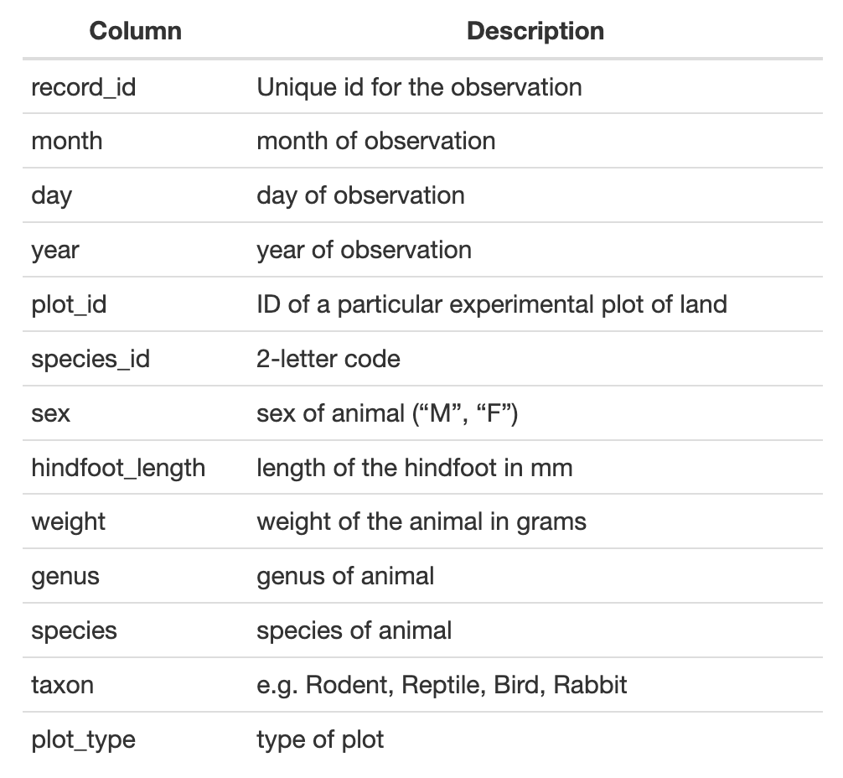
Example dataset
Download: download.file()
Read file: read_csv()
View data

