Slide 1
R Clud: Starting with data
Zaw Myo Tun

Slide 2
Intro to R (leftover from previous session)

Slide 3
Vectors and data types
Basic data type in R
Types
Logical: TRUE or FASLE
Numeric: Either integer or double (real)
Character (add double quote "dog" (more common) or single quote 'dog')
Complex
Raw

Slide 4
Vectors and data types
Functions for vectors
Attributes: length(), class(), str(), typeof()
Add more elements using c()
Other data structures
Lists
Matrices
Data frames
Factors
Arrays

Slide 5
Subsetting vectors
Means extracting elements and use them create a new vector
Two ways to subset a vector
Use indices: sequence of elements in a vector
Indices always start at 1
animals <- c("mouse", "rat", "dog", "cat")
1 2 3 4
Use logical vector
Can manually define a logical vector
More commonly, create the vector from logical tests

Slide 6
Missing data
Represented as NA
Feeding vectors with NAs to most functions will return NA making the user consciously remove the NAs (by adding argument na.rm = TRUE) in their operations.
Functions worth remembering when dealing with NAs.
is.na()
na.omit()
complete.cases()

Slide 7
Starting with data

Slide 8
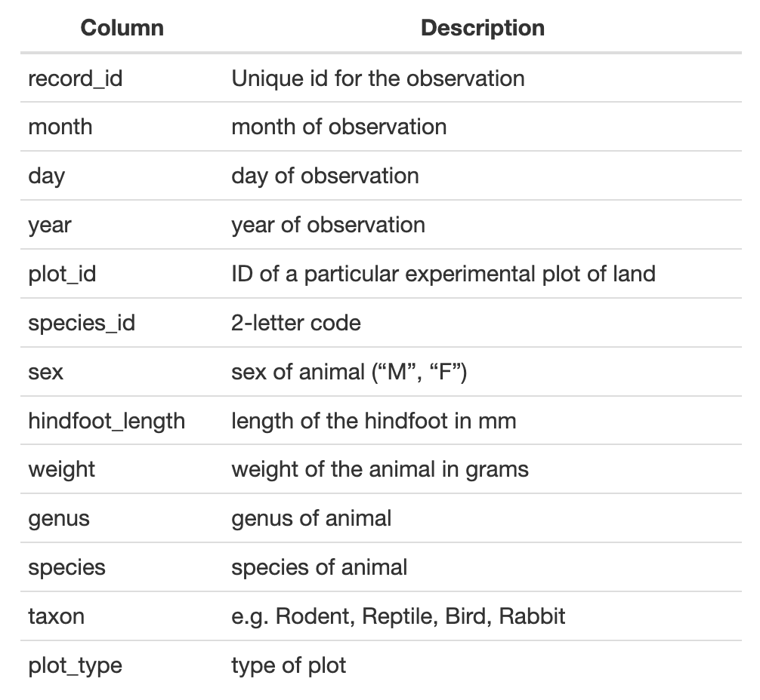
Example dataset
Download: download.file()
Read file: read_csv()
View data

Slide 9
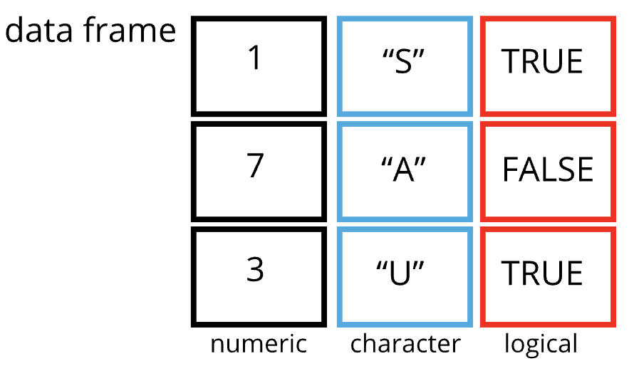
Data frames
read_csv() stores data as tibble, a special kind of data frame
De facto data structure for most tabular data
Columns are vectors (logical, numeric, character)
All vectors have the same length

Slide 10
Subsetting data frames
Two ways of subsetting a dataframe:
By indices of rows and columns
DF[row, column]
Column names
surveys[“species_id”]
surveys[, “species_id”]
surveys[c(“species_id”, “sex”)]
surveys[, c(“species_id”, “sex”)]

Slide 11
Subsetting data frames
By indices of rows and columns
DF[row, column]
Select columns using column names
surveys[“species_id”]
surveys[, “species_id”]
surveys[c(“species_id”, “sex”)]
surveys[, c(“species_id”, “sex”)]
DF[“var”] single bracket always returns a dataframe
DF[[“var”]] double brackets always return a vector
DF$var returns a vector

Slide 12
Factors

Slide 13
Formatting dates

