Slide 1
Sampling Variability of a Proportion
Zaw Myo Tun
IRD Global

Slide 2
Descriptive analysis
Summarising data
Frequency, mean, standard deviation, etc
Estimation
Confidence intervals

Slide 3
Population of interest
Sample taken
Statistical Inference
We want to use results from our sample to draw valid conclusions about the population of interest.

Slide 4
Statistical inference
How do we select our sample?
In an unbiased way
Randomly sampled
How many individuals should we sample?
Lots if possible
But numbers do not eliminate bias

Slide 5
Statistical inference
Assume randomly selected
Confidence intervals
Significance tests
Account for sampling variation

Slide 6
Categorical data
Variables with 2 categories (binary)
alive/dead
infected/not infected
smoker/non-smoker
Proportion (percentage)
proportion died
proportion infected
Proportion who smoke 127/335 = 0.379 or 37.9%

Slide 7
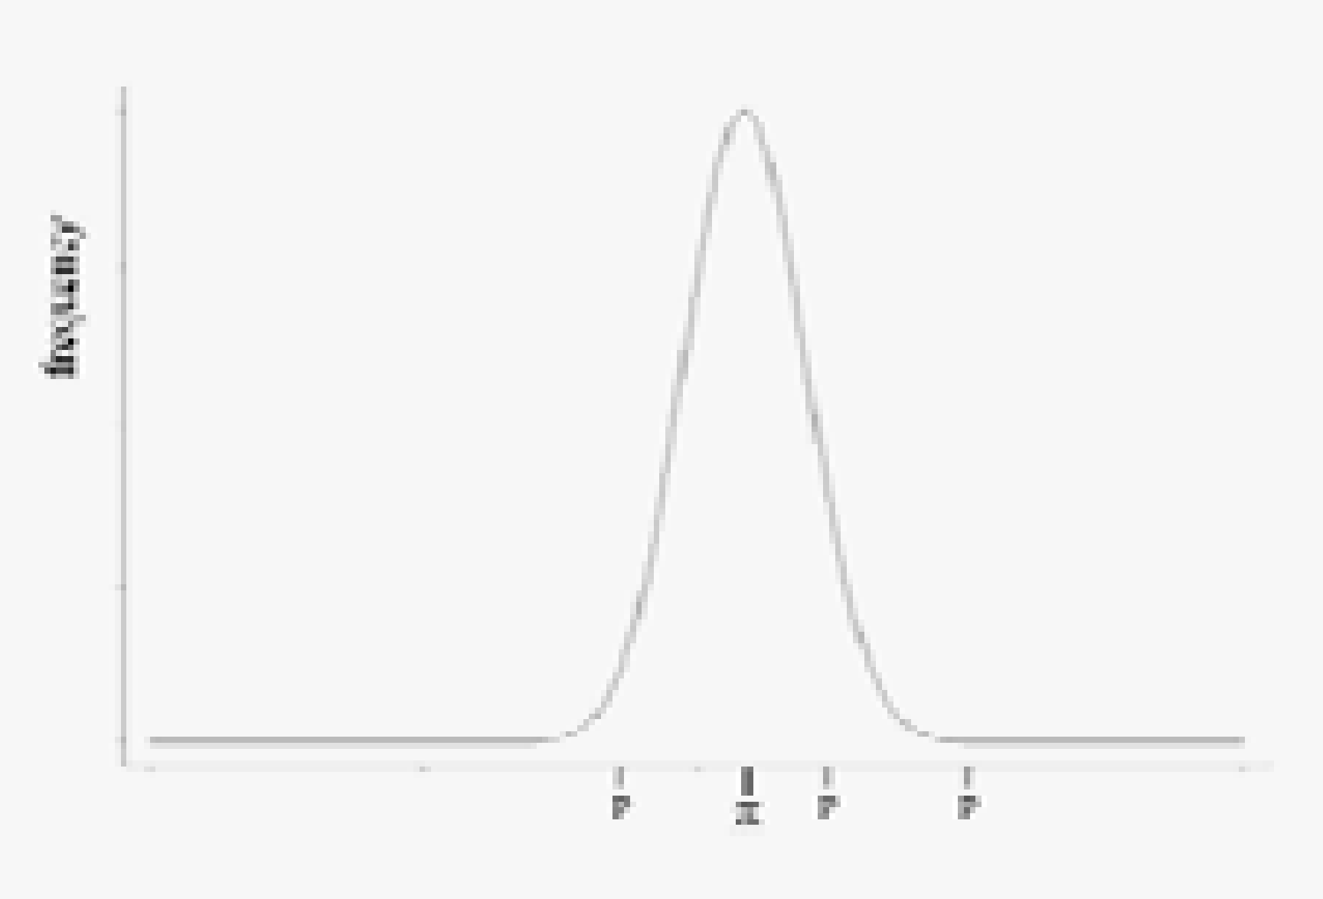
Sampling distribution
π = proportion of smokers in the population of interest (‘true’ proportion)
p = proportion of smokers in the sample
Use p to say something about π

Slide 8
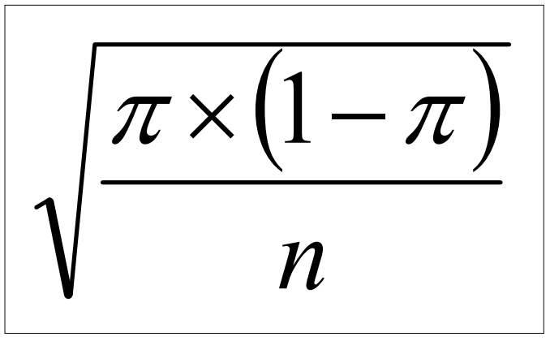
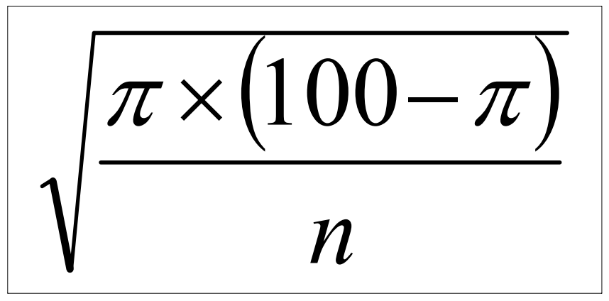
‘Average error’ in p is called the
STANDARD ERROR: SE(p)
SE(p) =
SE(%) =
Note the influence of n on the SE.

Slide 9
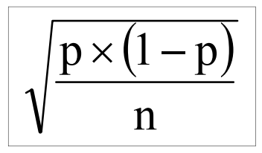
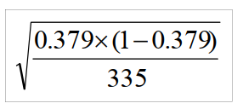
Estimate π with p
SE(p) =
Eg, Survey of 335 men, 127 smoked
p = 127/335 = 0.379 or 37.9%
SE(p) = = 0.0265

Slide 10
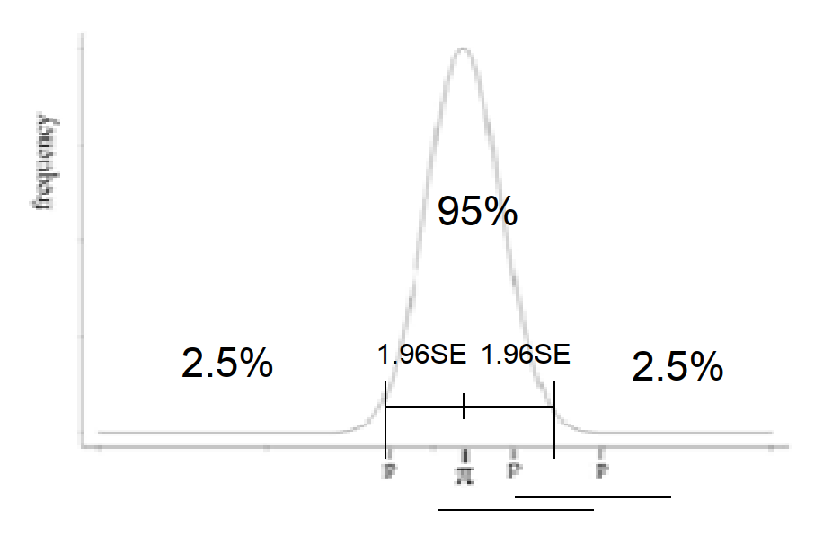
95% confidence interval for π
Graph shows the Sampling Distribution of p
We use properties of a specific statistical distribution known as the Normal Distribution to construct a confidence of π

Slide 11
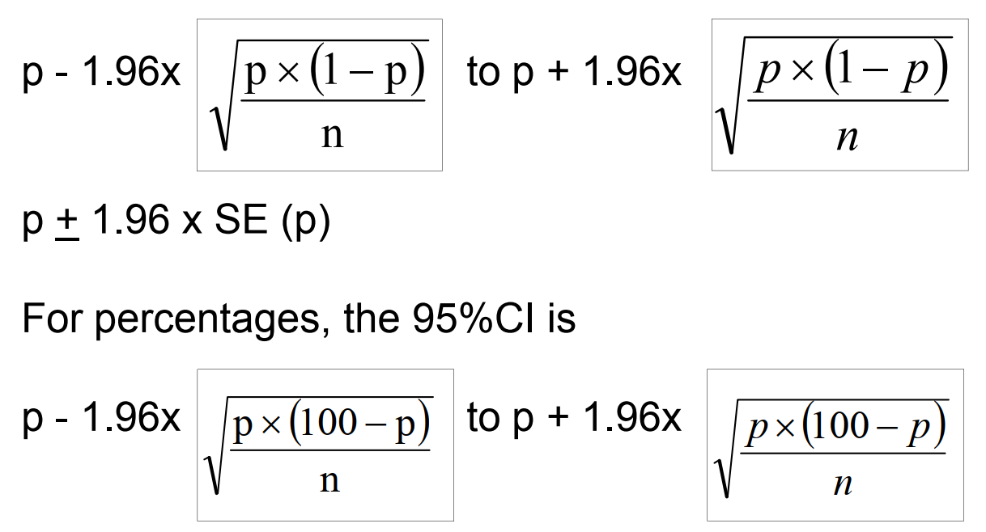
95% confidence interval for π

Slide 12
Example
The 95% confidence interval for the true population proportion of smokers in Karachi
0.379 ± 1.96 x 0.0265
0.327 to 0.431
or 32 7% to 43 1% .7% to 43.1%
There is a 95% chance that this interval includes the true proportion/percentage
So, our best estimate of the percentage who smoke is 37.9% but we’re quite confident that the true percentage lies between 32.7% and 43.1%

Slide 13
What is a ’good’ confidence interval?
Influence of sample size (n)

Slide 14
Summary
When a sample is taken, random error (sampling variability) occurs. Have to take account of this when interpreting results.
When measuring a proportion (or percentage) in a sample, this is our best and only estimate of the true proportion (or percentage) in the population.
A confidence interval gives us two limits which we are reasonably sure include the true proportion.

Slide 15
Summary
﻿An important factor in determining the width of the CI is the size of the sample (n).
95% CIs are the most frequently used.
General formula: estimate ± 1.96 x SE(estimate)
Proportion: p ± 1.96 x √ {p(1-p)/n}
Percentage: % ± 1.96 x √ {% (100-%)/n}

