Slide 1
Comparing Two Proportions
Zaw Myo Tun
IRD Global

Slide 2
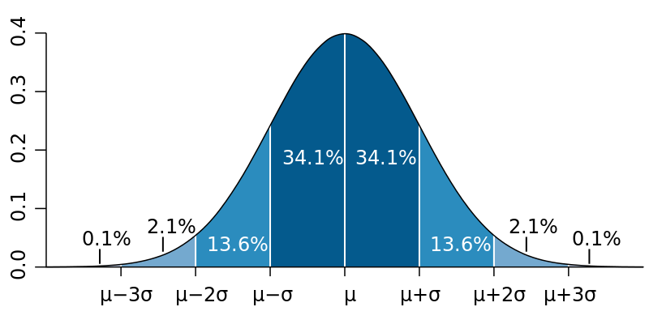
Normal distribution
Mean (µ) = 0, Standard deviation (σ) = 1
AUC: 68%, 1 SD
AUC: 95.4%, 2 SD
AUC: 95%, 1.96 SD
AUC: 99.6%, 3 SD
AUC: 99%, 2.72 SD

Slide 3
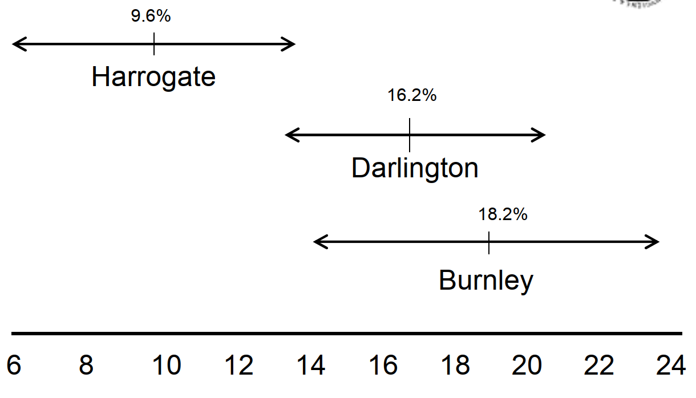
Karachi
Peshawar
Islamabad

Slide 4
Comparing two proportions
Statistical test of significance for the comparison of two proportions
The Z-test for two proportions
95% confidence interval for the difference in two proportions

Slide 5
Example
﻿Clinical trial for advanced breast cancer
Patients randomly assigned to a treatment
Tumour response = Shrinkage of tumour surface area by ≥50% for at least two weeks

Slide 6
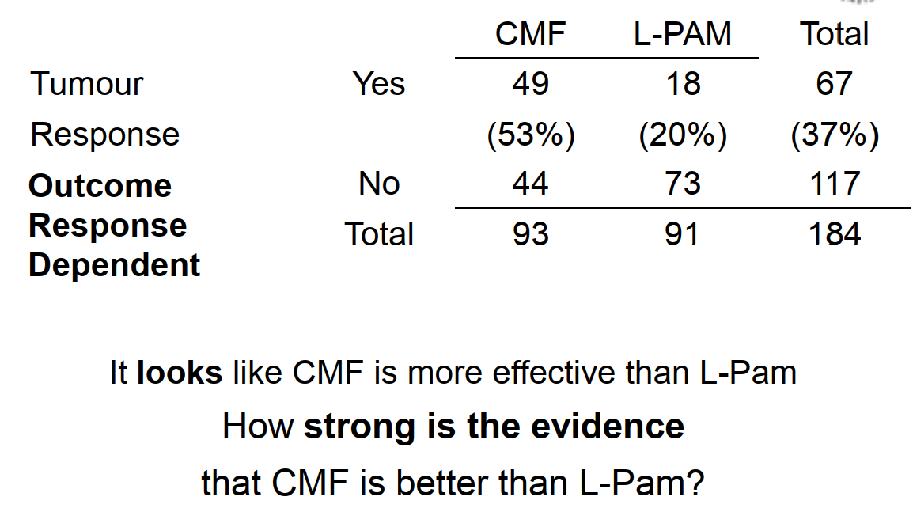
Treatment

Slide 7
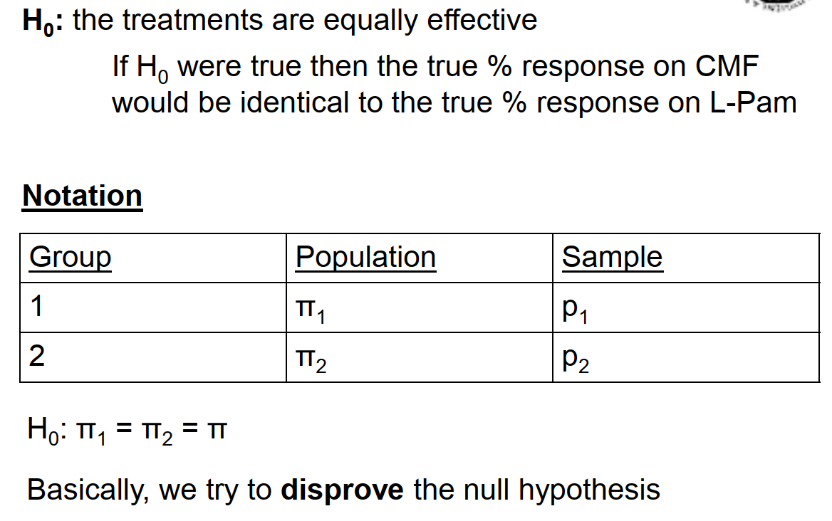
﻿The Null Hypothesis – H₀

Slide 8
Example
The question:
﻿If H₀ were true, what is the chance of getting as big (or bigger) a difference in the two proportions/percentages as that observed?
If CMF and L-Pam were truly equally effective, what is the chance (or probability) of observing in our sample a treatment difference as large as (or larger than) 53% vs 20%?
This probability is denoted by P and is known as the P-value and is calculated from a significance test

Slide 9
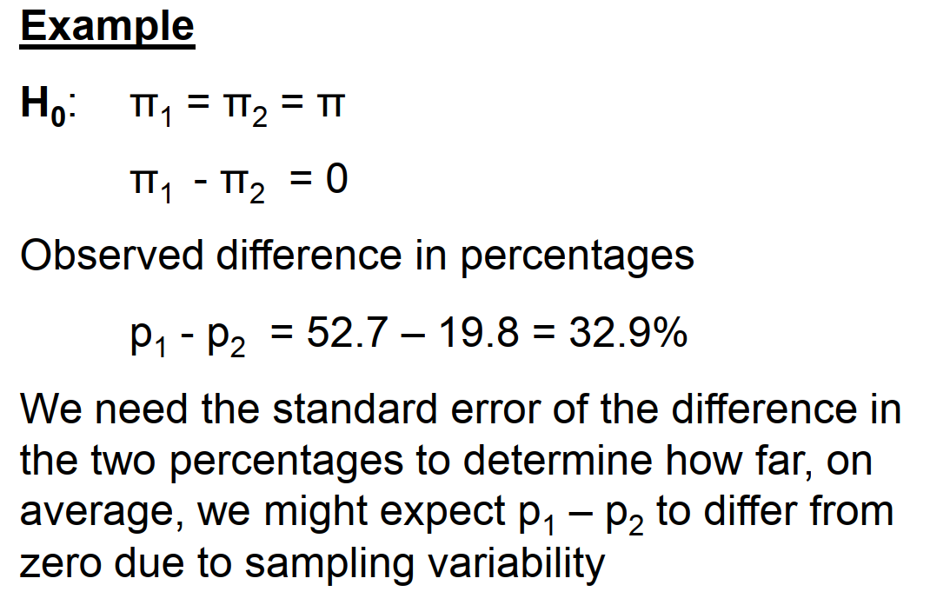
﻿Z-test for comparing two proportions

Slide 10
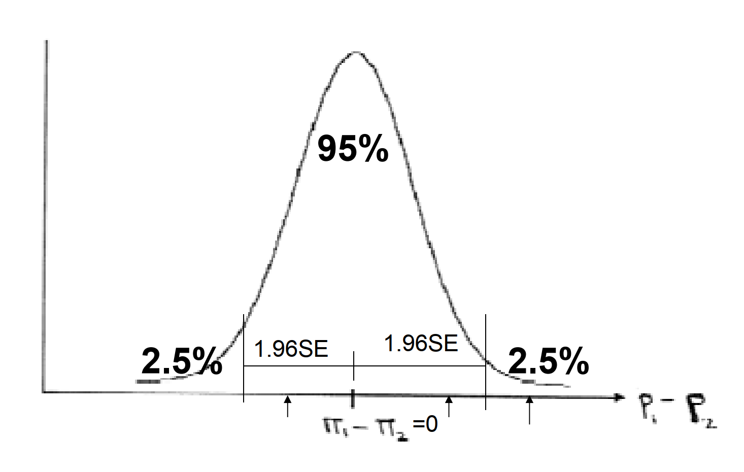
﻿Sampling distribution of p₁ – p₂

Slide 11
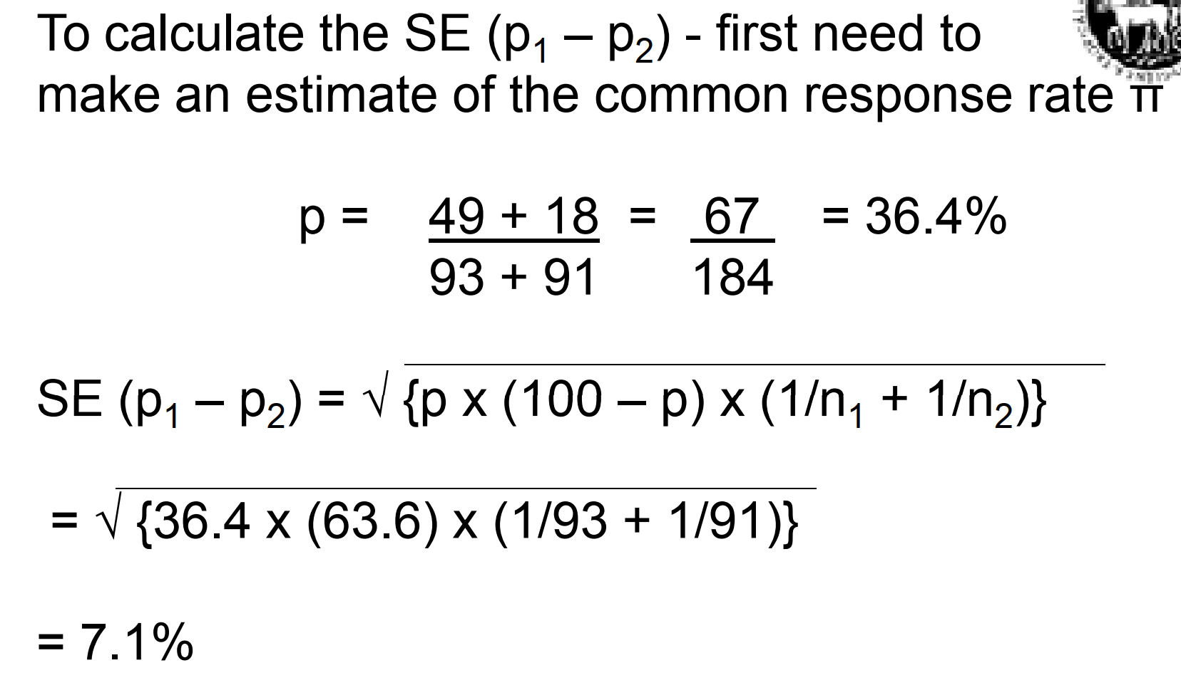

Slide 12
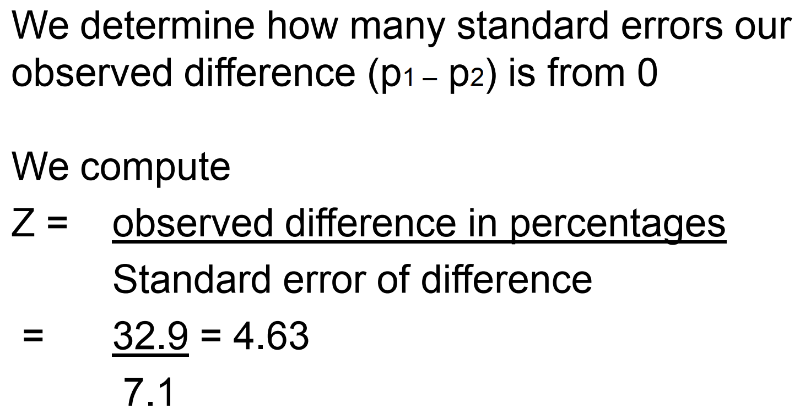

Slide 13
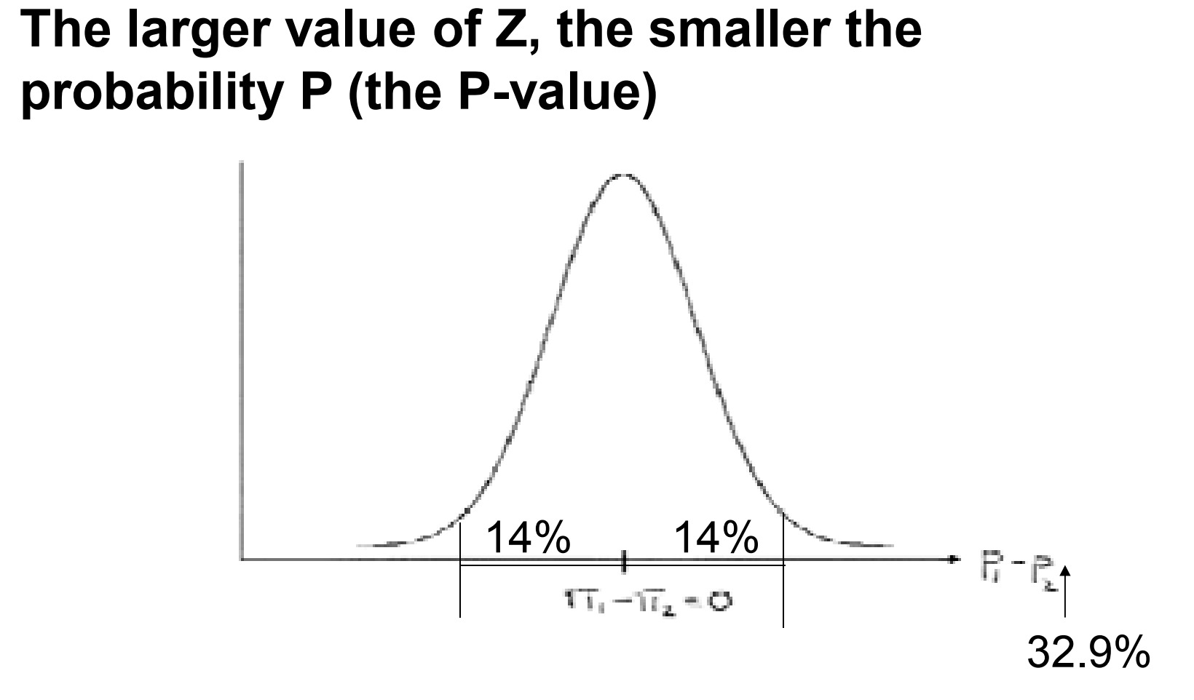
If the null hypothesis is true,

Slide 14
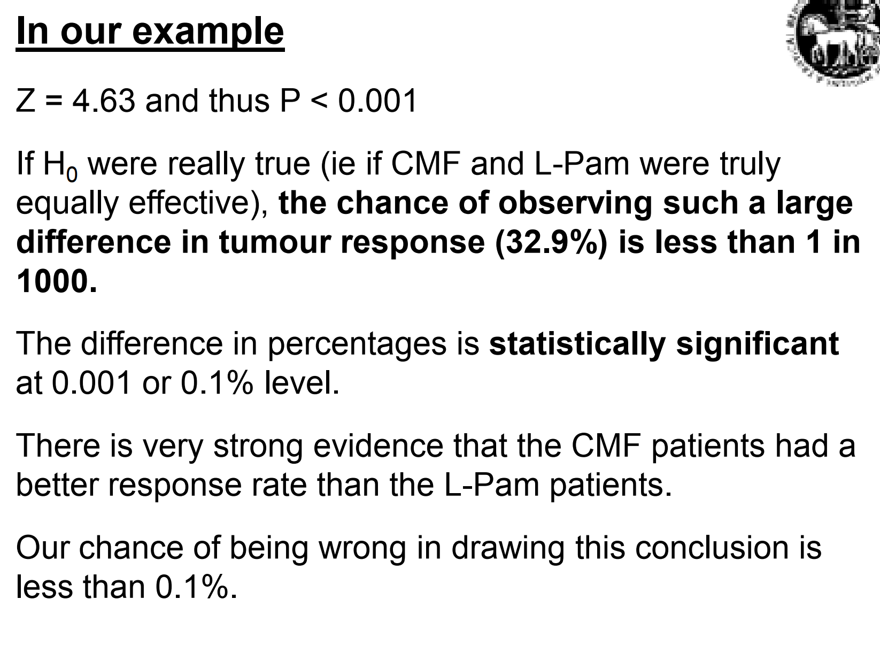

Slide 15
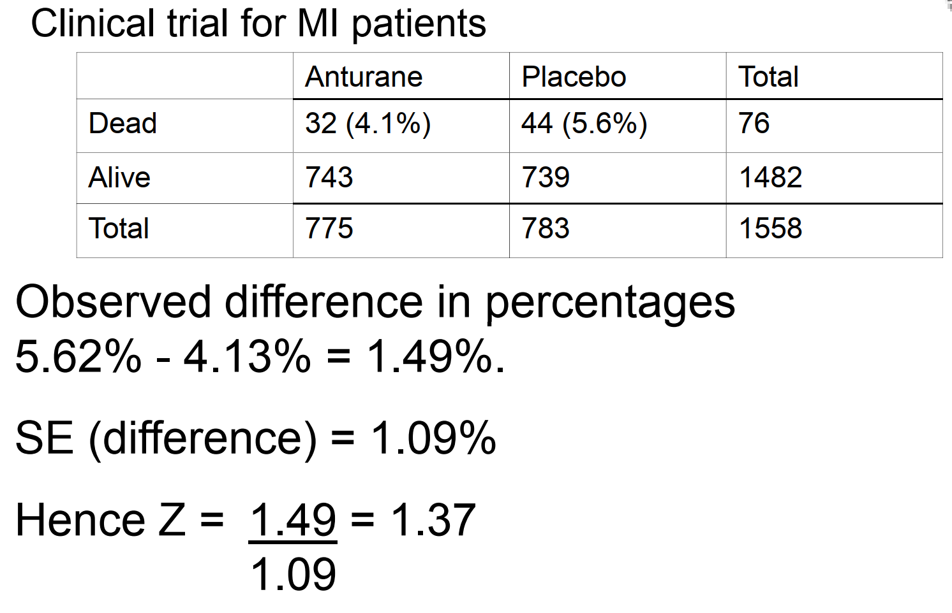
A second example

Slide 16
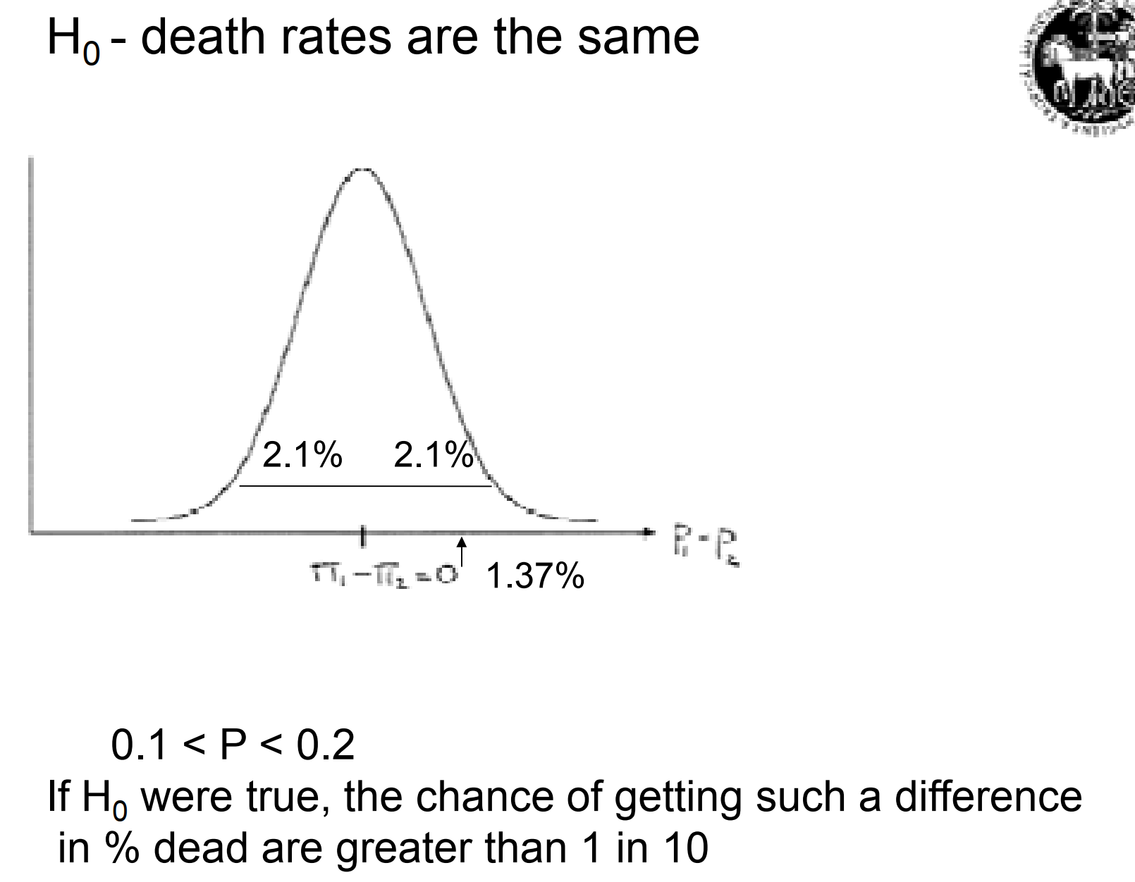
P = 0.17

Slide 17
Interpretation of P value
The larger the value of Z, the smaller the probability P (the P-value)
The smaller the P-value, the less likely it is that we would observe a difference in percentages as large as the one we have, if the null hypothesis were true.
As the P-value gets smaller and smaller, our evidence gets stronger that there is a difference in the true percentages/ proportions.

Slide 18
Interpretation of P value
For small P-values, we tend to say that we reject the null hypothesis and assume that a true difference exists.
For larger P-values, we say that we cannot reject the null hypothesis and that our observed difference probably arose by chance (due to sampling variability)

Slide 19
﻿How small is small?!
Many people use P=0.05 as their cut-off point for rejecting or not the null hypothesis
Caution – the “grey area”
It is better, where possible, to present the actual P-value rather than simply say it is <0.05 or >0.05

Slide 20
﻿How small is small?!
﻿Actual P-values (or almost) can be obtained from statistical tables or computer programs
We will use R in today’s exercise.

Slide 21
Exercise
Women aged 19-24
4893 vegetarian, of whom 1429 were anaemic p₁ = 29.2%
11031 non-vegetarian, of whom 3011 were anaemic p₂ = 27.3%
Z-test to compare 2 proportions → P=0.01
Conclusion?

Slide 22
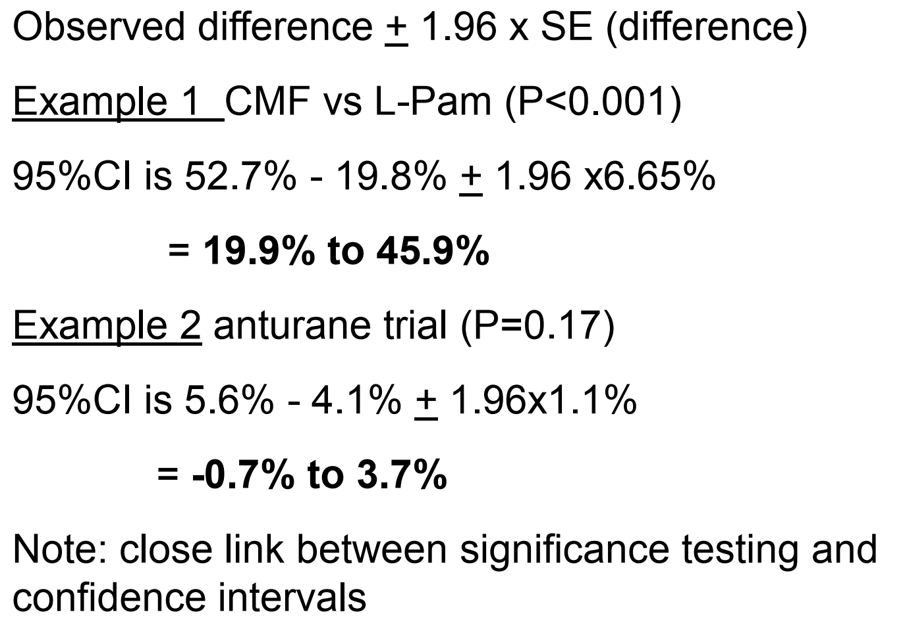
95% confidence interval for a difference in two percentages

Slide 23
Summary
To compare results between two groups, must take account of sampling variability. Use a significance test.
Formulate a null hypothesis, H₀ (no difference in the two true values) and try to disprove it.
Today - Z-test for the comparison of two proportions (or %s).
Compute Z-statistic which depends on the magnitude of the difference in the proportions and the sample sizes.

Slide 24
Summary
Calculate P-value from Normal distribution (in R or using statistical tables)
P-value tells us how likely it is that we would observe a result like we have in our sample, if H₀ was true.
Small P-values, reject H₀, true difference is likely.
Large P-values, cannot reject H₀ and observed difference likely due to chance.
Balance statistical significance with clinical/public health importance

Slide 25
More exercises

Slide 26
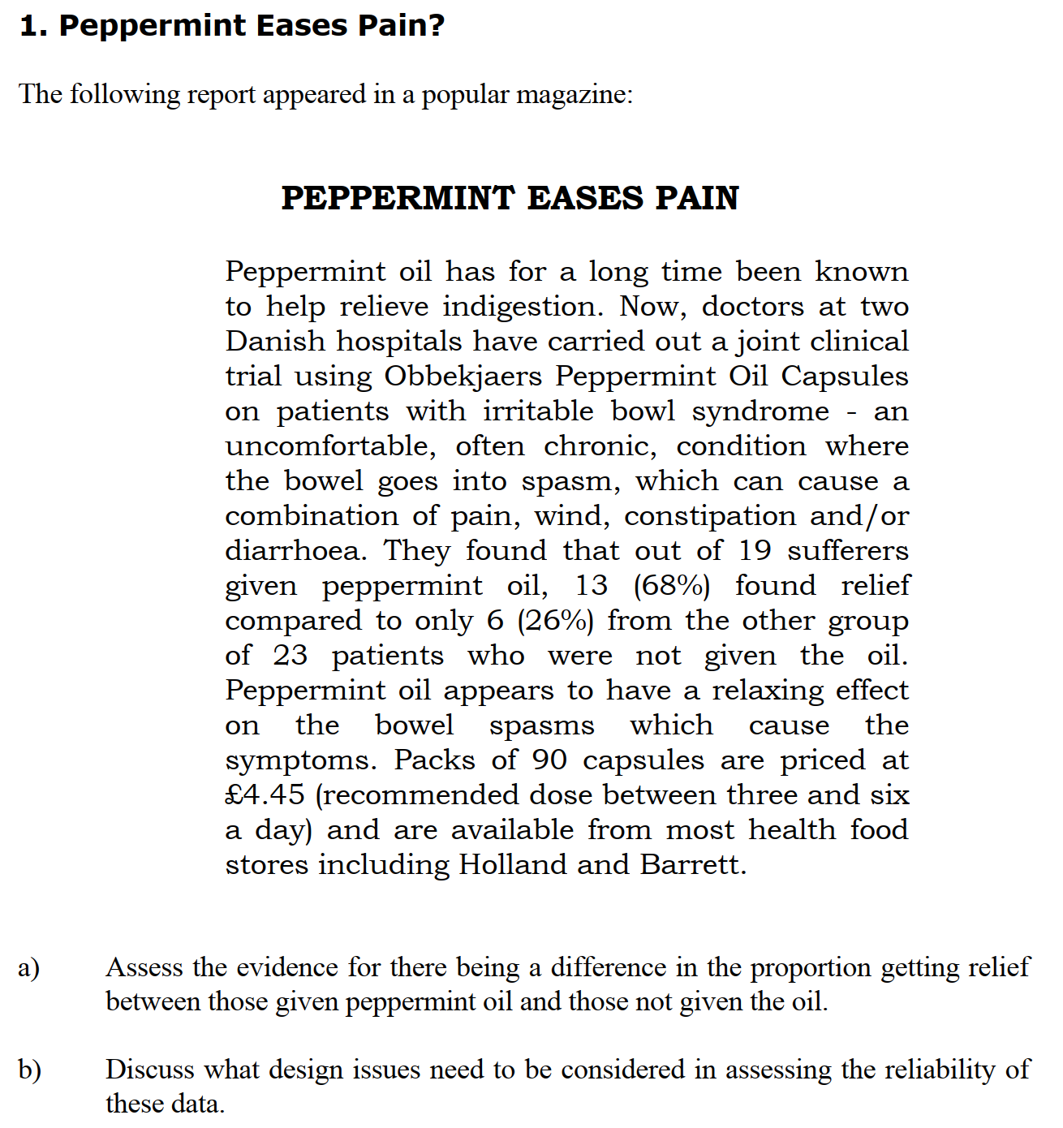

Slide 27
