Slide 1
R Club: Data Visualisation
Zaw Myo Tun

Slide 2
Outline
ggplot2 package
Basic template
Faceting
Theme
Arranging plots
Exporting plots

Slide 3
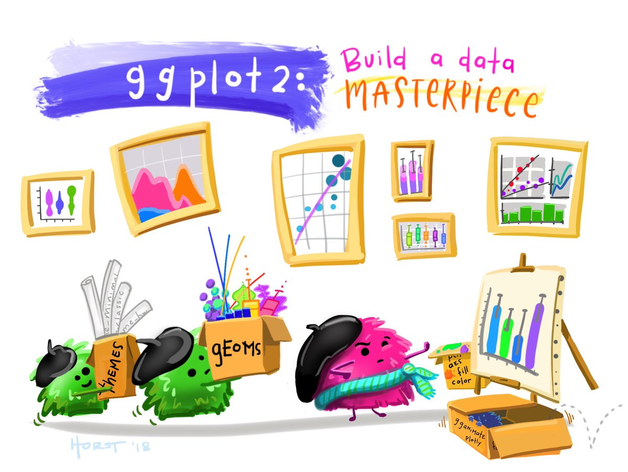
ggplot2 package
Create complex and publication quality plots
Work best with data in ‘long’ format
ggplot graphics are built layer by layer

Slide 4
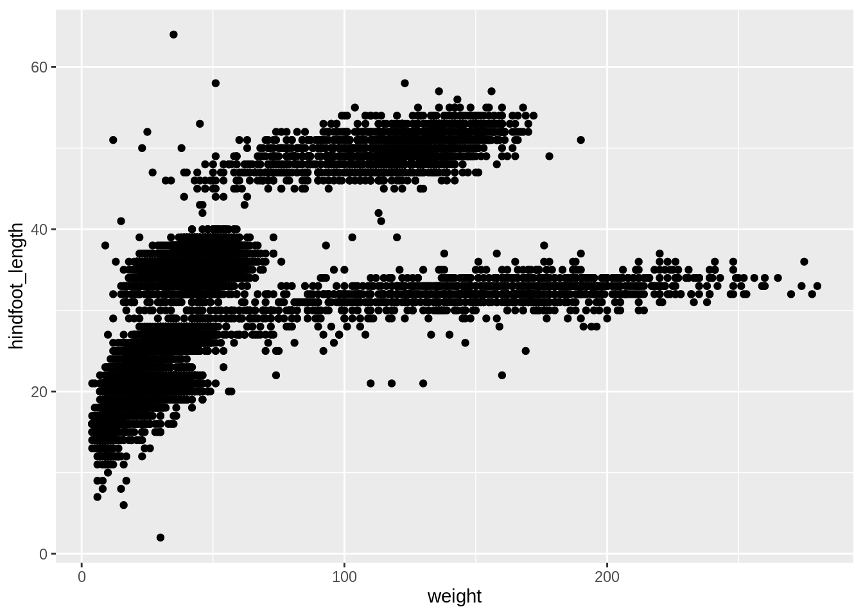
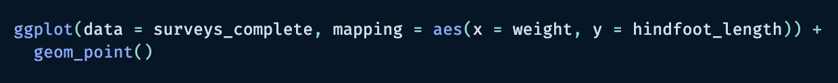
Basic template
Base plot
Geom layer
ggplot(data = <DATA>, mapping = aes(<MAPPINGS>)) +
<GEOM_FUNCTION>()

Slide 5
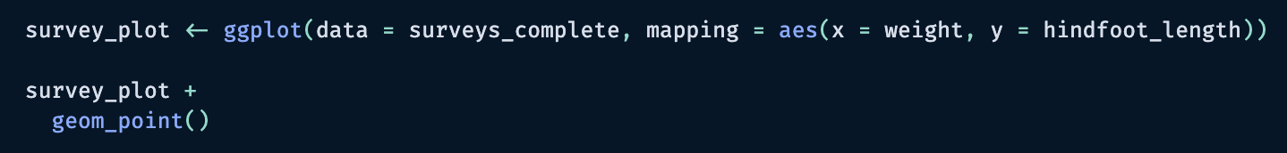
Pipe
Can assign a name to ggplot objects for reuse
+ pipe: link layers together
ggplot(data = <DATA>, mapping = aes(<MAPPINGS>)) +
<GEOM_FUNCTION>()

Slide 6
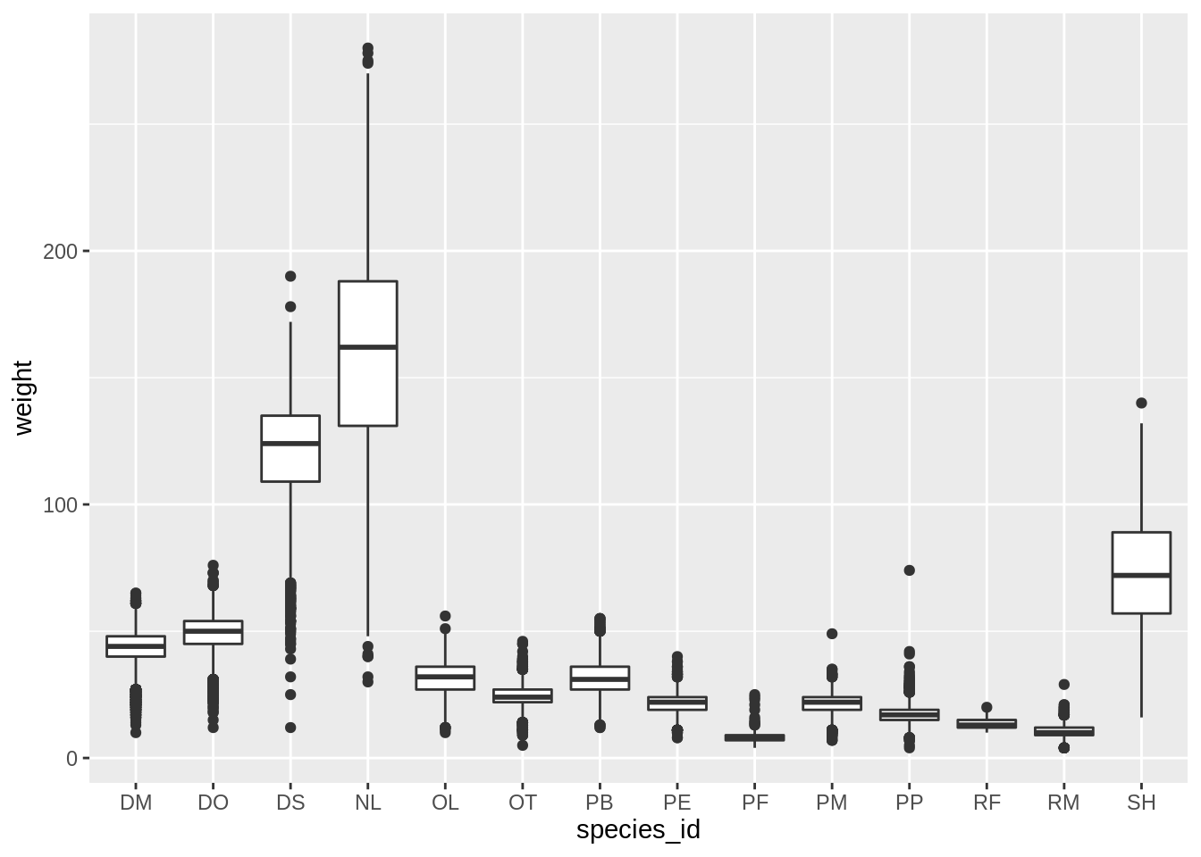
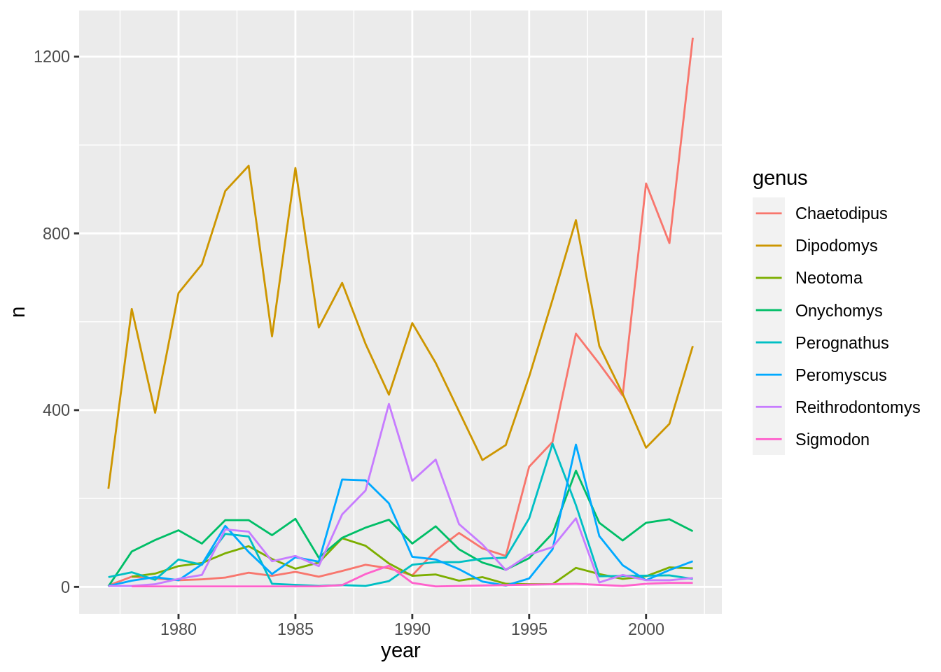
Coding!
Now, let’s make some plots!!

Slide 7
Faceting

Slide 8
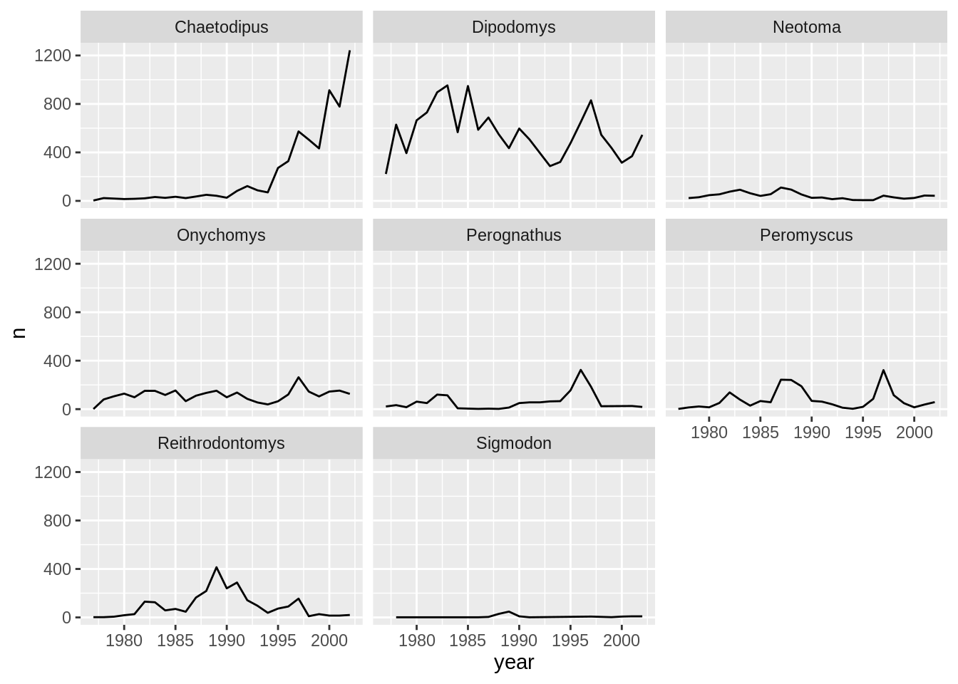
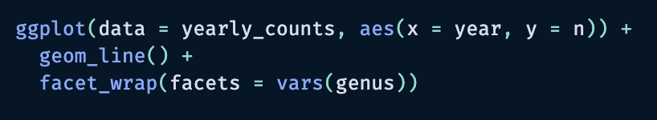
Facets
Split one plot into multiple plots based on a categorical variable
facet_wrap(), facet_grid()
Wrap facet variable in vars()

Slide 9
Theme

Slide 10
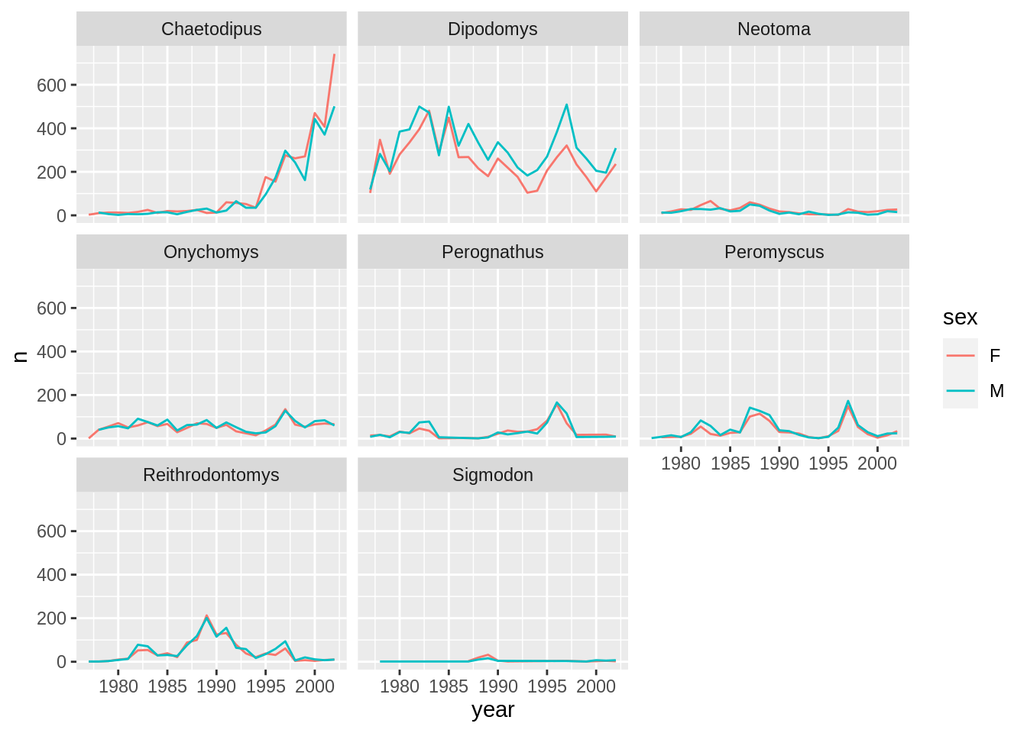
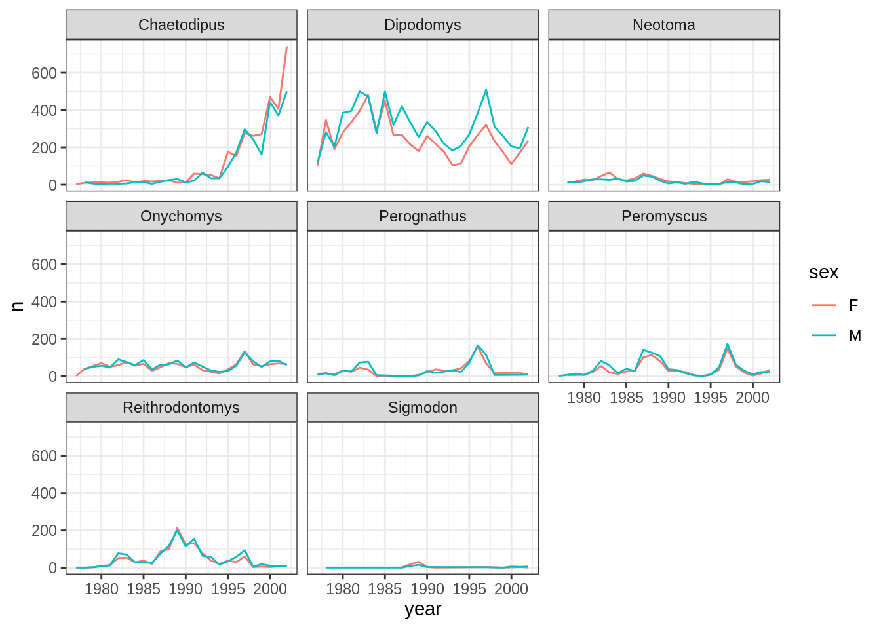
Default theme VS theme_bw()

Slide 11
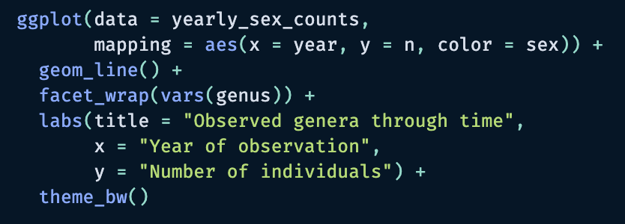
theme_bw()

Slide 12
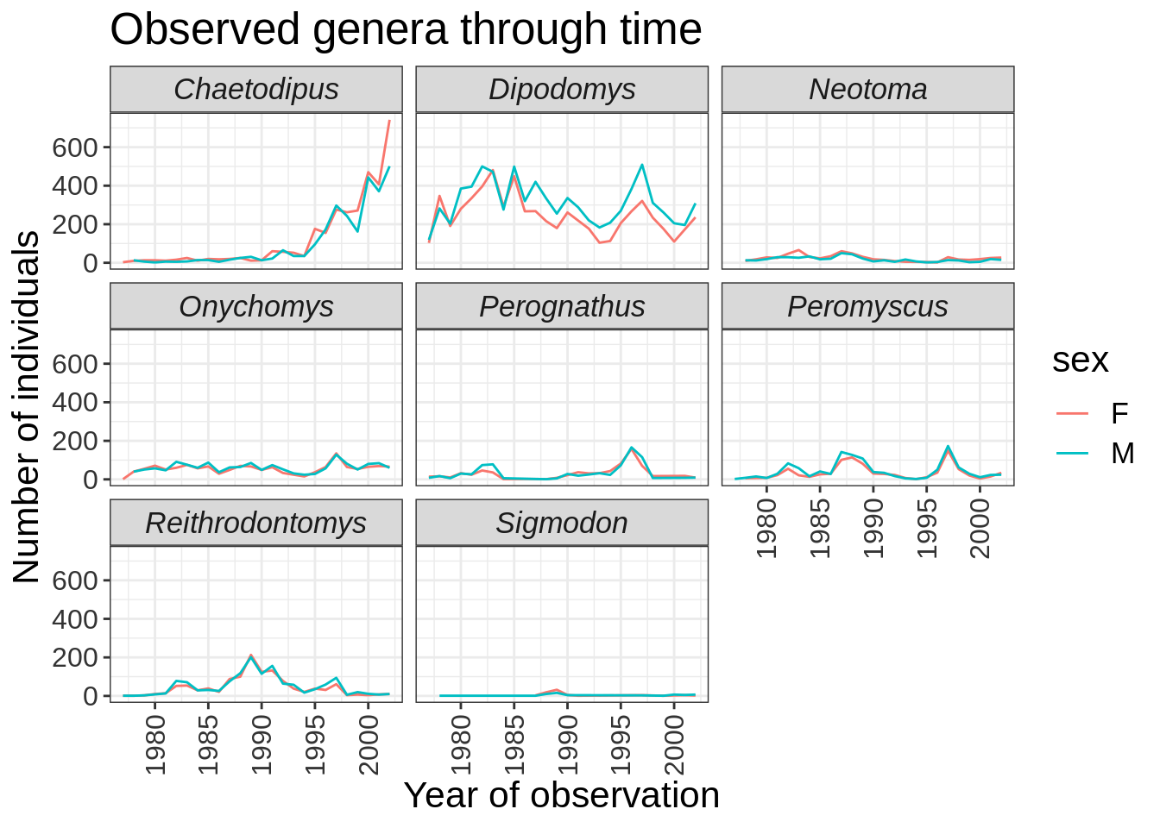
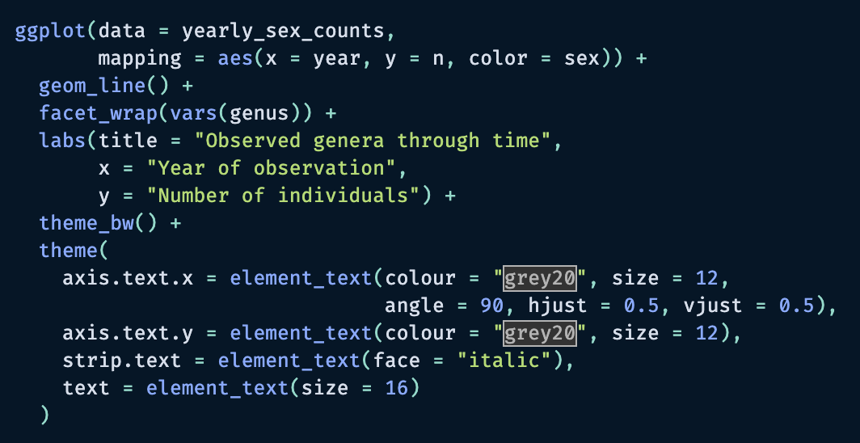
Customise how your plot looks

Slide 13
Arranging plots

Slide 14
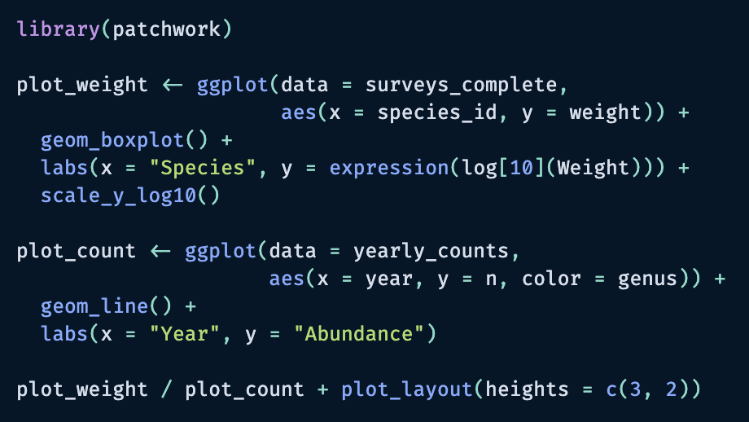
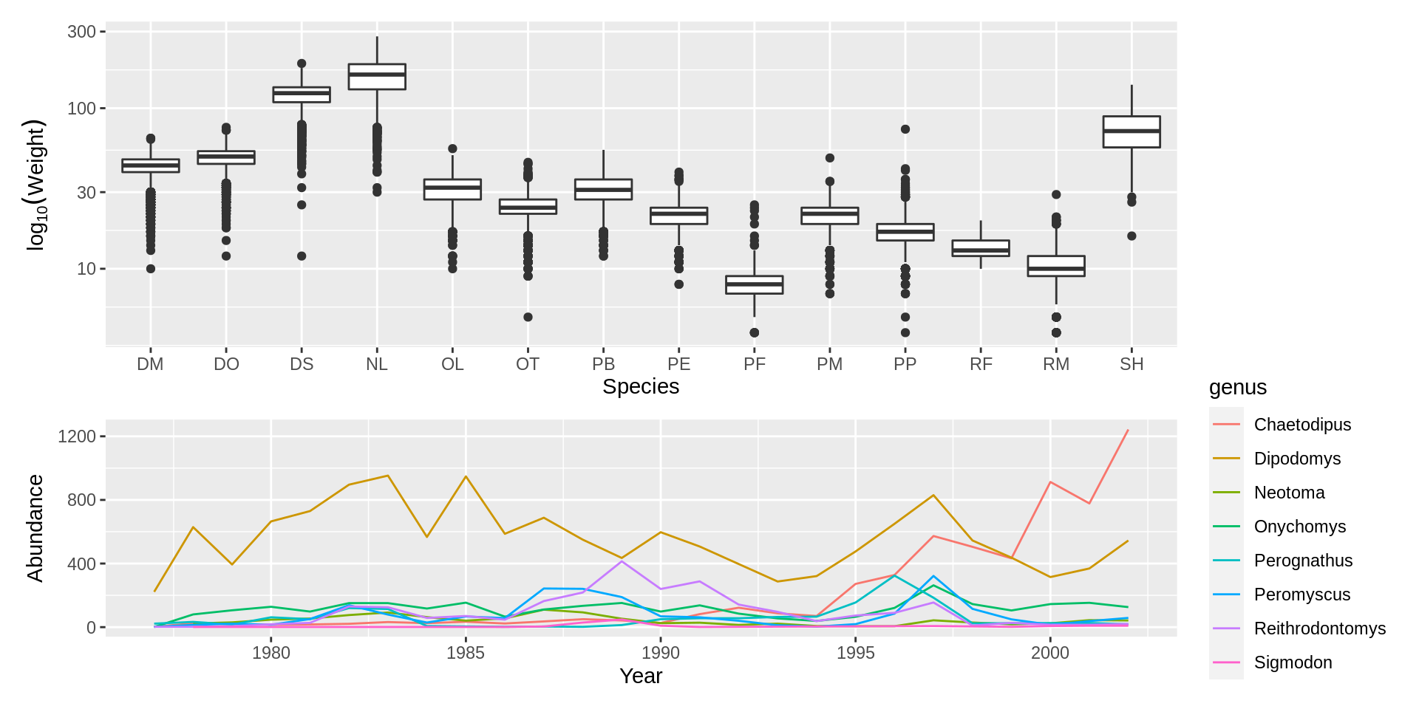
patchwork package

Slide 15
Exporting plots

Slide 16
