Slide 1
R Clud: Starting with data
Zaw Myo Tun

Slide 2
Intro to R (leftover from previous session)

Slide 3
Vectors and data types
Basic data type in R
Types
Logical: TRUE or FASLE
Numeric: Either integer or double (real)
Character (add double quote "dog" (more common) or single quote 'dog')
Complex
Raw
weight_g <- c(50, 60, 65, 82)
animals <- c("mouse", "rat", "dog")

Slide 4
Vectors and data types
Functions for vectors
Attributes: length(), class(), str(), typeof()
Add more elements using c()
Other data structures
Lists
Matrices
Data frames
Factors
Arrays
Challenge time!

Slide 5
Subsetting vectors

Slide 6
Missing data

Slide 7
Starting with data

Slide 8
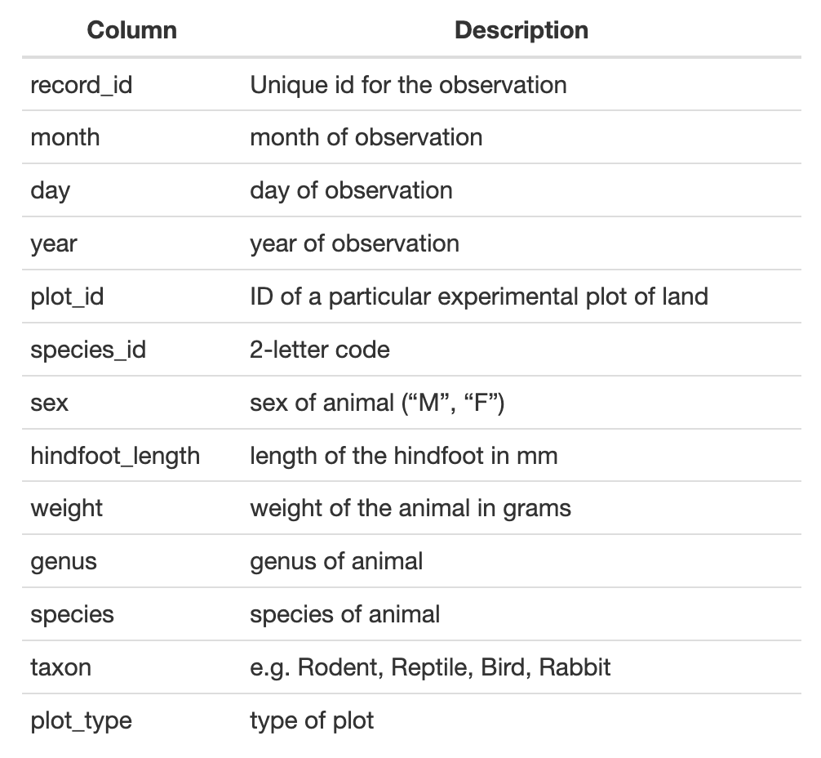
Example dataset
Download: download.file()
Read file: read_csv()
Now let’s go to code file

Slide 9
Data frames

Slide 10
Indexing and subsetting data frames

Slide 11
Factors

Slide 12
Formatting dates

