Slide 1

10 Handy Tricks in the Tidyverse
Zaw Myo Tun

Slide 2
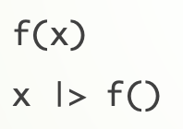
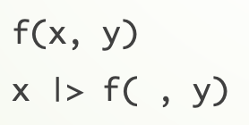
Assumptions
Some knowledge of
basic base R operations: indices and vector operations
{dplyr} basic verbs: select(), mutate(), arrange(), filter(), summarise()
Basic knowledge of base R pipe: |>

Slide 3
The tricks
Putting it all in a frame
Counting
Operate across() many columns
List columns are awesome!
Separate a column into pieces
reduce() them to one
Fuzzy join
Permutations
One two punch
Visualising categorical variables

Slide 4
1. Putting it all in a frame
enframe()
deframe()

Slide 5
2. Counting
count()
add_count()

Slide 6
3. Operate across() many columns
across()
mutate()
summarise()

Slide 7
4. List columns are awesome!
rowwise()
nest()
nest_by()

Slide 8
5. Separate a column into pieces
separate()
separate_rows()

Slide 9
6. reduce() them to one
reduce()

Slide 10
7. Fuzzy join
stringdist_*_join()

Slide 11
8. Permutations
crossing()

Slide 12
9. One two punch
Use function’s default behaviours to my advantage.

Slide 13
10. Visualising categorical variables
fct_lump_*()
fct_reorder()

