Slide 1
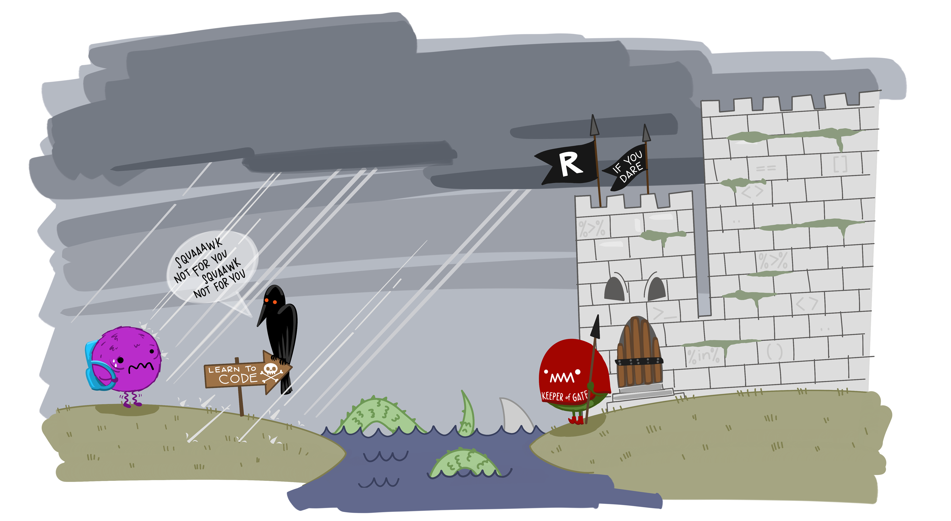
Introduction to Data Analysis with R
Zaw Myo Tun
10-14 April 2023

Slide 2
Learning objectives
To understand:
What is tidy data in R?
How to read a CSV file
The concept of tidy data
How to select columns and filter rows in a dataframe
How to use pipe
How to create new columns in a dataframe
How to aggregate data using summary statistics

Slide 3
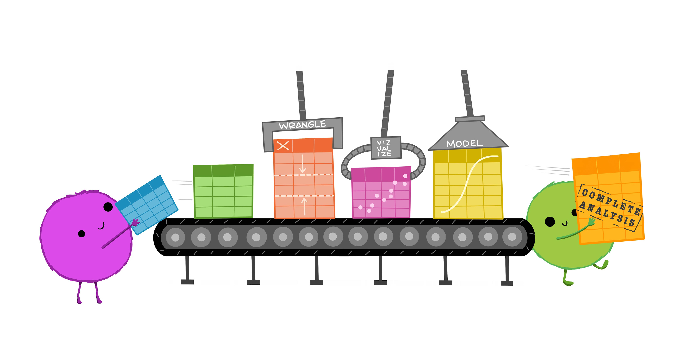

Slide 4
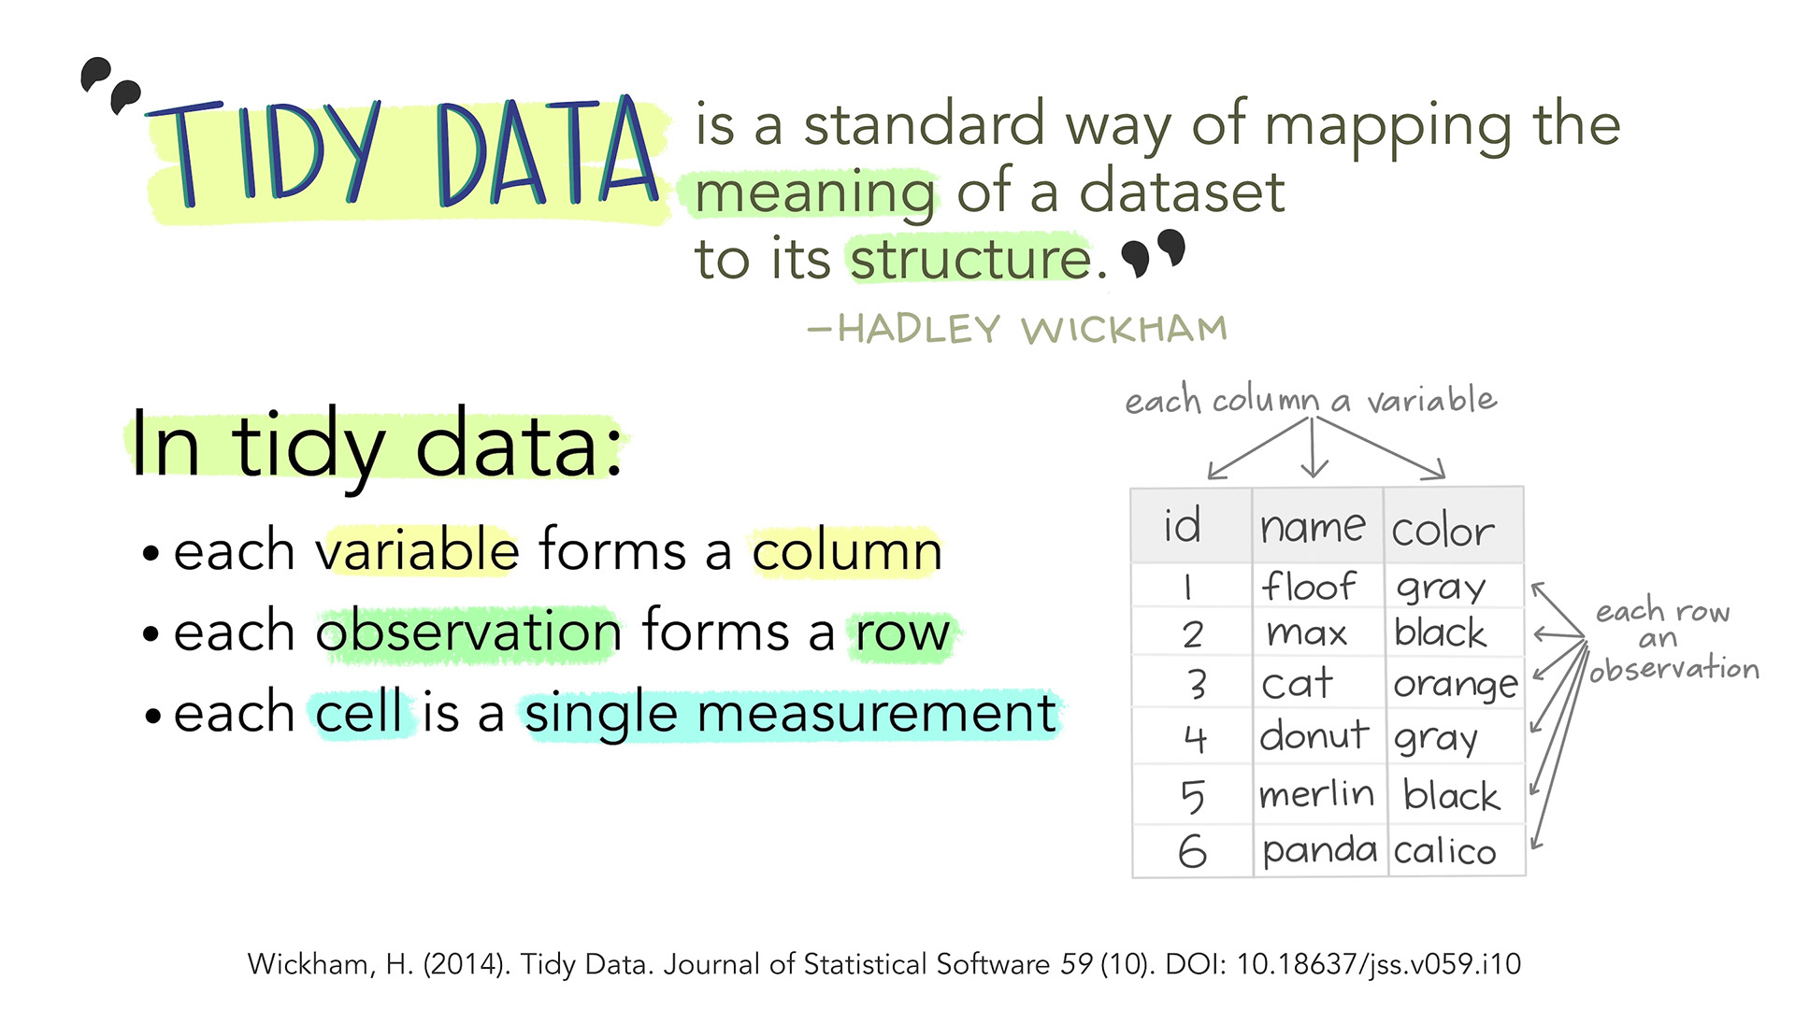

Slide 5
Data 1
date | patient_id | age | gender | systolic_BP | distolic_BP
9-Jun-22 | A | 55 | M | 130 | 90
12-Jun-22 | B | 60 | F | 122 | 88
13-Jun-22 | C | 48 | M | 143 | 78
Data 2
date | patient_id | age_gender | systolic_diastolic_BP
9-Jun-22 | A | 55-M | 130/90
12-Jun-22 | B | 60-F | 122/88
13-Jun-22 | C | 48-M | 143/78

Slide 6


Slide 7

Data Wrangling

Slide 8
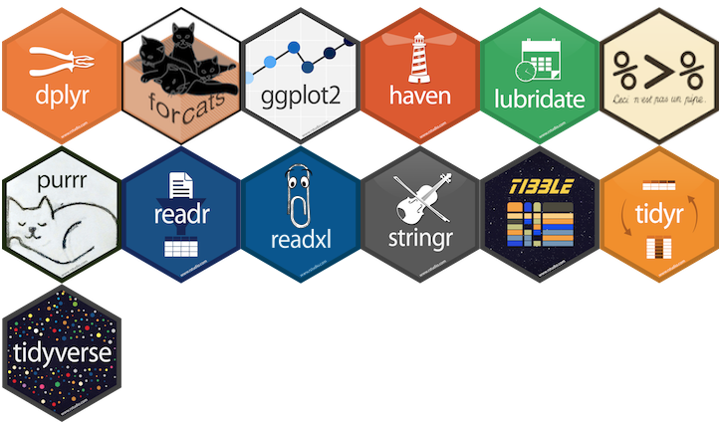
Data wrangling
Meta-package

Slide 9
dplyr functions
Function | Description
select() | Select columns
filter() | Select rows on conditions
mutate() | Create new columns by using information from other columns
group_by(), summarize() | Create summary statistics on grouped data
arrange() | Sort results
count() | Count discrete values

Slide 10
Logical operators
x < y | x is smaller than y
x > y | x is greater than y
x <= y | x is smaller and equal to y
x >= y | x is greater and equal to y
x == y | x is equal to y
x != y | x is not equal to y
x %in% y | x is in the list of y
!x %in% y | x is not in the list of y

Slide 11
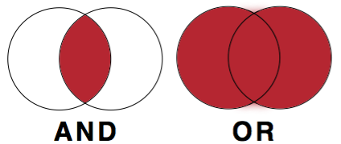
Combining logical statements

